Slide 1
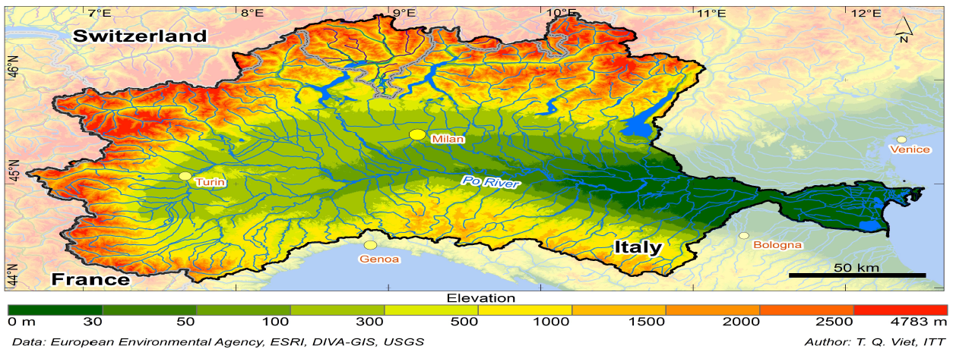
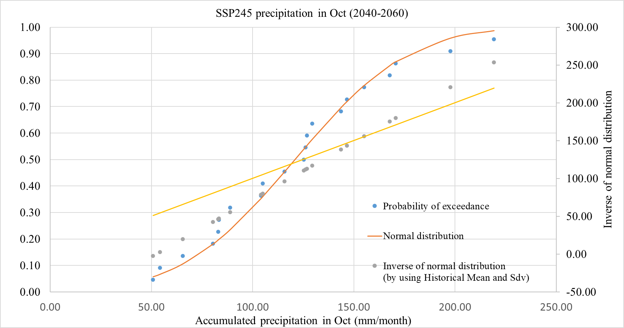
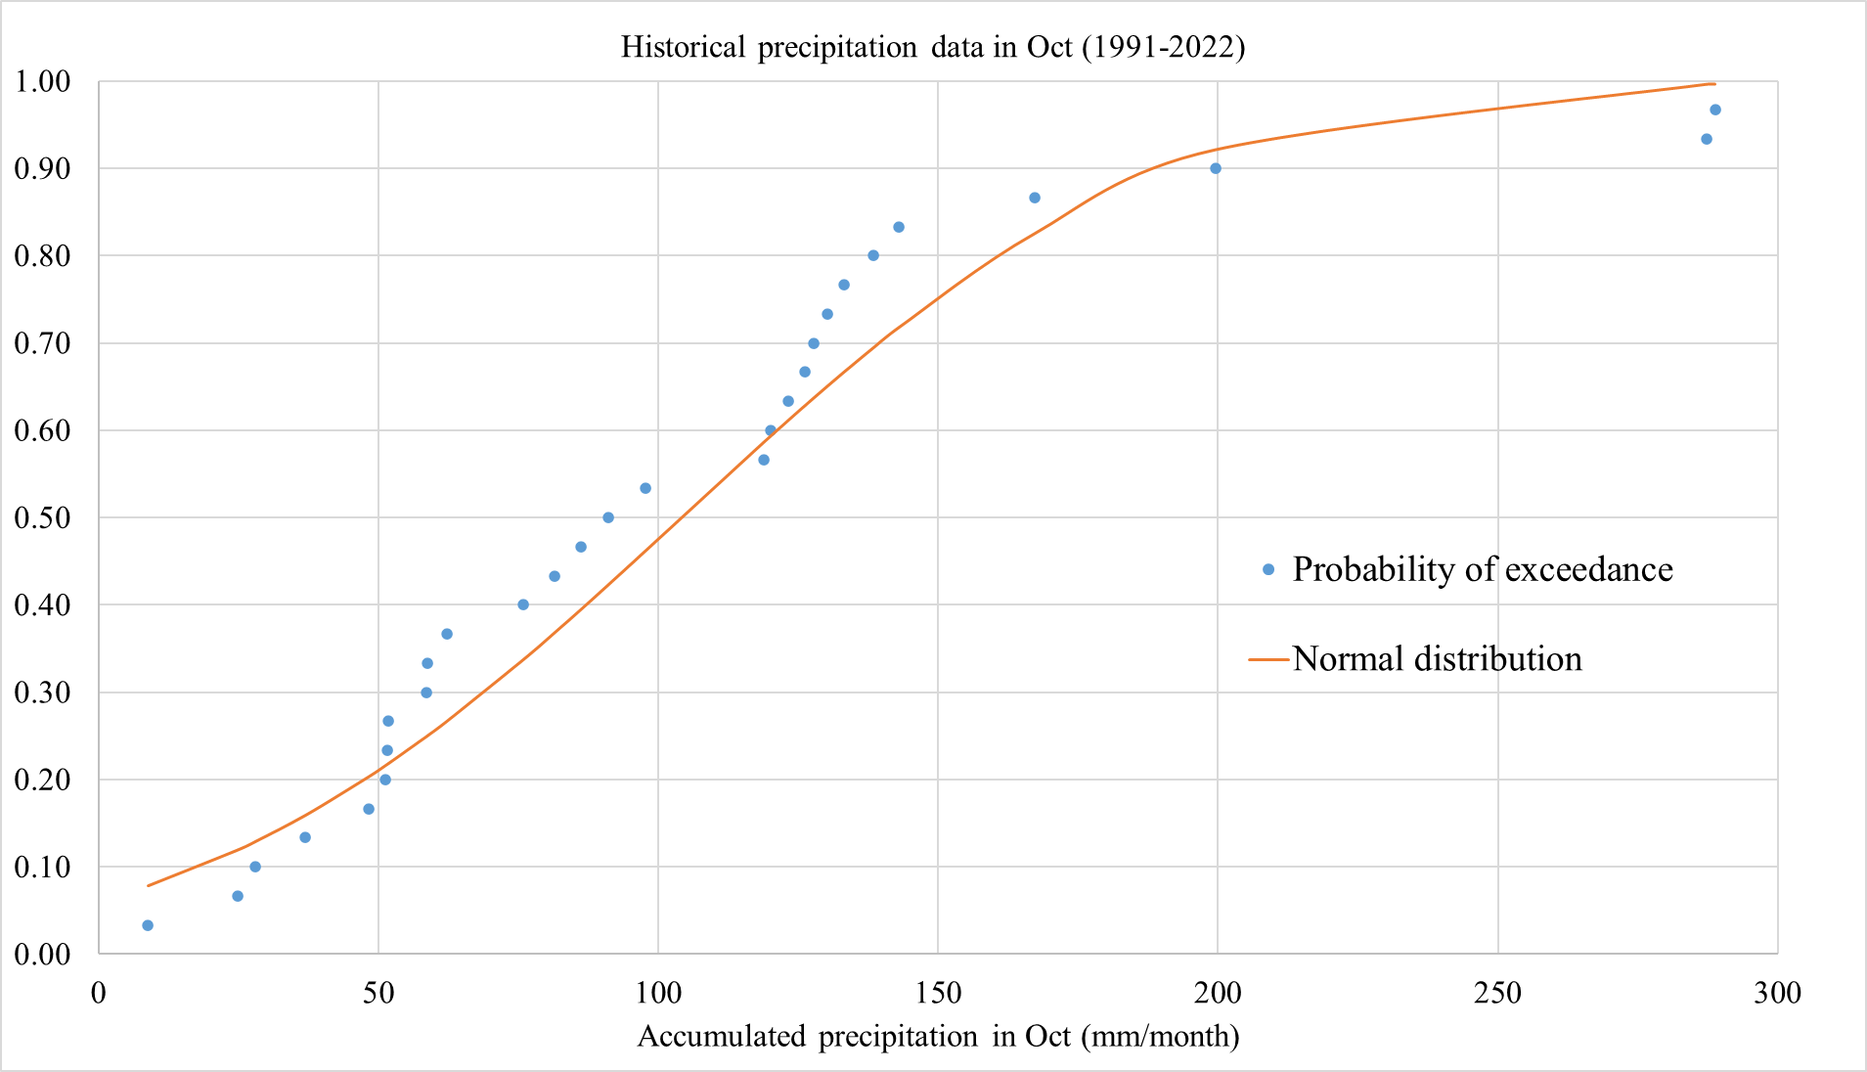
An integrated water system management model for assessing climate change impacts on water resources scenarios of the PoRiver Basin
Babak Razdar¹, Giovanna Grossi²
1 Department Civil, Environmental, Architectural Engineering and Mathematics (DICATAM), Italy, babak.razdar@unibs.it
2 Department Civil, Environmental, Architectural Engineering and Mathematics (DICATAM), Italy, giovanna.grossi@unibs.it
Study area:
The Po River with 652 km of length is the longest river in Italy. The River Basin covers an area of 71,000 km2, which belong to 3,200 municipalities of 7 regions: Piemonte, Valle d´Aosta, Lombardia, Veneto, Liguria, Emilia-Romagna, Toscana and the Trento Autonomous Province in the north Italia. The basin has also small areas located in Switzerland and France.
The basin plays a significant role in Italian economy as producing 40% national GDP, consuming 48% of national produced energy, and approx. 25% Italian population living here. Large population, vibrant socioeconomic activities lead to water quality degradation, challenging management of water and land resources, increase in hydraulic and hydrogeological risks and loss of biodiversity. Consequently, the region is highly vulnerable to droughts and floods and to further degradation of environmental quality. (Figure 1)
(Figure 1)
Methodology:
By using climate generator models, climatic data such as minimum temperature, maximum temperature, and precipitation from rain gauge and meteorological stations were obtained separately under different scenarios for statistical periods 2010-2039, 2040-2069, and 2070-2099. (Figure 2)
The maximum temperature, minimum temperature, and daily precipitation calculated under three scenarios (SSP126, SSP245 and SSP585) were compared with the corresponding values in the base period of 1991-2022. (Figure 3)
The Water Evaluation and Planning System (WEAP) model is utilized to quantify the management balance of surface water. This flexible, highly visible, and user-friendly model assists users in evaluating water resources by considering scenarios based on various input variables.
Results analysis:
The increase in maximum and minimum monthly water levels leads to higher consumption of drinking water, industry, and agriculture in the basins.
Very hot days index: The increase in this index in the basin will lead to an elevated evaporation rate, intensifying water stress, and posing significant challenges for future water resource management.
Frost days index: The increase in this index signifies that the volume of water accumulated as snow and ice during cold seasons will melt earlier. This phenomenon plays a crucial role in the base flow of rivers in the studied area during hot seasons.
The index of heavy rains (defined as rainfall exceeding 25 mm per day) will significantly impact the water balance of the region.
The index of the number of annual dry days represents the number of days in a year with precipitation less than 4 mm. Calculating this index enables the comparison of changes in two precipitation-related indices affected by climate change: rainfall exceeding 25 millimeters and rainfall less than 4 millimeters. Alterations in this index will significantly impact the water balance of the region.
(Figure 2)
Conclusion:
Simulation of water resource allocation involves a model that utilizes input information such as flow, precipitation, and evaporation to calculate the diverse needs of the river across various time periods. Alongside physical parameters and flows entering the river, the model also integrates the system exploitation policy, encompassing instructions on how to allocate water for different purposes or withdraw water from various points in the system.
The decision-making variables include the river's output, the level of supply for needs, and the outputs of the simulation model. These variables can be utilized in studies that examine the impact of climate change on water resource allocation and usage.
(Figure 3)

