Slide 1
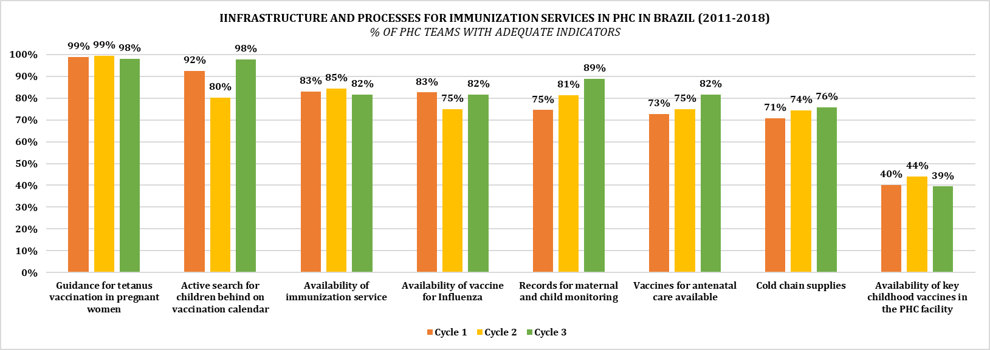
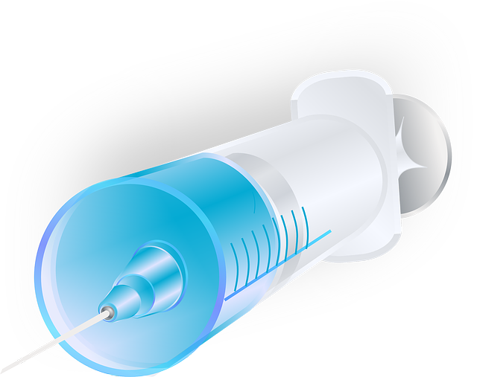
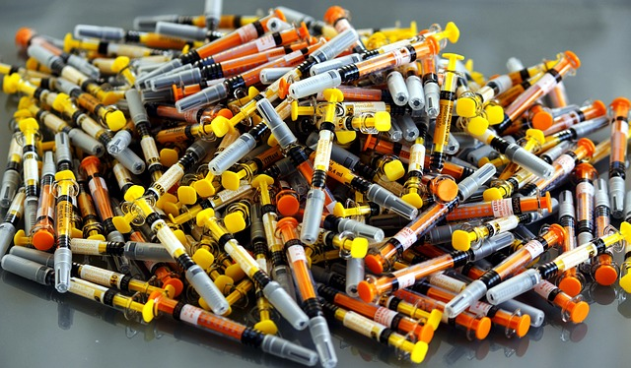
Variability in immunization infrastructure across the Brazilian primary health care system may help understand in more depth the relation between efforts to expand the coverage of immunization services and this intervention’s effectiveness, especially for child health.
Evolution of the quality of infrastructure
and processes for immunization services within PHC in Brazil – 2011-2018
Valentina Martufi¹, Maria del Pilar Flores-Quispe¹, Leandro Alves da Luz², Josemir Ramos de Almeida¹, Michelle Pereira Vale dos Passos¹, Acácia Maíra Pereira da Lima¹, Eduarda Ferreira dos Anjos¹, Rosana Aquino ³, Anya Pimentel Gomes Fernandes Vieira-Meyer ⁴, Leila Denise Alves Ferreira Amorim ⁵, Maurício Lima Barreto ¹, Maria Yury Ichihara ¹, Elzo Pereira Pinto Junior ¹
¹CIDACS-IGM/FIOCRUZ-BA, Salvador, Bahia, Brazil, ²Municipal Health Secretariat, Salvador, Bahia, Brazil, ³ISC/UFBA, Salvador, Bahia, Brazil, ⁴FIOCRUZ-CE, Fortaleza, Ceará, Brazil, ⁵IME/UFBA, Salvador, Bahia, Brazil
BACKGROUND
How has infrastructure of immunization services for maternal and child care (MCH) within primary health care (PHC) evolved between 2011 and 2018, in Brazil?
Immunization is a powerful intervention that can improve the population’s health overall, and MCH specifically;
This intervention has demanding infrastructural needs for the preservation of vaccines and their effective delivery;
The Programme for the Improvement of Access to and Quality of Primary Health Care (PMAQ-AB) aimed to boost infrastructure and processes within Primary Health Care (PHC), including in relation to immunization activities;
This study aimed to model an MCH-focused immunization component of PHC services, to measure its quality’s evolution over the three cycles of implementation of the PMAQ-AB (2011/2012 – 2013/2014 – 2016-2018).
RESULTS
‘Tetanus vaccine orientation for pregnant women’ - indicator with highest adequacy across the three cycles (approx. 99% of PHC teams across the country);
‘Availability of key childhood vaccines in the PHC facility’ - indicator with lowest adequacy (40.19%, 44.10% and 39.45% over the three cycles of PMAQ-AB, respectively);
Explicit improvements throughout the period of study:
‘Records for MCH vaccination monitoring’ (75% - 81% - 89%);
‘Vaccines for antenatal care available’ (73% - 75% - 82%); and,
‘Cold chain supplies available’ (71% - 74% - 76%).
METHODS
Retrospective cohort study of 8,776 PHC teams across Brazil, utilizing public PMAQ-AB data;
The variables were joined into indicators, then used to constitute the immunization component, and categorized as adequate/inadequate.
A descriptive analysis was carried out to determine the frequency of adequacy found among the surveyed teams, across the three cycles of the PMAQ-AB.

