Slide 1



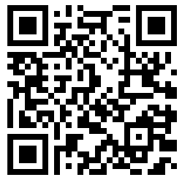
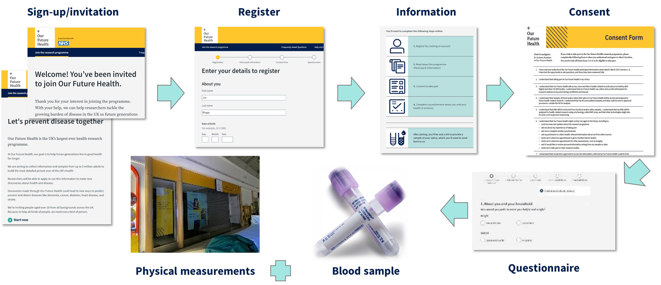
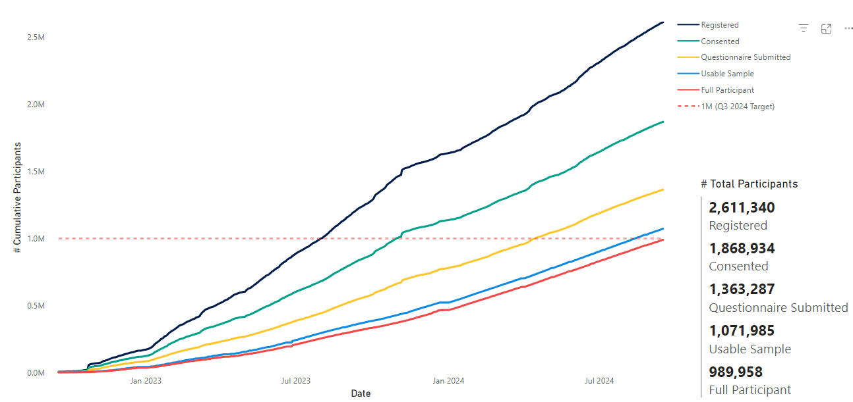
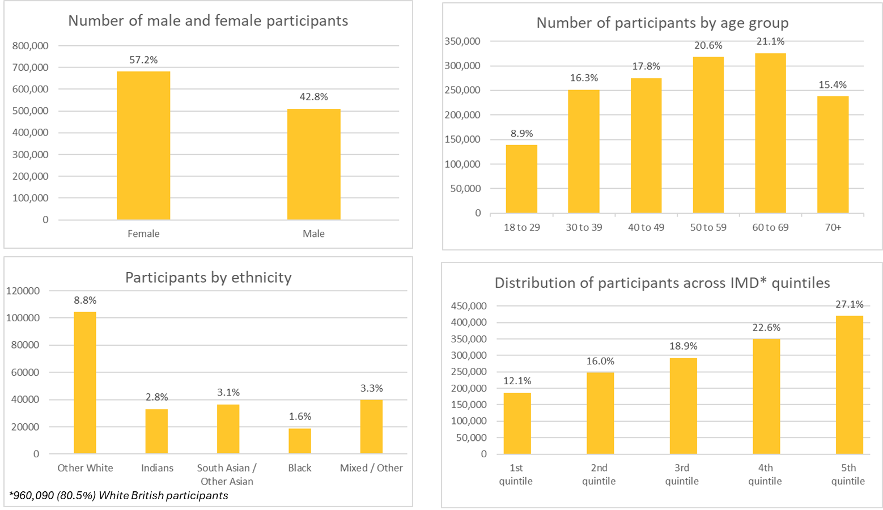
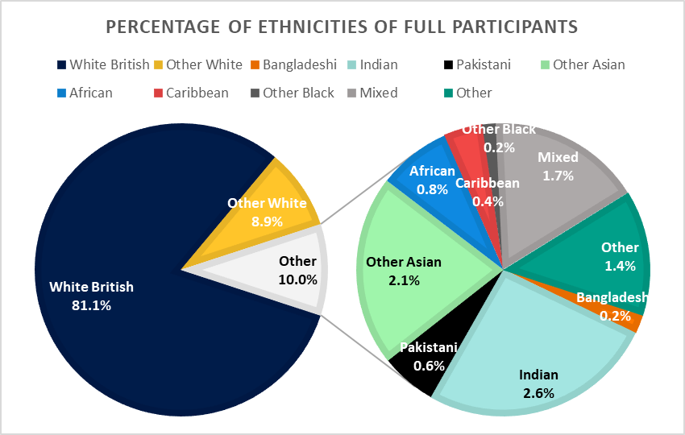
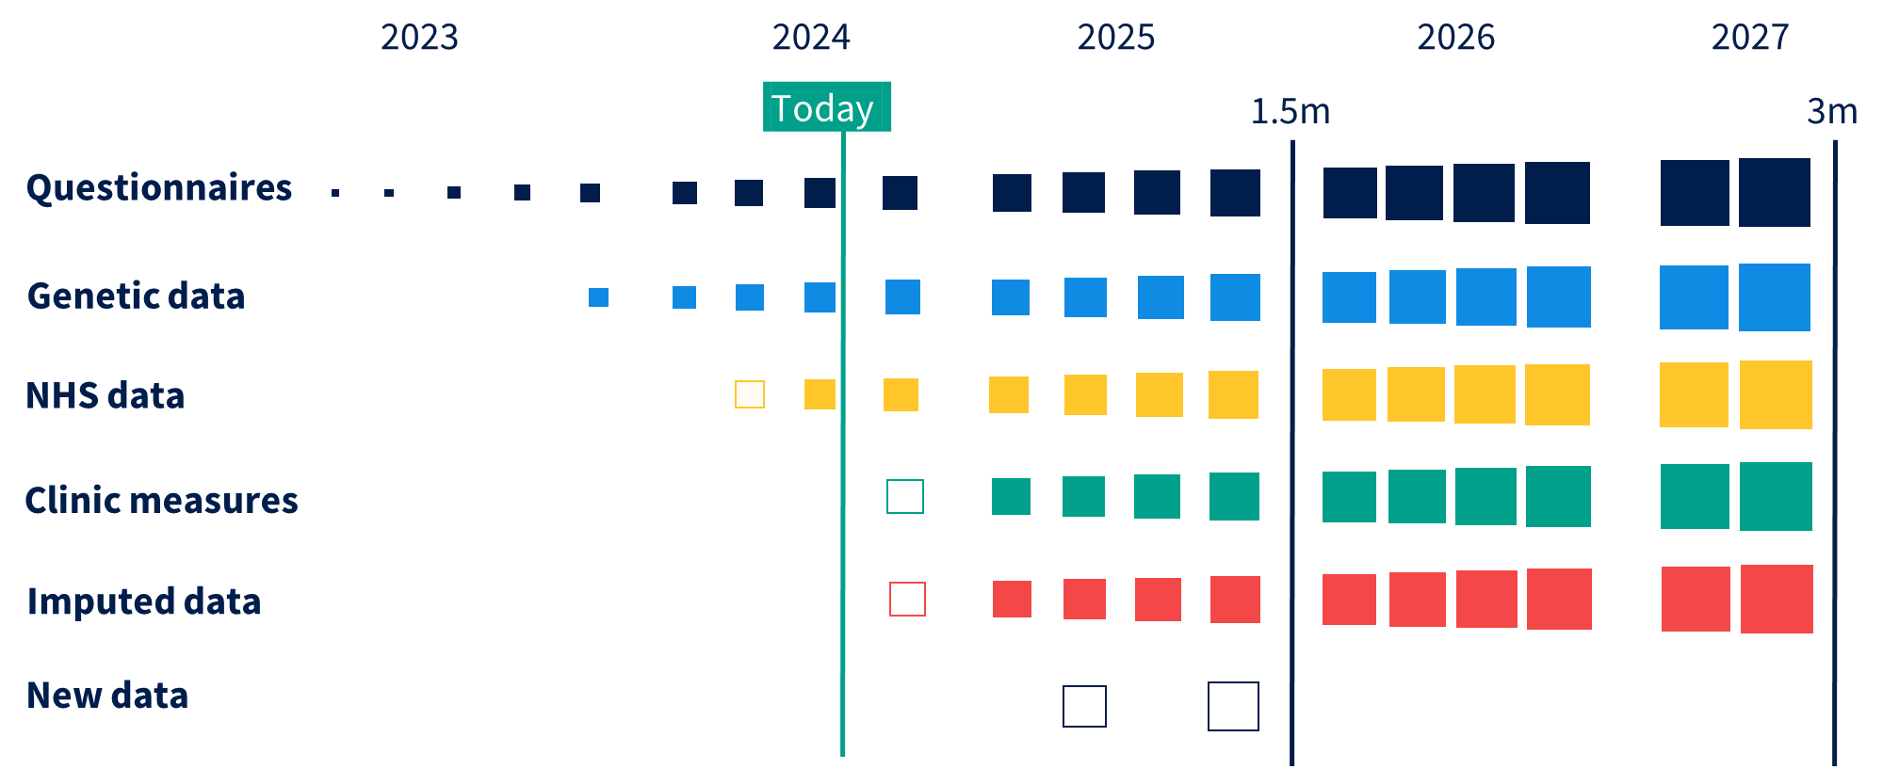
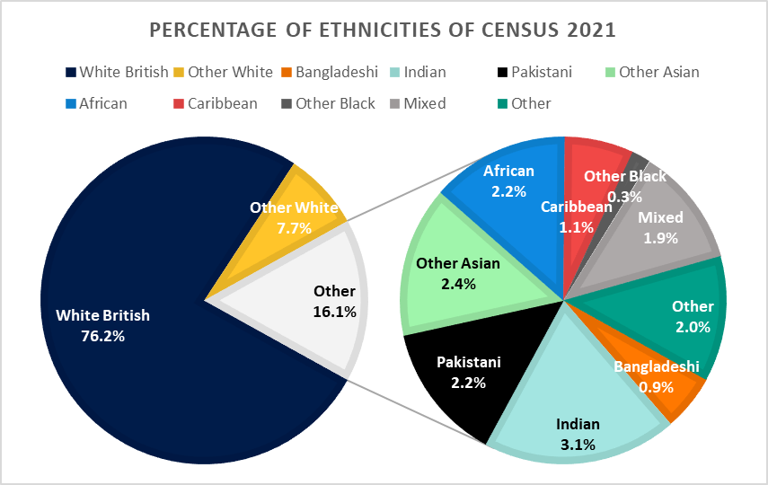
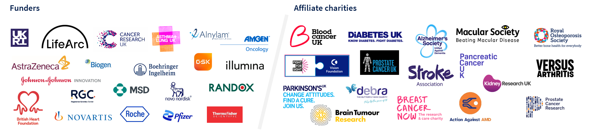
P3-S7
Our Future Health: a unique global resource for discovery and translational research
Aims of the programme
Our Future Health, a new prospective cohort in the United Kingdom, has a mission to help everyone live longer and healthier lives through the discovery and testing of more effective approaches to prevention, earlier detection, and treatment of diseases.
Our Future Health is a charity supported by the UK government, industry and medical charities which aims to recruit 5﻿ million volunteers from the UK adult population in order to create a unique resource which will catalyse aetiological and translational research for both common and rare diseases.
Our Future Health will facilitate translational research by providing access to stored biosamples, and by enabling recontact studies and trials with participants selectively invited based on demographics, phenotypes, and disease risks.
Apply for access now at research.ourfuturehealth.org.uk
The sign-up journey to becoming a participant of Our Future Health
What our participants donate to Our Future Health
Recruitment progress to date
A blood sample for genotyping and for long-term storage of plasma, buffy coat, and DNA
Complete a baseline questionnaire (~30 minutes; modules on demographics & household, work & education, lifestyle, family history, personal health history)
Provide permission for data linkage to health-related datasets (e.g., primary care, secondary care, cancer, death)
Provide permission to re-contact for further surveys/biospecimens/assessments and to invite participants to recontact studies.
Demographics – 1,547,014 consented participants
Ethnicity compared with census
Data roadmap

