Slide 1
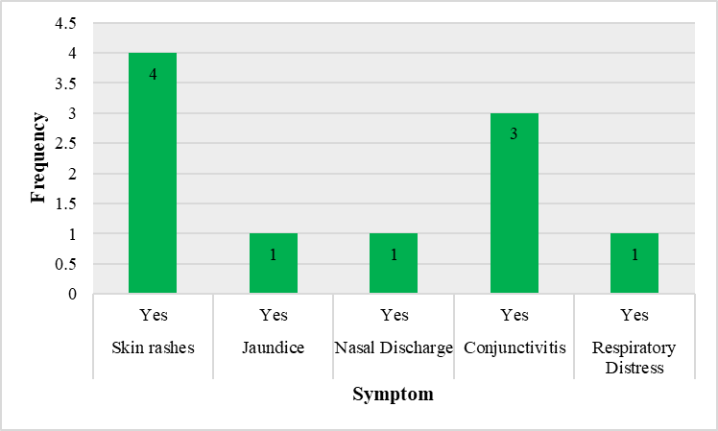
Seroprevalence of treponema pallidum in pregnant women at
Delivery time and neonates at Misisi Mini-Hospital and
Chawama General Hospital, 2022-2023
P2-L12
Nangoma A. Haambote^{1,3}, D. J. Banda³, Nyambe Sinyange^{3,}, M. Nawa¹ and Harriet K. Chiyangi^{2,3}
¹Department of Postgraduate Studies, School of Public Health & Environmental Sciences, Levy Mwanawasa Medical University, Lusaka, Zambia
²Directorate of Health Research & Development, Zambia Army Medical Services Branch, Lusaka, Zambia
³Zambia Field Epidemiology Training Program, Zambia National Public Health Institute, Lusaka, Zambia
Among the 274 participants, 28.5% were not tested for syphilis during antenatal visits, and 10% tested reactive for T. pallidum at delivery time.
Background
Results
A bacteria known as Treponema pallidum is the source of the common sexually transmitted disease known as syphilis.
Maternal and congenital syphilis continues to be a significant public health concern despite having an effective national antenatal clinic program.
Congenital syphilis can lead to several adverse birth outcomes.
Prevalence in pregnant women for sub-Saharan Africa is at 2.7%, while in Zambia it stands at 3.5%.
This study sought to determine the sero-prevalence of Treponema pallidum infection in pregnant women at delivery and their neonates at Misisi mini-hospital and Chawama General Hospital.
274 participants were enrolled into the study
Socio-demographic characteristics revealed that majority were above 24 years (56.41%), had attained secondary-level education (61.68%), and were married (81.39%).
Among the pregnant women, 28.5% were not tested for syphilis during antenatal visits, and 10% were diagnosed with syphilis at delivery.
Of the neonates exposed, 23% had clinical congenital syphilis.
Parity >2 (p < 0.05) and vaginal discharge (p < 0.05) were significantly associated with T. pallidum infection among pregnant women
HIV-positive status (p <0.001) and vaginal discharge (p <0.05) were significantly associated with congenital syphilis
T. Pallidum Positive
T Pallidum Negative
Figure 1. Sero-prevalence of Treponema Pallidum among pregnant women at Misisi-mini and Chawama general Hospitals, 2022-2023
Objectives
Discussion
Main objective:
To estimate the Sero-prevalence of Treponema pallidum among pregnant women at the time of delivery and estimate the prevalence of congenital syphilis among their neonates, and to determine their risk factors
Specific Objectives:
1. To estimate the Sero-prevalence of Treponema pallidum among pregnant women at the time of delivery
2. To estimate the prevalence of clinical and non-clinical congenital syphilis among neonates born to Treponema pallidum-positive mothers
3. To determine the main risk factors of Treponema pallidum infection among pregnant women
4. To determine the main risk factors of Treponema pallidum infection among neonates
People were aware and knowledgeable about COVID 19.
The study reported a much higher seroprevalence for syphilis among pregnant women when compared with other regions, indicating a need for better prevention and treatment.
Study findings coincide with the prevalence characteristic of sub-Saharan Africa
This study revealed a high prevalence of congenital syphilis.
The coexistence of HIV and syphilis is similar to other studies in the region due to them having similar transmission methods
Figure 2. Prevalence of clinical and non-clinical congenital syphilis among neonates at Misisi mini and Chawama general hospitals, 2022-2023
Conclusion
A significant portion of pregnant women were not screened for syphilis during antenatal care, highlighting gaps in preventive measures.
Many neonates born to syphilis-infected mothers showed signs of congenital syphilis, emphasizing the need for improved maternal screening and treatment.
HIV infection and vaginal discharges during pregnancy were identified as key risk factors for congenital syphilis in newborns
Materials and Methods
Figure 3: Congenital syphilis symptoms among neonates at Misisi mini and Chawama general hospitals, 2022-2023
Quantitative, cross-sectional study to estimate seroprevalence and risk factors of maternal syphilis at the time of delivery and prevalence of clinical and nonclinical congenital syphilis among their neonates.
The study population included pregnant women 18 years and above admitted for delivery and post-natal mothers.
Blood samples were investigated for the presence of active syphilis infection from delivery and post-natal mothers.
Convenience sampling method was used with a sample size of 267 participants.
Fisher’s exact was used to identify factors associated with congenital syphilis using Stata STATA v14.2.
Table 1. Risk factors for Congenital syphilis among neonates at Misisi Mini and Chawama General hospitals 2022-2023
Variable | Category | Congenital Syphilis |  | Fisher’s Exact P - value
 |  | Non-clinical n % | Clinical n %
HIV Status | Negative | 20 (90.91) | 2 (9.09) | 15.57 **
 | Positive | 0 (0) | 4 (100)
Vaginal discharge | No | 19 (86.36) | 3 (13.64) | 5.07 *
 | Yes | 2 (40) | 3 (60)
Contact:
Nangoma Agness Haambote
FETP Graduate
Email:haambotenangoma@gmail.com
Phone:+260973956693
*p < 0.05 ** p < 0.001

