Slide 1
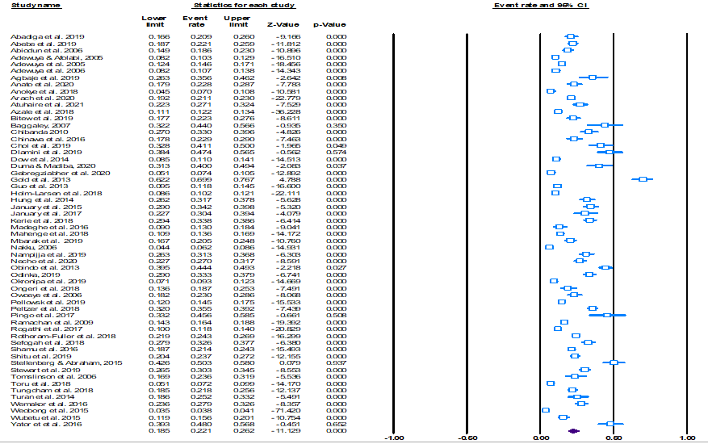
i. Prevalence of postpartum depressive symptoms ranged from 3.8 to 69.9%, with a pooled estimate of 22.1% An increase in prevalence of PPD from 2005–2010 (11%) to 2015–2021 (37%) ii. Prevalence of PPD was highest (30%) in Southern Africa (South Africa and Zimbabwe iii. Highest prevalence (25.6% CI 21.5-30.1) was obtained within 12 weeks postpartum. iv. The prevalence estimate was highest (23.3% CI 20.1-26.8) with the Edinburgh Postnatal Depression Scale
P3-P15
Burden of postpartum depression in Sub-Saharan Africa: An updated systematic review with meta-analysis
Martins Nweke¹, Maryjane Ukwuoma², Ada Adiuku-Brown³, Adaora Okemuo³, Princewill Ugwu ³ Elizabeth Nseka⁵ ¹University of Pretoria, Pretoria, South Africa, ²University of Nigeria Teaching Hospital, Ituku-Ozalla, Nigeria, ³University of Nigeria, Enugu, Nigeria
BACKGROUND
Globally, PPD is estimated to be between 10 and 25%, sub-Saharan Africa occupies Q4
Consequences beyond mothers: deleterious effects on children’s mental development
Impairs care provided to the baby and exposes babies to physical harm in extreme cases
A valid estimate of the PPD burden is a useful tool in expanding mental healthcare in SSA
Previous reviews omitted several eligible studies, querying the validity of the estimate
Hence, our study aimed to provide an update on the burden of depression in SSA
METHODS
The review was structured per the PRISMA -protocol
Included in the review were studies that reported the prevalence of PPD in SSA.
Databases: PubMed, Medline, CINAHL, Academic Search Complete, and PsycINFO.
A random-effect model was fitted to estimate the pooled prevalence of PPD in SSA.
We conducted subgroup analyses to estimate the distribution of postpartum depressive symptoms based on important study characteristics: sample size, the timing of diagnosis, design, study setting/region, instrument, and income/economy
Table 1. Sub-group analyses displaying prevalence per study characteristics
Characteristics | OR | P | Q | R² | Summary p | % total variance explained by the model
Timing of diagnosis < 12 weeks (ref) 3-6 months 6-9 months >12 months | -0.536 -0.555 -0.671 | 0.158 0.093 0.025* | 7.56 | 0.16 | 0.056 | 0.117
Study design Cross-sectional (ref) Longitudinal | -0.328 | 0.143 | 2.15 | 0.13 | 0.143 | 0.092
Sampling technique Probability (ref) Non-probability | 0.236 | 0.396 | 0.72 | 0.02 | 0.396 | 0.0141
Region East Africa (ref) Southern Africa West Africa | 0.670 0.169 | 0.015* 0.518 | 6.16 | 0.08 | 0.046 | 0.057
Income/economy Low-income (ref) Low-middle Upper-middle | 0.113 0.628 | 0.655 0.046* | 4.03 | 0.04 | 0.134 | 0.029
Instrument EPDS (ref) PHQ DSM-IV Others | 0.153 0.041 -0.233 -0.505 | 0.696 0.932 0.601 0.540 | 2.63 | 0.29 | 0.621 | 0.208
Country South Africa (ref) Ghana Ethiopian Kenya Nigeria Tanzania Uganda Zimbabwe | -0.755 -0.562 -0.322 -0.466 -1.214 -0.788 -0.066 | 0.053 0.106 0.499 0.191 0.027* 0.130 0.889 | 16.49 | 0.16 | 0.124 | 0.113
Period 2005-2010 (ref) 2010-2015 2015-2021 | 0.650 0.384 | 0.082 0.211 | 3.05 | 0.04 | 0.218 | 0.028
Sample size | 0.0002 | <0.001* | 17.85 | 0.55 | <0.0001* | 0.402
RESULTS
The prevalence estimates range from 3.8% to 69.9%. Pooled prevalence was estimated to be 22.1% ([CI 18.5–26.2]; PI = 5.0 – 61.0%) (Figure 1)
Prevalence of PPD was highest (30%) in Southern Africa
Variation in PPD prevalence due to sample size, the timing of diagnosis, study design, study setting/region, instrument, and income/economy (Table 1)
The highest prevalence (25.6% [CI 21.5-30.1]) was obtained within 12 weeks postpartum
The prevalence estimate was highest (23.3% CI 20.1-26.8) with the Edinburgh Postnatal Depression Scale
Figure 1: Meta-analysis of the prevalence of PPD in SSA
CONCLUSIONS
Given that PPD is a recurring mental health challenge among women in sub-Saharan Africa, there is an urgent need for strategic policy provisions to ameliorate its burden.
An increase in prevalence of PPD from 2005–2010 to 2015–2021 is indicative of the need for national governments to intensify efforts targeted at achieving the UN Sustainable Development Goals 3 and 5 in the region.
In SSA, the prevalence of PPD is highest (approximately 30%) in Southern Africa, precisely South Africa and Zimbabwe, where it is fast becoming an epidemic; hence strategies are needed to curtail its growing trend.
There is a need to characterise and stratify the risk factors of PPD in sub-Saharan to guide policy development of predictive algorithms and implementation strategies.
Additional Resources:
Nweke, M., Ukwuoma, M., Adiuku-Brown, A. C., Okemuo, A. J., Ugwu, P. I., & Nseka, E. (2024). Burden of postpartum depression in sub-Saharan Africa: An updated systematic review. South African Journal of Science, 120(1/2). https://doi.org/10.17159/sajs.2024/14197
Nweke M, Ukwuoma M, Adiuku-Brown AC, Ugwu P, Nseka E. Characterization and stratification of the correlates of postpartum depression in sub-Saharan Africa: A systematic review with meta-analysis. Womens Health (Lond). 2022 Jan-Dec;18:17455057221118773. doi: 10.1177/17455057221118773. PMID: 36039898; PMCID: PMC9434669.
Author Contact Information: martins.Nweke@gmail.com
Funding Source: Association of Common Wealth Universities
Conflicts of Interest: None
Acknowledgements: Thanks to all the primary study authors

