Slide 1
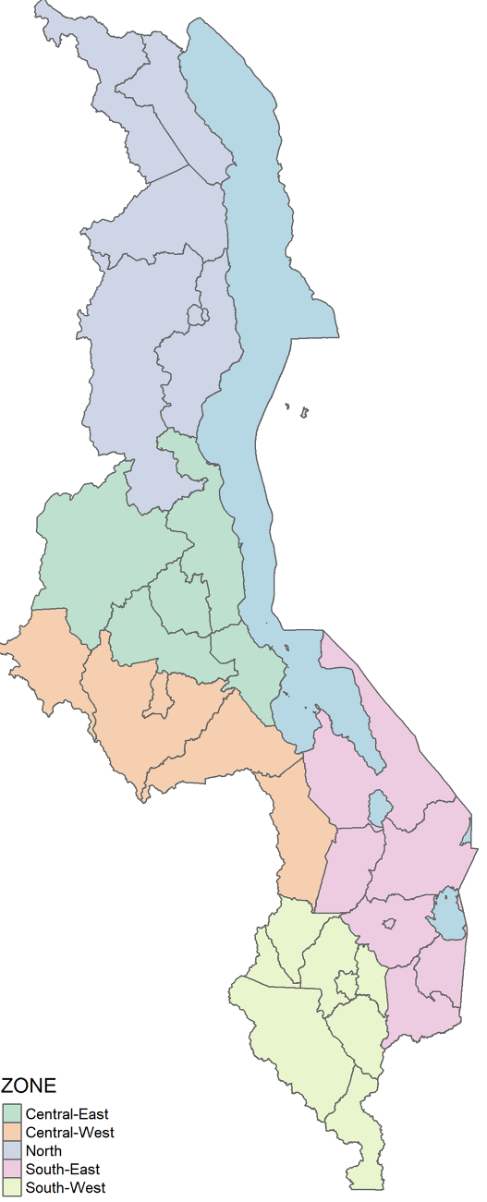
Surprisingly, "breathlessness" was associated with COVID-19 negativity, suggesting alternative diagnoses in women with respiratory symptoms. Despite no direct link between COVID-19 and adverse maternal outcomes, the pandemic correlated with an increase in maternal deaths, emphasising the need to address the indirect impacts on maternal health in future pandemic responses.
Learning to live with Coronavirus: Insights into Hospitalised Pregnant and Recently Pregnant Women suspected for COVID-19 infection in Malawi
P1-G4
Chikondi Chapuma^{1, 2}, Leonard Mndala^{1, 2}, Jeniffer Riches ^{1,2}, David Lissauer ^{1,2} for the Maternal Health Group
1. Malawi Liverpool Research Program, Blantyre, Malawi, 2. University of Liverpool, Liverpool, United Kingdom
BACKGROUND
As we move past the intense phase of the COVID-19 pandemic, it's crucial to sustain preventive measures and learn from previous outbreaks. Based on the Malawi National Surveillance platform (MATSurvey), this study provides insights into the demographic characteristics, clinical manifestations, and outcomes of hospitalised pregnant and recently pregnant women suspected to have COVID-19.
METHODS
Data from 605 hospitalized pregnant women (June 2020 - August 2022) were analyzed, focusing on demographics (age, region, parity), clinical characteristics (pregnancy state, chronic illnesses, antenatal visits, HIV status, SARS-CoV-2 symptoms), and outcomes (maternal near-miss, death, neonatal death).
COVID-19 positive (n=354) vs. negative (n=251) groups were compared using Fisher's Exact or Chi-squared tests at 95% confidence, with multiple testing adjustments via False Discovery Rate.
RESULTS CONTINUED
Table 2. Maternal Outcomes in hospitalised pregnant and recently pregnant women suspected for COVID-19 infection
 | Negative (N=251) | Positive (N=354) | Total (N=605) | P value | Relative Risk
Maternal outcomes |  |  |  | 0.034 | 0.62 (0.45, 0.87)
Dead* | 59 (24%) | 52 (15%) | 111 (18%)
Near Miss | 30 (12%) | 30 (9%) | 60 (10%)
No adverse outcomes | 162 (65%) | 272 (77%) | 434 (72%)
Cyanosis |  |  |  | 1 | 1.06 (0.18, 6.32)
No | 249 (99%) | 351 (99%) | 600 (99%)
Yes | 2 (1%) | 3 (1%) | 5 (1%)
Gasping |  |  |  | 0.56 | -
No | 251 (100%) | 353 (100%) | 604 (100%)
Yes | 0 (0.0%) | 1 (0%) | 1 (0%)
Respiratory rate > 40 or < 6 breaths/ minute |  |  |  | 0.49 | 0.64 (0.26, 1.55)
No | 241 (96%) | 345 (98%) | 586 (97%)
Yes | 10 (4%) | 9 (3%) | 19 (3%)
Oxygen saturation < 90% |  |  |  | 0.49 | 0.71 (0.35, 1.42)
No | 236 (94%) | 339 (96%) | 575 (96%)
Yes | 15 (6%) | 15 (4%) | 30 (5%)
Mechanical ventilation not due to anaesthesia |  |  |  | 1 | 0.95 (0.21, 4.19)
No | 248 (99%) | 350 (99%) | 575 (95%)
Yes | 3 (1%) | 15 (4%) | 30 (5%)
COVID-19 symptoms as the primary reason for hospitalisation |  |  |  | 0.76 | 1
No | 143 (57%) | 209 (59%) | 352 (58%)
Yes | 108 (43%) | 145 (41%) | 253 (42%)
RESULTS
Table 1. Demographic characteristics of hospitalised, pregnant and recently pregnant women suspected for COVID-19
 | Total (N=605)
Age in years
Mean (SD) | 27 (7)
Median (Q1, Q3) | 27 (21, 32)
Median (Range) | 27 (14, 51)
Zones
North | 44 (7%)
Central East | 42 (7%)
Central West | 65 (11%)
South East | 61 (10%)
South West | 393 (65%)
Parity
Missing values | 6
Multigravida | 403 (67%)
Primigravida | 196 (33%)
CONCLUSIONS
This study in a low-resource setting highlights predictive symptoms of COVID-19 in pregnant women, aiding the adaptation of screening tools. Surprisingly, "breathlessness" was associated with COVID-19 negativity, suggesting alternative diagnoses in women with respiratory symptoms. Despite no direct link between COVID-19 and adverse maternal outcomes, the pandemic correlated with an increase in maternal deaths, emphasizing the need to address the indirect impacts on maternal health in future pandemic responses.
SARS-CoV-2 symptoms and other clinical characteristics
Women who tested positive for COVID-19 were more likely to have a sore-throat (p = 0.002), loss of taste/ smell (p = 0.038), international or confirmed COVID-19 contacts (p < 0.001) and were more likely to be post-delivery (p <0.001).
Women living with HIV were significantly lower in those testing positive for COVID-19 (p<0.001). COVID-19-negative cases were also more likely to have breathlessness (p <0.001), and conditions such as hypertension (p = 0.075) and asthma (p = 0.59) did not exhibit significant differences.

