Slide 1
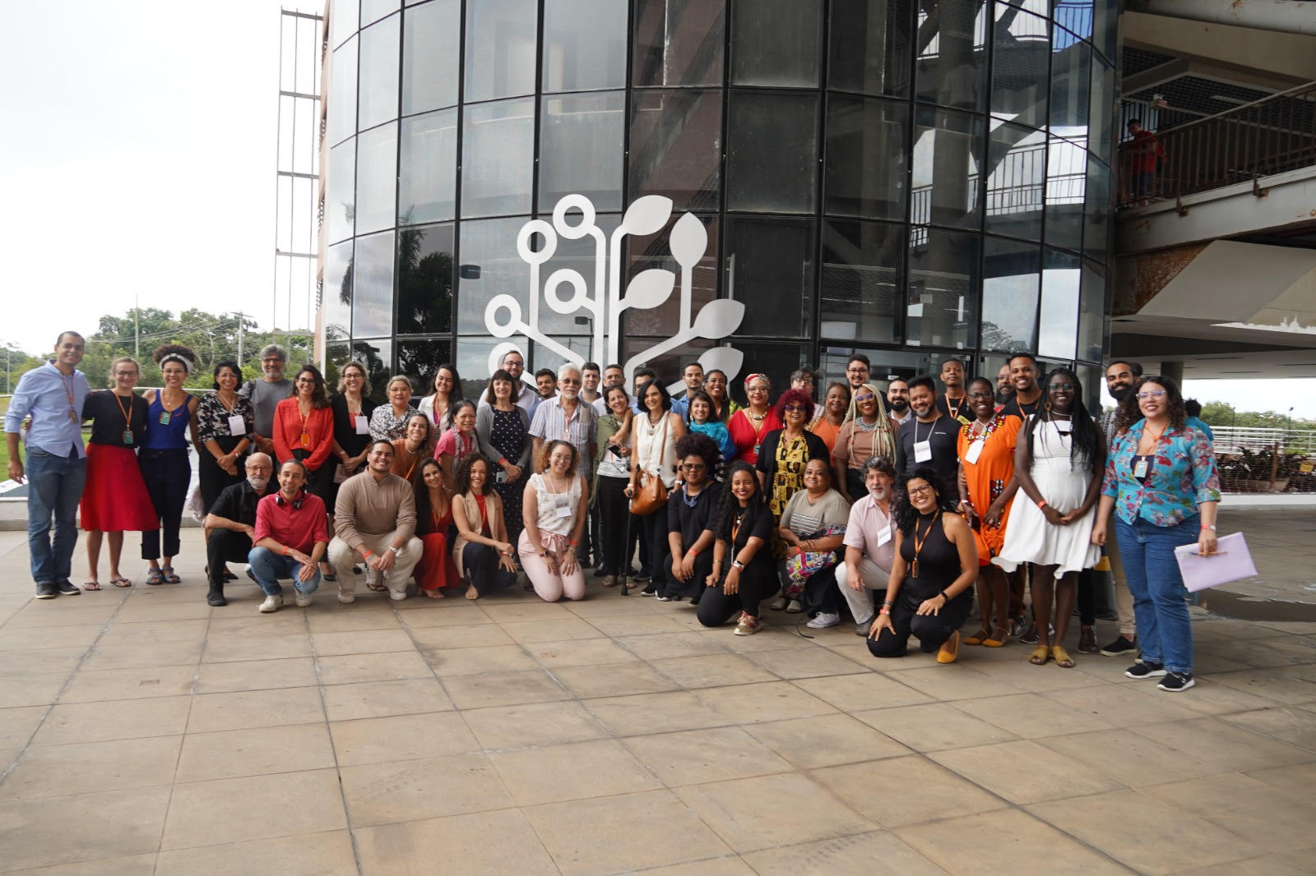
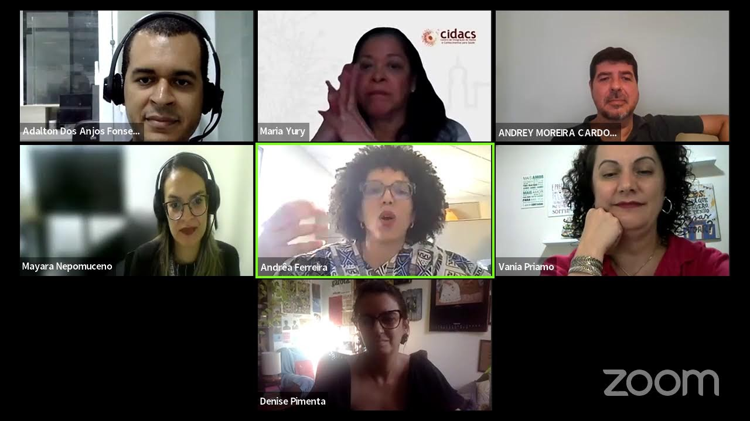
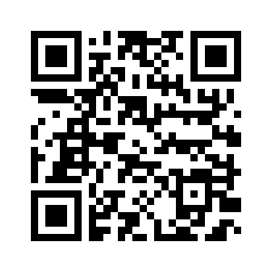
How to carry out scientific dissemination of health research considering the context of different stakeholders? In Brazil, a successful experience of creating a collaborative environment among multiple stakeholders was carried out at Cidacs, a research center that links national governmental health and social databases focused on to investigate social determinants and the impact of health, social and environmental policies on different health problems of the Brazilian population. Scientific dissemination is an important pillar of this work. To ensure knowledge produced is accessible and relevant to various audiences, we have been developing strategies on public engagement and co-production.
Challenges of co-production with multiple stakeholders in disseminating research results generated at a Brazilian data center
P3-S8
Adalton Fonseca¹,², Denise Pimenta¹, Mariana Sebastiao¹, Raiza Lima¹, Daiane Machado¹,³, Maria Yury Ichihara¹ e Mauricio L. Barreto¹ | ¹Cidacs/Fiocruz Bahia; ²Universidade Estadual do Sudoeste da Bahia (UESB); ³Harvard Medical School
Background: A Data Center beyond Big Data
The Centre for Data and Knowledge Integration for Health (Cidacs) is a Brazilian center for the investigation of social determinants in health, based in Salvador, Bahia.
It has one of the biggest cohorts in the world: the "100 Million Brazilian Cohort," making it an important research hub in the Global South, working alongside relevant institutions in South Africa, Ghana, Mexico, Pakistan, Kenya, the U.K., the U.S.A., etc.
Due to its massive dataset, Cidacs is able to investigate the impact of Brazilian social and political policies on the health of the population. Since its inception in 2016, the Center has been developing strategies, tools, and skills to work closely with society, promoting public engagement in science, scientific dissemination, and co-production with stakeholders.
Currently, Cidacs is conducting two investigations involving the "100 Million Brazilian Cohort" and engaging society, including vulnerable communities, policymakers, health workers, and researchers.
The research is focused on mental health and gestational/congenital syphilis. Through co-creation and co-production, Cidacs has been building a method to integrate big data, society, and public engagement in science/scientific dissemination.
Methods: Betting on the Southern Approach
Influenced by the Decolonial Approach and Paulo Freire's Method
Aligning Collective Health and Popular Education
Stakeholder mapping
Existence of a Public Engagement Steering Committee
Scientific dissemination products inspired by the co-creation concept to incorporate diverse viewpoints
Considering different contexts, formats, languages, channels, and messages
Holding meetings, webinars, and conducting continuous evaluation
Cidacs' Public Engagement Steering Committee – Salvador, Brazil, 2023.
RESULTS
Stakeholders have been contributing to the construction of dissemination products, including materials for youth, populations living in peripheral urban areas, indigenous people and the black population.
For instance, integrated to a youth mental health research a series of training workshops with teachers from a local community school is underway, engaging their students together with teachers and researchers to coproduce a policy recommendation document to be presented to local policymakers.
In a project on gestational and congenital syphilis, community leaders and policymakers suggested narrative formats such as audio for WhatsApp and community radio, as well as videos to disseminate results and inform about the prevention and treatment of the disease
CONCLUSIONS
Working directly with stakeholders can be a challenge, consediring certain historical distance between the science and the society. However, Cidacs understands that proximity to a diverse kind of stakeholders is an essential point to improve data analyses and promote a better science that impacts the real life of Brazilian population.
ADDITIONAL KEY INFORMATION
https://cidacs.bahia.fiocruz.br/
denise.mpimenta@fiocruz.br

