Slide 1
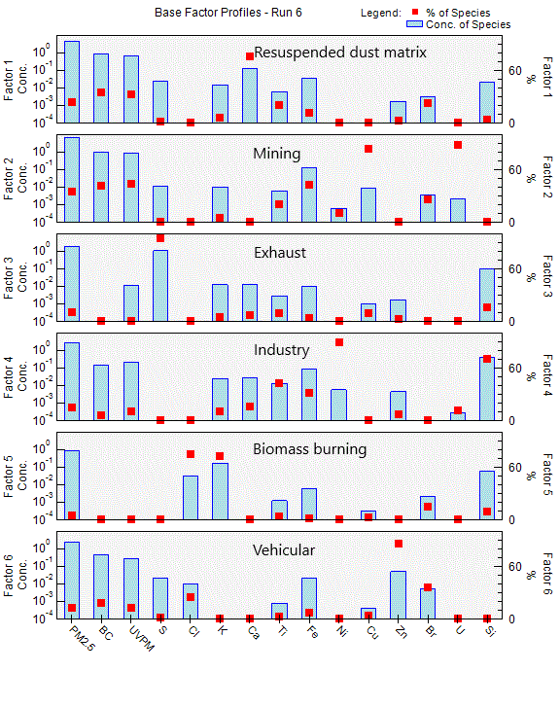
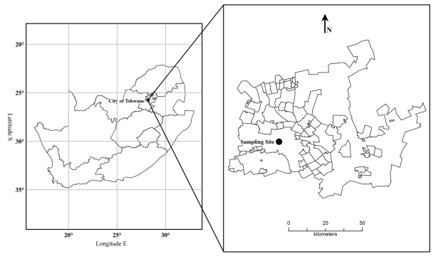
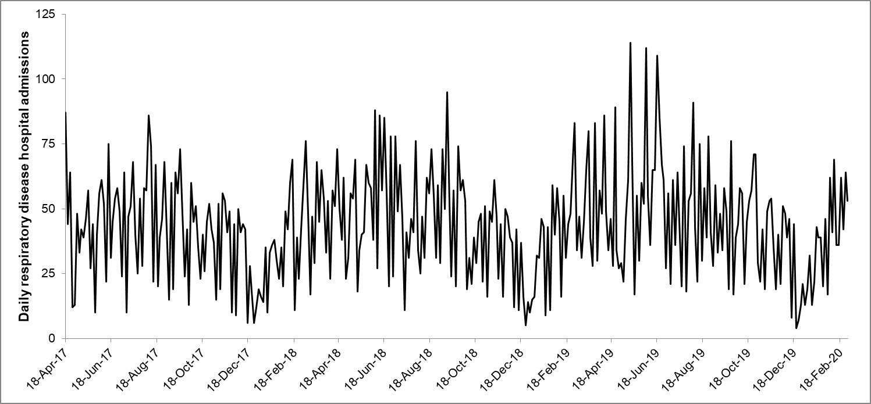
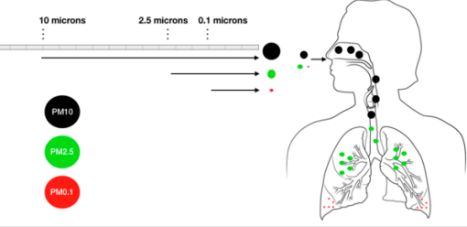
CASE-CROSSOVER STUDY BETWEEN PM_{2.5} AND HOSPITAL ADMISSIONS FOR RESPIRATORY DISEASES IN PRETORIA P2-H2
Chantelle Howlett-Downing¹, Peter Molnár ², Johan Boman ³ , Joyce Shirinde¹ and
Janine Wichmann¹
¹ School of Health Systems and Public Health, Faculty of Health Sciences, University of Pretoria, Gezina 0031, South Africa
² Department of Occupational and Environmental Medicine, Institute of Medicine, Sahlgrenska Academy, University of Gothenburg, SE-405 30 Göteborg, Sweden
³ Department of Chemistry and Molecular Biology, University of Gothenburg, SE-412 96 Göteborg, Sweden
RESEARCH QUESTION
Is there an association between ambient PM_{2.5} and the constituent trace elements and respiratory hospital admissions in central Pretoria, Tshwane Metropolitan Municipality?
AIMS AND OBJECTIVES:
To find an association between increased hospital admissions for respiratory diseases and an increase in PM_{2.5} (IQR 10 µg.m⁻³ ) and trace element bound PM_{2.5} (IQR 1 ng.m⁻³ ) by means of a case-crossover epidemiology study.
BACKGROUND:
Most developing countries have experienced an increase in air pollution due to urban development, industrialisation, and modernisation. The impact of air pollution on human health has thus received more attention on public platforms. Evidence studies and other epidemiological studies have revealed a significant correlation between fine particulate pollutants and respiratory morbidity and mortality numbers. According to the WHO, in 2016, ambient (outdoor) air pollution in both cities and rural areas was estimated to have caused 4.2 million premature deaths worldwide. Mortality was attributable to cardiovascular, respiratory diseases and cancers. Most studies on ambient air and respiratory morbidity were done in developed countries.
The WHO updated the daily and yearly guidelines for PM_{2.5} in 2021. The report was supported by evidence studies and epidemiological studies. The report also highlighted the paucity of environmental health studies in African regions including South Africa. The City of Tshwane (Pretoria) has grown significantly over the past two decades, resulting in more industries, increase in traffic and other activities contributing to air pollution. It is for this reason that the study was conducted in this area to investigate the association between air pollution and respiratory conditions.
A stacked species profile for 6-factors as processed by the positive matrix factorisation model. Mean contributions (in µg.m⁻³) of PM_{2.5}, BC, UV-PM and trace elements as measured at the School of Health Systems and Public Health, University of Pretoria from 18 April 2017 to 28 February 2020.
Resuspended matrix (24%), mining (33%), exhaust (12%), industry (15%), biomass burning (4.2%), and vehicular emissions (12%) contributed to the modelled total annual PM_{2.5} concentration
Descriptive statistics of 24-hour PM_{2.5}, soot, black carbon, organic carbon and trace elemental levels and meteorological conditions on 350 days at the School of Health Systems and Public Health, University of Pretoria during 18 April 2017 and 28 February 2020
Pretoria is situated in central South Africa and has an overall population of 2 566 000 in 2020. It is located approximately 50 km north of Johannesburg in the north-east of South Africa. Geographically it lies in a transitional belt running between the plateau of the Highveld to the south and the lower-lying Bushveld to the north. With an altitude of about 1,350m above sea level, the city enjoys a moderate climate surrounded by hills of the Magaliesberg range and a sheltered and fertile valley. The sampling site is at the School of Health Systems and Public Health of the University of Pretoria (S25° 43' 57” E28º 12' 10”). Activities surrounding the site range from background urban, large educational institutions, two governmental hospitals and industry in the northern and north-western areas.
Variable | Mean | Std Dev | Median | Min | Max
PM_{2.5} | 23.2 | 17.3 | 17.7 | 0.7 | 139
Soot | 1.8 | 1.7 | 1.0 | 0.0 | 11.0
BC | 3.1 | 2.5 | 2.1 | 0.2 | 11.4
UV-PM | 2.5 | 1.7 | 2.1 | 0.1 | 7.6
Br | 17 | 23 | 8.6 | 0.2 | 254
Ca | 156 | 160 | 106 | 0 | 997
Cl | 53 | 129 | 11.8 | 0.0 | 1238
Fe | 297 | 216 | 261 | 1.7 | 1454
K | 251 | 327 | 115.9 | 1.5 | 1917
S | 1175 | 1752 | 496 | 0.4 | 11841
Si | 646 | 687 | 507 | 4.1 | 5532
Ti | 34 | 29 | 27.7 | 0.5 | 212
Zn | 57 | 91 | 20.5 | 0.1 | 809
Units: PM_{2.5} (µg/m³), soot (m⁻¹ x 10⁻⁵),
BC (μg.m⁻³),
UV-PM (μg.m⁻³), temperature (ºC), relative humidity (%), windspeed (ms⁻¹), rainfall (mm),
trace elements (ng.m⁻³)
No missing values, except for four soot values
METHODS:
A case-crossover epidemiology study was performed to find an association between sampled PM_{2.5} air pollutants and health data was sourced from three Mediclinics (Medforum, Meulmed and Kloof). Environmental data as sampled at the School of Health Systems and Public Health, UP, for 34 months, included PM_{2.5}, BC, UV-PM, and 10 trace elements: Br, Ca, Cl, Cu, Fe, K, S, Si, Ti and Zn which were above the LoD. The annual mean concentration of the PM_{2.5}, BC, UV-PM and the trace elements were seasonal, p<0.001.
In total, 15 155 respiratory disease hospital admissions were included in this study. Approximately 1000 fewer male (n=7 095) than female (n=8 060) patients were admitted. At most, 114 patients were admitted for respiratory disease in a day. The respiratory hospital admissions had clear seasonal trends with more hospital admissions per day during winter than in summer, p<0.001. The CCO model controlled for sex, age and Tapp.
The perceived heat due to the combined effect of temperature and relative humidity was also considered by means of the Tapp analysis. Tapp = -2.653 + (0.994 × Tc) + (0.0153 × Td²) Equation 1
where Tc was temperature in °C and Td was dew point temperature in °C.
The median for Tapp for the study period was 19.1 with a range of 6.27 - 30.6 ºC . A case-crossover study by design takes advantage of the temporal factors by investigating the relative risk daily (Lag0) and thus no in-depth individual information is required. To account for potential co-pollutant confounding and overestimation in the effects estimates, the total PM_{2.5} was controlled for in a second analysis.
One of the assumptions in environmental health studies is that PM_{2.5} demonstrates regional homogeneity. This is not true since a range of sources contribute to the collective total ambient PM_{2.5}. Biomass burning is seasonal (p<0.001). Sources due to industrial, mining and resuspended dust factors are more ubiquitous (p>0.05). A supporting analysis with the 6 sources supports the CCO study.
Percentage change (95% CI) in daily respiratory disease hospital admissions per inter-quartile range increase in trace element levels (lag0) in model 2, measured at the School of Health Systems and Public Health, University of Pretoria during 18 April 2017 to 28 February 2020 (350 days).
Air pollutant | All | 0-14 year old | 15-64 year old | ≥65 year old | Females | Males
Br | 0.6 (-1.7, 2.9) | 0.0 (-2.9, 3.1) | 1.1 (-2.3, 4.6) | 2.2 (-3.1, 7.7) | 2.0 (-0.8, 4.8) | -1.0 (-4.1, 2.1)
Ca | 3.2 (0.3, 6.1) | 5.2 (1.5, 9.1) | 0.6 (-3.7, 5.0) | 0.1 (-6.4, 7.1) | 3.0 (-0.6, 6.8) | 3.3 (-0.4, 7.3)
Cl | 0.5 (-0.3, 1.2) | 0.7 (-0.3, 1.7) | 0.3 (-0.8, 1.4) | 0.2 (-1.5, 2.0) | 0.7 (-0.2, 1.6) | 0.2 (-0.8, 1.2)
Fe | 1.9 (-1.5, 5.3) | 3.8 (-0.7, 8.4) | -0.6 (-5.5, 4.5) | 0.0 (-7.5, 8.0) | 2.6 (-1.7, 7.0) | 1.1 (-3.2, 5.6)
K | 1.2 (-0.5, 3.1) | 2.2 (-0.1, 4.5) | -0.2 (-2.9, _{2.5}) | 0.2 (-3.8, 5.8) | 1.0 (-1.2, 2.4) | 1.6 (-0.8, 3.9)
S | 0.7 (-1.3, 2.7) | 1.0 (-1.6, 3.6) | 0.1 (-2.8, 3.1) | 1.0 (-3.6, 5.8) | -0.1 (-2.6, 2.4) | 1.6 (-1.0, 4.2)
Si | 0.9 (-0.4, 2.1) | 1.6 (0.0, 3.2) | -0.3 (-2.2, 1.7) | 0.0 (-3.0, 3.0) | 0.7 (-0.9, 2.3) | 1.0 (-0.6, 2.7)
Ti | 0.7 (-1.7, 3.1) | 2.0 (-1.0, 5.2) | -0.5 (-4.8, 2.0) | 0.3 (-5.1, 6.1) | 1.5 (-1.4, 4.5) | -0.3 (-3.3, 2.9)
Zn | 0.3 (-1.7, 2.4) | 0.9 (-1.7, 3.6) | -1.0 (-4.0, 2.0) | 0.9 (-3.6, 5.6) | 0.0 (-_{2.5}, _{2.5}) | -1.8 (-1.8, 3.4)
All the models included only one trace element air pollutant. Models adjusted for PM2.5, apparent temperature (lag0), day of the week, public holidays and monthyear
The IQR is used as the increment for the trace elements (in ng.m-3): Br (11.6), Ca (124.4), Cl (29.2), Fe, (150.8), K (162.2), S (1017.2), Si (256.1), Ti (19.2), Zn (48.2)
10 µg.m-3 is used as the increment for PM2.5 and 1 µg.m-3 for BC and UV-PM
The increment for soot is per 1 m-1 x 10-5 increase
RESULTS:
A full dataset including total PM_{2.5}, soot, BC, UV-PM and nine trace elements were analysed. For model 1, respiratory hospital admissions increased significantly by 2.7% (95% CI: 0.6, 4.9) per 10 µg.m⁻³ increase in PM_{2.5}.
An increase in respiratory hospital admissions increased significantly with an increase in Ca by 4.0 % (95% CI: 1.4% - 6.8% per 124.4 ng.m⁻³ increase), for Cl by 0.7 % (95% CI: 0.0% - 1.4%) per 29.2 ng.m⁻³ increase, Fe (3.3 % 95% CI 0.5% - 6.1% per 150.8 ng.m⁻³ increase), K ( 1.8% 95% CI 0.2 – 3.5 per 162.2 ng.m⁻³ increase and Si (1.3 % 95% CI 0.1% - 2.5% per 256.1 ng.m⁻³ increase).
Respiratory hospital admissions increased significantly for females with increased soot of 5.8% (95% CI: 0.6 – 11.3) per 1 m⁻¹ x 10⁻⁵ incremental increase. When stratified for age, the ≥65 years age group, although not significant, tended to experience adverse effects as the percentage change in respiratory hospital admissions > 0%.
When stratifying for sex, hospital admissions significantly increased by an increase of Br by 2.6 % (95% CI; 0.2% - 5.2%) with an IRQ of 11.6 per 1 ngm⁻³, of Ca by 3.8 % (95% CI: 0.5% - 7.3%) with an IRQ of 124 per 1 ngm⁻³, of Cl by 0.9 % (95% CI: 0.1% - 1.8%) with an IRQ of 29 per 1 ngm⁻³ and by Fe of 3.6 % (95% CI: 0.1% - 7.2%) with an IRQ of 151 per 1 ngm⁻³. For males, a significant increase of Ca by 4.3 % (95% CI: 0.8% - 7.9%) with an IRQ of 11.6 per 1 ngm⁻³.
When considering the positive correlations between the constituents of the total PM_{2.5}, the Spearman’s Rank correlation test, Br is positively correlated with Cl, K and Ti (rho = 0.64, 0.65 and 0.56, p<0.001, respectively). These were coarse particulates and seasonal, which implies winter biomass burning as well as urban industrial activities. Further coarse particulate correlations include Si and Ti (rho = 0.60, p<0.001). There is a good positive correlation between K and Cl (rho = 0.72, p<0.001). This trace element combination is a tracer for biomass/biofuel burning in the PMF model.
A caveat is proposed by Achilleos et. al., (2017), whereby constituent tracer elements that are more strongly correlated with PM_{2.5} may appear to be more closely related to adverse health outcomes due to total PM_{2.5}. After controlling for PM_{2.5} in the model 2, fewer significant associations were observed between respiratory hospital admissions and the trace elements. Respiratory hospital admissions increased significantly for total Ca by 3.2 % (95% CI: 0.3, 6.1) and for the 0 – 14 age group by 5.2 % (95% CI: 1.5, 9.1). The associations were slightly weaker compared to model 1.
When analysing for an association between hospital admissions and sources of total PM_{2.5}, hospital admissions significantly increased with an increase in resuspended dust matrix by 2.9 % (95% CI: 0.1% - 5.7%) and biofuel burning by 1.6 % (95% CI: 0.1% - 3.2%) sources. This implied that although positive associations between constituents may increase the estimated effects, a secondary analysis can confirm the association of the constituent on the health effect.
STRENGTHS AND LIMITATIONS
Since particulate matter is heterogenous in composition and may vary spatially and temporarily, the geographical and meteorological origins may play a role in confounding and bias. Previous studies included multiple point and multiple city sampling points and found that there was intercity heterogeneity. This study is a single point sampling point and thus may reduce the risk of effect modification due to the above heterogeneity. One of the assumptions in environmental health studies is that PM_{2.5} demonstrates regional homogeneity over a time period. This is not true since a range of sources contribute to the collective total ambient PM_{2.5} and demonstrates seasonality, p<0.001). The 72 hour sampling regime may thus introduce ambiguity in the PMF analysis, should emission incidents occur.
CONCLUSION:
In total, there were 15 155 reported hospitalizations due to pneumonia, bronchitis, chronic obstructive disorder, asthma, respiratory disorder syndrome, respiratory and other related respiratory disorders over the 34-month period. As mentioned, two models were applied in the case-crossover study using lag0 (exposure for the same day as hospitalization). Not only is there a positive association between total PM_{2.5} and hospital admissions but also between toxic tracer elements and hospital admissions. Sources of PM_{2.5} confirm the positive associations. Policies directed at reducing air pollution should consider both types of sources of air pollutants.
 | PM_{2.5} | Soot | BC | UV-PM | Br | Ca | Cl | Cu | Fe | K | S | Si | Ti | U | Zn
PM_{2.5} | 1
Soot | 0.45 | 1
BC | 0.74 | 0.47* | 1
UV-PM | 0.71 | 0.47* | 0.95* | 1
Br | 0.81 | 0.45* | 0.80* | 0.79* | 1
Ca | 0.58 | 0.34* | 0.52* | 0.51* | 0.64* | 1
Cl | 0.55 | 0.40* | 0.60* | 0.57 | 0.64* | 0.58* | 1
Cu | 0.38 | 0.14* | 0.32* | 0.24* | 0.33* | 0.26* | 0.39* | 1
Fe | 0.67 | 0.50* | 0.64* | 0.68* | 0.78* | 0.69* | 0.57* | 0.14* | 1
K | 0.55 | 0.38* | 0.49* | 0.51* | 0.65* | 0.67* | 0.72* | 0.19* | 0.68* | 1
S | 0.21 | 0.21* | 0.07 | 0.11* | 0.21* | 0.38* | 0.27* | -0.07 | 0.37* | 0.53* | 1
Si | 0.39 | 0.19* | 0.22* | 0.22* | 0.39* | 0.58* | 0.36* | 0.17* | 0.51* | 0.49* | 0.48* | 1
Ti | 0.54 | 0.28* | 0.3-* | 0.38* | 0.56* | 0.70* | 0.50* | 0.25* | 0.68* | 0.55* | 0.37* | 0.60* | 1
U | -0.81 | 0.12* | 0.19* | 0.24* | 0.18* | 0.16* | -0.10 | 0.12* | 0.27* | 0.13* | 0.20* | 0.08 | -0.08 | 1
Zn | 0.68 | 0.45* | 0.69* | 0.66* | 0.75* | 0.60* | 0.54* | 0.31* | 0.69* | 0.47* | 0.29* | 0.37* | 0.56* | 0.22* | 1
Correlation between 24-hour PM_{2.5} and the trace elements on 350 days at the School of Health Systems and Public Health, University of Pretoria during 18 April 2017 and 28 February 2020
Correlations were significant; mostly p<0.001
*Not significant; p≥0.05
No missing values
Daily hospital admission for respiratory diseases from April 2017 to 28 February 2020 at three private hospitals in Pretoria, South Africa during the 350 days that PM_{2.5} was sampled at the School of Health Systems and Public Health, University of Pretoria
The particulates are divided by size into coarse (diameter larger than 2.5 µg/m³) and fine particulates (PM_{1.0}, mass concentration of diameter smaller than 2.5 µg/m³). Fine particles are divided into two size classes, of which the range from 0.01 to 0.1 µm in diameter is known as the ultrafine or nuclei mode which is emitted particularly from combustion processes or formed in homogeneous nucleation of supersaturated vapours. The characteristic of these fine particles is their high number per unit of air volume. These ultrafine behave differently in human lungs as they are prone to deposition deeper into the lung.
Descriptive statistics of the daily number of respiratory disease hospital admissions at three private hospitals, in Pretoria
Group | Mean | Min | Median | Max
All ages and both sexes (n=15155) | 43.3 | 4.0 | 44.0 | 114.0
Females (n=8060) | 23.0 | 0.0 | 23.0 | 61.0
Males (n=7095) | 20.3 | 0.0 | 20.0 | 66.0
0-14 year olds (n=8225) | 23.5 | 0.0 | 23.0 | 71.0
15-64 year olds (n=4932) | 14.1 | 0.0 | 14.0 | 37.0
≥65 year olds (n=1998) | 5.7 | 0.0 | 5.0 | 25.0
REFERENCES:
1. Molnár P, Tang L, Sjöberg K, Wichmann J. Long-range transport clusters and positive matrix factorisation source apportionment for investigating transboundary PM2.5 in Gothenburg, Sweden. Environmental Science. Processes & Impacts. 2017; doi:10.1039/C7EM00122C
2. Almeida SM, Manousakas M, Diapouli E, Kertesz Z, Samek L, Hristova E, et al. Ambient particulate matter source apportionment using receptor modelling in European and Central Asia urban areas. Environmental pollution. 2020; 266:115199. doi:https://doi.org/10.1016/j.envpol.2020.115199
3. Achilleos S, Kioumourtzoglou M-A, Wu C-D, Schwartz JD, Koutrakis P, Papatheodorou SI. Acute effects of fine particulate matter constituents on mortality: A systematic review and meta-regression analysis. Environ Int. 2017; 109:89-100.
4. World Health Organization. WHO global air quality guidelines: Particulate matter (PM2.5 and PM10), ozone, nitrogen dioxide, sulfur dioxide and carbon monoxide. Geneva: World Health Organisation; 2021.

