Slide 1
Excelsior Scholarship

Slide 2
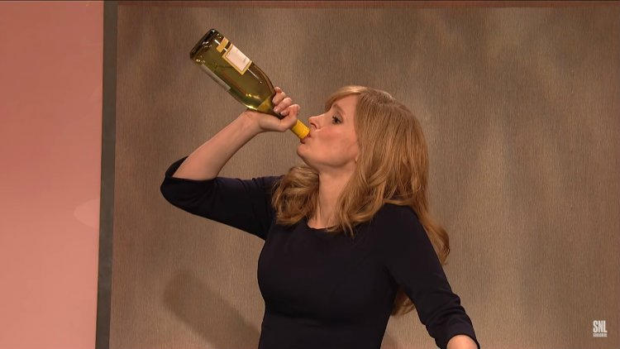
How does Excelsior make you FEEL?

Slide 3
The Benefits
Additional Aid for students, reducing reliance on federal student loans
Holds student accountable in hopes to increase graduation rates
Only have to apply ONCE

Slide 4
The Challenges
Tuition ONLY
Tracking is a NIGHTMERE
Only aid that students lose retroactively
Rules change
Communication is challenging
A lot of work for a scholarship that could disappear
Does not cover remedial classes
Who is responsible at the campus for the management

Slide 5
How Fredonia managed the CHAOS

Slide 6
Who is at the TABLE?
Our Table
Registrar
Financial Aid
Student Accounts
Academic Advising
IT
Notes:
Self appointed committee
Meet weekly
Started because we kept calling each other….too time consuming
Needed a point of contact for students to eliminate the Fredonia Fit program of running around campus
_Academic Advising Services is the advertised point of contact with this team supporting questions, problems, and managing data and communication—
Functions like a students of concern group

Slide 7
Timeline
September
Review Spring Starts for Benchmarks
October
Invite student to Excelsior General Campus Meetings
Email students FAQ list
Send Advising Sheets to Departments
January
Review Eligibility for Spring Starts
Notes:
Benchmarks…are spring starts enrolled in enough credits in the fall-they are on trace

Slide 8
February
For Fall Starts
If their Eval Year Credits or Benchmark Credits will not meet requirement
Outreach to suggest Summer Coursework
Short Credit Hours: Subject Line Excelsior Update and Eligibility Email
March
Email invite to Excelsior General Meeting
Contact students who are repeating course work
Send individual Advising Sheets to Departments
May/June
Identify Summer Credits in Progress (Google Form)
Outreach verification of credits in progress
Contact students who are registered for Part Time

Slide 9
June
Phone calls to students who are registered for Fall but in jeopardy of losing excelsior (excluding those that responded to the Summer Registration Google Form)
July
Letter mailed from Student Account with options flyer
August
Phone calls to students who indicated they were enrolled in Summer Coursework-we need verification
Another phone call to students who still have a balance and are registered for classes-last chance before schedule is dropped

Slide 10
Summer Coursework Google Form

Slide 11
Our Successes
Fall 2018,8 students schedules were dropped
717 students receiving or eligible for Excelsior
Fall 2019, Zero student schedules were dropped
1031 students receiving or eligible for Excelsior
Accurate information and consistent messaging
Many student services are AWARE and Equipped to have conversations regarding Excelsior

Slide 12
What is working well on your campus?

Slide 13
What challenges are you facing on our campus?

Slide 14
Questions?

