Slide 1
How to, When, and When not to Record Video for your Courses
Tonka Jokelova, Ph.D. (SUNY Canton)
&
Jason Hy (SUNY Oswego)

Slide 2
Overview
Why?
What?
When?
How?
How not to?

Slide 3
Pedagogical benefits
Deeper learning
Enhanced learning experience
Learner autonomy
Motivating and inspiring
(Wilmott et al. 2012)
Notes:
Deeper learning - Student can watch the video as many times as they need to
+ good for providing a variety of formats (UDL)
+ good for student engagement

Slide 4
What can be a video?
Visual content
Additional information
Real life situations
Just in time examples
Demonstrations
Screencast
Hands-on
Assignment instructions
Interview

Slide 5
Don’t
repeat what is in the book
or
what is already conveyed somewhere else

Slide 6
How?
Level of engagement:
Yes! shorter videos
Yes! informal talking-head
Yes! Khan-style tablet drawings
Eh! (even high-quality) pre-recorded classroom lectures
(Guo, Kim, & Rubin, 2014)

Slide 7
Length
6 min
9 min
Notes:
Less than 6 minutes <= focused, narrow topic
If longer than 9 minutes, not clicked

Slide 8
Instructor presence / student engagement
Informal
Simple
Personal
Humorous

Slide 9
Video + Assignment
= most views (Hibbert, 2014)
? Make students work while they watch ?
Notes:
Make students work while they watch: Have questions or some sort of assignment to complete while they watch
- I don’t like it, but research suggests it.

Slide 10
Do not forget audio-only
+ transcript

Slide 11
Video
+ accurate and synchronous closed captions

Slide 12
Prepare for your video shoot

Slide 13
Lighting tips

Slide 14
Avoid windows behind you

Slide 15
Use natural light to your advantage

Slide 16
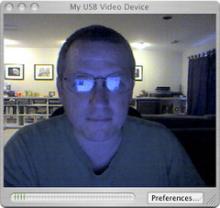
Never use your computer monitor as your light source

Slide 17
Use your room lights to your advantage

Slide 18
Height of camera / framing

Slide 19
Try to have your camera at eye level. Avoid the “up the nose” shot.

Slide 20
Raise the height of your computer, to be more at eye level.

Slide 21
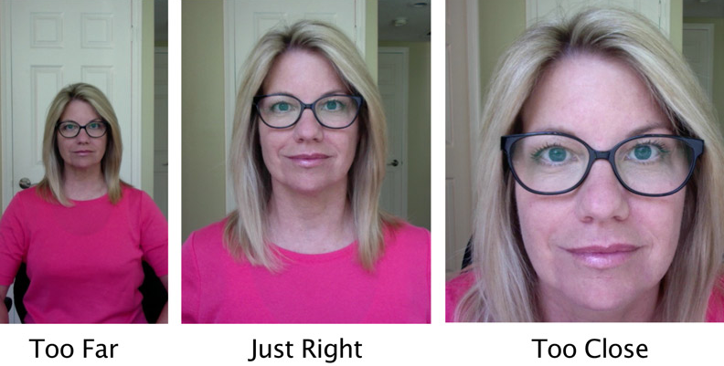
Be aware how close/far you are from the camera.

Slide 22
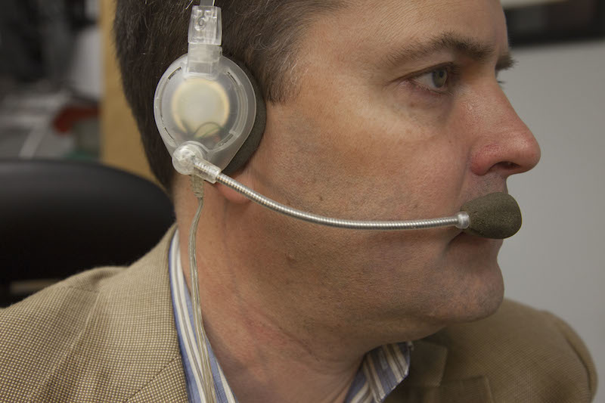
Audio
If possible, use a headset. This will dramatically improve the quality of the audio of your recording.

Slide 23
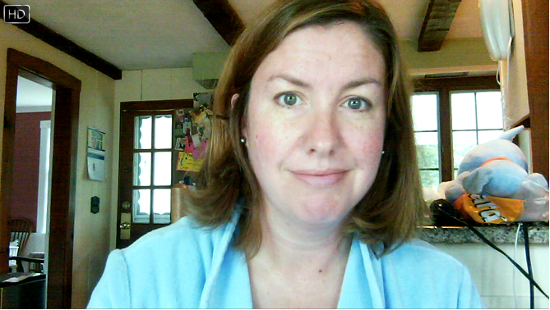
Wardrobe
Be aware what you are wearing while on camera. Try to avoid stripes, sheer or patterns. Bathrobes are not recommended.

Slide 24
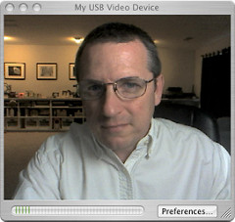
Wardrobe … again
One suggestion is white clothing. This will provide excellent color and light exposure for you. Solid colors are also excellent choices.

Slide 25
A few additional tips
If using scripts:
Practice, practice, and … practice
If you’re dissatisfied, do it again
If editing your own video:
Imovie
Moviemaker
Avoid jump cuts if possible

Slide 26
Resources
Guo, P. J., Kim, J., & Rubin, R. (2014). How video production affects student engagement: An empirical study of MOOC videos. Proceedings from Association for Computing Machinery: Learning @ scale. New York, NY: ACM
Hibbert, M. (2014). What Makes an Online Instructional Video Compelling? Retrieved from http://er.educause.edu/articles/2014/4/what-makes-an-online-instructional-video-compelling
Willmot, P., Bramhall, M., & Radley, K. (2012). Using digital video reporting to inspire and engage students. The Royal Academy of Engineering. Retrieved from https://www.raeng.org.uk/publications/other/using-digital-video-reporting

Slide 27
For recordings and other resources, please visit:
www.suny.edu/OTTER

