Slide 1
How online discussion forum format influences student learning
Naren Peddibhotla (SUNY Polytechnic Institute)
peddibn@sunypoly.edu
Arpan Jani (University of Wisconsin – River Falls)
arpan.jani@uwrf.edu

Slide 2
Structure of the presentation
Context: Ill-structured problems
Problem: Online Case Study teaching
Design of the study
Results
Discussion

Slide 3
Context: Ill-structured problems
Business, law, medicine, public administration
Complex problems
Teaching using the Case Study method

Slide 4
Problem: Online Case Study teaching
Expertise development
Deliberate practice
Performance feedback
Five challenges for student learning online (Schwartz, 2014)
Live case discussions vs. discussion forums
Two uses of Discussion Forums

Slide 5
Design of the study
Two aspects of discussion forum format
Group size (Large vs. Small)
Structure (Structured vs. Semi-structured)
Undergraduate students (campus-based)
Three sections of an introductory course at a midwestern university – Spring 2019
Varied by size and structure together in same study
Graduate students (online)
Three classes of two MBA courses at a university in Northeast US – Fall 2018 and Spring 2019
Varied by size and structure in separate studies

Slide 6
Case essay
Undergraduate class:
Problem, Cause, Solution
Graduate class:
Problem, Most Important problem, Stakeholders, Causes, Solutions, Recommendation, Implementation steps, Pitfalls

Slide 7
Group size
Undergraduate (Spring 2019) – 89 students
Group sizes were 8-9 for Large and 4-5 for Small
There were 6 large groups (5 groups of 9 and one group of 8) and 12 small groups – six groups with 5 members and six groups of 4 members.
Graduate (Fall 2018) – 32 students
Only one group size
Graduate (Fall 2017):
Class 1: 11 (half the class) vs. 22 (full class)
Class 2: 15 (half the class) vs. 30 (full class)

Slide 8
Structure
Problem post
Most important Problem post
Most Important Problem post
Cause post
Stakeholder Post
Cause post
Stakeholder post
Cause post
Solution post
Solution post
Solution Post
Recommendation post
Recommendation post
Solution post
Recommendation post
Implementation post
Pitfall post
Implementation post
Recommendation post
Solution post

Slide 9
Summary of Results (Size)
Spring 2019 – One undergraduate class
No significant difference in survey response scores
Identification of problems
Identification of causes
Design of solutions
Fall 2017 – Two graduate classes
No significant differences in case essay scores
Full class:
Better at enabling preparation for case essay (63.16% and 73.08% )
Better at enabling learning of course material (52.63% and 76.92% )
Better at enabling participation (42.11% and 50.00% )

Slide 10
Summary of Results (Structure)
Spring 2019 – One undergraduate class
No significant difference in survey response scores
Identification of problems
Identification of causes
Design of solutions
Fall 2018 – One graduate classe
No significant difference in survey response scores
Identification of problems
Identification of causes
Design of solutions
No significant differences in case essay scores

Slide 11
Summary of Results (Size and Structure)
Spring 2019 – One undergraduate class
Significant difference in survey response scores
Identification of problems
Identification of causes
Design of solutions
Structured format and small group size had best scores
Structured format and large group size had worst scores

Slide 12
ANOVA results
Learning Value of Discussion
Engagement Value of Discussion

Slide 13
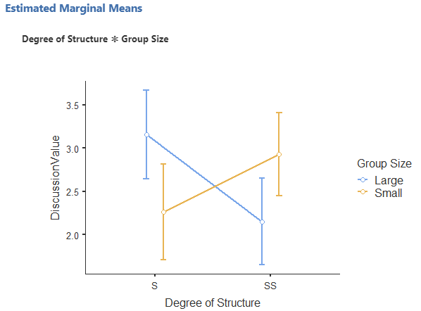
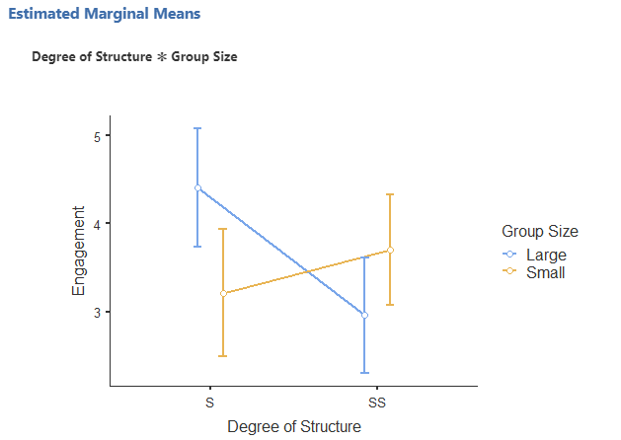
Interaction of Degree of Structure and Group Size on Learning Value of Discussion and Engagement
Note: Higher values indicate less learning value or less engagement as Strongly disagree was coded as 7 and Strongly Agree as 1

Slide 14
Conclusion
Structure and group size alone do not influence learning of problem-solving skills
Together, however, they impact learning of problem-solving skills
Design of discussion forums should therefore consider both aspects of format to optimize student performance

Slide 15
Discussion
Why does structure or group size not affect learning by itself?
How do structure and group size interact to develop problem-solving skills?
What other aspect(s) of online format might affect student learning?

Slide 16
Questions, comments, suggestions
Naren Peddibhotla (SUNY Polytechnic Institute, Utica)
peddibn@sunypoly.edu
315-314-3154
https://sunypoly.edu/faculty-and-staff/naren-peddibhotla.html
Arpan Jani (University of Wisconsin – River Falls)
arpan.jani@uwrf.edu
https://www.uwrf.edu/FacultyStaff/5611480.cfm

