Slide 1
Universal Design for Learning … Activities
Tonka Jokelova, Ph.D. (SUNY Canton)

Slide 2
Overview
Definitions
Brain networks
Your activity edits

Slide 3
And the results are in…
Is UDL the same as accessibility?
Of course!
UDL > accessibility
Accessibility > UDL

Slide 4
Universal
Definition
Students might differ in:
Notes:
Universal = used and understood by all, removing barriers so that all learners can learn
UDL reaches students where they are
–how they learn
–skills
–interests
–needs
–home environments
–work environments
–first language
–experiences
–anxieties

Slide 5
Learning
Notes:
When learning, 3 primary brain networks come into play:
They are associated with core principles (engagement, representation, action and expression)

Slide 6
Affective
Why should I care?
Notes:
Why is learning important to students?
How do we engage students?
Motivation and persistence

Slide 7
Solution: Affective
Multiple Means of Engagement
Recruit interest
Sustain effort
Self regulation
Provide
clearly stated purpose, expectations
choice
collaboration opportunities
opportunities to practice, self-assess
feedback that focuses on development, perseverance, effort
Relevance and value through authentic and meaningful assignments

Slide 8
Example: Affective
After
As a team, select one of the causes of WWII and analyze it from two angles:
What happened and how your chosen event contributed to the start of WWII.
Provide an alternative course of action and a possible alternative outcome of your chosen event.
Write a 2000 word research paper. You must use at least 4 scholarly sources.
This activity serves as our preparation for Module 6, where we will discuss the post-war world.
Before
Write a paper on the causes of WWII.
Notes:
Purpose, expectations, choice, collaboration, authenticity > relevance, value

Slide 9
Recognition
What am I learning?
How is information presented to me?

Slide 10
Solution: Recognition
Multiple Means of Representation
Perception
Language
Comprehension
Accessibility
Different media (video, audio, text)
Alternatives (what’s your +1?)
Ways of customizing the display of information
Clarify vocabulary and symbols
Clarify structure
Illustrations
Provide background knowledge
Highlight patterns
Guide information processing
Notes:
Perception – content does not depend on one sense (sight, hearing, etc.)
Comprehension – highlight patterns

Slide 11
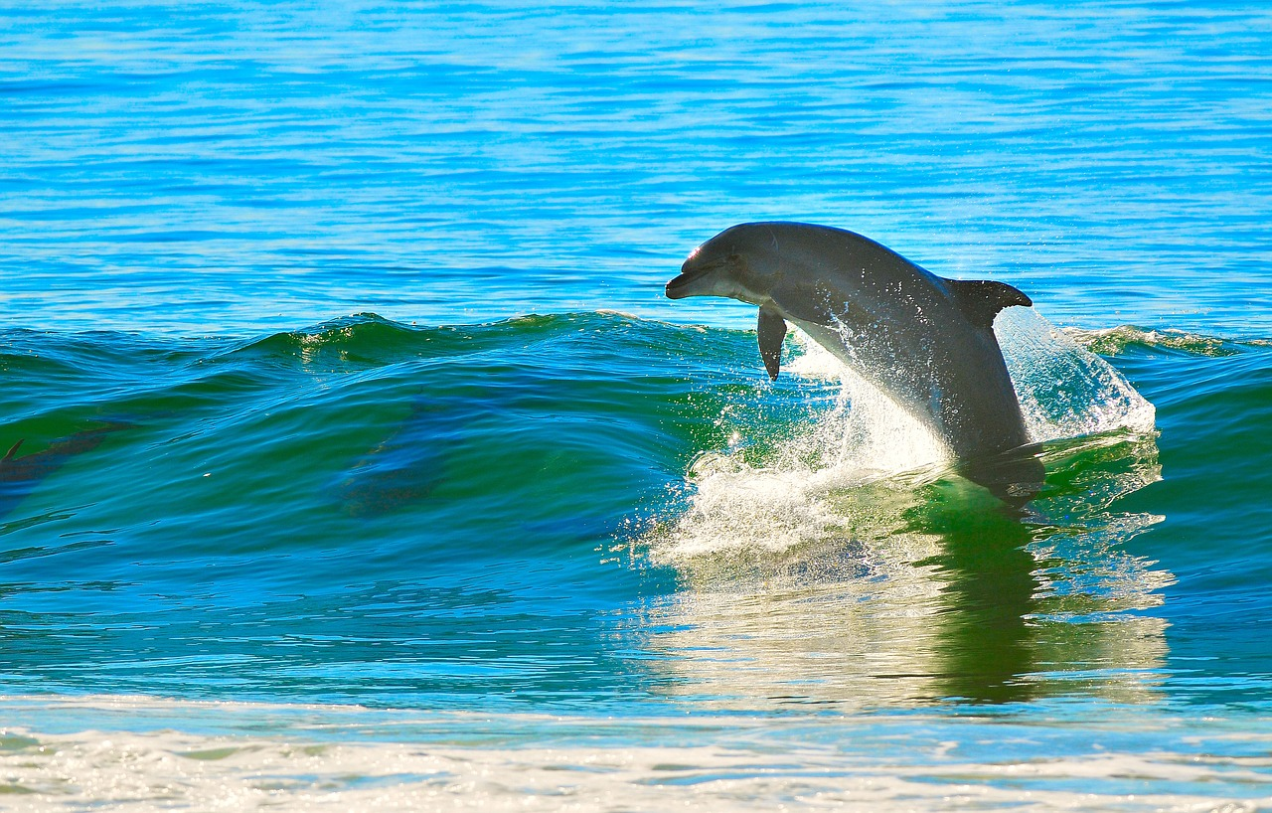
Example: Recognition
Before today’s lecture
Review the video on basic information on dolphin habitat.
Communication
Dolphins communicate through chirps and whistles (listen to the dolphin whistle). Not a lot is known about their communication.
How well can dolphins see and hear?
Dolphins have excellent eyesight and hearing. Underwater they use echolocation. Their hearing is so sensitive to echoes that they can almost "see" objects in the water by hearing.
Notes:
Background knowledge
Structure
Multiple senses
Vocabulary clarification

Slide 12
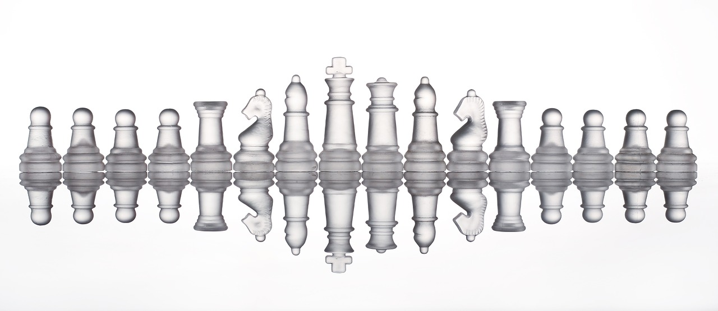
Strategic
How will I participate and show you what I know?

Slide 13
Solution: Strategic
Multiple Means of Action and Expression
Physical action
Expression & Communication
Executive functions
Accessibility
Multiple
means of mastery demonstration, in multiple media
ways of communication
strategies to solve problems
Examples of novel solutions, student work
Graduated levels of support (from more to less)
Guides, checklists, rubrics, and schedules
Encourage use of spellcheckers, grammar checkers, calculators, concept mapping tools
Encourage planning and strategy
Notes:
Executive functions – planning and strategy development, use of schedules, checklists to monitor progress

Slide 14
Examples: Strategic
After after
As a team, select one of the causes of WWII and analyze it from two angles:
What happened and how your chosen event contributed to the start of WWII.
Provide an alternative course of action and a possible alternative outcome of your chosen event.
Select how you will present your analysis (2000 word research paper, or 6-9 minutes-long video presentation, or a video game storyline. You may suggest another format and ask me for an approval). You must use at least 4 scholarly sources. Complete the assignment checklist and review the assignment rubric before you submit your work.
This activity serves as our preparation for Module 6, where we will discuss the post-war world.
Notes:
I would not give previous student work example here as it might stifle student creativity.

Slide 15
Examples: Strategic
After after
As a team, select one of the causes of WWII and analyze it from two angles:
What happened and how your chosen event contributed to the start of WWII.
Provide an alternative course of action and a possible alternative outcome of your chosen event.
Select how you will present your analysis (2000 word research paper, or 6-9 minutes-long video presentation, or a video game storyline. You may suggest another format and ask me for an approval). You must use at least 4 scholarly sources. Complete the assignment checklist and review the assignment rubric before you submit your work.
This activity serves as our preparation for Module 6, where we will discuss the post-war world.
What is the objective here?
To practice writing?
To explore WWII causes?
Notes:
I would not give previous student work example here as it might stifle student creativity.

Slide 16
How is UDL like cooking spaghetti?

Slide 17
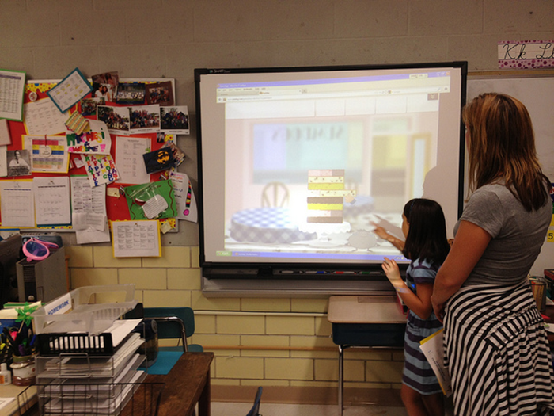
+ UDL for F2F
Consider:
Space lights, sounds
Multiple formats for instructions, handouts (print, digital)
Flexible timelines
Allow breaks
Provide notecards for (anonymous) questions
Eye-contact sensitivity

Slide 18
Pop Quiz
Jonathan, a student at a local high school, has a mental block when it comes to Math. He says he doesn’t understand Math no matter what he does and how hard he tries. He is frustrated because the rest of his peers seem to get Math, but he sees Math as an insurmountable obstacle. Some of the strategies that would address his affective brain networks are:
Ask Jonathan to formulate his short- and long-term goals to overcome his aversion.
Use multiple media to explain concepts to Jonathan.
Vary the difficulty levels of assignments to give Jonathan an experience of success.
Ask Jonathan many clarifying questions.
A and C
A and D
Notes:
e) A and C

Slide 19
Not done yet…
Which question relates most directly to the Recognition Networks?
How will students make sense of presented information?
Why is learning this important to the student?
How do students demonstrate mastery of learning?
How will motivation and participation impact learning?
Notes:
a)

Slide 20
Almost done
Summarize UDL in 1 word

Slide 21
Almost done
Summarize UDL in 1 word
Summarize UDL in 1 word

Slide 22
Almost done
Summarize UDL in 1 word
Summarize UDL in 1 word
OPTIONS

Slide 23
Who has questions?
Jokelova@canton.edu

Slide 24
Resources
About Universal Design for Learning (CAST): https://www.cast.org/impact/universal-design-for-learning-udl
Universal Design for Learning – a teacher’s guide (K-12): https://www.understood.org/en/school-learning/for-educators/universal-design-for-learning/understanding-universal-design-for-learning

Slide 25
For recordings and other resources, please visit:
www.suny.edu/OTTER

