Slide 1
Proposals Invited: Joint SUNY Applied Learning Co-Curricular Service Events

Slide 2
https://www.farmingdale.edu/nexus/

Slide 3
As of fall 2019, all students entering Bachelor-Degree granting programs are required to fulfill the Applied Learning Graduation Requirement.
Ten hours of approved Applied Learning activity is the minimum for meeting the Applied Learning Graduation Requirement.

Slide 4
Satisfy AL Grad Requirement:
Applied Learning Courses
- Applied Learning (Full) Course 10+ hours (often many more) of applied activity
- Applied Learning Enhanced Course 5-10 hours of applied activity
And… NON-CREDIT OPTION!
Co‐curricular Activities 5+ hours of activity (must meet all criteria)

Slide 5
Co-curricular Activities:
Non-credit bearing options to satisfy AL Grad Requirement in full or part depending on the hours required (minimum of 5 hours of applied activity)
Pursued in addition to the normal course of study, administered by an FSC faculty or staff member (the “Co-Curricular Activity Supervisor”)
Examples:
Club-related community service activities
SGA leadership
Campus Jobs (e.g. Resident Assistants) – shout-out to SBU Marianna Savoca, “A Good Job: Campus Employment as a High Impact Practice”

Slide 6
Co-curricular Activities:
Approved by FSC AL Review Board (just like AL courses)
Meet all criteria for AL
Structured, Intentional and Authentic
Learning Outcomes
Preparation, Orientation and Training
Monitoring and Continuous Improvement
Structured Reflection and Acknowledgment
Assessed and Evaluated

Slide 7
Co-curricular Activity Categories
Full Co-curricular AL Activity = 10+ hours
Enhanced Co-curricular Activity = 5-10 hours
Co-Curricular Internship (must be 10 hours)
Co-Curricular Community Service
Co-Curricular Undergraduate/Graduate Research
Co-Curricular Entrepreneurship
Co-Curricular Field Study

Slide 8
SUNY Professional Development Funding
Recognizing underdevelopment of non-credit formally approved AL, provides support for the development of non-credit Co-curricular Applied Learning Activities.
Funds support faculty and staff in developing and conducting institutionally approved Co-curricular Activities, including community service and civic engagement.
FSC has opened Nexus Center Co-curricular Community Service event to students of other SUNY campuses and invites proposals for joint efforts.

Slide 9
Nexus Center Fall 2019 Service Day
Partnered with Community Legal Advocates of NY
Open to all SUNY campuses
Learning Outcomes
Participants will be able to articulate the differences between DACAmented, undocumented, and individuals in the US on a visa.
Participants will be able to articulate the privileges and challenges of citizenship status.
Participants will be able to identify available resources, in addition to ways to advocate effectively and legally (whether it be for themselves or others).
Participants will be able to reflect upon their own group membership with respect to citizenship status (with no pressure to disclose their status).

Slide 10
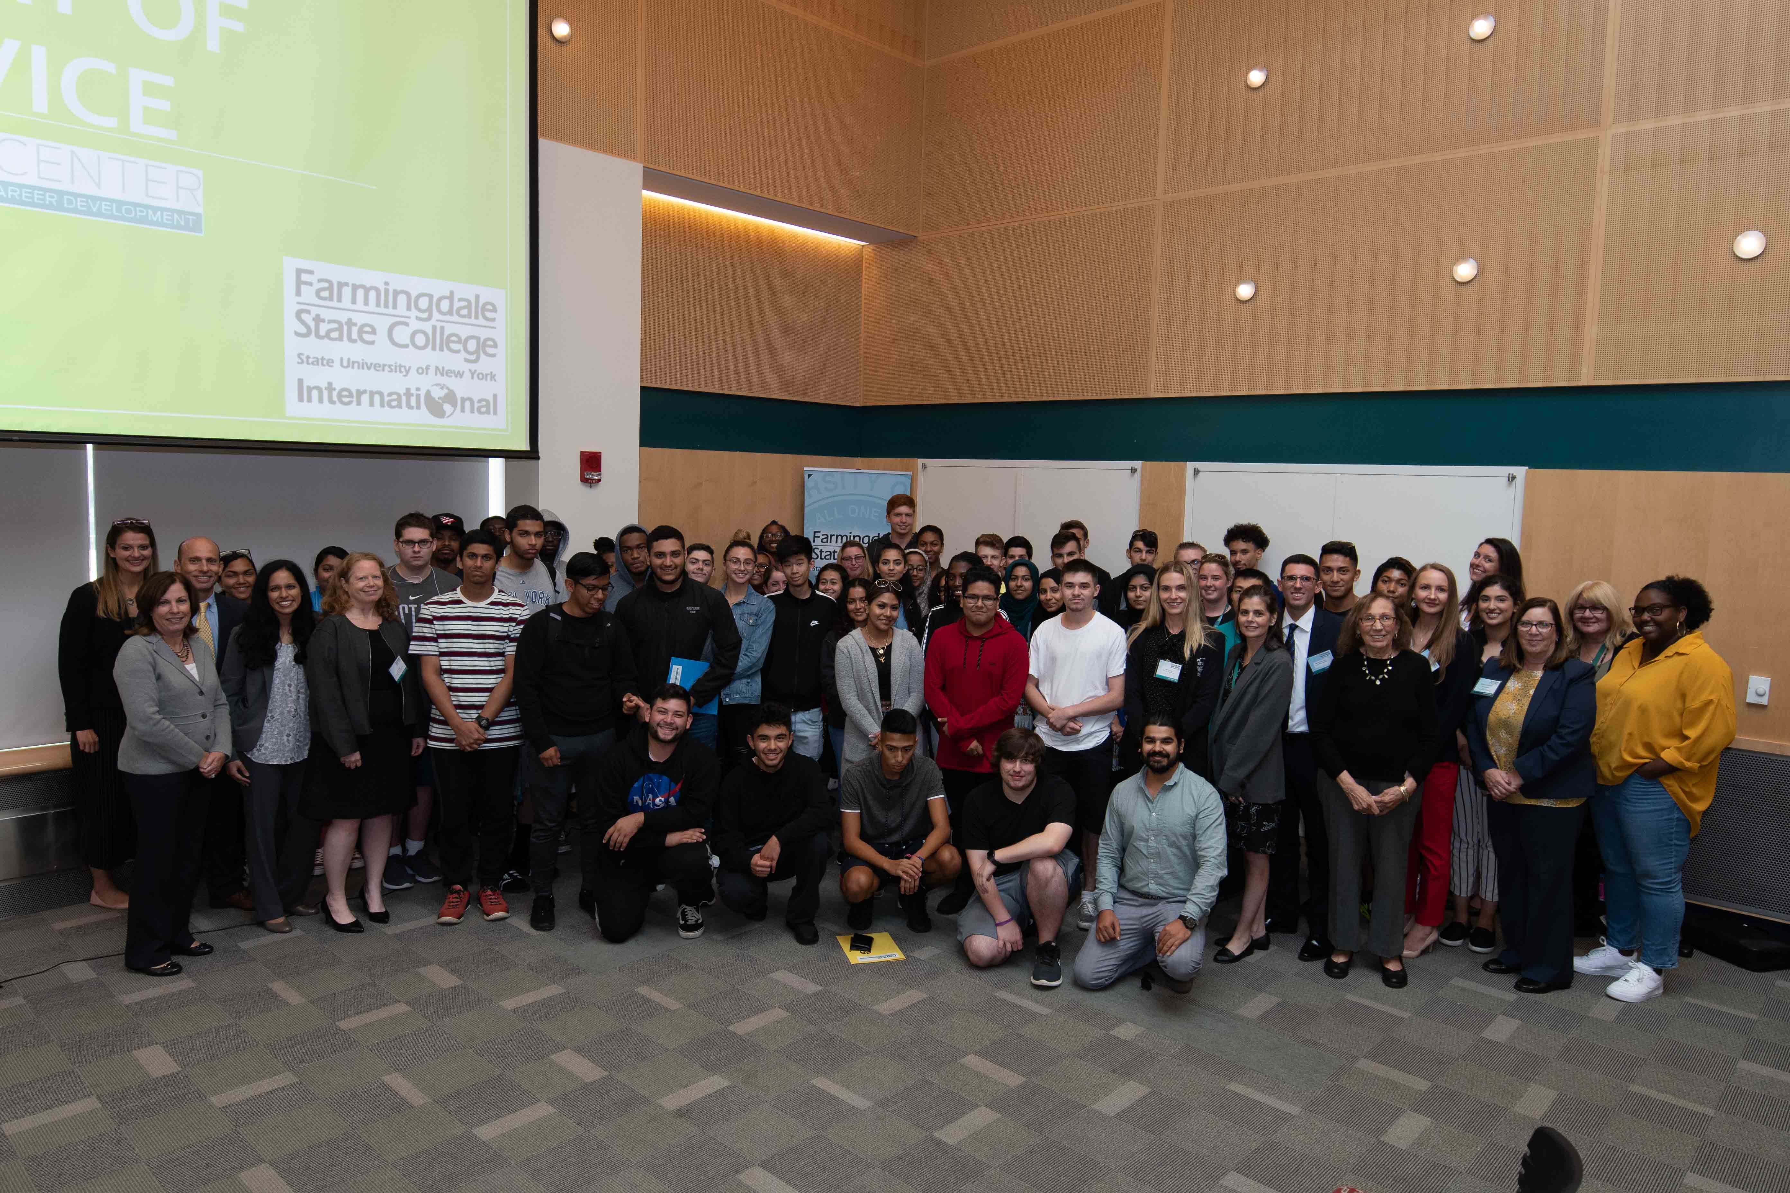
Nexus Center Fall 2019 Service Day
72 students attended, with more than 20 academic programs represented across FSC’s four schools. 80% of the students were freshmen.

Slide 11
Nexus Center Fall 2019 Service Day
When evaluating Learning Outcomes after the event:
83% of students felt more confident about articulating the differences among various immigration statuses;
86% felt more confident in describing the privileges and challenges of different statuses;
87% felt greater awareness of how to identify and contact their legislative representatives regarding issues of importance.
Before the event, 21% of students reported no awareness of their legislative representatives or how to contact them. After the event, only 1% of students reported less awareness.

Slide 12
Invitation for Joint Proposals
We may be able to contribute funding to support Joint Applied Learning Co-curricular Activities
Community Service activity for students across multiple colleges.
Other Co-curricular Activity categories may lend itself to collaborative events: e.g. Entrepreneurial challenges.
Minimum of 5 hours (this may include training materials distributed beforehand; post-event reflection or assessment; related activities conducted virtually).
Geographic proximity to FSC considered, although innovative ideas for joint projects are welcome - for example, virtual or remote projects.

Slide 13
Invitation for Joint Proposals
Campus representatives proposing joint events should be responsible for the supervision and related administration for their participating students (different considerations if no Grad Requirement like FSC).
Collaborating campus would work closely with the Nexus Center in hosting the event, promoting at respective campuses, and verifying participation of FSC students.
Indicate expected cost/expenses in your proposal. The Nexus Center may be able to cover the related costs for all participating students depending on the project scope.
Planning now for spring 2020!

Slide 14
Invitation for Joint Proposals
Contact Rena Varghese, Executive Director: rena.varghese@farmingdale.edu
Any Questions?

