Slide 1
Align Your Design
Open SUNY Center for Online Teaching
CIT 2019
SUNY Purchase
Notes:
Introduce yourself

Slide 2
Introduction
  Who am I?
  Instructional Designer since 1999
  Led the original team to construct the OSCQR rubric
  Have reviewed 50+ courses with OSCQR
  Big fan of the Socratic Method of ID

Slide 3
Introduction
  I was moving along in my course review, using the OSCQR rubric, when all of a sudden …
Not to mention …

Slide 4
Introduction
Alignment in an online course is the cohesion between:
Stated learning objectives/outcomes;
Relevant learning activities;
Authentic assessments.

Slide 5
Language Matters
We will be looking at language used in …
Course Objectives/Outcomes;
- action verbs
- measurable outcomes
- relevant connections with course activities
Assessments/Learning Activities
- instructions
- rubrics

Slide 6
Process
Open the course/module objectives;
Open the first assignment (new tab);
Open the rubric (new tab);
Open the alignment worksheet (new tab);
Copy/paste from 1-3 into the worksheet to see all side-by-side.

Slide 7
Process
Look for alignment in the language in the first 2 columns …
  Can we used the same verbs as in the objectives?
  Can we make the instructions more salient in regard to the stated learning outcomes?
  Can we alter one or the other for accuracy?
If possible, copy/paste the revised instructions/expectations (column 2) into the criteria cells of the rubric for that assessment.
  Revise language as necessary.
  Revise directions if necessary.

Slide 8
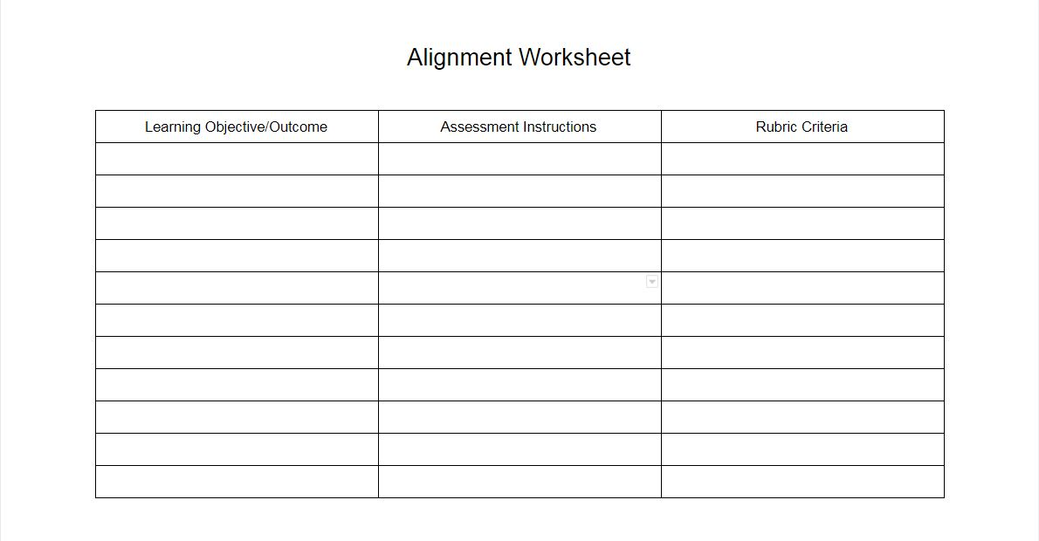
Alignment Worksheet

Slide 9
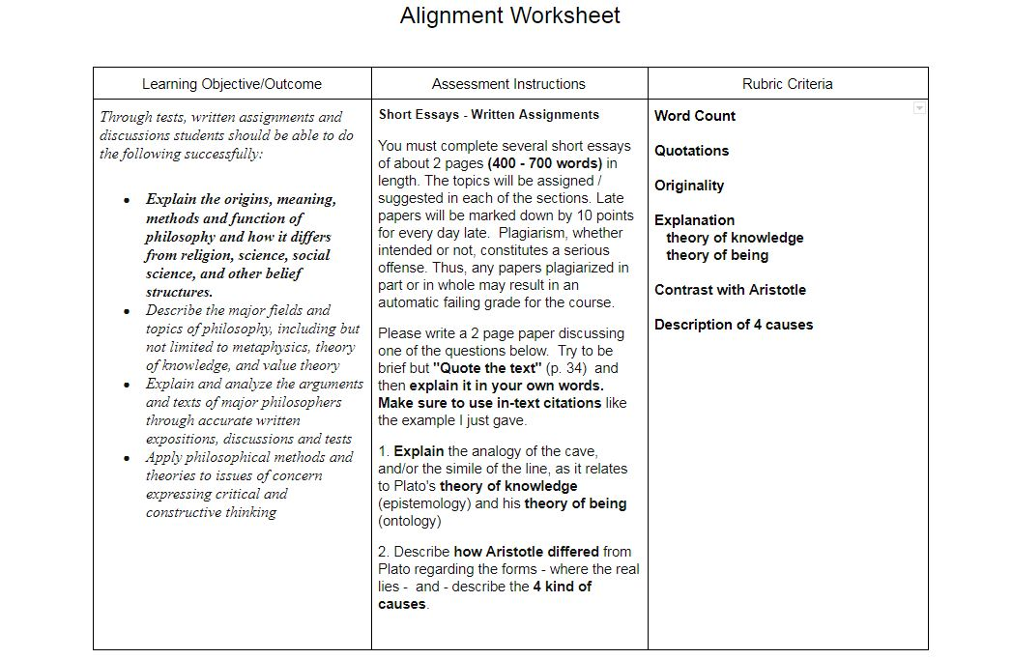
Example

Slide 10
Recommendations
Be sensitive to ….
What faculty have already written. Alignment is the goal.
Time management … for a whole course, this can take a while.
More pressing design issues, you may have to shelve this for a later date.
Keeping the learners at the center of YOUR language ….
  “Students may see the connection better if …”
  “Students will know exactly what will be evaluated.”
5. Faculty workload …. If possible, fill out the worksheet for a module or two.

Slide 11
Your Questions
?

Slide 12

robert.piorkowski@suny.edu
THANK YOU!
http://cotecommunity.open.suny.edu/

Slide 13
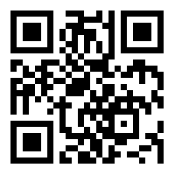
QR Code for all resources

