Slide 1
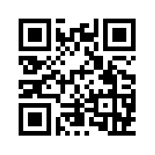
What’s your accessibility plan for your own teaching?
Rebecca Mushtare SUNY Oswego

Slide 2
Table of Contents
Be Realistic
First Impressions
Syllabus/Policies
Tools & Materials
On-boarding
Inclusive Pedagogy
Flex
Engage
Support
Resources

Slide 3
Be Realistic

Slide 4
Expectations

Slide 5
Expectations | Be Realistic
Prioritize based on experience
Iterate and add new features
Your health matters—do what you can
Make mistakes—getting started is more important

Slide 6
First Impressions

Slide 7
Syllabus

Slide 8
Syllabus | First Impressions
Create a document that will:
Work across digital devices and assistive tech
Invite readers to engage with the contents
State your commitment to access and inclusion
Contextualize required standardized content/policies
Include components that students collaborate on
Establish ground rules for dialog/interaction
Focus on learning and growth

Slide 9
idea: Use headings to help students see the syllabus in outline form.

Slide 10
idea: Annotate the syllabus.

Slide 11
idea: Establish that documents shared within the community need to be accessible.

Slide 12
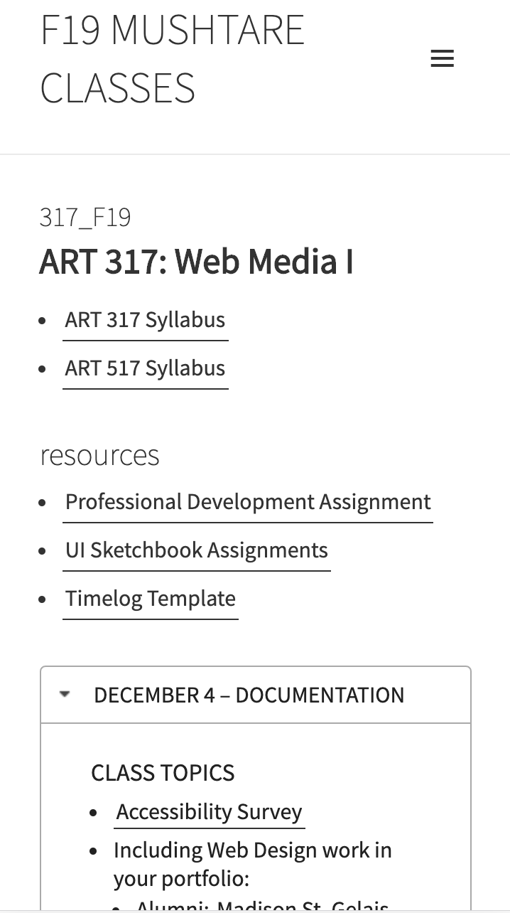
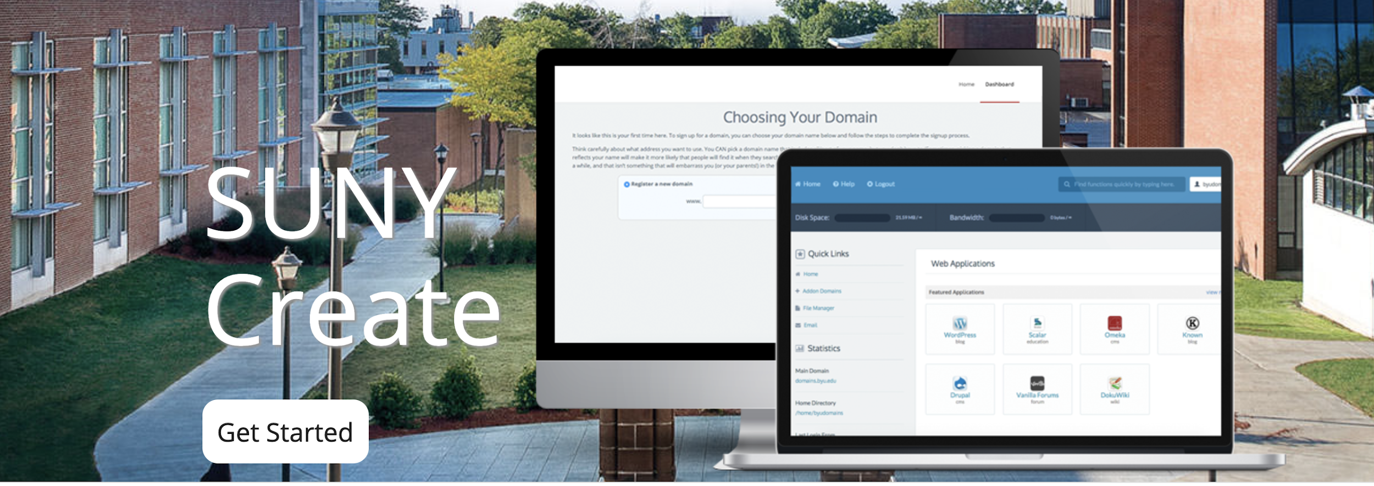
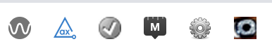
Tools & Content

Slide 13
Tools & Content | First Impressions
Reduce barriers to the course by considering:
Availability and accessibility of texts, materials and tools
Cognitive load of learning and using tools/platforms
Your workflow to create accessible content

Slide 14
idea: Use Ally and automated tools.

Slide 15
idea: Adopt an OER.

Slide 16
On-boarding

Slide 17
On-boarding Students | First Impressions
Introduce students the course and the community by:
Send a welcome email
Build a start here module
Make the course rhythm and structure explicit
Connect students to each other

Slide 18
idea: Set a predictable schedule based on your own constraints.

Slide 19
idea: Connect current events or media to the course content.

Slide 20
Inclusive Pedagogy

Slide 21
flex

Slide 22
Flex | Inclusive Pedagogy
Support learners by exercising flexibility.
What does it mean to participate and be present?
Where can I offer choices to facilitate autonomy?
How can I represent concepts in different ways?
Where have I imposed unnecessary barriers/hurdles?

Slide 23
idea: Provide choice in discussion, format, assignment, etc.

Slide 24
idea: Find or develop a new way to represent a key muddy point.

Slide 25
idea: Remove spelling, grammar from evaluation criteria.

Slide 26
idea: Allow students to co-create the course by posing questions the class can explore.

Slide 27
support

Slide 28
Support | Inclusive Pedagogy
Be supportive by
What options can I build in for students that encourage taking risks and learning from mistakes?
How can I structure the semester so that students have the opportunity to succeed early and often?
What structures/routines do I need to put in place to help students stay on track and moving forward?

Slide 29
idea: Share weekly summaries of key discussion points.

Slide 30
idea: Provide multiple reminders of key ideas and deadlines.

Slide 31
idea: Be explicit in all assignments (what, why, how, where, when).

Slide 32
idea: Allow revisions or drop lowest grade.

Slide 33
idea: Break large assignments into smaller ones with iterative feedback.

Slide 34
idea: Nudge students who would benefit with personalized communication.

Slide 35
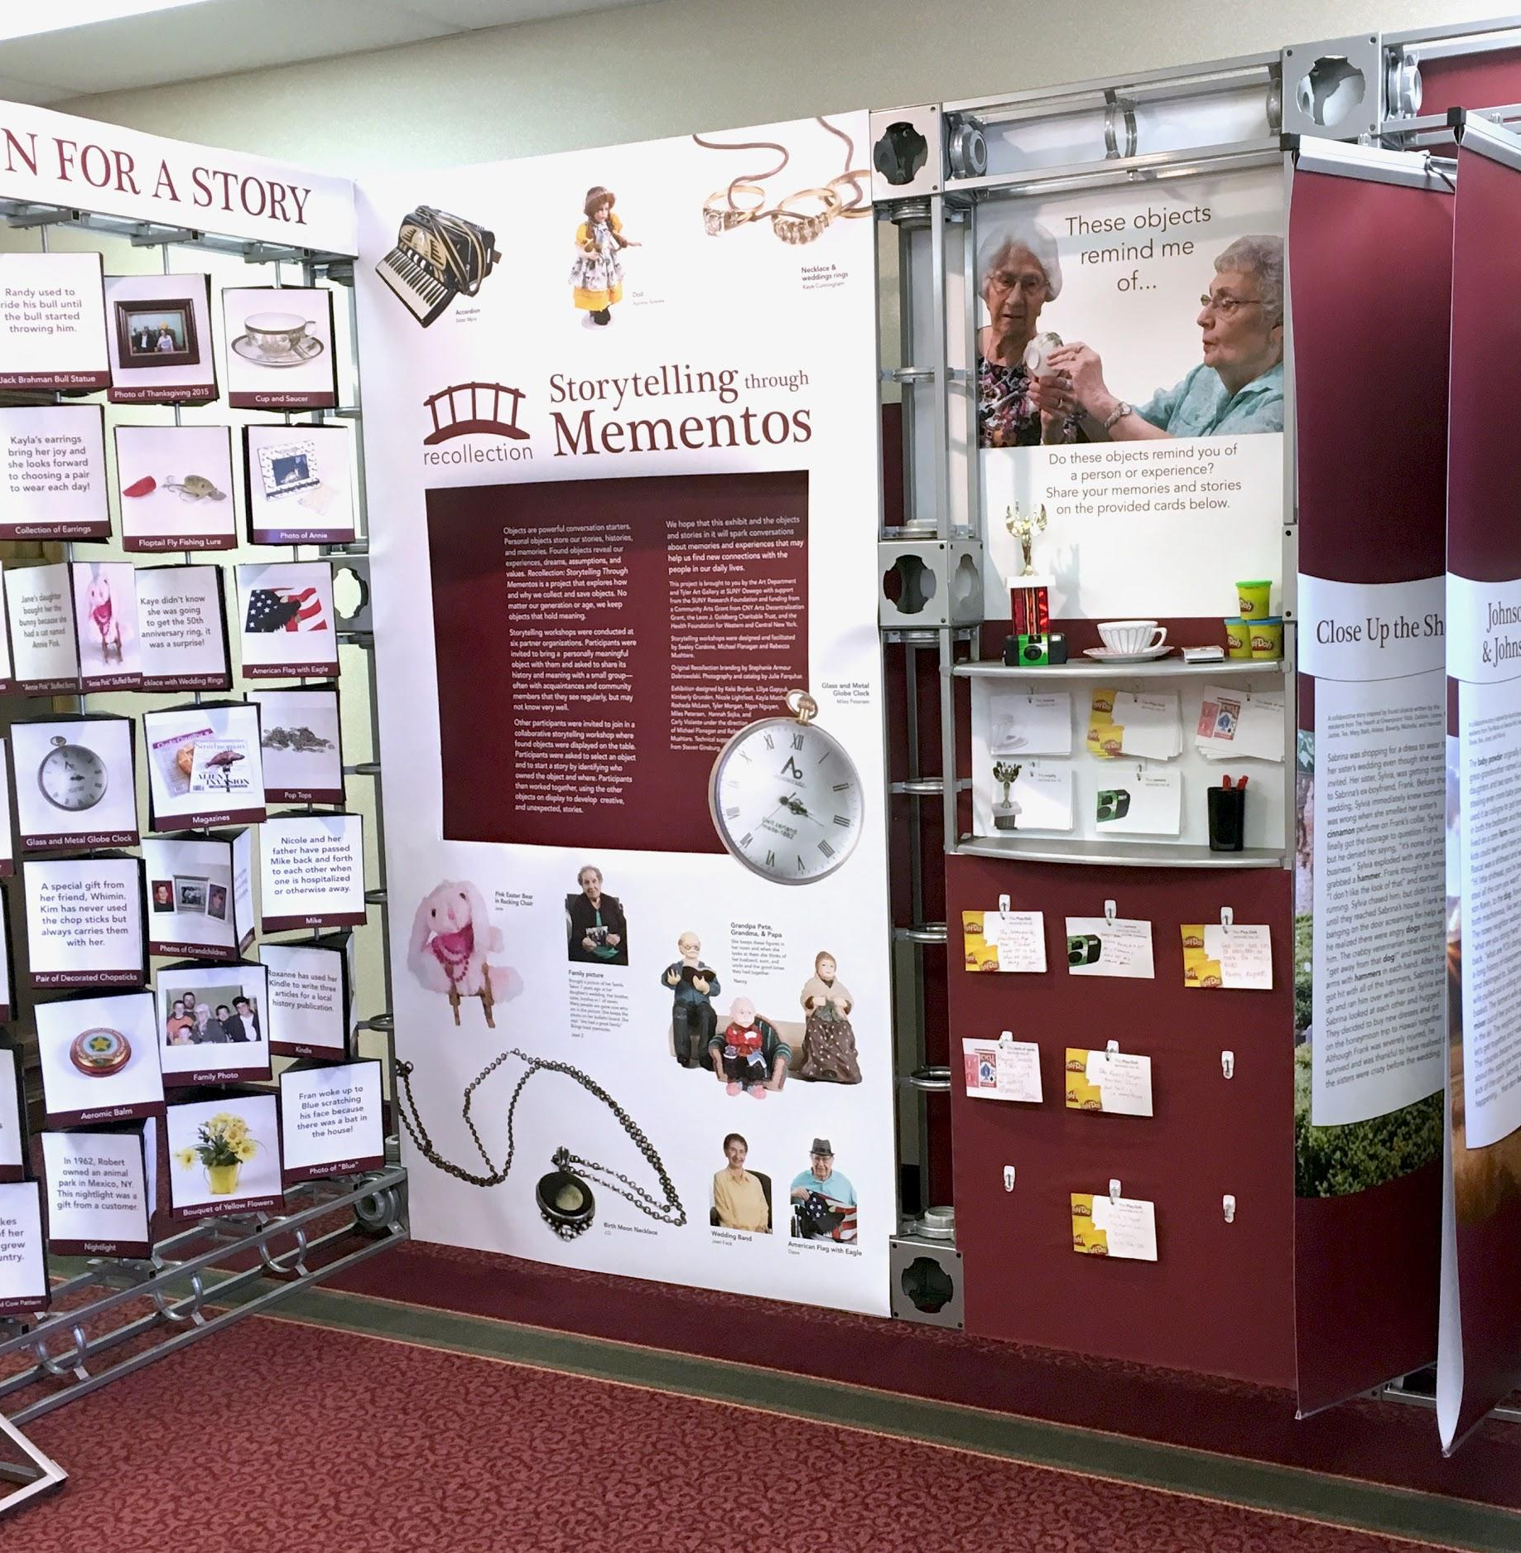
engage

Slide 36
Engage | Inclusive Pedagogy
Engage students by
Provide rationale behind assignments/activities
Invite students to be a member of the community
Connect students to each other and to you
Get students started on large projects the first week

Slide 37
idea: Build in time and structure for reflection.

Slide 38
idea: Consider creating something “real” as a class that would exist beyond the semester.

Slide 39
idea: Integrate the work of diverse scholars throughout the semester.

Slide 40
Resources

Slide 41
Syllabus | Resources
The Accessible Syllabus
Dartmouth example Diversity and Inclusion Statement
Toward a Cruelty-Free Syllabi (Matthew Cheney)

Slide 42
Creating Accessible Content | Resources
SUNY Oswego Accessibility Website
SUNY EIT Accessibility Website
Deque University
WebAIM

Slide 43
Universal Design For Learning | Resources
Values-Centered Instructional Planning (Robin DeRosa)
Universal Design: Places to Start (Jay Dolmage)
Places to Start Wiki
UDL on Campus (CAST)
Radical Hope: A Teaching Manifesto (Kevin M. Gannon)

Slide 44
Teaching Online | Resources
Small Teaching Online (Flower Darby)
Teaching Online: A Guide to Theory, Research, and Practice (Claire Howell Major)
Online Teaching Survival Guide: Simple and Practical Pedagogical Tips (Judith Boettcher)

