Slide 1
Showing the Way: Developing a
Wayfinding App using Beacon
Technology at an Academic Library
CIT Conference. SUNY Purchase | May 30, 2019
Kiichi Takeuchi and Ben Turner
Caroline Fuchs, Ann Jusino, Heather Ball, Shilpa Karnik, Valeda Dent

Slide 2
St. John’s University Student Body, at a Glance
Total Enrollment: 21,643
Undergraduate: 16,884
Graduate: 4,759
Pell Eligible: 38%
Students Come from 47 states and 123 countries
59% female, and 41% male

Slide 3
Book Usage at St. John’s Library, 2017-18
584,528 electronic books
114,829 check outs of electronic books
358,047 print books
12,222 check outs of print books

Slide 4
Potential Barriers to Print Book Usage
General preference for online material.
Lack of understanding of LC Call numbers.

Slide 5
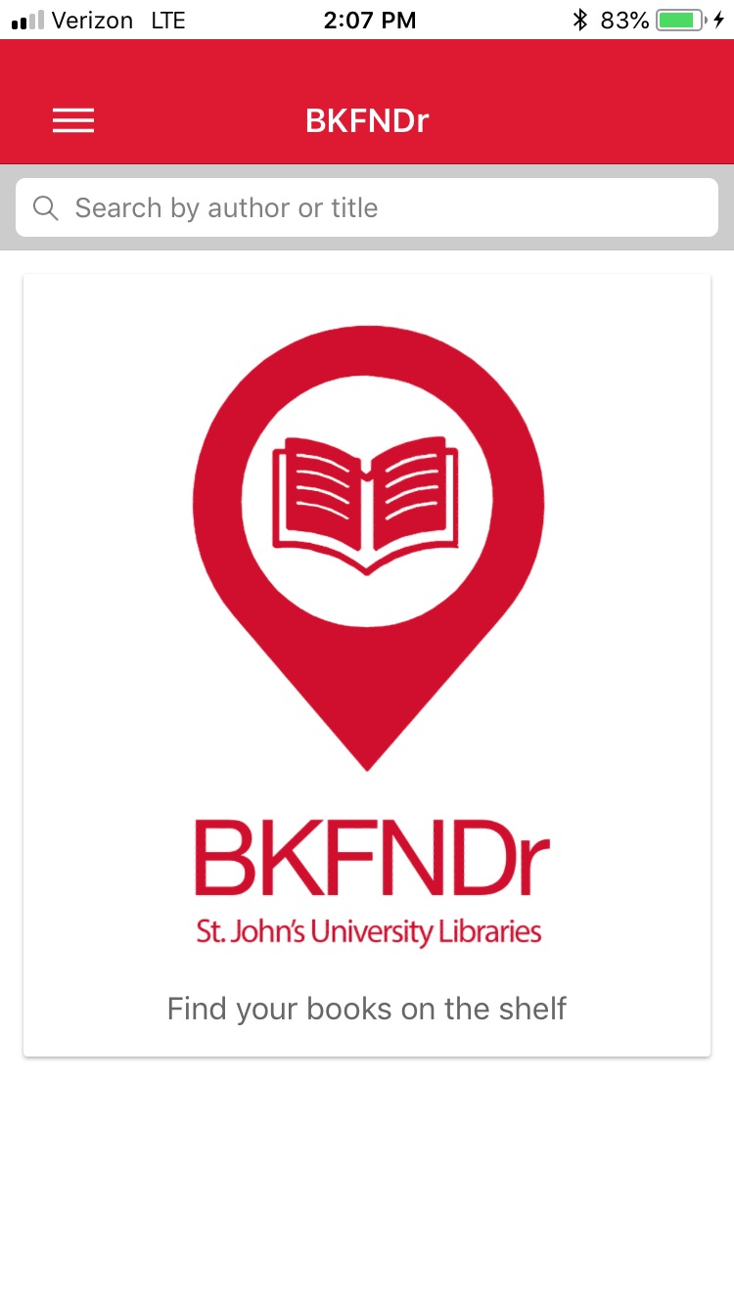
Navigation Apps
Allow users to navigate physical spaces.
Increasingly popular in hospitals, museums, and educational institutions.
Librarians at St. John’s were inspired by NavAPP,® developed at the University of Oklahoma.

Slide 6
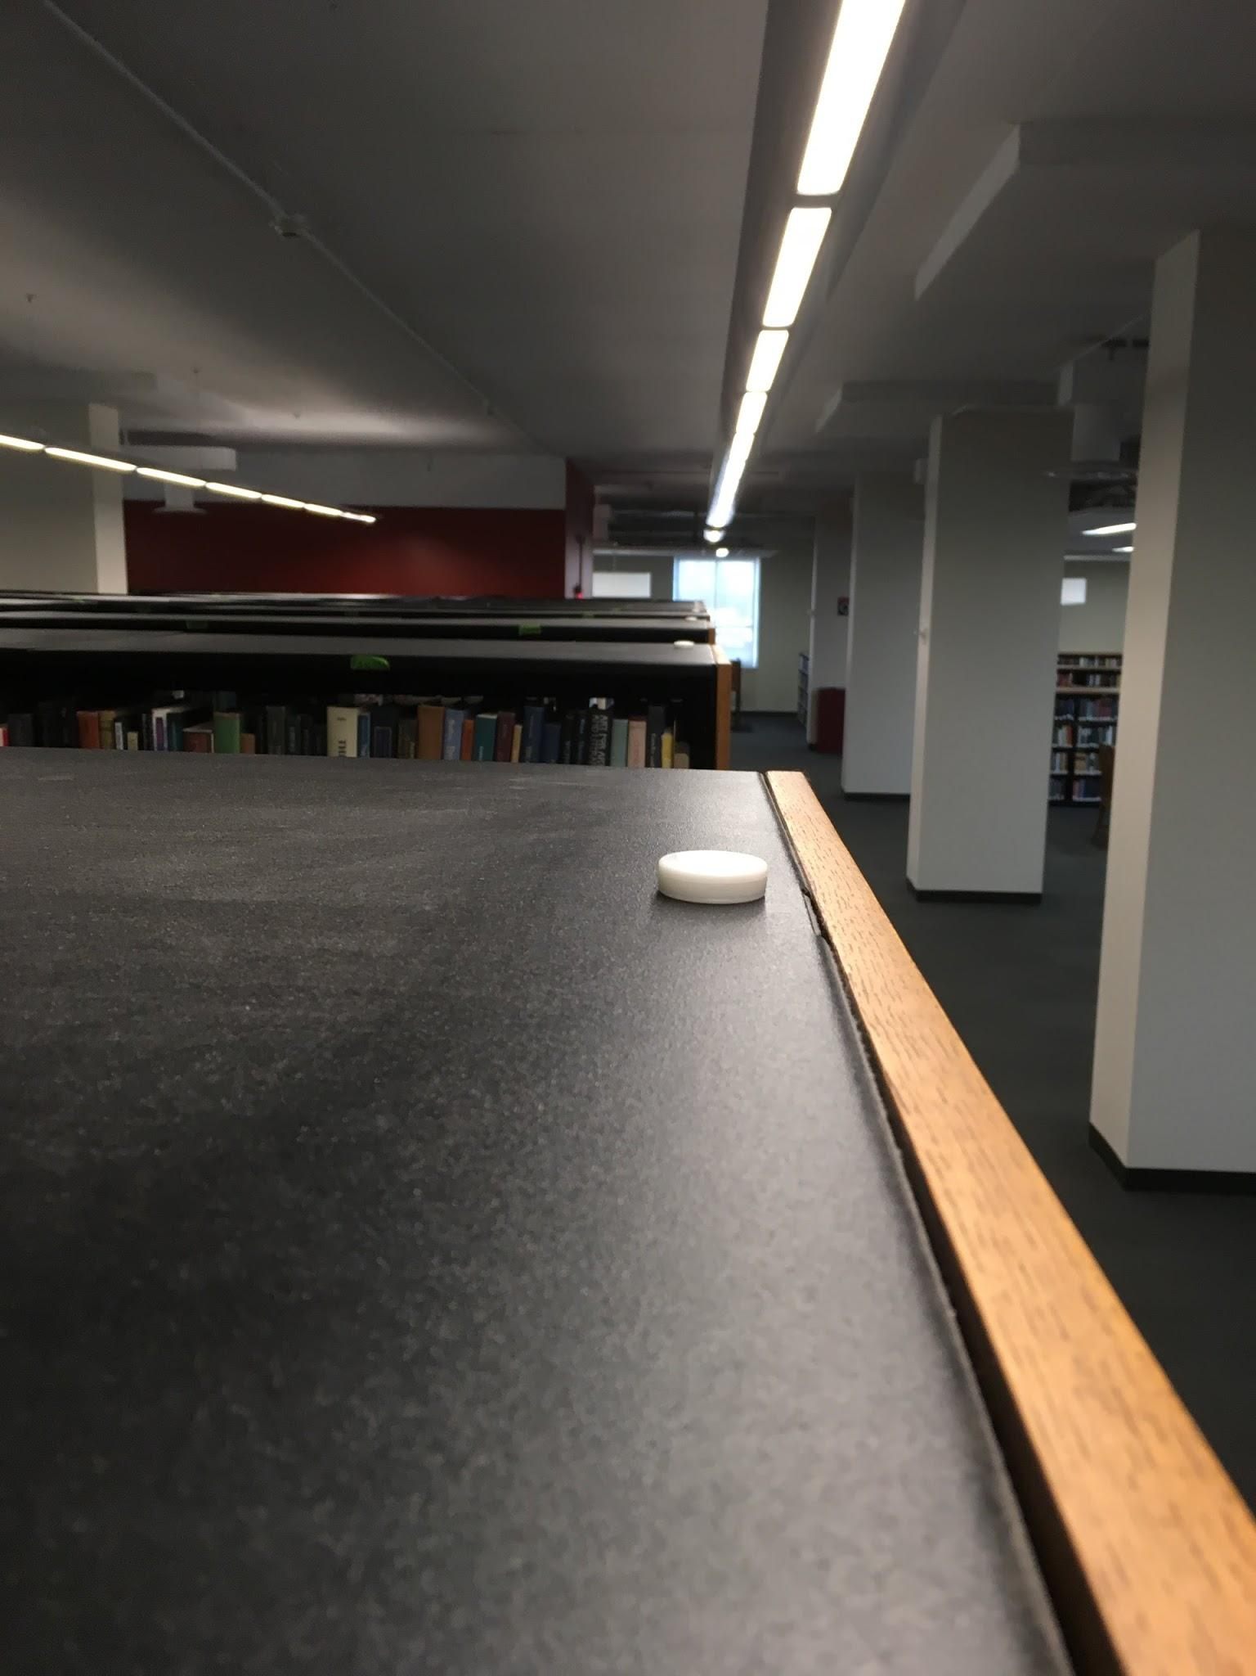
BKFNDr
SJU Libraries began development in 2017.
Designed to help users locate books in the library.
Works off of Radius Network beacon.
Fuchs, C. CTL Fac Tech Forum 2018

Slide 7
iBeacon / Beacon
Bluetooth Low Energy (BLE)
Broadcast Identifier
UUID
Major Number
Minor Number
Strength (Not the distance)
Frequency and strength of signal are configurable
Available in multiple platforms (iOS / Android)
Far: 2 - 40m
Near: 2 - 40m
Immediate: 0-0.5m

Slide 8
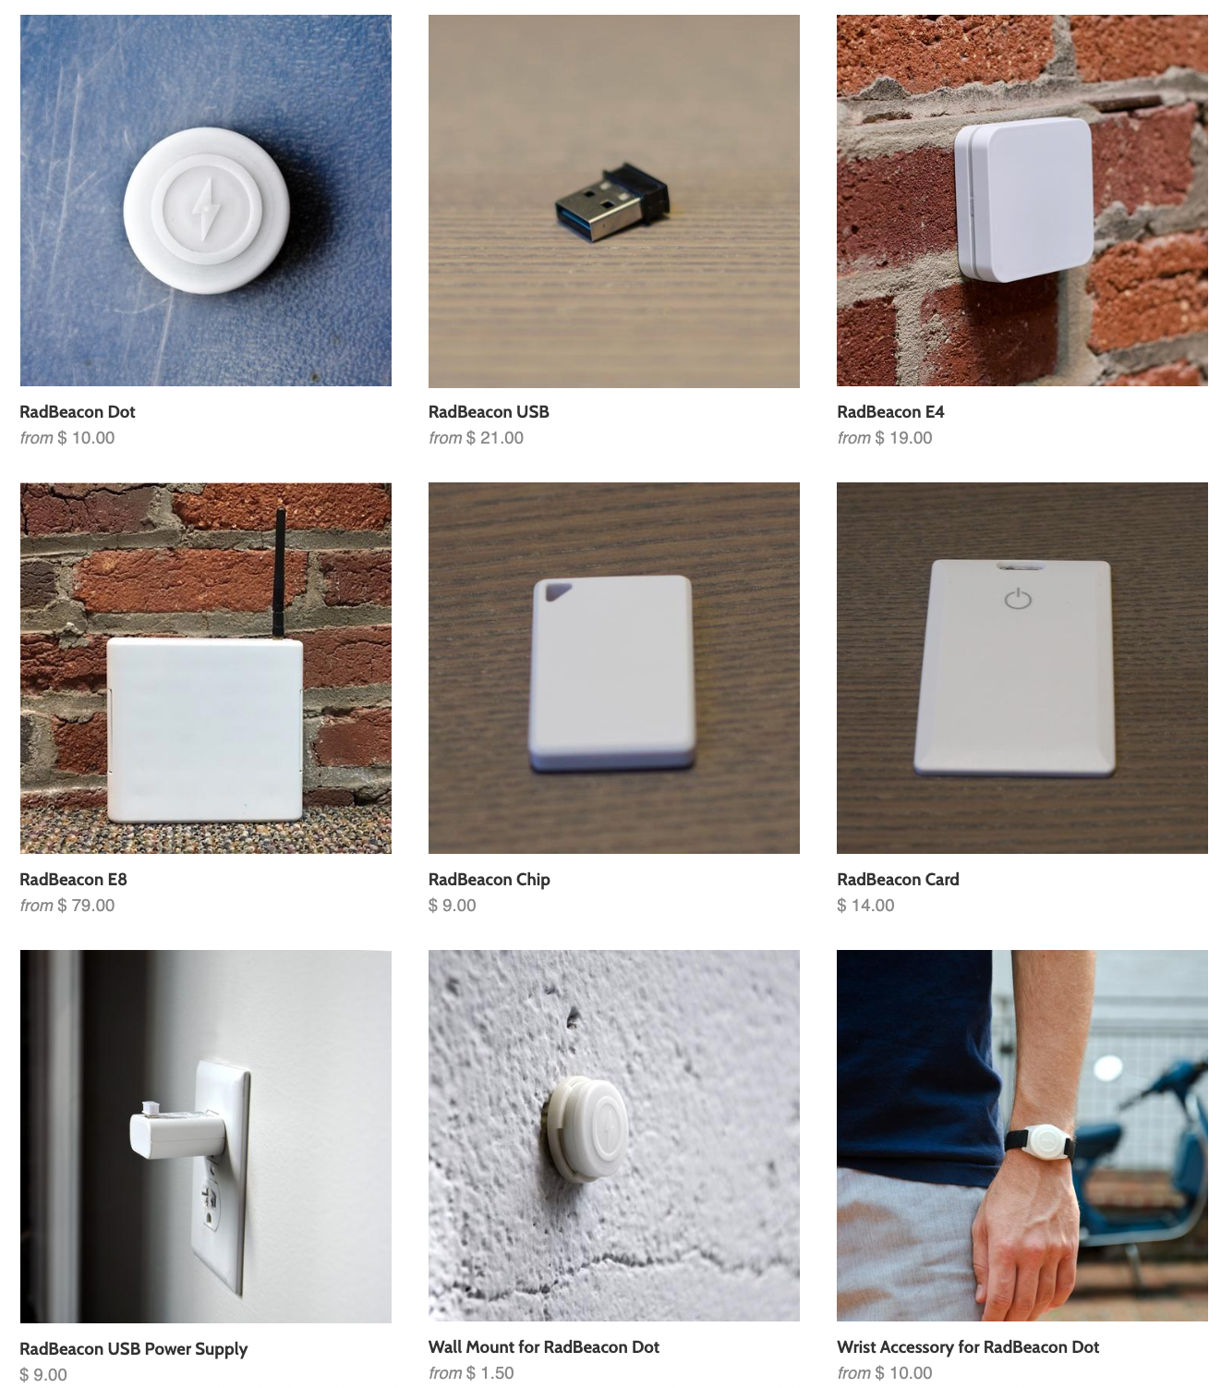
RadBeacon
Cost ($10 - )
Various Types
Battery (3-12 month)
USB
Wall Plug
Scalable / Support
Source: Radius Networks, inc.

Slide 9
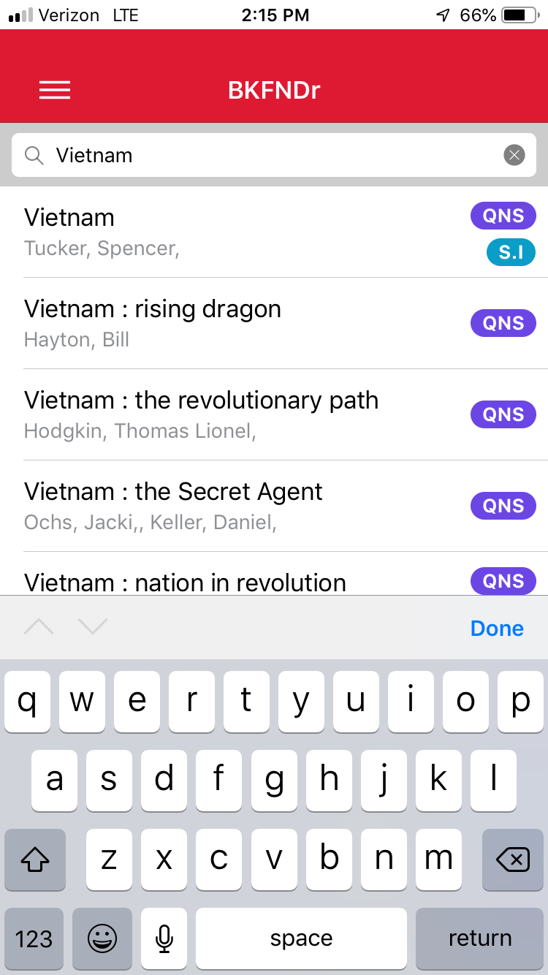
Search
Enter your keywords in the search box
Results will be displayed immediately below
The app indicates if the item is in the Queens (QNS) or Staten Island (SI) library
Tap on the book you want
Fuchs, C. CTL Fac Tech Forum 2018

Slide 10
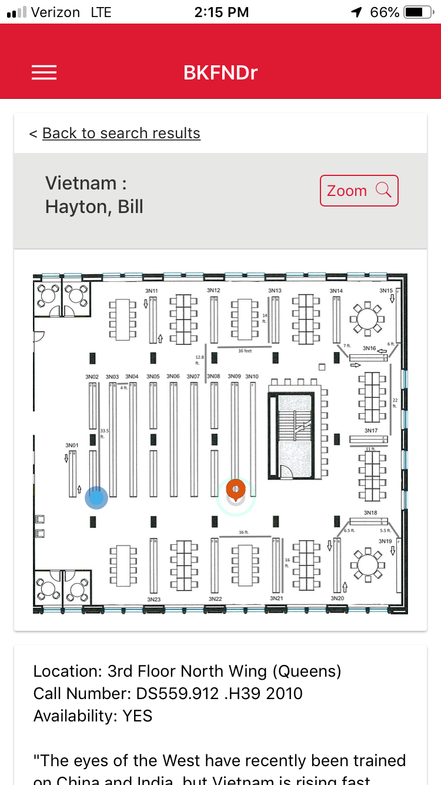
Find the book
App lets you know the location of the book, the call number, and whether or not it is available
Blinking blue dot indicates your location
Follow the bouncing red dot to the book location
Fuchs, C. CTL Fac Tech Forum 2018

Slide 11
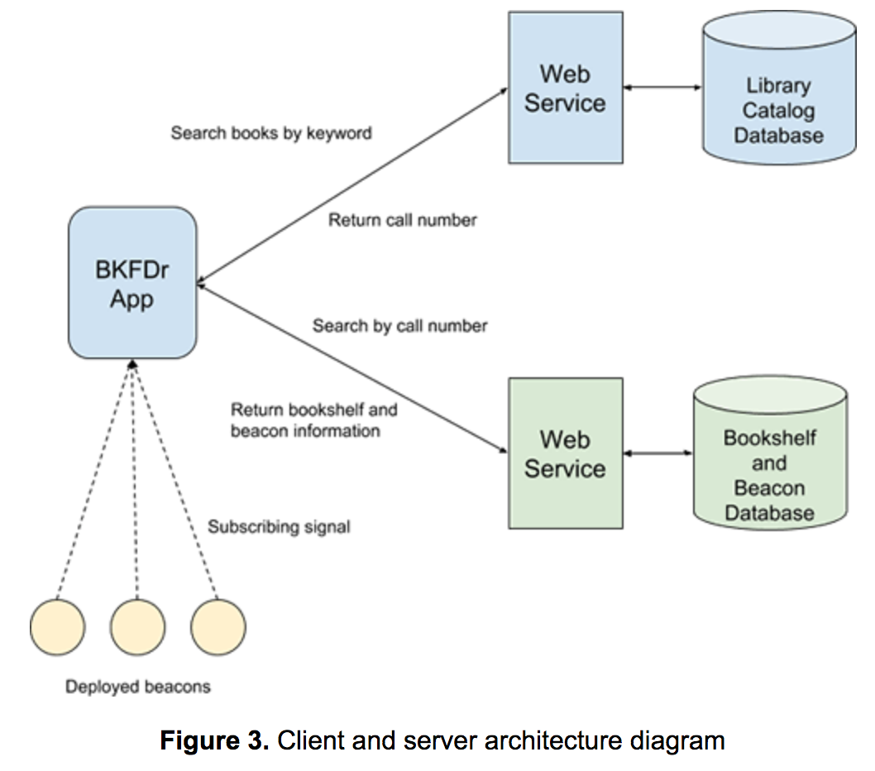
Client and Server Architecture

Slide 12
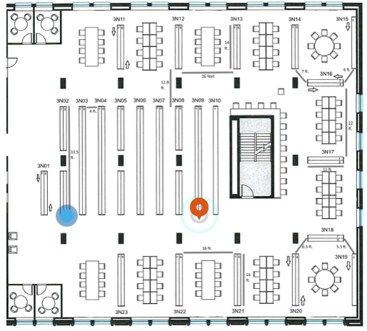
Searching the target shelf
"The catcher in …"
The Catcher in the Rye
@ Queens Library
2294
PS3537.A426 C3
Search Words
User Selection
Database ID
Call Number
(67,78)
3005,1
N3-05-F
Screen Coordinates
Beacon
Major,Minor
Shelf Number

Slide 13
Current Location
"The catcher in …"
The Catcher in the Rye
@ Queens Library
2294
PS3537.A426 C3
Search Words
User Selection
Database ID
Call Number
(21,81)
3001,1
N3-05-F
Screen Coordinates
Beacon
Major,Minor
Shelf Number

Slide 14
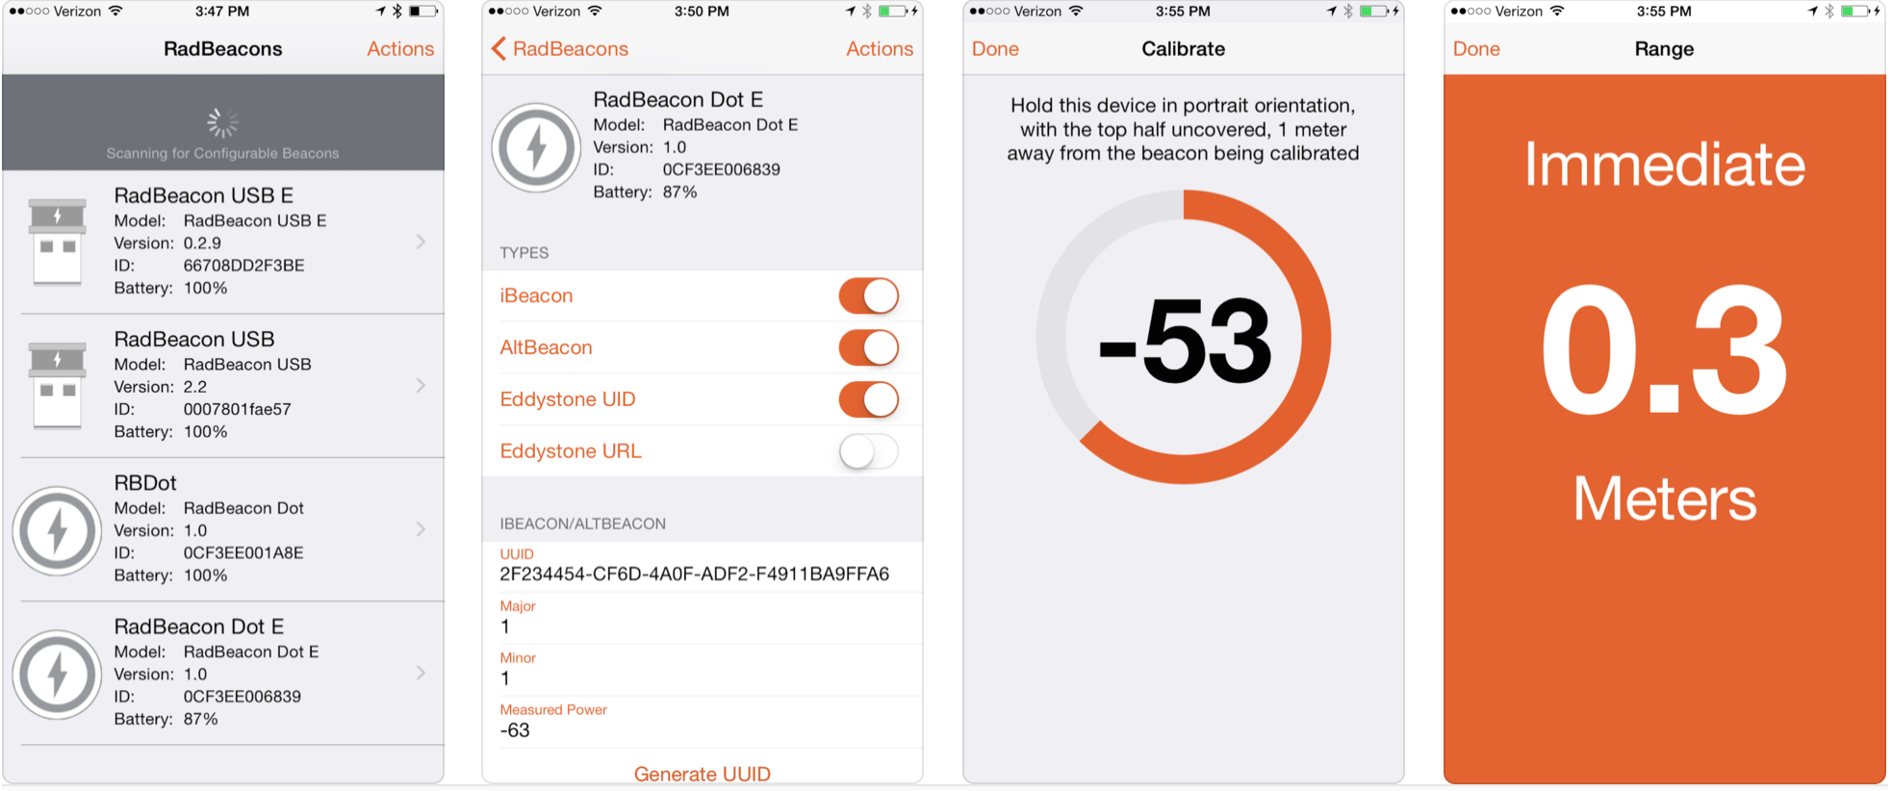
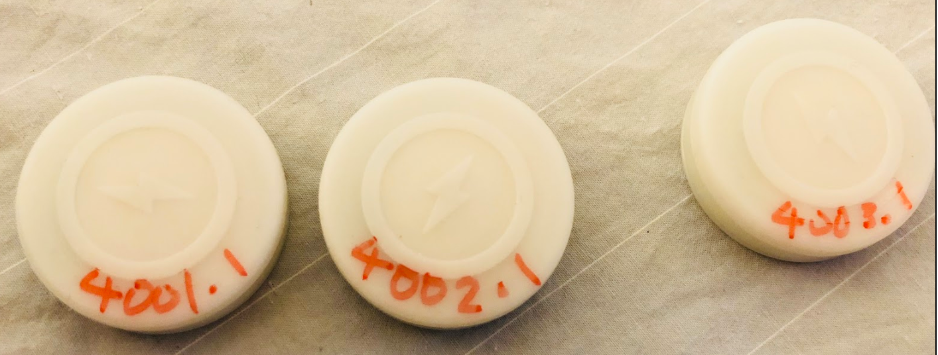
Managing Beacons
RadBeacon App
Deployment Worklog
Numbering and Labeling Codebook

Slide 15
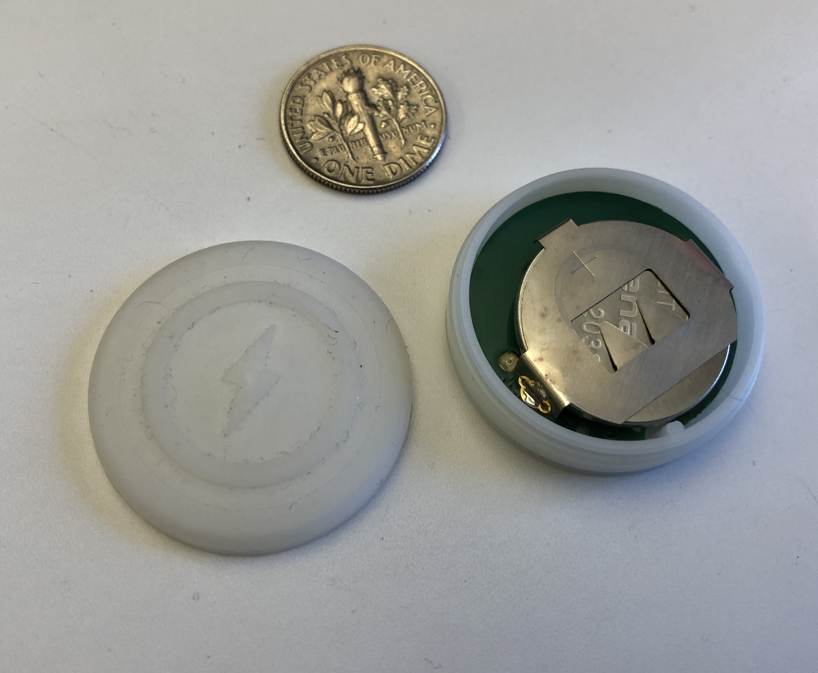
Maintenance
Battery replacement
Lost Beacons
Shelf Layout Change

Slide 16
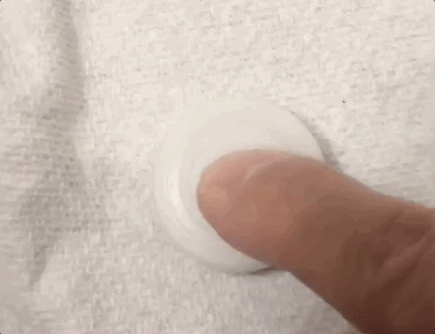
Security and Privacy
UUID, Major, and Minor (Beacon Identifier) are publicly scannable
Encrypted but no secret protocol (e.g. Same identifier?)
Not associated with Latitude / Longitude
Password protected
Need physical access to configure beacons
BKFNDr does not collect personal information

Slide 17
User Testing, August 2018
Main findings:
App performed well in directing users to correct stacks.
User feedback was positive.
Users had some difficulty in initially orienting themselves in the map.
Some lag time in the movement of the blue dot.
Several users requested a zoom feature for the map (since added).

Slide 18
References
Dent, V., Takeuchi, K., Turner, B., Ball, H., Fuchs, C., Jusino, A., & Karnik, S. (2018). Wayfinding
serendipity: The BKFNDr mobile app. Code4Lib Journal, (42).
The University of Oklahoma Libraries Launches NavApp to Provide Mobile Indoor Navigation and
Content for More Than One Million Visits Annually 2015 | Aruba Networks Newsroom. [accessed
2018 Apr 13]. http://news.arubanetworks.com/press-release/university-oklahoma-libraries-launches-navapp-provide-mobile-indoor-navigation-and-con.

