Slide 1
Decision Making
“When you come to a fork
in the road, take it.”
Yogi Berra

Slide 2
Good Decision/ Bad Decision
Good Decision
Bad Decision
In 1983 Quaker Corp. acquires Gatorade for $220 Million, it grew to $3 Billion
In 1994, Quaker brought Snapple for $1.8 Billion- sold it 3 years later for $300 Million
William Smithburg

Slide 3
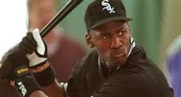
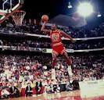
Good Decision/Bad Decision
Bad Decision
Good Decision
Michael Jordan playing basketball- Led the NBA in total points for 11 seasons, playoff average of 33.5 points, scored 30 points of more in 563 games, won six NBA titles….
Michael Jordan playing baseball- he played one year in AA minor league and hit 202, struck out 100 times and made 11 fielding errors…

Slide 4
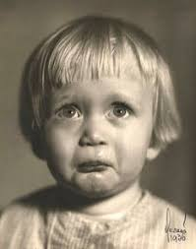
Good Decision/Bad Decision
Good Decision
Bad Decision
A strong liberal arts student attends college and graduate school and earns a position as a faculty counselor/advisor. Life is good…
The same student attends private colleges and is financially strapped with $120,000 in student loans. Life is still good, but with financial struggles.

Slide 5
Research
Research in psychology has revealed that our decisions are disrupted by an array of biases and irrationalities.
For example, we seek out information that supports us and downplay information that doesn’t.
Our brains are flawed decision making instruments.

Slide 7
Good Decision/Bad Decision
Good Decision
Bad Decision
Boy meets girl and they move in together after five days.
Guess What?

Slide 8
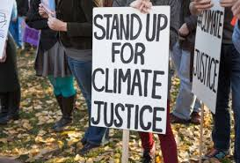
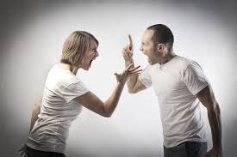
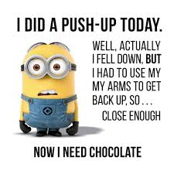
The Seven Big Ticket Items
Environment
Relationships
Health and wellness
Education
Leisure activities
Field of study
Career

Slide 9
The Classic Pros/Cons Approach
This is the only decision making process in wide circulation- it is a deliberate approach that helps us hunt for both positive and negative factors pushing the “spotlight” around.
This approach has a proud historical pedigree-Benjamin Franklin suggested this approach to his colleagues.
The pros-cons approach is familiar, commonsensical, and also profoundly flawed.
Psychological research over 40 years has identified a set of biases in our thinking that dooms this model of decision making

Slide 10
Exercise Integrity at the Moment of Choice
Should I go to bed on time or watch another hour of Netflix?
Will I go to the gym and eat healthier or not?
Will I be faithful to my significant other or not?
Do I care more about myself or others?
Work versus family?
Are you going to help a friend in need or be selfish?
Will I stay in college or go out and get a job?
What toothpaste should I buy?

Slide 11
Information Overload!

Slide 13
Biases Cloud Our Judgments
LOSE $
BIASES
Poor Choices
False Beliefs

Slide 14
The Top Four Biases
Self-Serving Bias
Cognitive Fluency
Sunk Cost Fallacy
Confirmation Bias

Slide 15
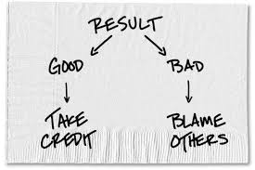
1. Self-Serving Bias
The tendency to perceive oneself in an overly favorable manner. People tend to attribute positive events to their own character but negative events to external factors
Tip: Be with friends who will keep you grounded. Get honest feedback. Old Texas saying.

Slide 16
2. Cognitive Fluency
The illusion of truth
Tip-If if sounds to good to be true…

Slide 17
3. Sunk Cost Fallacy
When you keep putting time, effort and money into something that rationally just won’t work out. Examples a movie that after 20 minutes you don’t like, or a dead end relationship. Why do you stay? You don’t want to lose your initial investment.
Tip- Focus on future cost and benefits, not past losses

Slide 18
4. Confirmation Bias
Considered one the most dangerous biases. We only search for confirming evidence- we are only getting one side of the story.
Tip- Search for contradictory evidence.

Slide 19
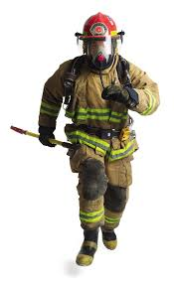
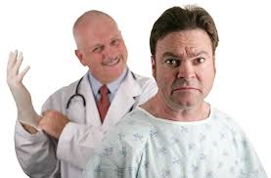
WHY THESE CAREERS?

Slide 20
The Career Planning Process
The career planning process can be a slow, messy, meandering, difficult, time consuming journey or,
You can reframe it as one of the great challenges of life.
In any event, it takes patience, dedication and thoughtful decision making.

Slide 21
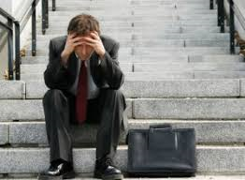
Good Decision/Bad Decision
Good Decision
Bad Decision
Attend Law School and work to promote social justice while being involved in a prestigious career.
An American Bar Association survey found that 44% of lawyers would not recommend law as a career.

Slide 22
The Straight Line to Success is Rare
Notes:
Mary Catherine Bateson in her book “Composing a Life,” notes that we can compose “multiple versions” of our life stories…Often, our dread of being seen as a “loser” means that we tell a version that has us surefootedly progressing from birth to the present. But we could just as easily highlight the discontinuities…Our stories more accurately reflect our experiences if they began like this: After lots of surprises and choices, or interruptions and disappointments, I have arrived at some place I couldn’t have anticipated.” The Continuous story reflects a yearning for logical patterns and consistency…

Slide 23
Relationship Decision

Slide 27
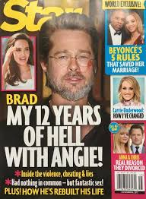
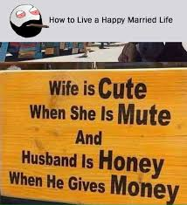
Good Decision/Bad Decision
Bad Decision
Good Decision
Marriage is a good decision when you love the person, want to make a lifelong commitment, like companionship, want to have children, want to build financial stability…
Marriage is a very bad decision if you marry the wrong person. Life can be a living hell.
In America, there is one divorce every 13 seconds, that’s 6,646 per day, and over 46,000per week.

Slide 28
Doctors have just
Identified a food
That can cause
Grief and suffering
Years after it’s
Been eaten.
It is called a %$*_&
Wedding Cake!

Slide 29
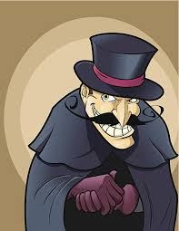
Villains of the Process
You encounter a choice. But narrow framing makes you miss options.
You analyze your options. But the confirmation bias leads you to gather self-serving information.
You make a choice. But short-term emotion will often tempt you to make the wrong one.
Then you live with it. But you’ll often be overconfident about how the future will unfold.

Slide 30
The WRAP Process
Widen Your Options. How can you expand your set of choices?
Reality-Test Your Assumptions. How can you get outside your head and collect information that you can trust?
Attain Distance Before Deciding. How can you overcome emotion and conflicted feelings to make the best choice?
Prepare to Be Wrong. How can we plan for an uncertain future so that we give our decisions the best chance to succeed?

Slide 31
Opportunity Cost
Is a term from economics that refers to what we give up when we make a decision.
How much hamburger could you buy with the same money you spent for beluga caviar?
A private versus a public college?
A fancy new car versus a reliable used car?
How much is it worth to have___________?

Slide 32
Beluga Caviar 2oz Price $395.00

Slide 33
President Dwight D. Eisenhower
“The cost of one modern heavy bomber is this: a modern brick school in more than 30 cities. It is two electric power plants each serving a town of 60,000 people. It is two fine, fully equipped hospitals…”
Start every decision with: What am I giving up by making this choice? What else could I do with the same time and money?
Helps to prevent a narrow frame?

Slide 34
Guidance for Widening Your Options
Run the “vanishing option test”. What are you going to do if the option you were considering disappeared?
Try “laddering” ask people who solved the problem you’re struggling with how they did it. Analyze the results so that you can potentially reproduce it.
Expand options. Shift your spotlight to options you wouldn’t normally consider.

Slide 35
More Ideas
Multitrack- think AND not OR. Can you follow multiple paths at once? If not, can you embrace one and sample another?
( E.g., select a major and sample a minor, broad undergraduate education and specify your career at graduate school, if you’re thinking of a career shift, keep your current job but volunteer a few hours somewhere else).

Slide 36
Guidance for Reality Testing Your Assumptions
Fight the confirmation bias- Double check your ideas by considering the opposite. If a career is appealing, consider why it may be unappealing.
Spark constructive disagreement- Can you find someone you trust who will disagree with you? Get unvarnished, trustworthy guidance
Ask disconfirming questions- “What’s the biggest obstacle you see to what I’m trying to do?” “If I failed, why do you think it would be?”

Slide 38
More Ideas
Ooch- can you sampling the options that you’re considering?
Think of a budding pharmacy student who would be well-served to do a two-week internship at the local pharmacy.
Take a course to explore a major.
Ooching is used for gathering information about an ambiguous issue, not for delaying commitments.

Slide 39
Guidance to Attain Some Distance Before Deciding
Try 10/10/10. What will the impact be in 10 minutes, 10months and 10 years. Talk this through with a friend.
Shift perspectives to gain distance. What would I tell my best friend to do?
Identify and enshrine your core priorities. If it’s not a “Hell yes”, it’s a No.”
Fight the “status quo bias” ( mere exposure + loss aversion).

Slide 40
Examples of “status quo bias”
If you were not already involved in your current relationship, would you go back into it? (If not, why are you still in it?)
If you didn’t own your home today, would you buy it? (If not why are you so hesitant to sell it?)

Slide 41
Guidance for Preparing to Be Wrong
The mission: to avoid being overconfident about the way our decisions will unfold, and, instead, taking the opportunity to plan for both good and bad potential scenarios.
TOOLS
Bookend the future. Because we’re so poor at predictions, we need to treat the future as a spectrum of possibilities

Slide 42
Summary
We beat back many of the villains of decision making by respecting multiple perspectives and not being caught in a narrow frame.

