Slide 1
Completion Program at Brockport
Dr. Eileen Daniel,
Vice Provost, College at Brockport
Presented to 2019 Advising, Applied Learning and Student Success Summit, Albany NY
October 2019

Slide 2
Completion Program Overview
Began in AY 2014-2015 in Vice Provost’s office;
Seeks out students who stepped out prior to degree completion;
Encourages and facilitates their return;
Provides personal support: advisement, registration, affirming enrollment, etc.;
Currently funded via a PIF grant; hired Completion Specialist in 2016.

Slide 3
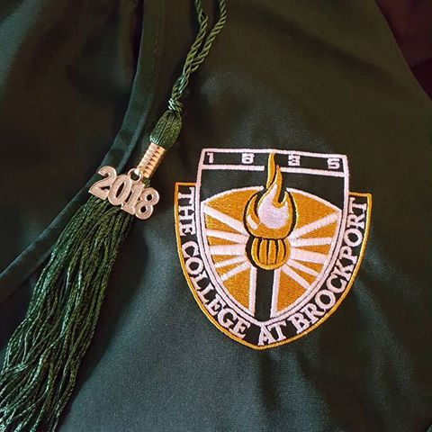
Project Goals
Support the return, degree completion among students who stepped out prior to graduation
Retrieve past due balances, fees, fines
Earn tuition revenues
Increase the 6 year graduation rate
Develop Advancement opportunities among this
group
Identify reasons our students stepped out
Identify barriers to their return

Slide 4
Need
About one in three students who enroll in college never earn a degree.
Many dropouts amass large debts, have limited job/career options
Only 59% of students graduate within 6 yrs.

Slide 5
Brockport’s Six year Graduation Rate
Expected 68%; Actual 83%.
Brockport Identified as a "Top-Performing School" in a Recent New York Times Article
Study conducted by The New York Times and the Urban Institute recognized Brockport for achieving far greater than predicted graduation rates.
The New York Times identified The College at Brockport as one of only 15 “top-performing schools” in the country in a recently published article that examined the “College Dropout Crisis (NYT, 5/23/19)
The study looked at 368 schools across the country and determined what they expected their graduation rates to be, based on the average for colleges with similar student bodies. Brockport was among the 15 institutions who exceeded this expectation the most.
https://www.nytimes.com/interactive/2019/05/23/opinion/sunday/college-graduation-rates-ranking.html

Slide 6
Data to date (2015-present):
Students graduated 502
Credit hours IP Fall, ’19 303 (n=46)
Past due balances recovered: $67,347
Tuition generated $985,247

Slide 7
Keys to Success
Collaboration w/other depts- Registration, Admissions, Academic Depts., Advancement, Advisement
Advisement, support and follow up (contacting at midterm, etc.)
Mapping out requirements

Slide 8
Reasons students walked away (in order)
Personal: relationships/family
Academic:
failed course (s); trigger course; didn’t earn requisite grade; <2.0 overall or in major
non-admission to program with secondary admissions requirement, e.g. NUR
Job
Financial

Slide 9
Barriers to return
Financial
Geographic
Fear: “been away from school”
Unclear requirements
Administrative: forms, etc.
Notes:
Kristal Herndon
Shawn Jarrold

Slide 10
Ongoing Progress and Next Steps
Temporary Academic Leave lists
‘16-’17=282
‘17-’18=213
’18-’19=454
Not registered for upcoming semester
Academic dismissals
Referrals

Slide 11
Case Studies

Slide 12
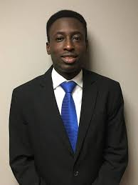
Timothy Jackson, BS Accounting
Tim left the College in 2010 minus one course to complete his degree in Accounting
Returned Summer 2014, graduated August 2014
Working as an accountant in Buffalo

Slide 13
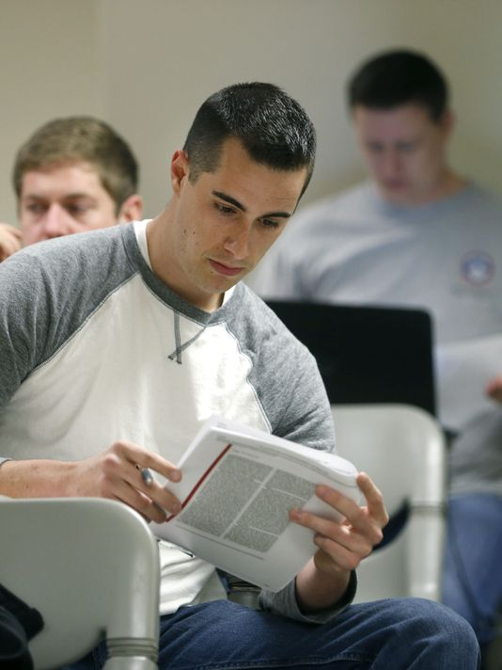
Case Study: Shawn Jarrold.
BUS major
Left for job-2009 -needed- 4 BUS courses
Needed degree for administrative promotion
Returned 2014
Completed online and evenings over two years
Earned degree 2016

Slide 14
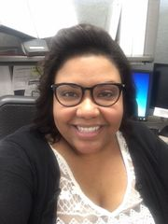
Crystal T.
Criminal Justice major
Left for personal reasons in 2010
Completed two online courses
Graduated in 2017
Now employed in professional position

Slide 15
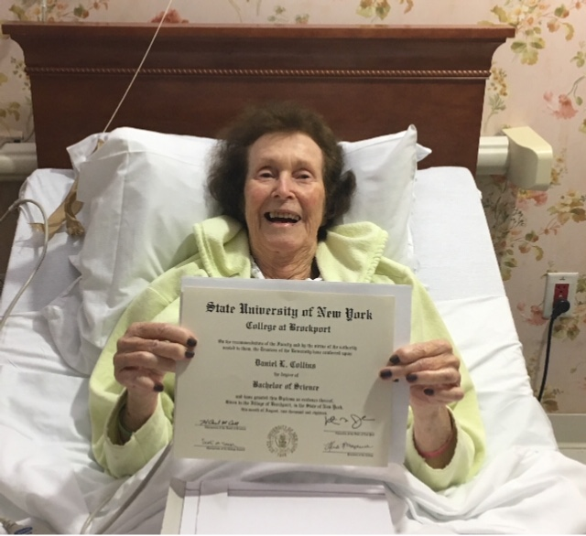
Proud mother of summer 2018 graduate- calendar year Fall 1984.

Slide 16
Questions????

