Slide 1
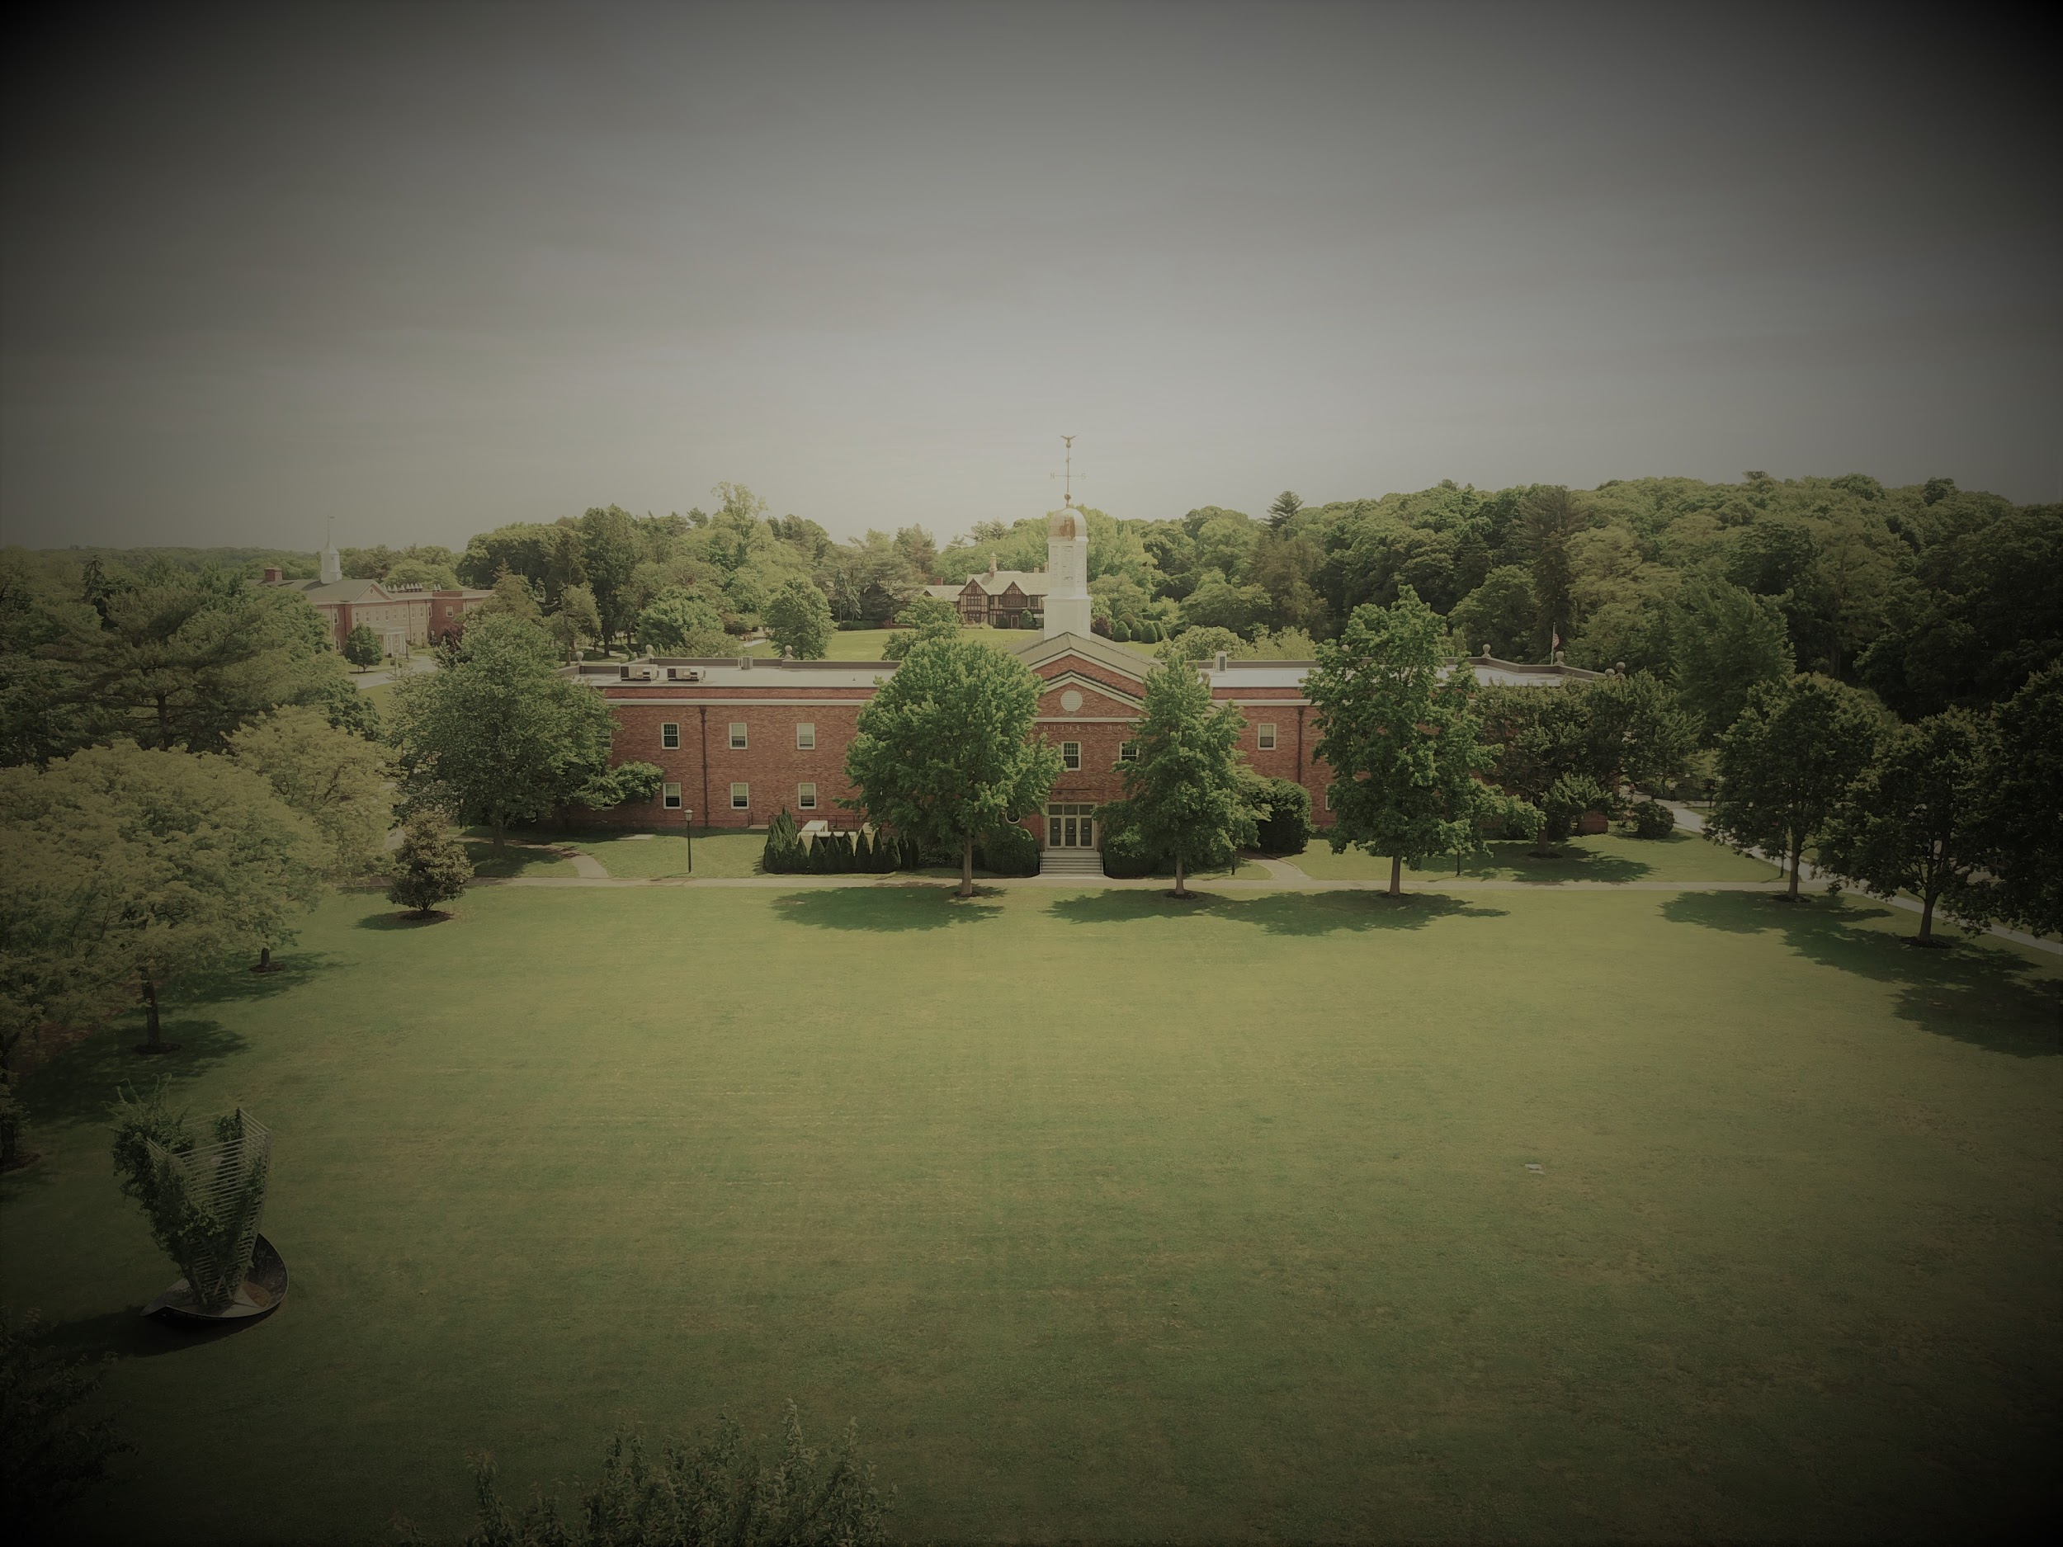
Post 101 Course Redesign
Working Across Departments to Create
A shared FYE in the Online LMS
Long Island University, Post Campus
John Lutz, Chair of English, Philosophy and Foreign Languages
Director of the First-Year Experience and Learning Communities
Carol Hernandez, Instructional Designer
Ashley John, Director of Student Engagement

Slide 2
LIU Post
Demographic
Profile
Total enrollment | 8,499
Undergrad enrollment | 6,316
Male | 40.8%
Female | 59.3%
White | 53%
Race/ethnicity unknown | 18%
Hispanic/Latino | 12.5%
Black or African American | 6.1%
Asian | 5.5%
Non-resident alien | 3.1%
Two or more races | 1.6%
Source: IPEDS college data 2018-2019/Enrollment data Fall 2017

Slide 3
Silos or Students?
Silo image by Dimitris Vetisikas from Pixabay

Slide 4
Exploring Three “Lenses”
Faculty / Academic | Student Engagement / Student Development | Instructional Design / Technology
Image by skeeze from Pixabay

Slide 5
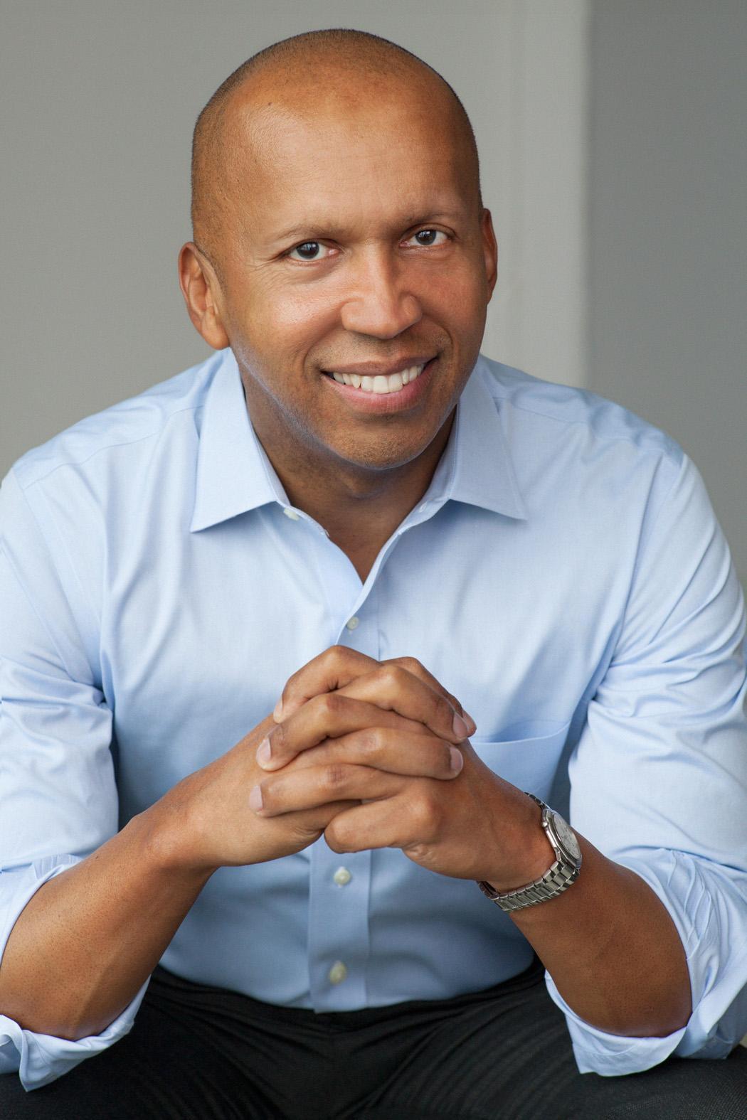
Post Foundations: A Holistic Approach to Student Engagement
1 credit
Free text was Fall 2018 common read
Student learning outcomes: college readiness, social justice, respect for all people, critical thinking, ethical reasoning, student leadership, digital and information literacy
Tie-in to FY Seminar
Photo by Nina Subin

Slide 6
The Common Read
Addresses aspects of the human condition or experience in a way that encourages intellectual and emotional growth
Raises intercultural knowledge and tolerance by presenting diverse cultural perspectives or contemporary social issues
Contains content and/or themes that encourage critical thinking
Appeals to all genders
Captures the imagination of first-year students and draws then into reading and self-reflection
Provides an accessible and readable engagement with an issue or issues relevant to the contemporary world
Introduces students to academic expectations and provides a model of serious intellectual engagement
}

Slide 7
Peer Mentors
Post Foundations currently makes use of peer mentors assigned to each class section.
Peer mentors are part of a teaching team aimed at student engagement.
The peer mentors serve as leaders in organizing the service learning component of the course.
Peer mentors enroll in a three-credit course called Post Foundations Leadership to prepare them for their role.

Slide 8
IDS 100: Post Foundations Leadership
Post Foundations Leadership is offered in two parts: a one credit course in the spring in which the mentors design the service learning project for the fall and a two-credit course in the fall.
Peer Mentors learn the values of leadership as they develop the skills needed to engage first-year students.
´

Slide 9
First-Year Seminars
The first-year seminar is a four-credit class with twenty first-year students. It is conducted in a discussion format and focuses on a particular theme or set of problems with a disciplinary or interdisciplinary focus.
Students enrolled in the first-year seminars will have mentoring and guidance from classroom and library faculty members working in collaboration to foster student learning.
Students in a first-year seminar will be enrolled in a linked section of Post Foundations taught by the same faculty member teaching the first-year seminar or a student life representative.
Along with the additional support from a campus life representative and a peer mentor, library faculty with expertise in the discipline will be available to assist students with their research.
Learning Goals: Critical Reading, Oral Communication

Slide 10
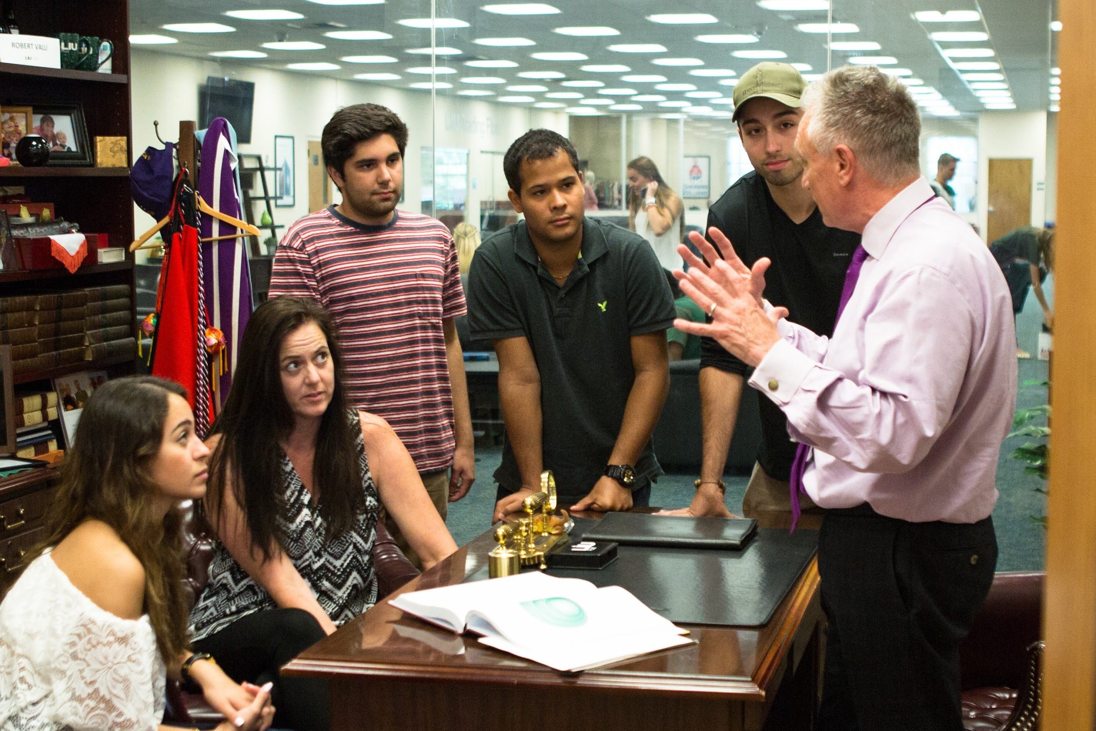
Student Engagement /Development
Notes:
Question for Ashley: In addition to veteran faculty who were about to teach Post 101, can you tell us about other instructors and what their teaching background was? Talk a little about your own experience teaching the course and the feedback you got from students.

Slide 11
The LIU Promise Model
Academic Advising
Student Life, Leadership Opportunities
Orientation, Building Community

Slide 12
Instructional Design / Technology
Listen to faculty and students’ needs and challenges.
Backwards design is driven by student learning outcomes. (What students will be able to do by taking the course.)
What content can be created or curated?
What library resources can be embedded?
What OER multimedia can be embedded to enhance the course?
What assessments can be embedded to make it easy for students to upload or post their work?

Slide 13
Examples and Demo of Course Site
Week by week schedule of assignments and activities that align with common read and focus on having students talk in class and reflect on their own learning.
Organization creates flexibility for instructors--from veteran to novice.
Instructor resources for teaching from a culturally sensitive perspective (Rendon’s Validation Theory, 1994; Charbeneau, 2015).
Multimedia content for students: Author’s TED Talk, Project Implicit Website, links to social media for students, newspaper and journal articles.

Slide 14
LIU Post 101 Timeline: About One Year
Winter to Spring
Faculty, staff, students meet and discuss common read for upcoming course. Student Engagement, Library and IT are part of the conversations. Talk through pros and cons of each book and how it impacts learning outcomes. What resources exist? Such as the publisher’s teaching guide for the common read? TED Talks, websites, articles, etc. Remain flexible, open-minded.
Summer to Fall
A master course site is built in the LMS and tested. Review the course site and all resources. Further test drive the course site. Once it is ready, it is copied to all sections. All instructors and peer mentors meet and start preparing to teach the course.
Spring
Fall
Winter
Summer
Spring to Summer
A book is selected. Instructional designer, IT, faculty, and staff work on creating or curating content, creating and embedding assessments, embedding multimedia and upload links. Alignment with student learning outcomes drives the design. Build and test in chunks--rapid prototyping. Test drive the course site multiple times.
Course launches
Distribute common read book, coordinate with orientation activities. Course can be enhanced by connecting with other student life activities, celebrations, traditions.

Slide 15
Planning Grid
Department | What resources will assist instructors in teaching? | What resources will support student learning? | What multimedia can be added to the course site that enhances connections?
Faculty / Academic
Student Engagement / Student Development
Instructional Design / Technology

Slide 16
Think-Pair-Share Activity
Identify one approach for collaborating across departments to design and build a shared First Year Experience (FYE).
Discuss what that approach might look like at your institution.
Image by Robert Armstrong from Pixabay

Slide 17
Got
Questions? Feel free to contact Carol Hernandez, Instructional Designer Long Island University carol.hernandez@liu.edu 516-299-3428.

