Slide 1
Putting Language in the Center:
Reflective and Practical Exercises on Translanguaging in the College Classroom
SUNY Faculty Development Conference, New Paltz
April 5, 2019
Lucy McNair and Leigh Garrison-Fletcher
LaGuardia Community College, CUNY

Slide 2
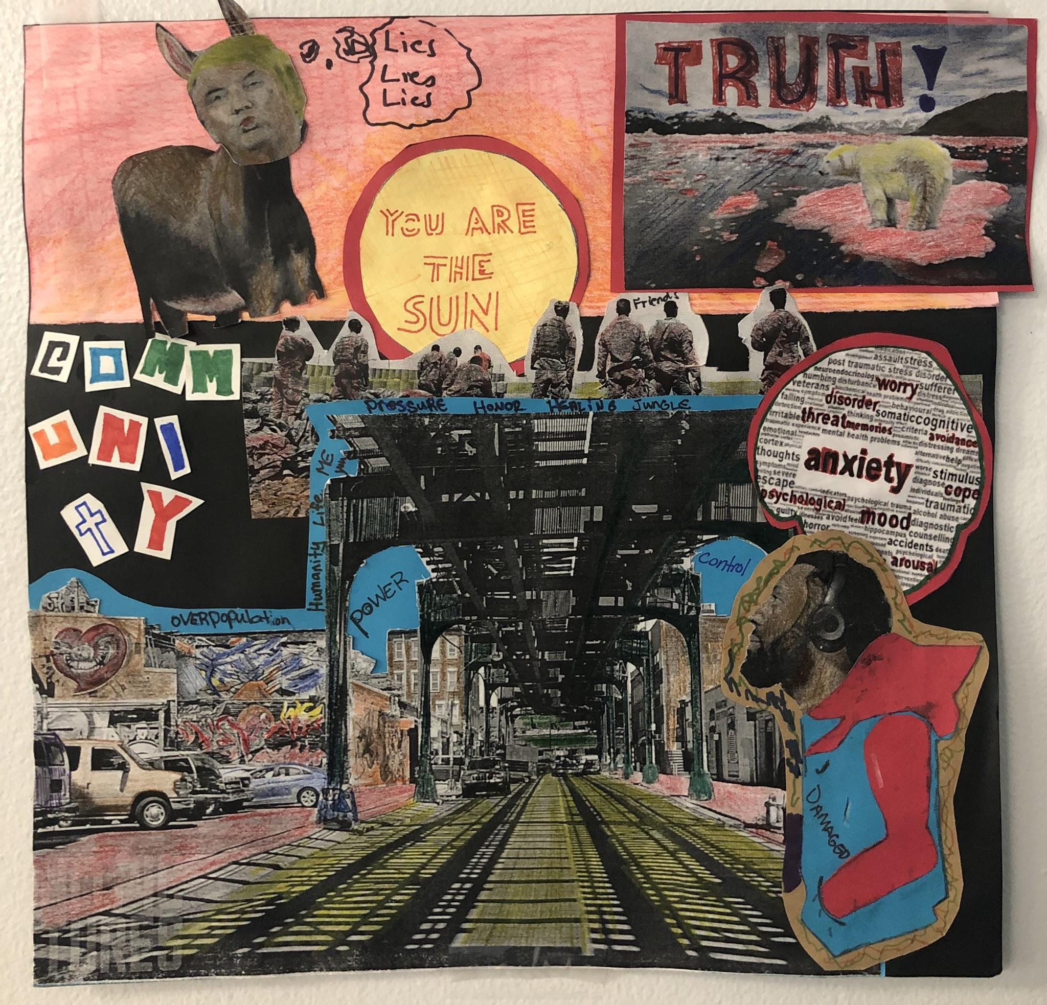
Overview/Agenda
Bring language to the center
Discuss the theory of translanguaging
How can we apply translanguaging in our classes?
Workshop student work, course assignments
and activities
Notes:
Should we hand out our syllabus right from the start? Mention that we are doing a very abridged version of it during the workshop.

Slide 3
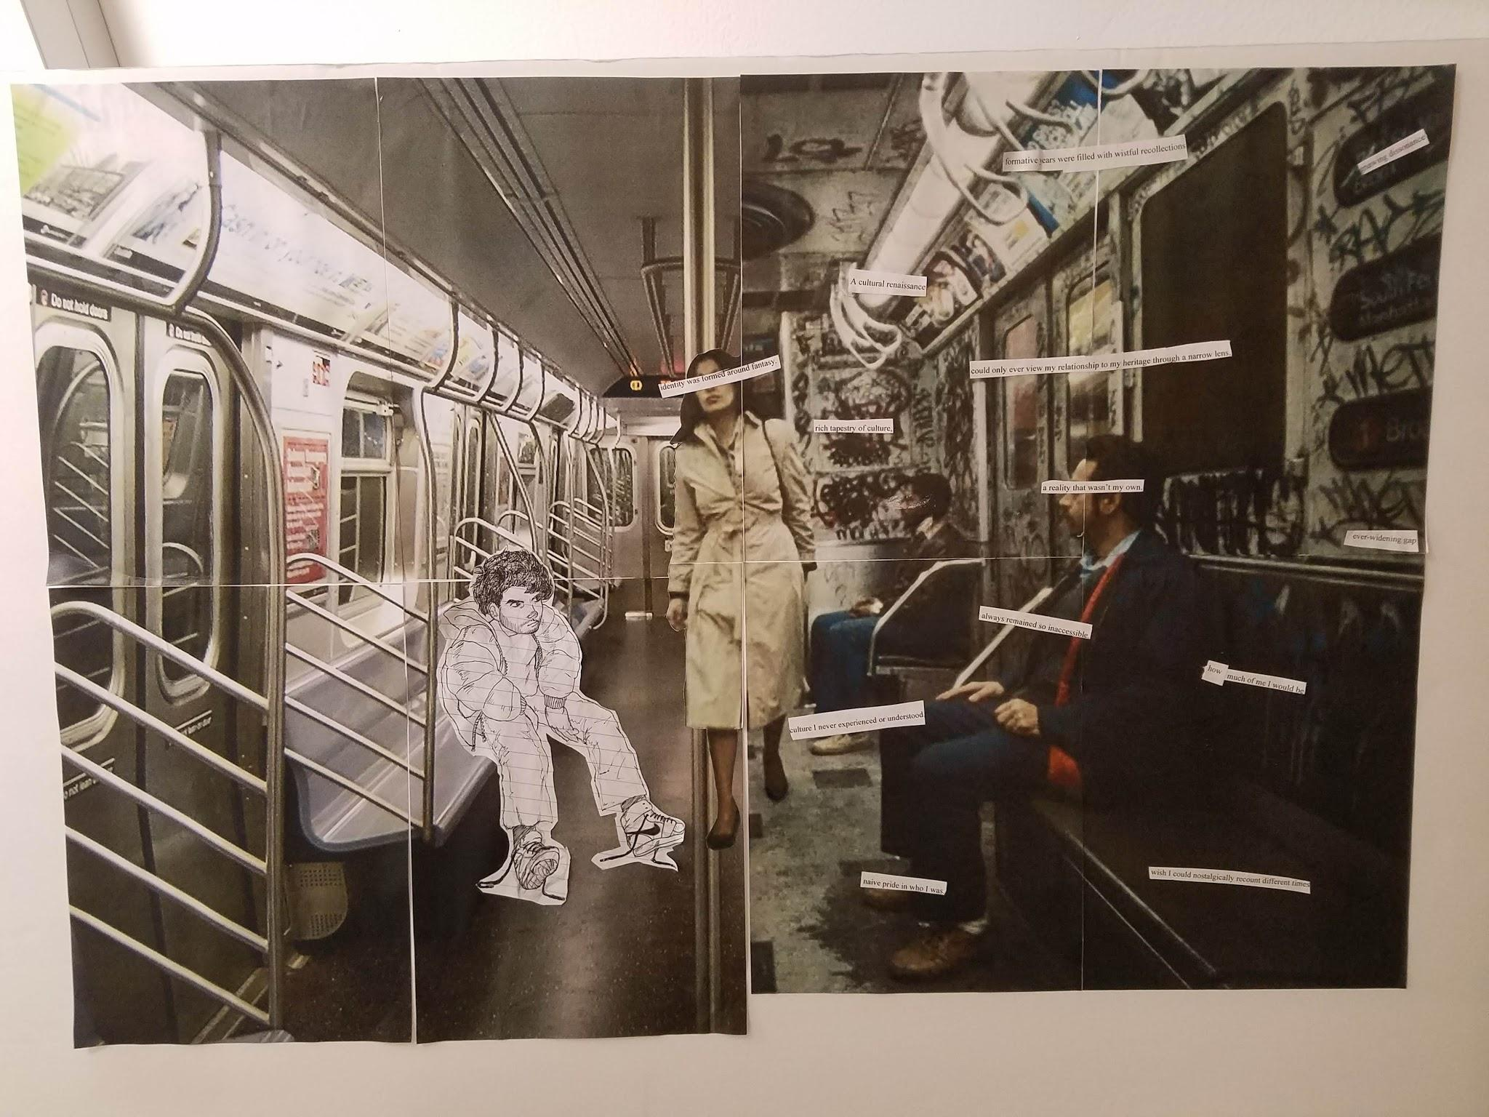
Bring Language to the Center
“The words I learn now don’t stand for things in the same unquestioned way they did in my native tongue. “River” in Polish was a vital sound, energized with the essence of riverhood, of my rivers, of my being immersed in rivers. “River” in English is cold - a word without an aura.”
Eva Hoffman, Lost in Translation
Notes:
Interdisciplinary approach. Whether we consider ourselves monolingual or multilingual, we each have a language history that involves language acquisition and sometimes loss/translation. It’s connected to our childhoods, to memory, to growing up, to our identities. To achieve learning goals, we can also look at it as an innate human skill, a process we can examine, understand much better, and build on.

Slide 4
Language Continuum
Consider which tasks you are able to do in each of your languages/language registers. Where do they fall on this continuum?
Emerging Confident
←---------------------------Listening to an academic lecture ----------------------------->
←---------------------------Giving directions on the street--------------------------------->
←----------------------------Reading an article in the newspaper------------------------->
←----------------------------Writing an informal letter to a friend-------------------------->
Notes:
We have different language practices,

Slide 5
Bring Language to the Center:
Language Resources Exercise
In small groups, take turns discussing your linguistic resources. Which languages/language registers do you speak, understand, read, write, use in the past or periodically today, or consider yourself fluent in? In which contexts have you acquired them? Write down a list or draw a visual image of your group’s language resources to share with the group.
Notes:
We want particpants to know what we mean by “linguistic resources” or “repertoire” by the end, and know their own better.

Slide 6
Language Continuum
Our answers:
Emerging Confident
←------X--------------------Listening to an academic lecture ----------------------------->
←---------------------------Giving directions on the street----X---------------------------->
←------------------X--------Reading an article in the newspaper------------------------->
←----------------------------Writing an informal letter to a friend---X--------------------->
Notes:
We have different language practices,

Slide 7
Our answers with scaffolds (**)
Emerging Confident
←------X-----------------**---Listening to an academic lecture --------------------------->
←---------------------------Giving directions on the street----X----------**---------------->
←------------------X--------Reading an article in the newspaper---**------------------->
←----------------------------Writing an informal letter to a friend---X---**---------------->
Notes:
We have different language practices,

Slide 8
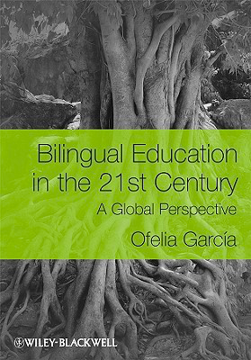
Translanguaging
Ofelia Garcia’s work
Notes:
Language practices adapt to the context of communication.
Grow in different directions at the same time. Rather than separated, as enemies, we need to see them as rooted in a unitary system.

Slide 9
What is Translanguaging?
“...translanguaging posits that bilinguals have one linguistic repertoire from which they select features strategically to communicate effectively.” (Hesson, Seltzer, & Woodley, 2014)
“Translanguaging, or engaging in bilingual or multilingual discourse practices, is centered...on the practices of bilinguals that are readily observable.” (Garcia, 2009)
“...rather than treating writers as passive, conditioned by their language and culture, we would treat them as agentive, shuttling creatively between discourses to achieve their communicative objectives.” (Canagarajah, 2017)

Slide 10
Codeswitching and Spanglish,
student examples
Living in a low income NYCHA development (also known as projects,) I learned to be verbally bilingual very early on in an effort to fit in. Speaking too proper was looked down on, and you could only be ‘down’ if you knew the latest slang. So at home and in class I spoke and behaved in a polite, well-mannered way, while in social settings like the hallways, or the community center I spoke African American Vernacular English (AAVE) also known as ‘urban slang.’
It’s here that the apartment door opens and I’m greeted by the joy of my world: my mother, Senora Luz. I’m welcomed just by the look in my vieja’s eyes, as loving and pure as any parent in a privileged home. Attired in her triple XL shirt, reading glasses, pink flip-flops (aka la chancleta, a Hispanic mother’s go-to weapon) and high bun, my rena hugs me and it’s an embrace you wish you could pocket forever. It’s the type of love older men tell me you only live once, sharing that heartbreaking, grateful, nostalgic look in their eyes at sentence’s end. “Papi, quieres cafe” (the Colombian way of breaking bread) “Claro que si a ma.”
Notes:
Translanguaging differs from codeswitching in terms of emphasis on one underlying system and on transfer, choice and negotiation rather than mastery of a standard code. Internal view of how language functions rather than prescriptive external view.

Slide 11
Translanguaging Pedagogy
“Translanguaging...represents an approach to language pedagogy that affirms and leverages students’ diverse and dynamic language practices in teaching and learning.” (Vogel & Garcia, 2017)
“As a pedagogical practice, translanguaging leverages the fluid languaging of learners in ways that deepen their engagement and comprehension of complex content and texts. In addition, translanguaging pedagogy develops both of the named languages that are the object of bilingual instruction precisely because it considers them in a horizontal continua as part of the learners’ linguistic repertoire, rather than as separate compartments in a hierarchical relationship.” (Vogel & Garcia, 2017)
Notes:
Think the second is too long? Maybe just need that one?

Slide 12
Student response to a translingual orientation in an ESL class
“In our classroom our professor never stops us from speaking our own language. Every time I write essays in class, I can relax and express my thoughts. In my last semester, my professor required us to speak English in class. In her class, just only English. Even in the classroom writing essays we cannot use the translation dictionary, only English dictionary. This is very difficult for me because my level and my vocabulary do not let me understand the meaning of English immediately. I often felt very nervous and stressful then I couldn’t express my own ideas.”

Slide 13
Language Across the Curriculum
“There is no classroom activity where speaking is not required and where texts are not used in support or written material is not the outcome. Each activity brings both oral and written language skills into play” (Council of Europe)
“Learning at school entails constantly expanding skills and practices regarding not only academic content but also language” (Uccelli & Phillips Galloway, 2018)
Notes:
We are all language teachers
We all teach using language to students with diverse language resources
Everyone can benefit from an understanding of translanguaging

Slide 14
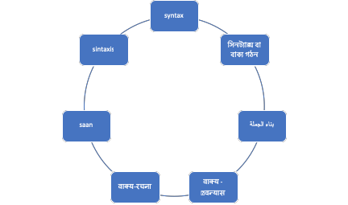
Word Maps

Slide 15
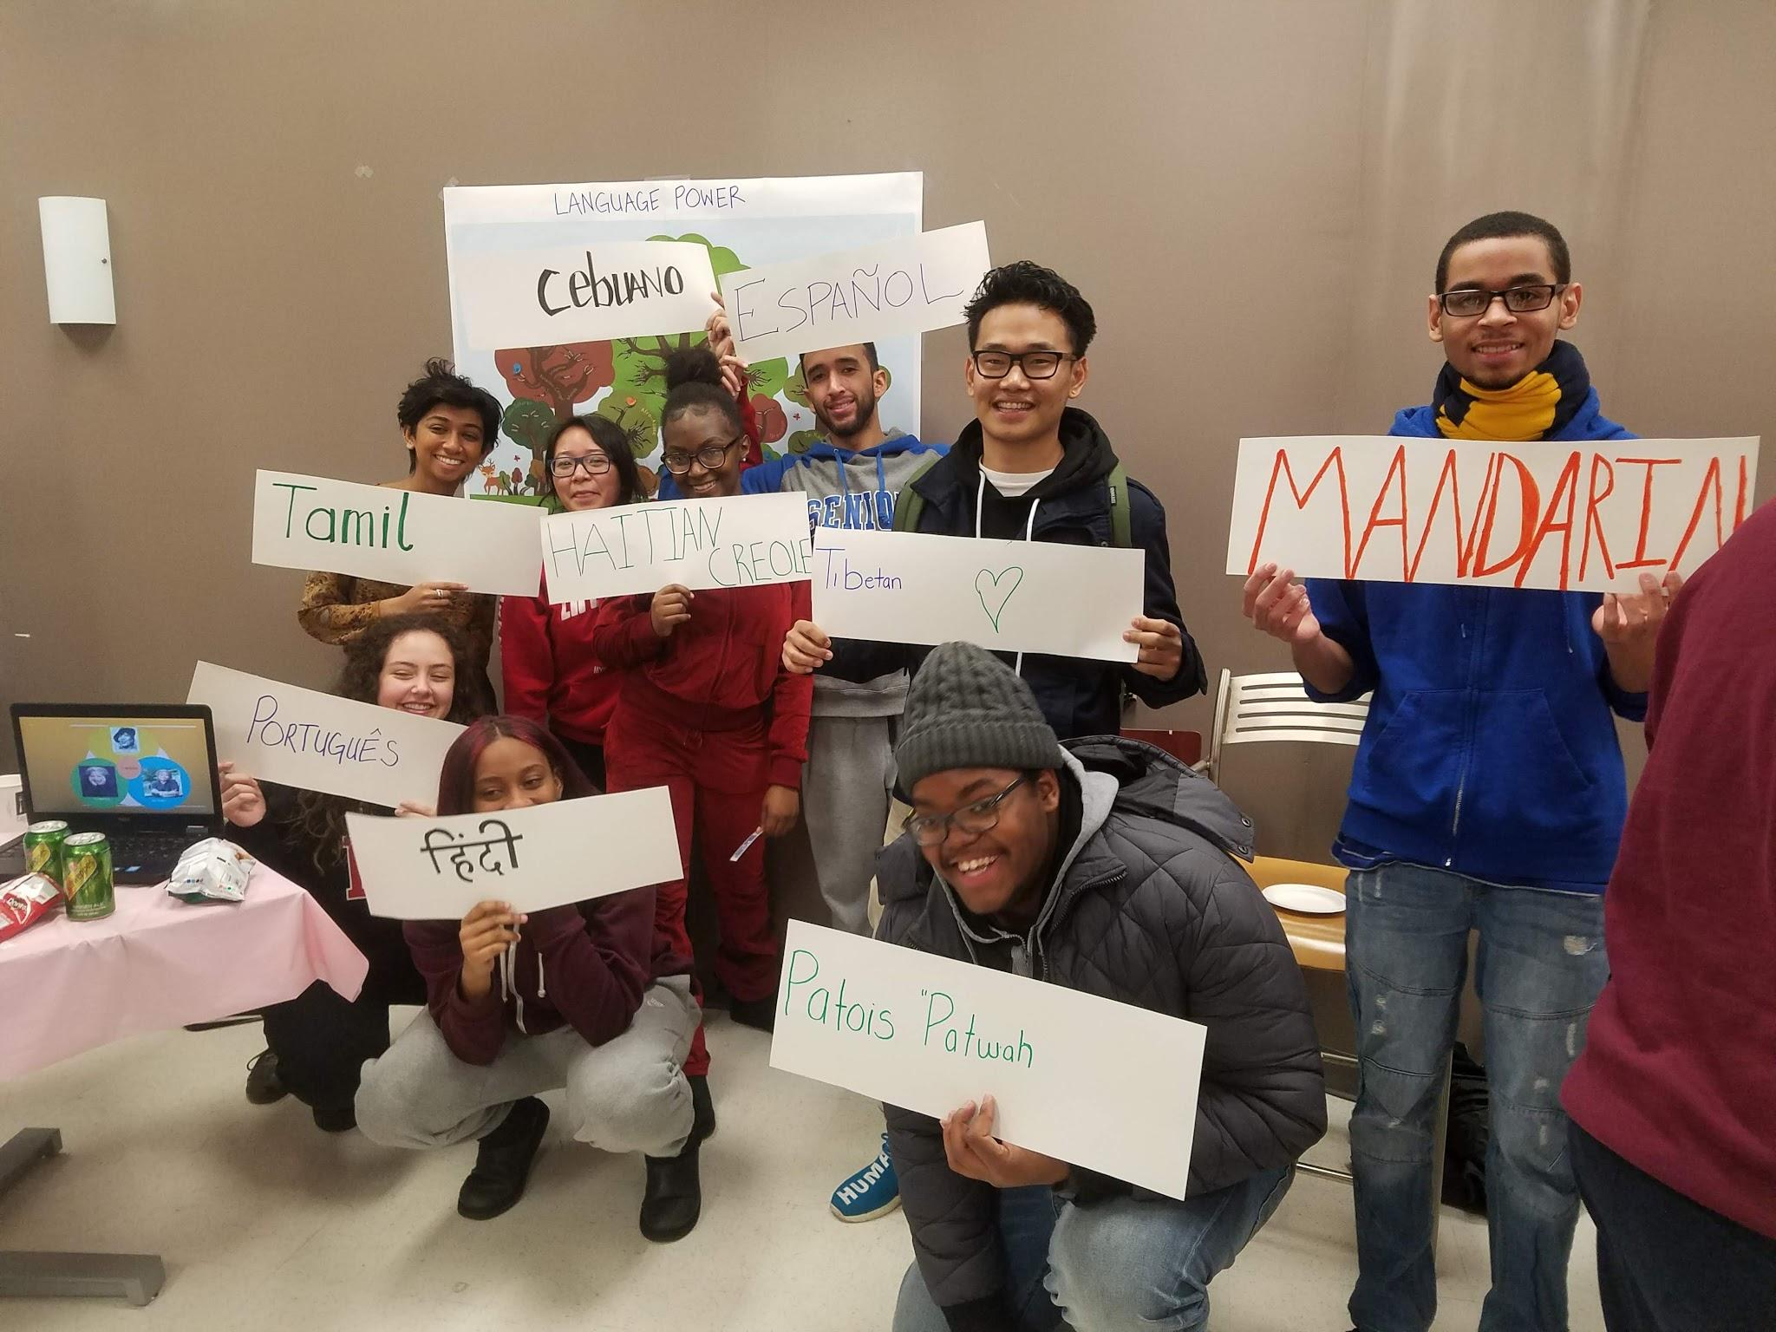
Discussion / Mapping your college & classroom multilingual ecology

