Slide 1
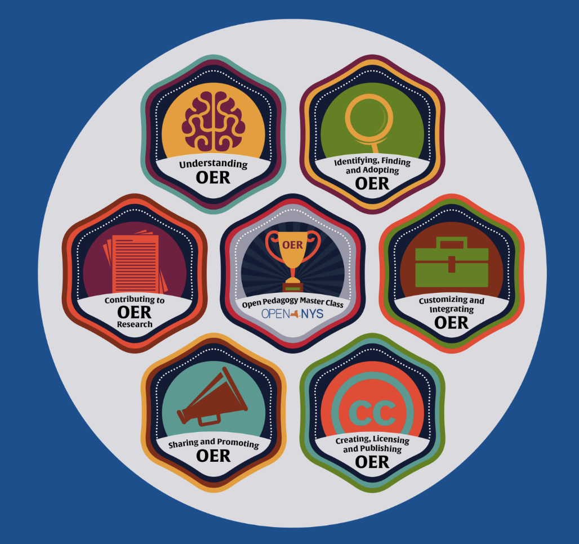
SUNY OER Community Courses
bit.ly/soscomcourse
Alexis Clifton
May 2019
Notes:
All slides CC BY unless otherwise noted

Slide 2
Professional Development
Community Building
Technical Integration
Notes:
My office, SUNY OER Services
we aren’t administering the money, but we are on hand to support campuses as they’re instituting big change, quickly

Slide 3
February, 2017
Inaugural Executive Director hired
Goal: Build up OER Program Development at individual institutions
Drafted 3-year cohort model
10-12 SUNYs onboarded every year over 5 years
Notes:
Original plan when I started in February 2017: work with cohort of institutions over a 3 year cycle, building local expertise and embedding mentoring
https://media.giphy.com/media/3o6MbbGc2STqF4D28w/giphy.gif

Slide 4
New York State OER Budget Allocation
April 2017:
“The Budget additionally includes $8 million to provide open educational resources, including e-books, to students at SUNY and CUNY colleges to help defray the prohibitive cost of textbooks.”
Notes:
You may be aware of NYS’s OER windfall of the past couple of years
Tied to the fiscal year budget, had to be spent in the same year
Repeated 2018, again in the budget for 2019

Slide 5
Notes:
And suddenly we were no longer walking, but rather doing a mad scramble through the entire system, all at once
https://media.giphy.com/media/7kn27lnYSAE9O/giphy.gif

Slide 6
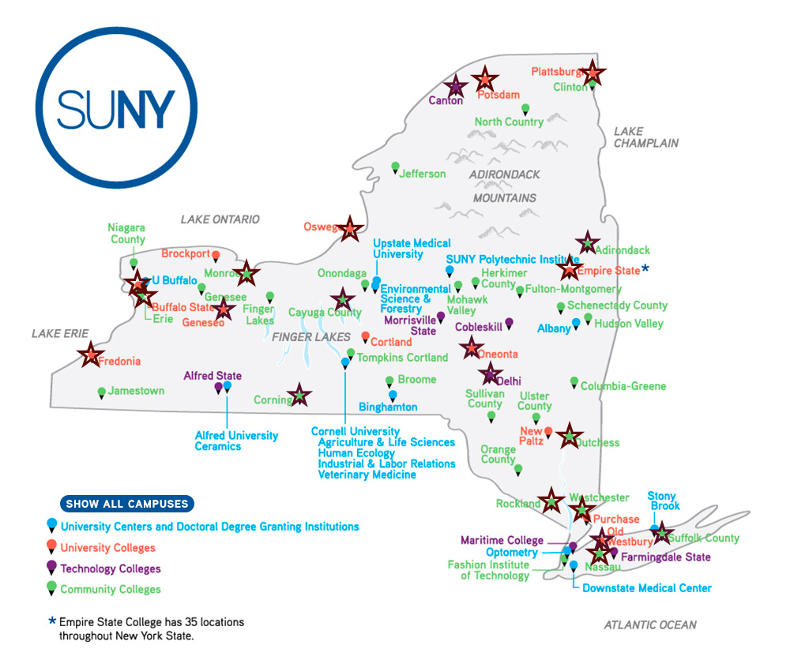
‘17-18 OER 1-Day Campus Workshops
Goal: 10
Actual: 24+
Notes:
One of the ways we opened conversations was through a series of in-person workshops
image all rights reserved

Slide 7
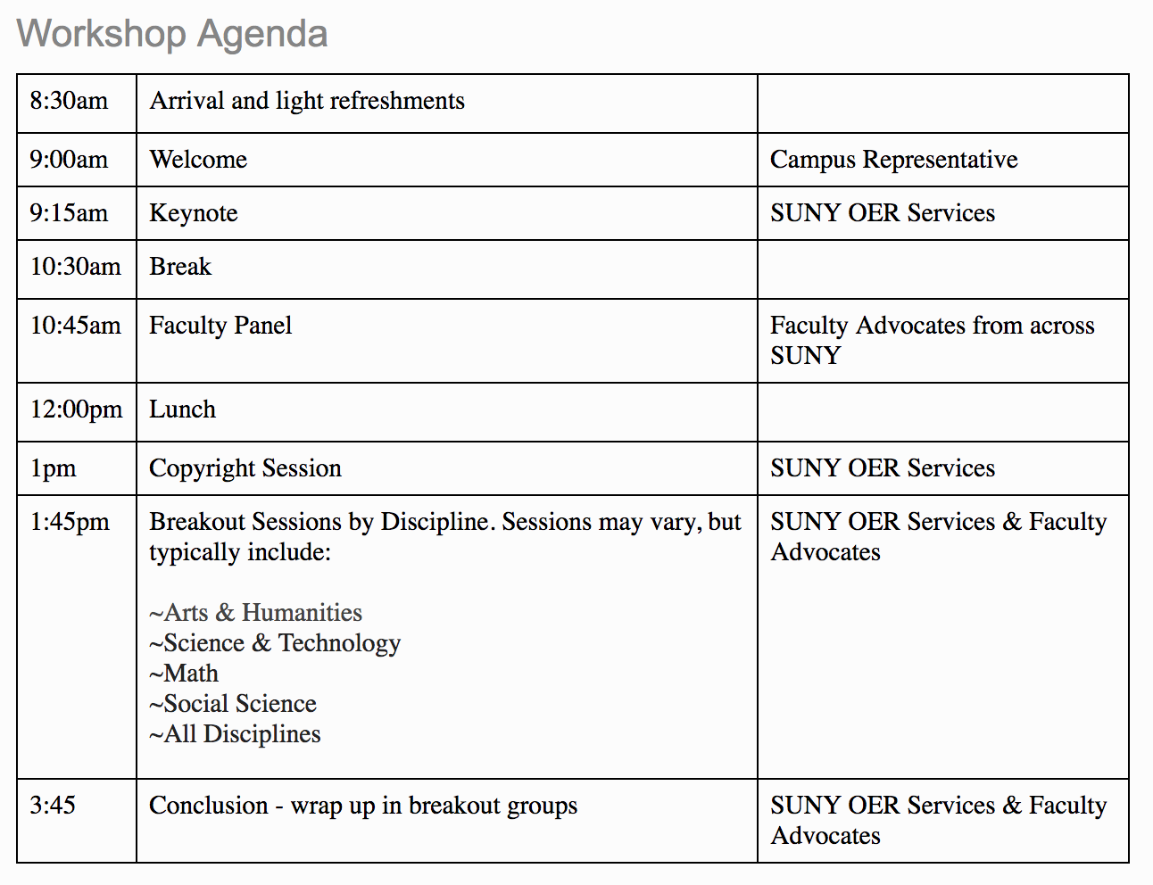
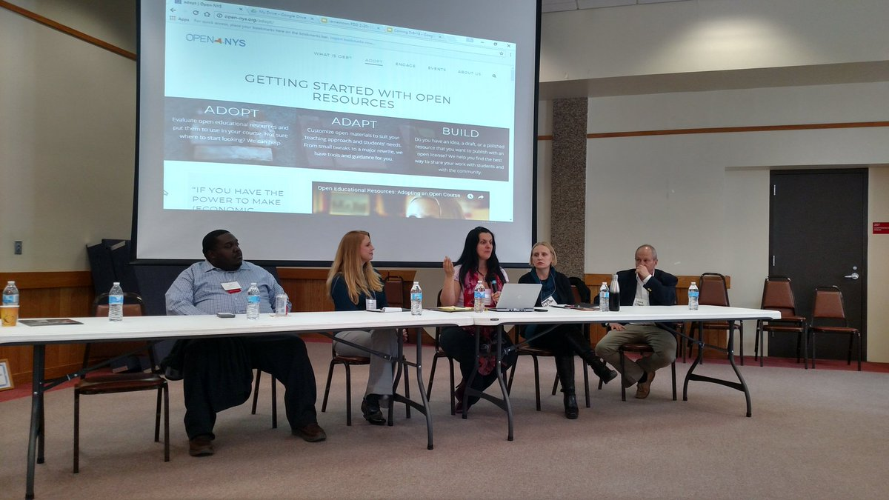
“The OER Road Show”
Notes:
Typical agenda - tried to be inclusive of different experience levels with OER, but geared as “entry level”
But, not the best way to address all the needs of the room - to meet people where they were most interested to go next

Slide 8
OER Community Course
bit.ly/soscomcourse
Notes:
The idea germinated Fall 2017. Work began in earnest Spring 2018, with full launch and release by Summer 2018.

Slide 9
OUR GOAL:
a shared learning journey that allows for individual work on readings, exploration of associated resources, conversation on forum topics, and group collaboration on learning activities

Slide 10
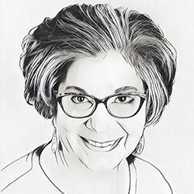
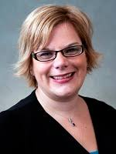
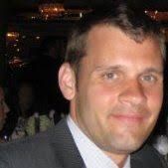
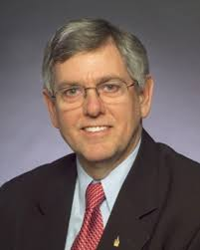
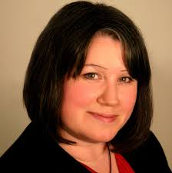
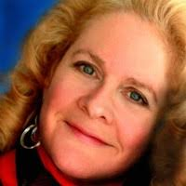
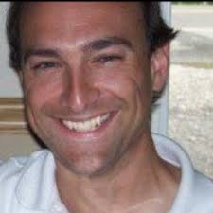
Phylise Banner
Lead Designer
pbanner@gmail.com
Notes:
Phylise Banner was our primary project manager. She and I collaborated closely on the course architecture and delivery elements. Each mini-course had one primary editor, who curated existing materials and wrote new content where appropriate.

Slide 11
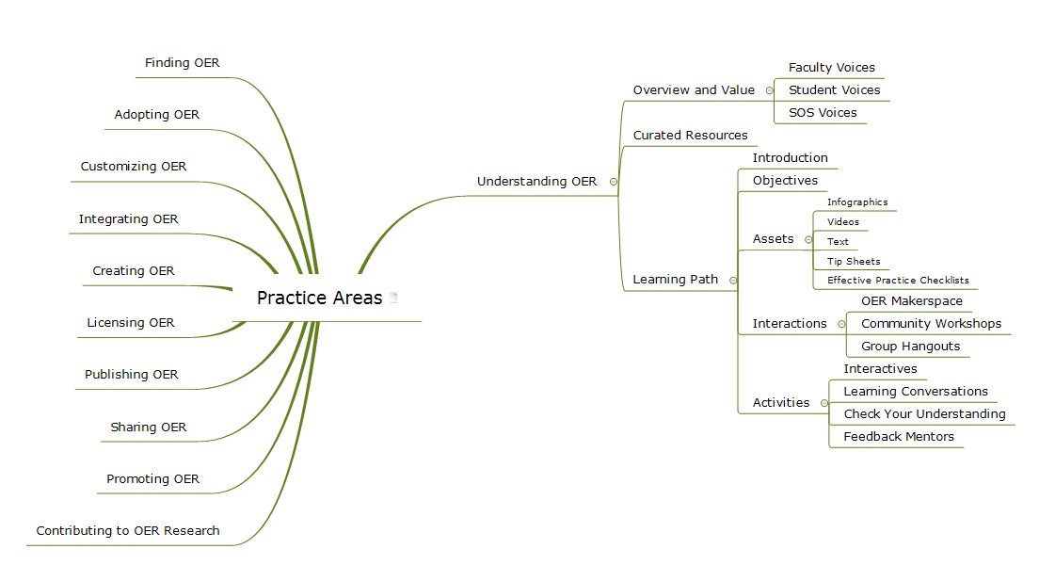

Slide 12
This learning journey is made up of six* courses that will guide learners through:
Understanding OER
Identifying, Finding, and Adopting OER
Customizing and Integrating OER
Creating, Licensing, and Publishing OER
Sharing and Promoting OER
Open Pedagogy Master Class
*for now
Notes:
We assume most people will take one or two of these; learners can start with any course and move in any order.

Slide 13
Learning Pathway Options

Slide 14
The Pathway to Discovery
The Mapped Out Journey
The SUNY OER Community Learning Cohort
The Bespoke Group Cohort
Notes:
The Pathway to Discovery: If you choose to follow this approach, you will be exploring the courses and associated resources on your own. There’s no set pathway that you need to follow, and no milestones to reach. Just an open learning landscape for you to explore. Note that there is no access to the discussion forums on this learning pathway.
The Mapped Out Journey: Each course in this OER Learning Hub has an established sequence of things to do, and ways to connect and communicate. Once you have completed the first course (Understanding OER) the remaining courses can be accessed, and activities completed out of order. You will still need to participate in conversations, complete knowledge checks, write short reflections, and submit evidence of learning exercises if you want to earn badges and a course completion certificate.
The SUNY OER Community Learning Cohort: Each OER Community Learning cohort will be facilitated by a study group leader – a SUNY peer who has experience in finding, adopting, customizing, integrating, creating, licensing and publishing OER. These study group leaders will guide you through each practice area, keep conversations on track, and help you with collaborative project logistics. As a group, you will move through the practice areas in sequence – participating in conversations, completing knowledge checks, writing short reflections, and submitting evidence of learning exercises to earn badges or a course completion certificate. Access the OER Community Learning Cohort schedule
The Bespoke Group Cohort: The courses in the OER Learning Hub are available for use by individual cohorts, under a Creative Commons Attribution license. A study group leader guide and accompanying documents are also available for use. Please contact oer@suny.edu for more information on running a Bespoke Group Cohort.

Slide 15
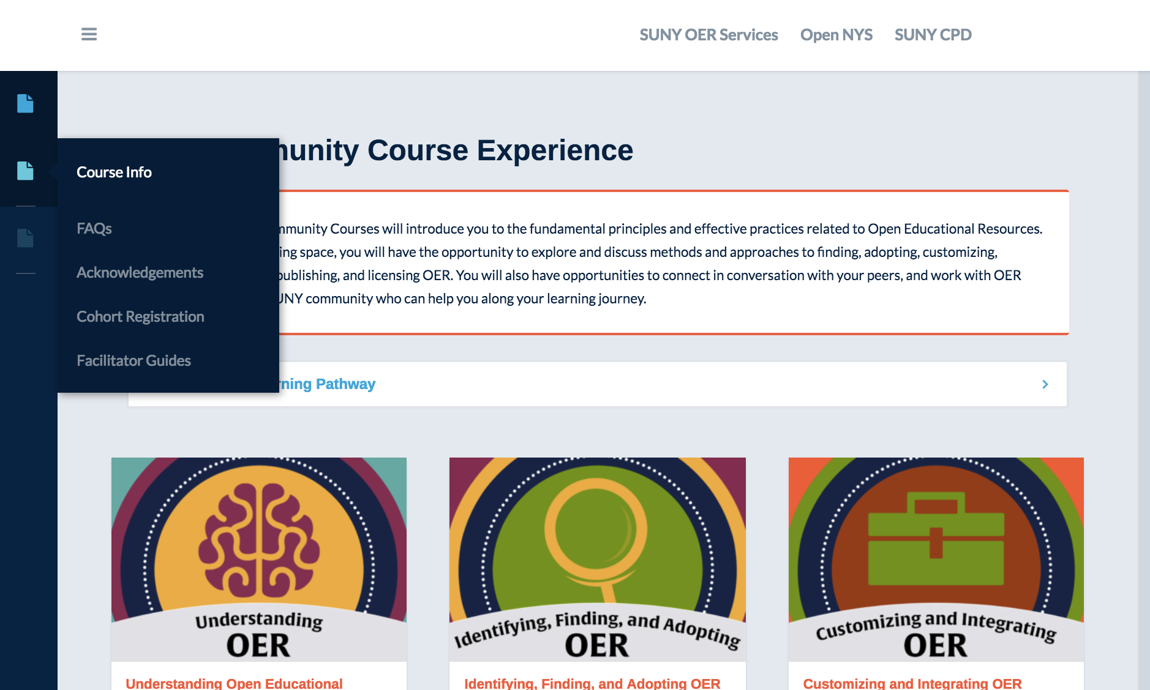
Not SUNY? oer@suny.edu
Notes:
Public, “always-on” website
FAQs
Facilitator Guides
email oer@suny.edu for source files

Slide 16
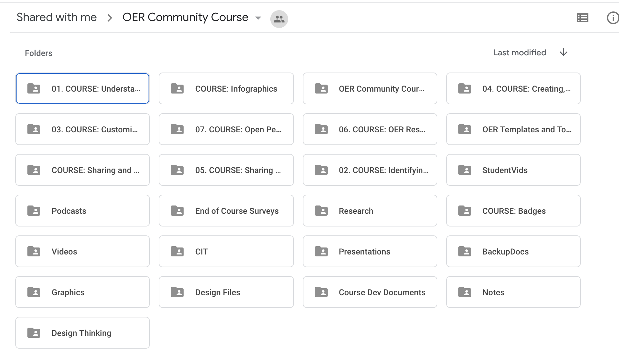
Other ways to access:
request via oer@suny.edu
Lumen Integration / Pressbooks
Google Drive Editable Files

Slide 17
Connect and Collaborate
Along with contributing to course forums, learners will be encouraged to add to the OER community by posting to social media, contributing to the Workplace OER Community Course page, or adding sites to the Diigo social bookmarking group.
#SUNYOERChat
Notes:
The thing about the “always on” website is that we didn’t want to host discussion forums there (for obvious reasons). So we’re using social media instead, or alternatives based on facilitator’s preference.

Slide 18
20 cohorts ran in Fall 2018
5-15 hours of work
open for 2 weeks (Open Pedagogy 3 weeks)
managed through Center for Professional Development
facilitated by SOS staff & OER Faculty Champions
Notes:
The cohort model was an experiment in F18. We launched many, but didn’t see the registration numbers or the # of badge earners we’d hoped.
S19 is entirely self-directed learning, which is steady participation.

Slide 19
8:30am | Arrival and light refreshments
9:00am | Welcome | Campus Representative
9:15am | OER in SUNY: Our Large-Scale Impact | SUNY OER Services
9:45am | Break
10:00am | Faculty Panel | SUNY OER Faculty Champions
11:00am | Workshop Focus Area #1 (Campus choice from OER Community Course series) | SUNY OER Services
12:00pm | Lunch
1:00pm | Student perspectives on OER | SUNY OER Services & Student Advocates
2:00pm | Workshop Focus Area #2 (Campus choice from OER Community Course series) | SUNY OER Services
3:00pm | Guided Exploration of OER content | SUNY OER Services & Campus Representatives
3:45pm | Wrap-up and Next Steps | SUNY OER Services & Campus Representatives
Notes:
These courses are also the focal point of how we delivered live professional development 2018-19

Slide 20
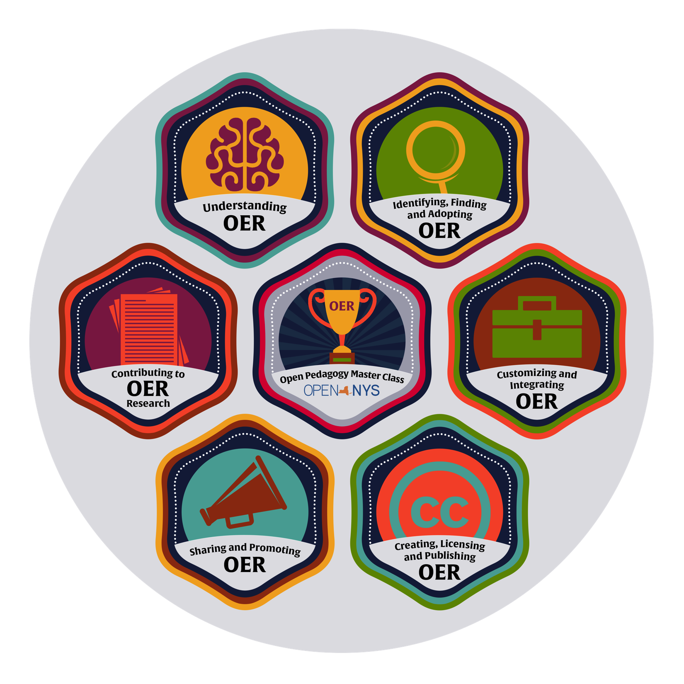
Course Badges Awarded (Credly)
Understanding OER: 90
Identifying, Finding & Adopting: 15
Customizing & Integrating: 12
Creating, Licensing, Publishing: 4
Sharing & Promoting: 5
Open Pedagogy Master Class: 2
Facilitator: 8
Notes:
Secret hidden badge: the facilitator
We know a lot of people are engaging with the courses, but not many have worked through the “evidence of learning” components

Slide 21
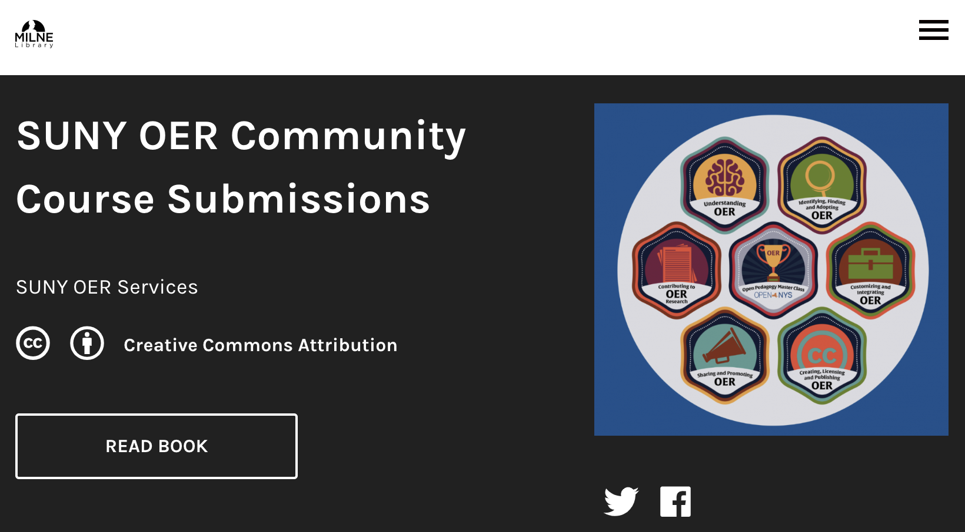
See Some Submissions
https://milnepublishing.geneseo.edu/communitycoursesubmissions/
Notes:
Authors of “evidence of learning” components are asked to apply a license to their work as they submit. We collect them here - not completely up to date, admittedly.

Slide 22
Two Challenges
Meaningful discussion space
Tracking without being creepy
"tempb" by whothinkaboutit is licensed under CC BY-NC-ND 2.0

Slide 23
Course Refresh Summer 2019
Clarify SUNY processes
Embed Help Desk Support
Embed Hypothes.is
Streamline Open Pedagogy Master Class
"" by LT - Lucytown is licensed under CC BY-NC-SA 2.0
Notes:
SUNY OER Services evolved a lot over the past year, as the course deployed and after. So we need to reflect the most effective ways for faculty to move forward with OER in the course. Plus stale links and more meaningful opportunities for interaction.

Slide 24
Who’s Interested?
College of Charleston
University of New Hampshire
University of Colorado - Pueblo
Rebus Community

Slide 25
Shall we take a tour?
bit.ly/soscomcourse

Slide 26
Let’s chat
oer@suny.edu oer.suny.edu @SUNYOERServices @openalexis
Notes:
All slides in this presentation are CC BY 4.0, Alexis Clifton, SUNY OER Services, unless otherwise noted

