Slide 1
Supporting Students with Disabilities Using the Social Model of Disability
2019 SUNY Student Success Summit
Andrea Piazza and Melissa Zgliczynski
Accessibility Resources & Services
SUNY Empire State College

Slide 2
Disability Defined by the Americans with Disabilities Act (ADA) and Section 504 of the Rehabilitation Act
An individual who has a physical or mental impairment that substantially limits one or more major life activities
An individual who has a history or record of such impairment
An individual who is perceived by others as having such an impairment

Slide 3
Under Section 504 and ADA:
Colleges & universities must offer “reasonable accommodations” to ensure that students with disabilities receive equal access to and participation in educational programs and activities, including, without limitation, courses, activities, housing, etc.
In the academic context, this may include:
  Extended time on individual assignments/tests
  Obtaining textbooks in alternative formats (i.e. electronic)
  Use of a note-taker or note-taking devices
  Providing ASL interpreters for classes, meetings, etc.

Slide 4
The Numbers
According to the National Center for Special Education Research, more than 200,000 students with Autism will be heading to college in the next 10 years
According to the World Health Organization, more than 1/3 of college freshmen struggle with a mental illness (and not all self-identify to Disability Services)
According to the National Center for Education Statistics, 11% of undergraduate college students report having a learning disability
The National Center for Special Education Research reports that only 34% of students with disabilities have completed a four-year degree eight years after graduating high school

Slide 5
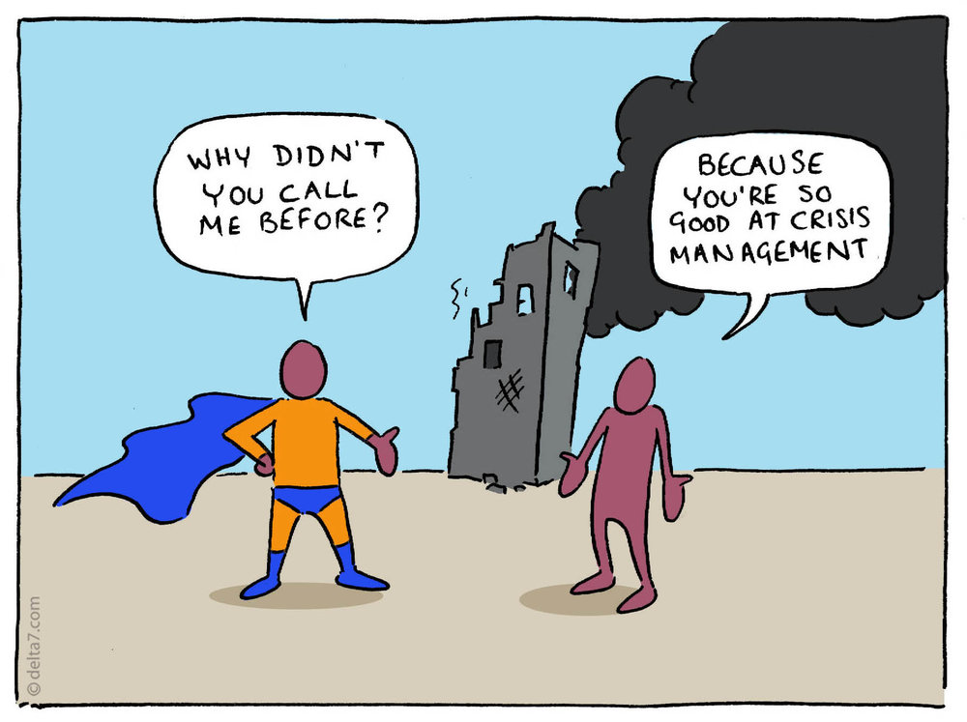
How can we take a proactive approach?

Slide 6
Universal Design
Ronald Mace, a wheelchair user and architect, coined the term universal design in the 1970’s
Universal design (UD) is “the design of products and environments to be usable by all people, to the greatest extent possible, without the need for adaptation or specialized design.”
Example of UD is a sidewalk with curb cutouts that can be used by people who are walking, using wheelchairs, pushing a stroller, pulling a cart, etc.

Slide 7
The Social Model of Disability
Views disability as one aspect of a person’s diversity
Disability is a piece of the individual’s identity
Disability is caused by the way society is organized, rather than a person’s impairment or difference

Slide 8
Takeaways from the Social Model of Disability
Move away from the medical model that views disability as a problem
A disability is NOT something that needs to be “fixed”
Focuses attention on the attitudinal obstacles people with disabilities face
Ableism – discrimination against people with disabilities or those perceived as having disabilities
Disability as a diversity issue

Slide 9
Putting Universal Design into Practice in the College Setting
Proactive process (not reactive)
Building in features that anticipate a diverse group of users’ needs and preference
Usable, accessible and inclusive
Benefits ALL students – those with different technological skills, non-traditional students, students whose first language is not English, students from various minority groups

Slide 10
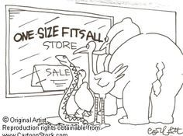
Universal Design – How?

Slide 11
The Process of UD
Create a welcoming environment for all students
Determine learning outcomes and/or essential requirements
Be clear about expectations (in writing, verbal explanation, specific examples)
Provide timely feedback
Take into account students’ diverse backgrounds, learning preferences, strengths & challenges
Provide students opportunities to interact with instructors, guest speakers, advisors, peers, student services staff, etc.

Slide 12
UD in Instruction
Syllabus statement inviting students to meet with instructor to discuss learning needs
Multiple modes of delivery – discussions, lectures, videos, readings, group presentations, etc.
Outlines of what will be covered in each class
Allow rough drafts to be turned in ahead of the deadline so feedback can be provided
Regular, clear, concise feedback from the instructor

Slide 13
More Examples of UD in Instruction
Videos that are captioned (benefits those who learn best by reading, who are viewing the video in a noisy environment, whose first language is not English, etc.)
Alternative text for images on web pages, power points, etc. so it is accessible for students using screen readers
Ensure the physical meeting space is accessible (adjustable height chairs & tables, flexible seating arrangements, easy to reach equipment at any height)

Slide 14
UD in Student Services
Printed material that is available in accessible formats (i.e. electronic format that works with screen readers, magnification software, etc.)
Student services websites that are compliant with Section 508 of the Rehabilitation Act (https://www.section508.gov/)
Staff that aware of how to make referrals to the Office of Accessibility/Disability Services and possible resources available
Campus events that are welcoming to a diverse group
Staff that view inclusion as everyone’s responsibility

Slide 15
Assessment
Identify learning outcomes
Determine skills to be assessed
Consider the various ways students can demonstrate these skills
  Papers
  Presentations
  Group projects
  Written and/or oral tests
  Discussion board posts
  Creative projects

Slide 16
Assessment (continued)
Consider providing options to students – ex: write a paper or give a presentation
Provide clear expectations and instructions
  Rubrics
  Step-by-step written directions
  Examples of high quality work
Evaluate the assessment and be open to making changes

Slide 17
Shared Responsibility
Under the social model of disability, accessibility does not fall to only one or two departments – everyone on campus plays a role
Committees related to diversity, equity and inclusion discuss disability when considering diversity
College policies and procedures are developed and reviewed with inclusiveness in mind
Procurement procedures always consider accessibility
Professional development is provided

Slide 18
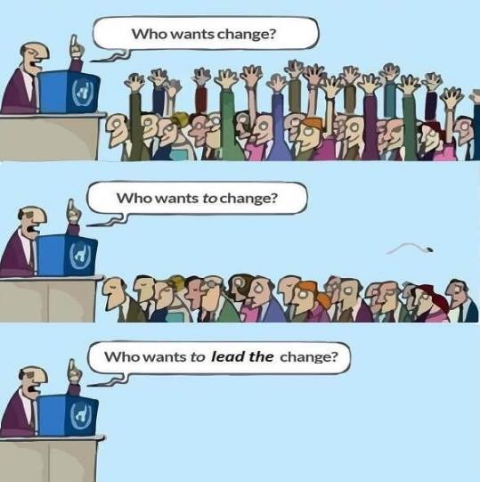
Professional Development

Slide 19
Meaningful Professional Development
Establish short and long term objectives
How are these objectives related to the college’s strategic plan?
Identify the leaders and/or experts on campus when it comes to diversity, inclusion, accessibility, and disability services
Consider various modes of delivery
  College-wide in-person trainings
  Division and/or department presentations
  Online workshops
  Conferences

Slide 20
Summary
Under the social model of disability, disability is a diversity issue, not something that needs to be “fixed”
Applying universal design can benefit all college students, whether they have a documented disability or not
Accessibility is everyone’s responsibility
Consider professional development opportunities as ways to educate the campus community about disability and diversity – get “buy in”
Thank you for taking time to explore this important topic!

