Slide 1
Understanding Collegiate Varsity eSports: Team Culture and Biopsychosocial Health
Barat Wolfe, PhD

Slide 2
Acknowledgments
Research Collaborators:
Janet Parcell-Mitchell, DPT
Chris Sweeney, PhD
2018-2019 eSports Coordinators:
Charles Murray III
Rob Snow
Funding:
Innovative Instruction Technology Grant (IITG)

Slide 3
Three Takeaways
Collegiate eSports offer an opportunity to address student interests and investment in campus
eSports competitors may be at risk for several negative mental health outcomes, potentially exacerbated by risky gaming behavior
Equipment, space, and coach are a minimum investment. Additional supports and training are necessary

Slide 4
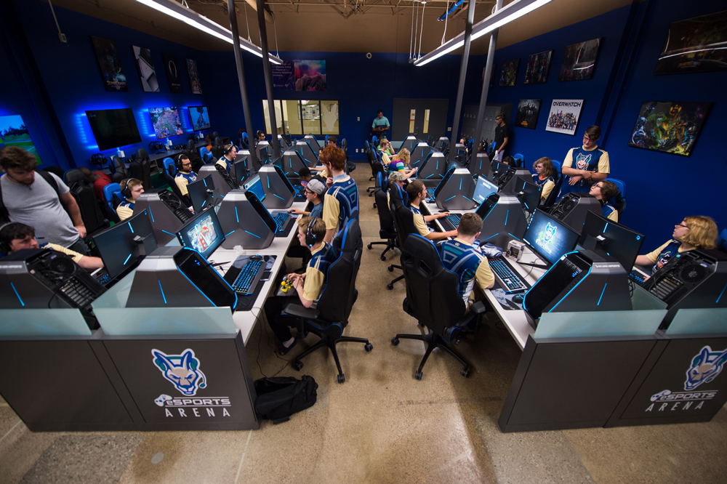
SUNY Canton Varsity eSports

Slide 5
Quick Facts 2018-2019
50 varsity players
Four coaches; one Coordinator
Six eSports
First SUNY collegiate eSports arena
First SUNY school to join National Association for Collegiate eSports (NACE)

Slide 6
What are eSports?
Competitive online gaming
Problem solving, strategy
War
Traditional sports
Role play, fantasy
SOCIAL
Compared to traditional sports:
Play, competition
Skill
Institutionalization
Physicality
Broad following
Worldwide audience 435 million people by end of 2019

Slide 7
What are Collegiate Varsity eSports?
Intercollegiate competition, overseen by NACE (150 teams)
Increased diversity and mixed-gender competition
Often, housed in Athletic Departments
Scholarships granted at some campuses
College players: On average, 3-4 hours/day (up to 10)

Slide 8
WHY eSports?
Rapid growth
New learning environment, emerging student population
Opportunity: Recruitment and retention
eSports = Path to institutional commitment
Social integration and connectedness
Campus involvement and engagement
Satisfaction, persistence, retention

Slide 9
Known Correlates and Outcomes
Health Compromising
Exhaustion/burnout
Stimulant use
ADHD
Addiction, dopamine activation
Anxiety, depression
Tetris effect
Eye fatigue, back and neck pain, wrist and hand issues
Sleep disturbance
Health Promoting
Cardiovascular conditions similar to mild/moderate exercise
Self-esteem
Conflict resolution
Cognitive skills
Information management
Communication skills
Spatial abilities

Slide 10
Known Correlates and Outcomes
Health Compromising
Exhaustion/burnout
Stimulant use
ADHD
Addiction, dopamine activation
Anxiety, depression
Tetris effect
Eye fatigue, back and neck pain, wrist and hand issues
Sleep disturbance
Health Promoting
Cardiovascular conditions similar to mild/moderate exercise
Self-esteem
Conflict resolution
Cognitive skills
Information management
Communication skills
Spatial abilities

Slide 11
Gaming Disorder
ICD-11 (WHO); DSM-V (APA) as condition for further study
Pathology: Significant impairment, 12 months; uncontrollable
Generally, five of nine symptoms:
Gaming preoccupation; withdrawal; tolerance; loss of interest in other activities;
minimizing use; loss of relationship, educational, or career opportunities; gaming to escape or relieve anxiety, guilt or other negative mood
states; failure to control; and continued gaming despite psychosocial
Problems
Gaming preoccupation
Withdrawal
Tolerance
Loss of interest in other activities
Minimizing use
Failure to control
Loss of relationship, educational, or career opportunities
Gaming to escape or relieve anxiety, guilt or other negative mood states
Continued gaming despite psychosocial problems

Slide 12
Our Research Questions
What is the biopsychosocial profile of our eSports competitors?
How do students understand culture of varsity eSports competition and what meaning do they derive from their experiences?
How can we contribute to best practices for recruitment, retention, and promotion of health and academic needs of our eSports competitors?

Slide 13
Full Project Methodology: 3 Parts
Part one: psychosocial measures
Part two: biophysical data
Part three: focus groups and interviews
Heart rate
Blood pressure
Grip strength
Abdominal core strength
Deep neck flexor muscular endurance
Visual tracking, fatigue
Sleep, recovery

Slide 14
Today’s Presentation
Preliminary psychosocial data
Implications and recommendations

Slide 15
Method: Participants
28 varsity eSports competitors:
Age: 19.3 years (range: 18-23)
Self report GPA: 3.2185 (range: 2.0-4.0)
26 males, 2 females
67.9% White
5 of 6 eSports represented

Slide 16
Method: Materials
Social Connectedness:
20-item Social Connectedness Scale – Revised (Lee et al., 2001)
State Anxiety:
6-item State Trait Anxiety Inventory (Marteau & Bekker, 1992)
Stress:
11-item College Students Stress Scale (Feldt, 2008)

Slide 17
Method: Materials
Depression:
Center for Epidemiological Studies Depression Scale (Radloff, 1977)
Health-Related Quality of Life:
SF-12 (Ware et al., 1995)
Disordered Gaming:
Internet Gaming Disorder Scale (Pontes et al., 2015)

Slide 18
Method: Procedure
Electronic survey
$10 gift card incentive
Option for additional research

Slide 19
Results

Slide 20
Social Connectedness
Higher scores = higher connectedness (scores 20-120; Lee et al., 2001)
M = 87.7 (SD = 17.45)
Just below Lee study average of 88.02
Average of 3.5 = tendency to feel socially connected (Lee et al. 2001)
24/28 (86%) meet threshold

Slide 21
State Anxiety
Higher scores = higher anxiety (scores 20-80)
M = 37.7 (SD = 12.37)
For college students, score over 36 = 90th percentile (Spielberger, 1983)
14/28 (50%) in 90th percentile
Cut point 39-40 to detect clinically significant symptoms (Julian, 2014)
10/28 (36%) meet threshold

Slide 22
Stress
Higher score = higher stress (scores 11-55)
M = 28.79 (SD = 10.55)
Lower than Feldt’s sample mean (29.3)
Items with highest average scores: financial and academic concerns

Slide 23
Depression
Higher scores = higher depression (scores 0 – 60; Radloff, 1977; Eaton et al., 2004)
M = 14.72 SD = 10.23
Standard threshold for risk of depression: 16
Met by 11/28 (39%)
Suggested cutoffs to eliminate false positives = 21 (Henry et al., 2018)
Met by 10/28 (36%)

Slide 24
Health-Related Quality of Life
Physical (PCS) and mental (MCS) scores, normed (Ware et al., 1995)
PCS mean in US, age 18-34 = 53.33
PCS: M = 56.66 (SD = 4.9)
16/28 (57%) below 50th percentile
MCS mean in US, age 18-34 = 49.18
MCS: M = 46.30 (SD = 10.45)
18/28 (64%) below 50th percentile

Slide 25
Internet Gaming Disorder
Pontes et al. (2015) suggest 5/9 symptoms; Lemmens et al. (2015) suggest 6/9
M = 2.9 (SD = 2.11)
APA: 0.3-1% general population qualify for diagnosis
6/28 (21%) meet Pontes’ diagnostic threshold of 5
Using Lemmens’ criteria:
43% normal; 46% at risk; 11% disordered

Slide 26
Sig. Correlations with Disordered Gaming
Anxiety (r = .429, p < 0.05)
Explains almost 18% of variance
Stress (r = .469, p < 0.01)
Explains 22% of variance
Depression (r = .435, p < 0.05)
Explains 19% of variance
Self-reported physical health (r = -.501, p < 0.01)
Explains 25% of variance

Slide 27
Discussion

Slide 28
Psychosocial Profile: Varsity eSports
As compared to US general population of their age:
Average social connectedness (skewed positive)
Slightly below average stress
Above average self-reported physical health
GPA above average SUNY Canton student

Slide 29
Psychosocial Profile: Varsity eSports
As compared to US general population of their age:
Above average anxiety
At risk for depressive symptoms
Below average mental health
More likely to indicate IGD than general population
Higher gaming disorder score: higher anxiety, stress, depression scores; lower self-reported physical health

Slide 30
A Word on the IGD Scale…
“Escape” criterion: almost all gamers (Ko et al., 2014)
As Griffiths (2017) notes, college/professional eSports competitors:
Behaviorally similar to addicts
Motivationally different
Over-diagnosis possible, must continue to study (Petry et al 2014)
Scale alone not enough for diagnosis

Slide 31
Implications
Can identify students at risk for poorer (bio)psychosocial health
Limitation – self-report (e.g., SF-12 scores)
Need biophysical data
Reconsider stereotypes of gamers as socially withdrawn, isolated, destigmatize gaming
Need qualitative data

Slide 32
Implications
Findings suggest integration of health professionals
Corroborates DiFrancisco-Donoghue et al. (2019)
Possible examples:
Mental health first aid training (coaches/support staff)
Relationship-building with on-campus mental health practitioners
Regular evaluation by trusted faculty/staff

Slide 33
Implications
Consider physical activity requirement/exercise prescription
Example: UC Irvine
50% of collegiate eSports competitors get 0-1 hour of exercise a week (DiFrancisco-Donoghue & Balentine, 2018)
Should be meaningful/preventive/health promoting

Slide 34
What Did We Learn?
Varsity eSports competitors defy stereotypes but may also be at risk
24% DI athletes = clinically relevant depression scores (Wolanin et al., 2016)
Have legitimized eSports funding, spaces, coaches, benefitted from their existence
MUST de-stigmatize student experience and invest in/legitimize supports for their health

Slide 35
Three Takeaways
Collegiate eSports offer an opportunity to address student interests and investment in campus
eSports competitors may be at risk for several negative mental health outcomes, potentially exacerbated by risky gaming behavior
Equipment, space, and coach are a minimum investment. Additional supports and training are necessary

Slide 36
Comments or Questions? Barat Wolfe wolfeb@canton.edu

