Slide 1
Creating a Campus Program to Recognize Faculty’s Professional Development
Kjersti VanSlyke-Briggs
Michelle Rogers-Estable
Jenna Turner
Chilton Reynolds

Slide 2
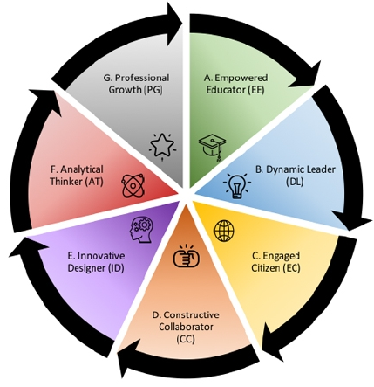
Professional Recognition of Excellence (PROE)
Recognizing and responding to needs assessment
Building partnerships and process
Creating relevance
https://suny.oneonta.edu/faculty-center/proe

Slide 3
PROE - Explorer

Slide 4
PROE - Explorer
During the 2018-2019 school year there were 183 unique participants in trainings aligned with PROE

Slide 5
PROE - Explorer
331 Requirements Fulfilled

Slide 6
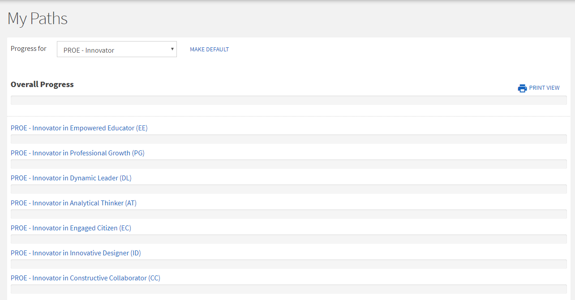
PROE - Innovator

Slide 7
Challenges & Future Goals
Kjersti VanSlyke-Briggs – Kjersti.VanSlyke-Briggs@oneonta.edu
Michelle Rogers-Estable – Michelle.Rogers-Estable@oneonta.edu
Jenna Turner – Jenna.Turner@oneonta.edu
Chilton Reynolds – Chilton.Reynolds@oneonta.edu
https://suny.oneonta.edu/faculty-center/proe

