Slide 1
Inspiring the Tentative: Recruiting and Supporting Faculty to Advise Health Pathways Students
Becky Babcock
Amanda Rampe
October 29, 2019

Slide 2
Session Agenda: How to start a successful health advising program
Assessing the need
Recruiting
Training
Supporting faculty advisors
Advisor assignments
Lessons Learned
Notes:
Becky

Slide 3
Assessing the Need
Notes:
Amanda
Numbers of nursing students program vs. pathway
Number of nursing faculty (would be 85-90 per advisor, assuming they’re all comfortable with even advising)
Graph showing % of students with advisor over the past few years
Tracking students by pathway lets us know who they are
Gap highlighted
Training fragmented
“the amount of knowledge required seems intimidating”

Slide 5
Assessing the Need
Notes:
Amanda
Numbers of nursing students program vs. pathway
Number of nursing faculty
Graph showing % of students with advisor over the past few years
Tracking students by pathway lets us know who they are
Gap highlighted
Training fragmented
“the amount of knowledge required seems intimidating”

Slide 6
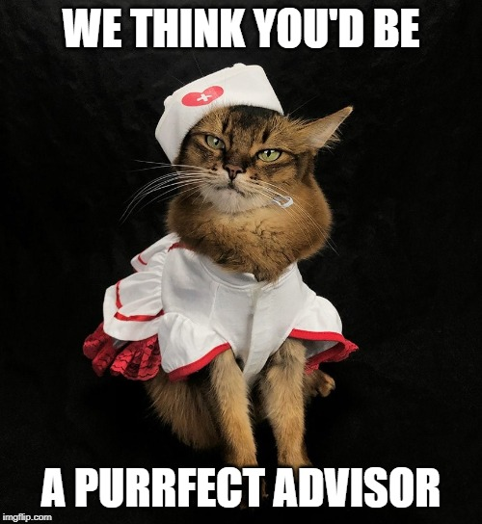
Recruiting Faculty
Application to participate in training
Volunteers
Encouraged by deans
Integrated advising model
Faculty in low population programs given selection of areas to advise in
Not quite enough advisors yet for student numbers
Notes:
Becky: Applied for and received grant funding for training
Volunteers, application, encouraged by deans
Amanda: integrated advising model

Slide 7
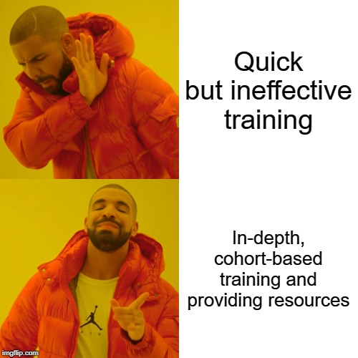
Training Faculty to Advise
Cohort-based
Comprehensive
Holistic advising
Videos
Variety of topics and people
Role-play scenarios
Notes:
Becky: Cohort
Comprehensive training
Hands-on, role-play scenarios
Appreciative advising
Met in fall as a group
Prep before training with videos (also review after)
The Institute was designed as an innovation and integrated approach to teaching and applying skills used in advising. Previously available trainings happened in small increments on focused topics. This full day training allowed for the integration of all the essential and supporting pieces needed to foster a positive and informed advisement session. Allowing participants to see all of the different areas and how to integrate and implement them left them feeling more confident to advise students. Much as we want students to experience holistic advising, we wanted the participants to experience holistic training.
Amanda: small groups, trainings offered multiple times in small window of time to maintain continuity

Slide 8
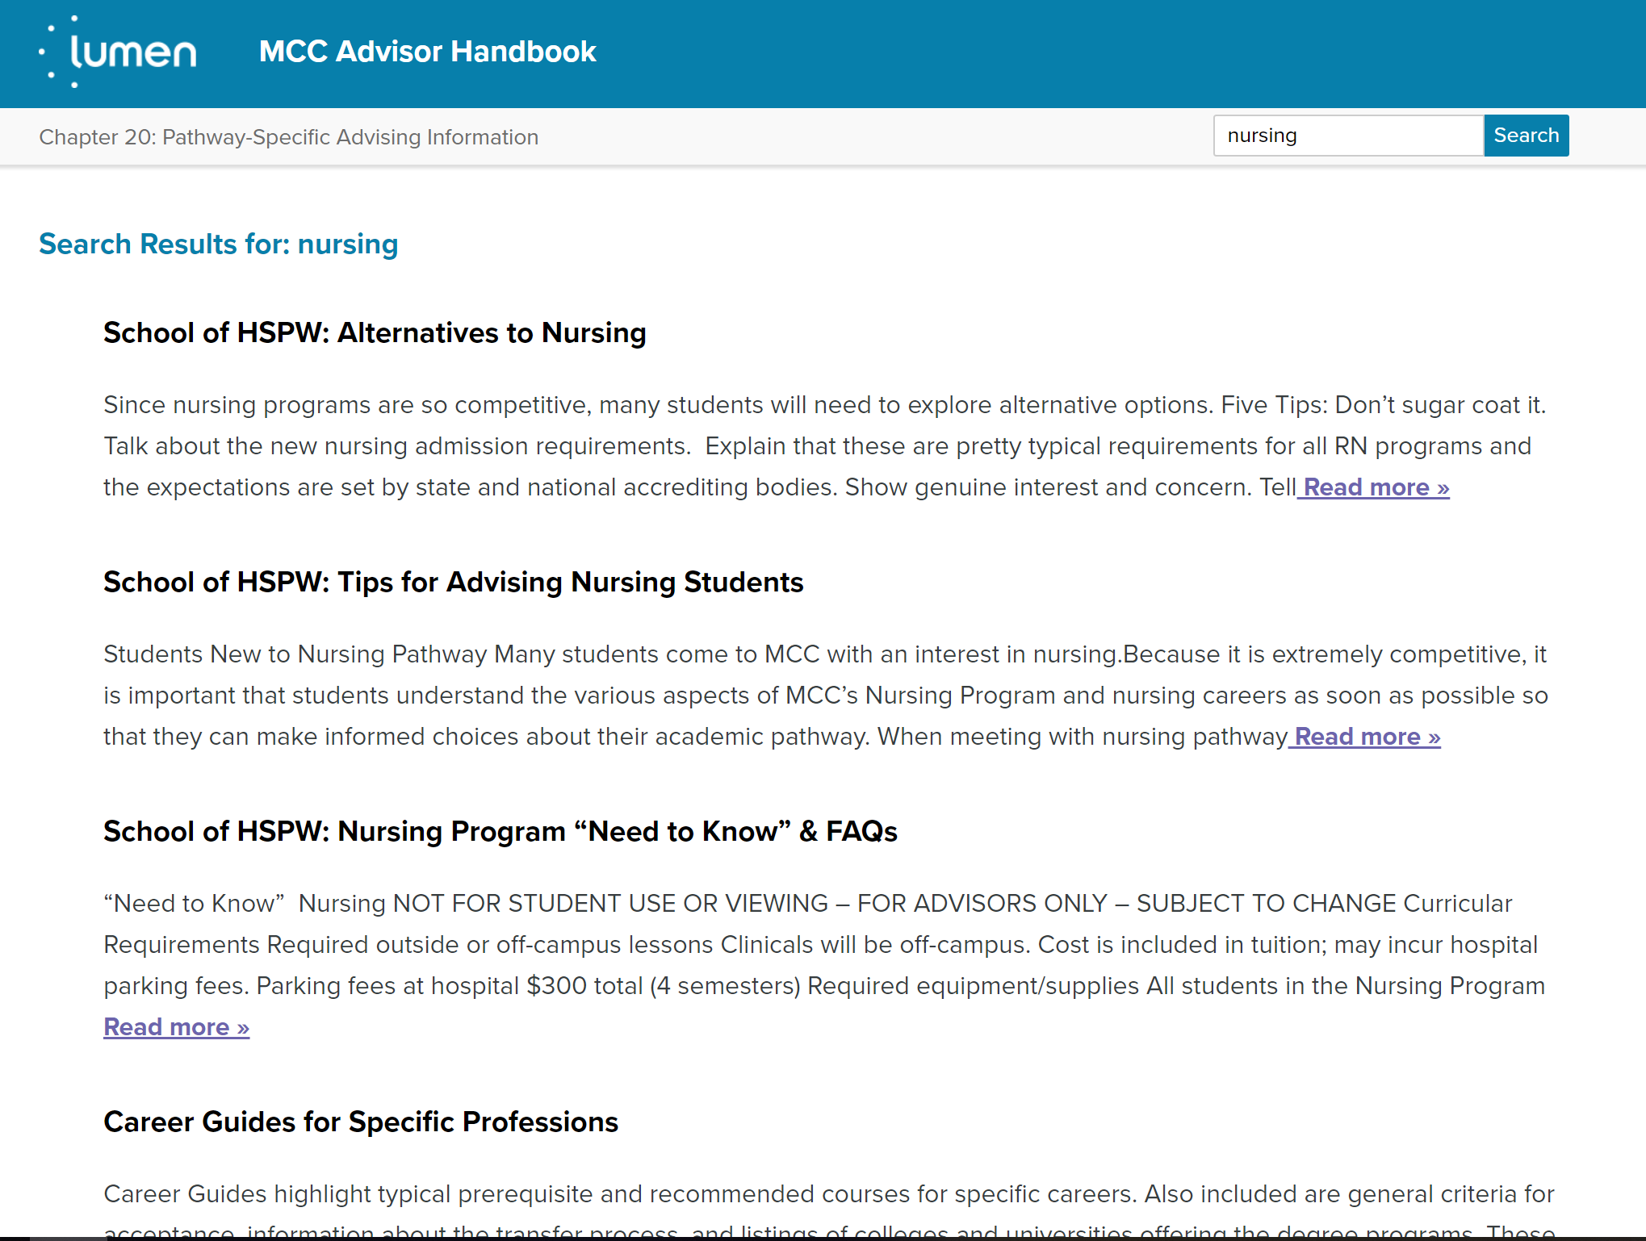
Supporting Faculty Advisors: Resources
Notes:
Amanda: Online handbook, Advisor dashboard, DW; Advising forums (having difficult conversations, updates to curriculum and admissions)
Becky: Website- points sheets; Sessions for faculty and students – will be recording; Health course;
Like printed resources still; Email updates, health points calculator

Slide 9
Quote from a faculty advisor
“I try to help the student fully understand that my role for them goes beyond helping them register for courses. I seek to be the first go-to person during their journey here at MCC.”

Slide 10
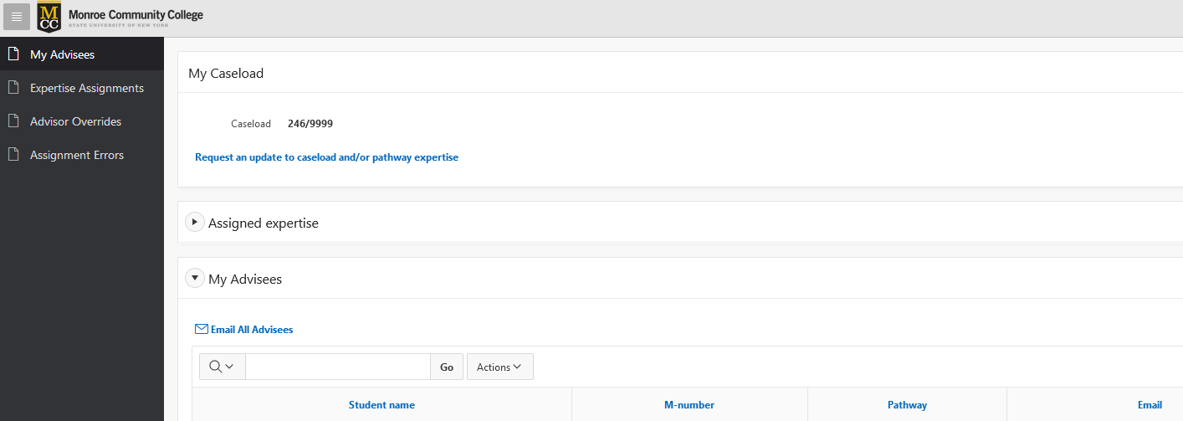
Advisor Assignments
Manual input and tracking
College-wide automatic advisor assignments
Automatic clean-up and assignment
Notes:
Manual to automated – matching to students in classes and locations;
Connect students and faculty that are already connected through classes
Need to automate to scale
Manual → upload excel → automatic
Input and send excel file of advisees to advisors

Slide 11
Notes:
Amanda

Slide 12
Lessons Learned
Assess faculty advisor needs and scaffold training appropriately
Build and maintain relationships
Everything is knowable!
Resources and support are essential
Notes:
Relationship building
Meeting where people are at-address gaps
On-going training and support
Assess individual needs
Building why this is valuable more

Slide 13
Questions?

Slide 14
Thank you!
Becky Babcock
rbabcock@monroecc.edu
Amanda Rampe
arampe1@monroecc.edu

