Slide 1
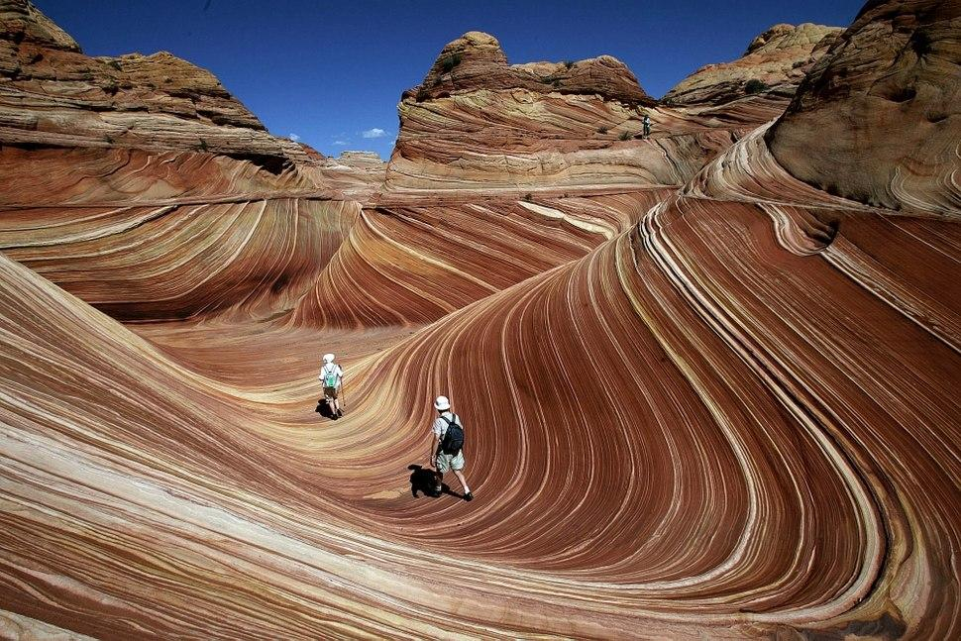
Working with Students on an Open Textbook Project in a STEM Discipline
Keith Landa, Purchase College SUNY

Slide 2
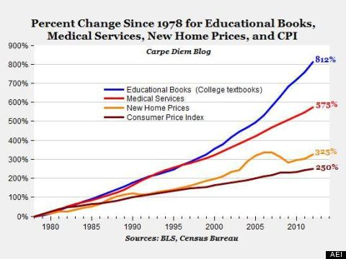
Student welfare & success
Faculty concerns about textbooks
Flexibility
Control over the curriculum
Open Pedagogy
Student vs. Administration vs. Faculty perspectives
http://www.open-nys.org/adopt/

Slide 3
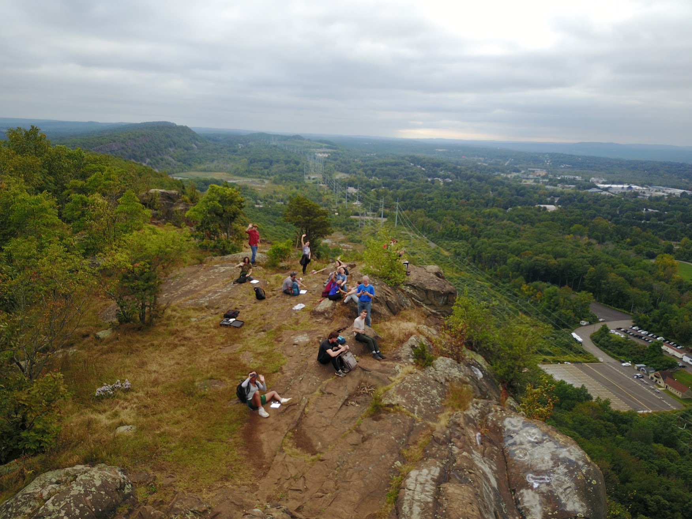
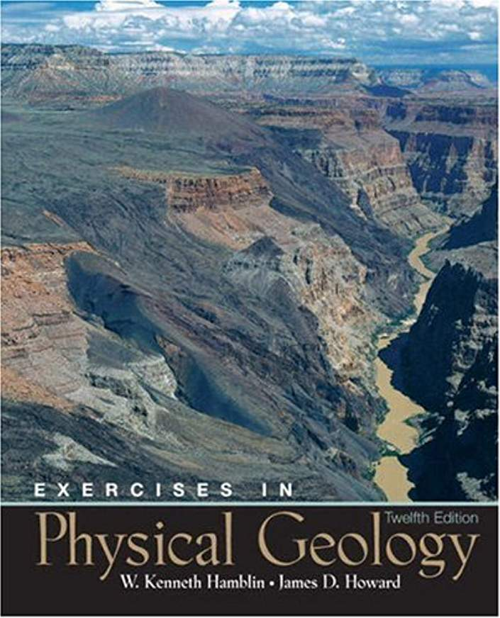
ENV 2720 Geology
“Sophomore-level”
ENV majors
Lecture / lab course
Field component
Fall 2016
Required texts
OER option? Course redesign issues

Slide 4
Open Text options
CNX
https://oasis.geneseo.edu/ - OASIS tool at SUNY Geneseo

Slide 5
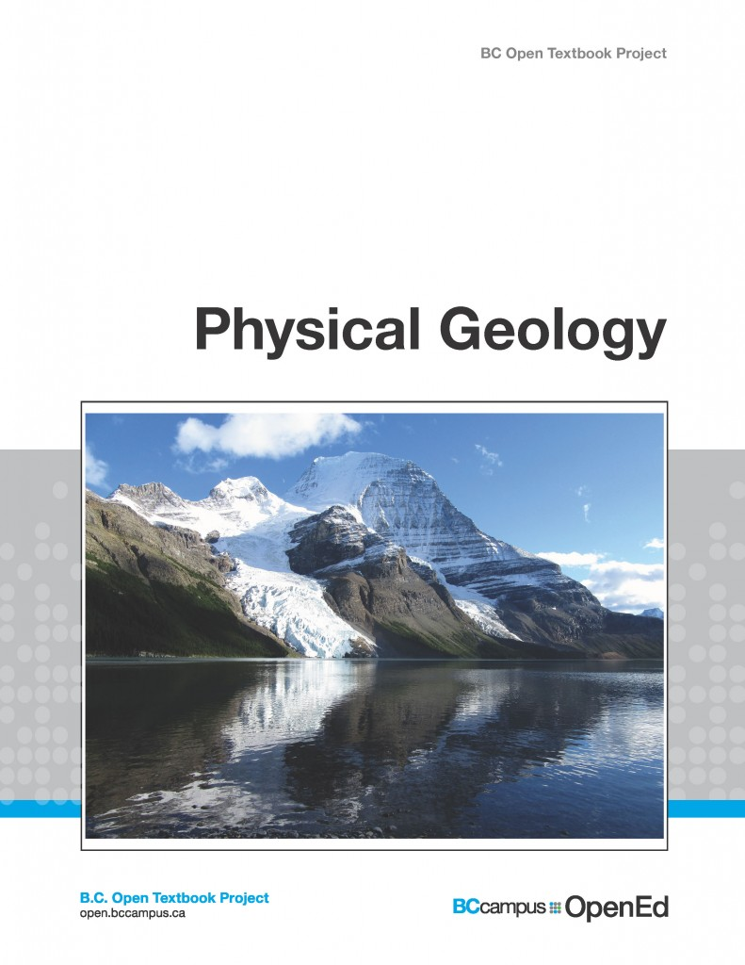
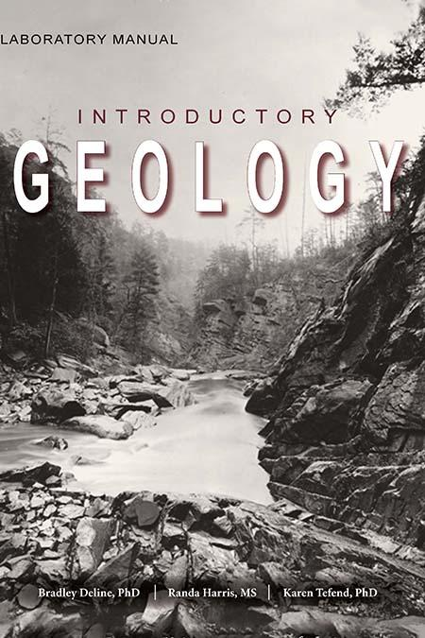
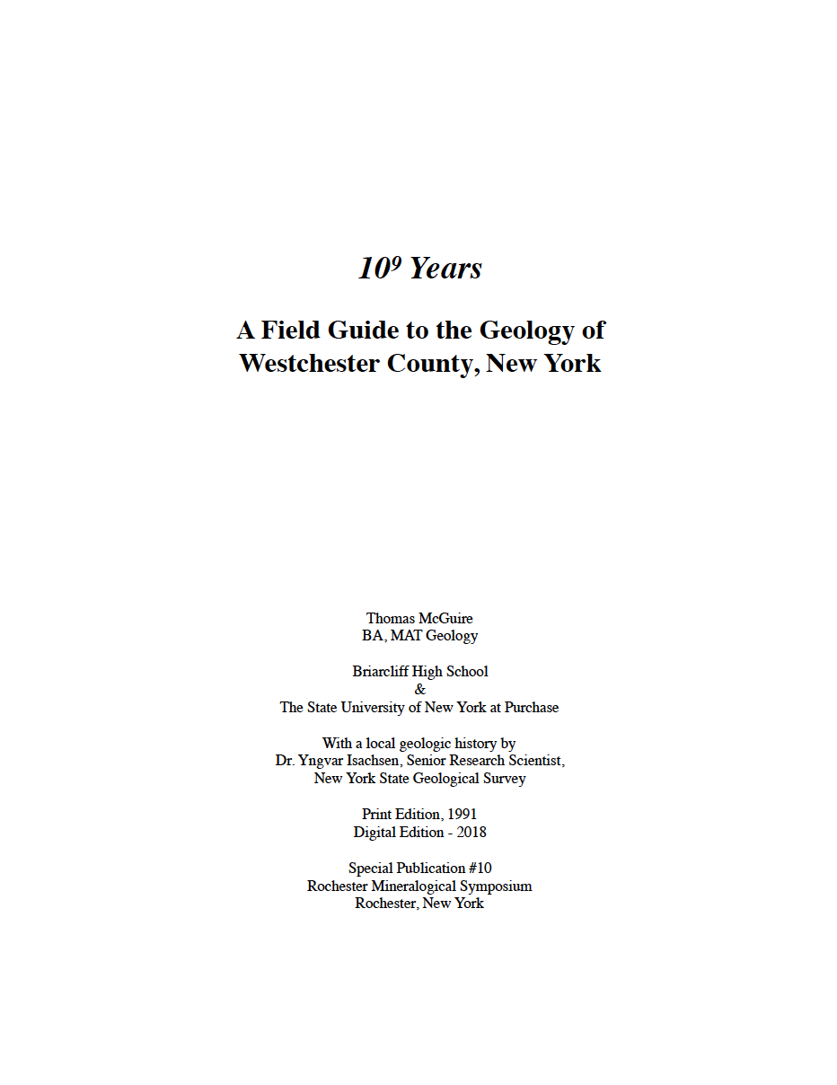
Fall 2016 - Adopt
Student perspectives
Faculty perspective

Slide 6
Renewable assignments
 | Student creates artifact | Artifact valuable beyond class | Artifact made public | Artifact openly licensed
Disposable | X
Authentic | X | X
Constructionist | X | X | X
Renewable | X | X | X | X
WIley and Hilton, 2018, Defining OER-Enabled Pedagogy

Slide 7
Not a good model for my Geology course though

Slide 8
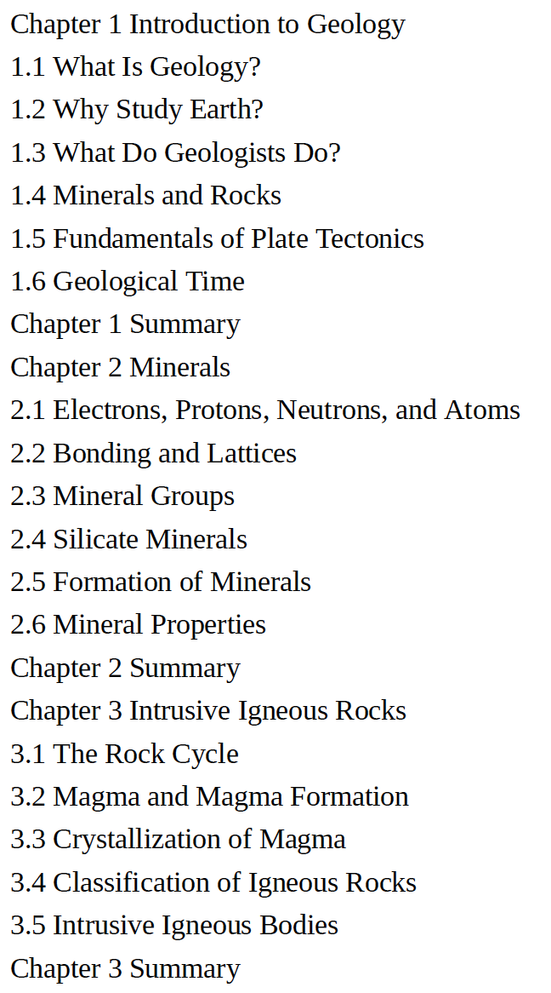
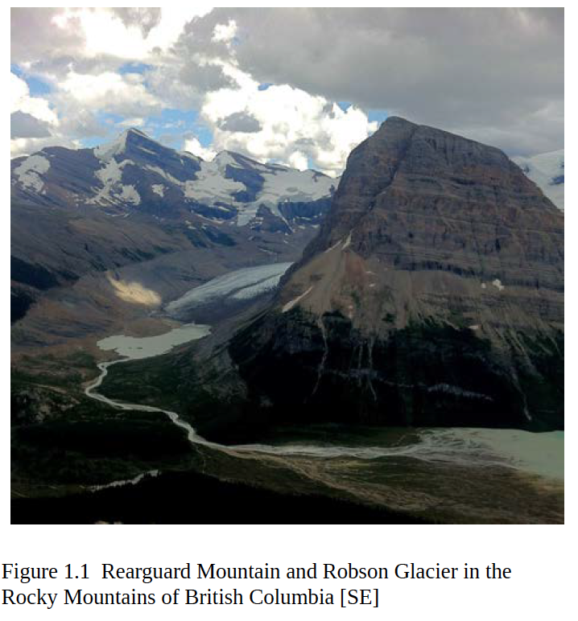
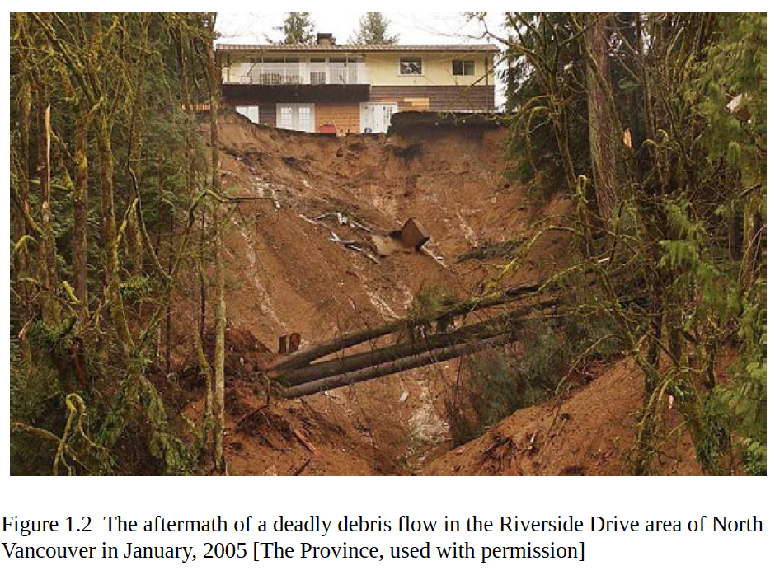
BC Physical Geology as principal text

Slide 9
Fall 2017 & Fall 2018 - Adapt / Build
Students select topics
Content curation
Review available content
Remix in new chapter
Lecture/Lab/Field materials
Edit for readability
Content creation
Local / regional examples
Multimedia resources
Purchase
College
ENV 2720
Geology

Slide 10
Fall 2017 - disappointing results
Reuse/remix: foreign concepts for academic assignments
Effects of plagiarism training
Impact of assignment format
Word doc write-ups
Assignment submission to Moodle
Difficult to break out of past assignment behavior

Slide 11
Fall 2018 - better, but still a ways to go
Use of Moodle Wiki activity
‘Individual wiki pages’ option
Helped to move students out of their usual practice
More explicit discussion of Creative Commons licensing and OER “5 R’s”
Collaborative development of expectations (“rubric”)

Slide 12
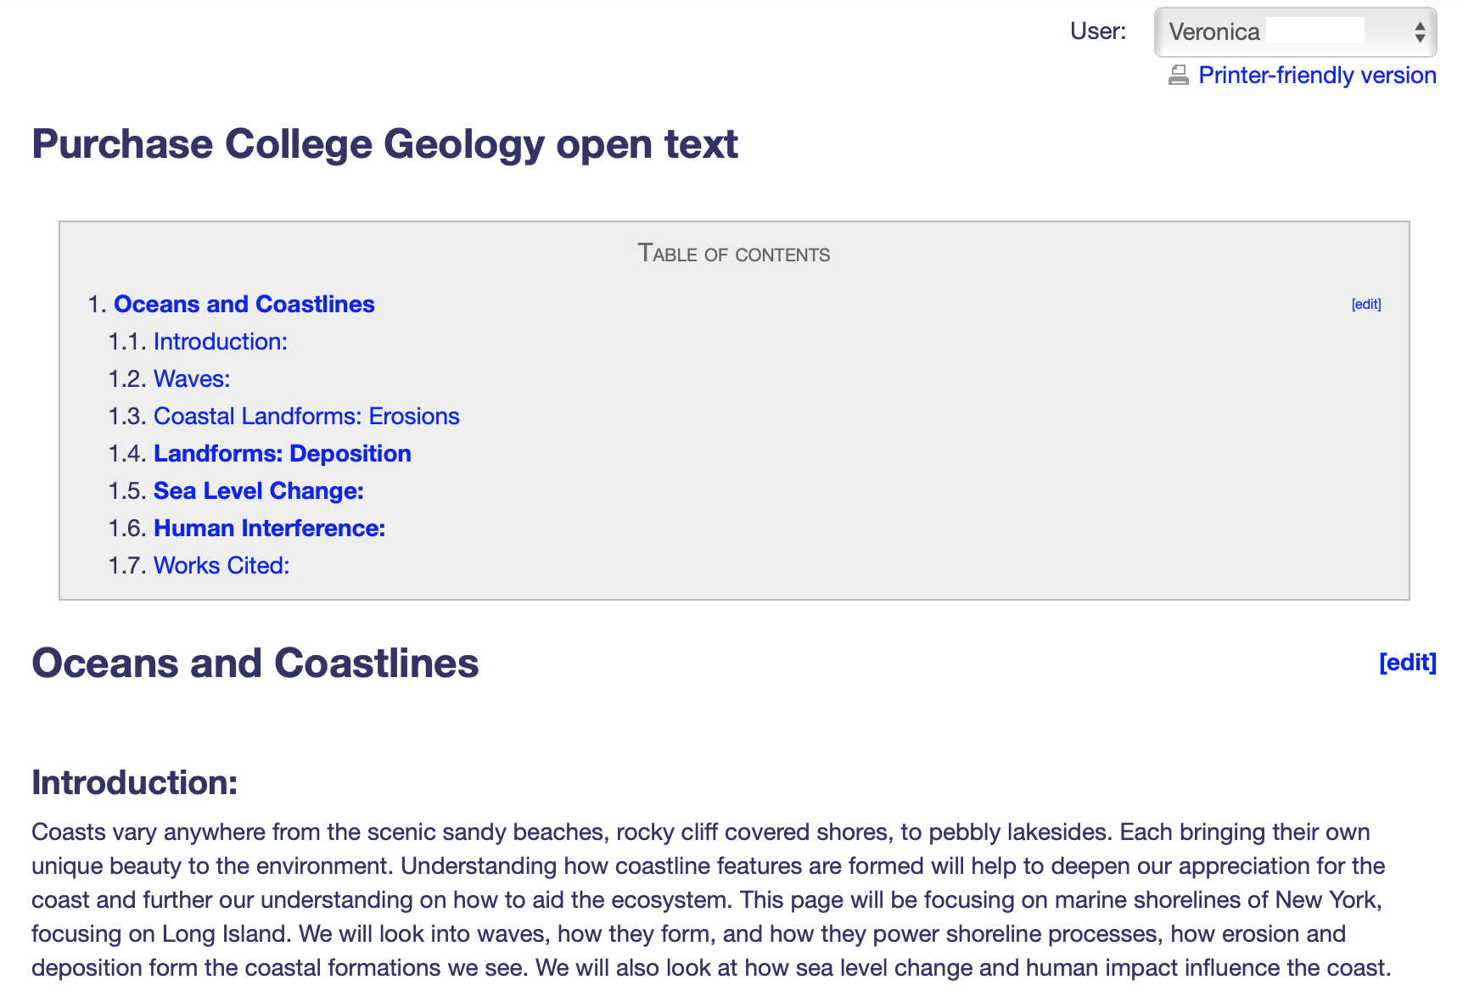

Slide 13
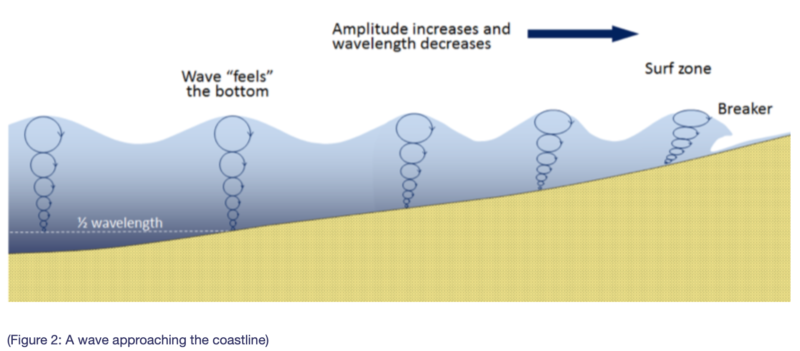
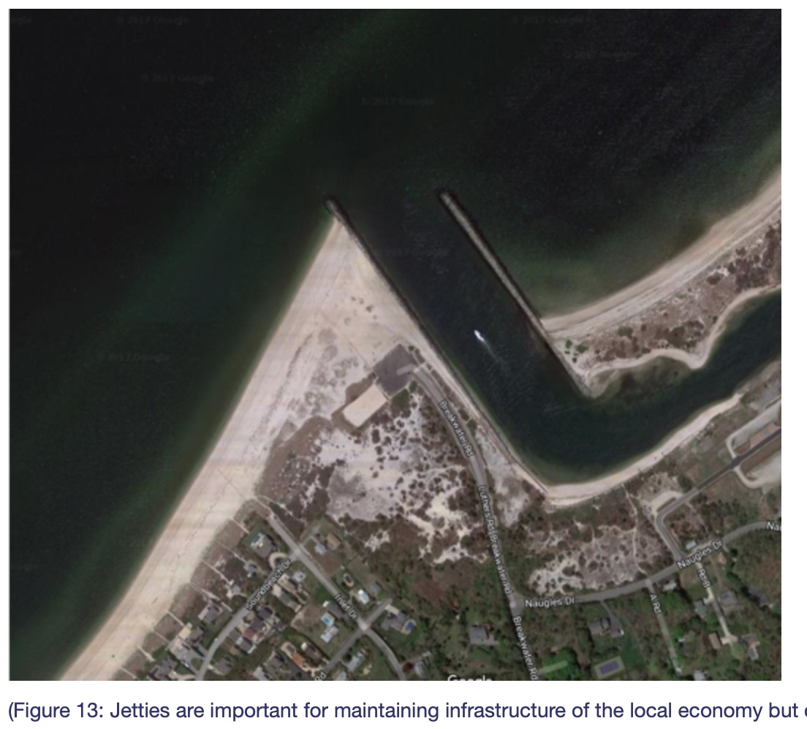
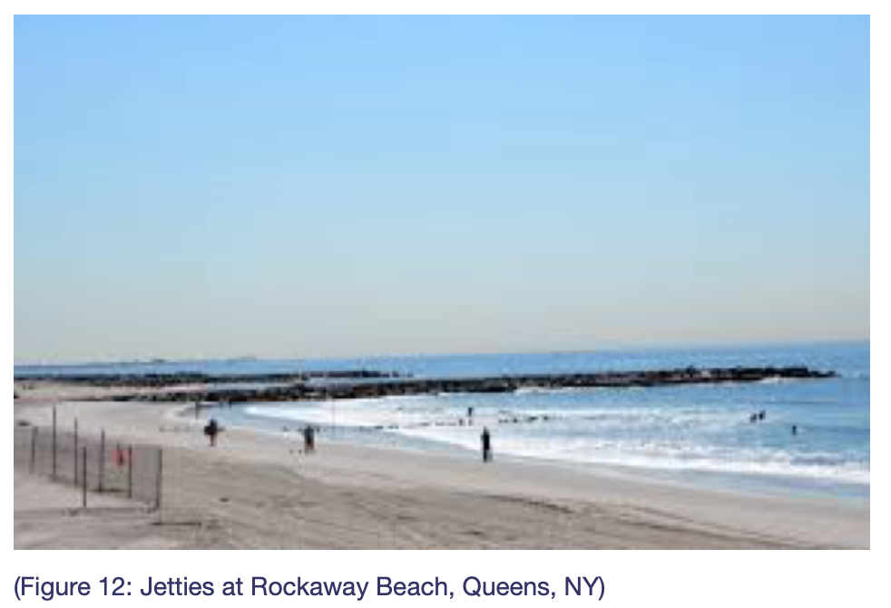

Slide 14
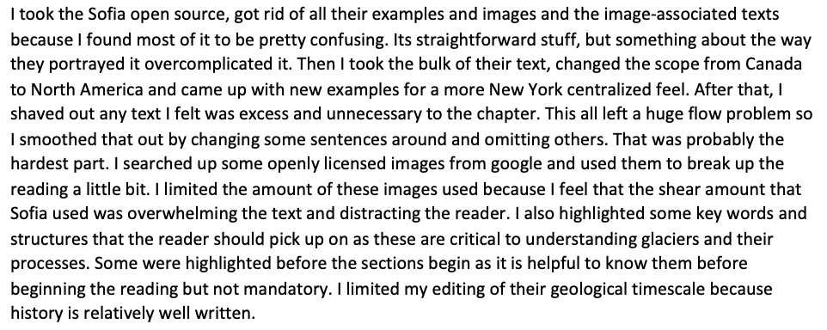
Student reflections
Workflow example

Slide 15
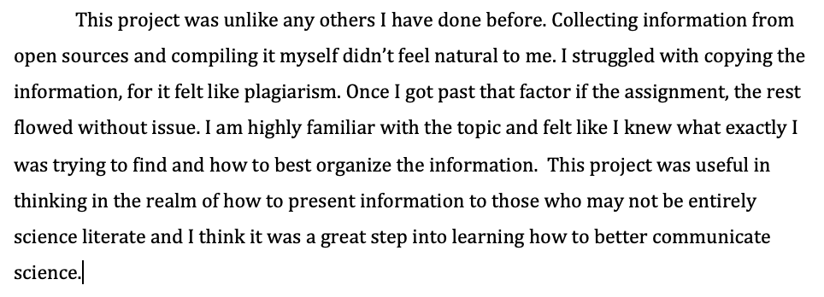
“Plagiarism” issues
Science communication focus more apparent

Slide 16
Personal experience

Slide 17
Open Text project tied to other work in the course

Slide 18
Still misconceptions about reusing and remixing
Perceived higher stakes than the typical term paper assignment (ie, disposable assignments)

Slide 19
Future plans
No more student chapter rewrites
Pressbooks edition - my summer project
Student focus on more discrete content creation
Short, explanatory videos to embed
Regional topics (ie, textbook “Text box” materials)
Question banks
Involving students in developing ideas for renewable assignments for the class

Slide 20
Keith Landa - keith.landa@purchase.edu

