Slide 1
http://suny.edu/emtech
Roberta (Robin) Sullivan
Emerging Technologies Librarian
Head of Media Services
University at Buffalo Libraries
rrs@buffalo.edu
Cherie van Putten
Instructional Designer
Binghamton University cvanp@binghamton.edu

Slide 2
Slides available at:
http://bit.ly/emtech-cit19

Slide 3
#EmTechMOOC
Discovery learning to explore and reflect on innovative and creative uses of emerging technologies.

Slide 4
#EmTechMOOC
Discovery learning to explore and reflect on innovative and creative uses of emerging technologies.

Slide 5
Learning Opportunity targeted to...
ALL Learners
Students, faculty, staff, & anyone with an interest to stay current with today’s rapidly changing technologies

Slide 6
“Four Cs of 21st Century Skills”
Communication
Collaboration
Creativity &
Critical thinking

Slide 7
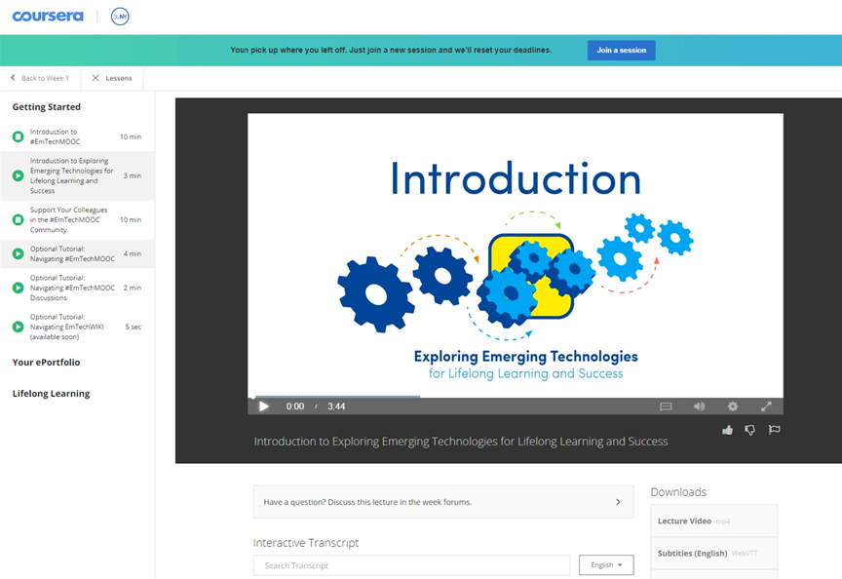
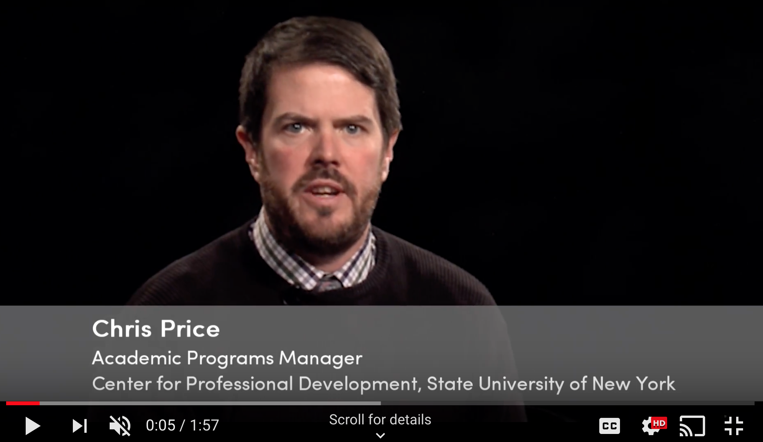
#EmTechMOOC
Place your screenshot here
Coursera-based MOOC supportive online learning opportunity

Slide 8
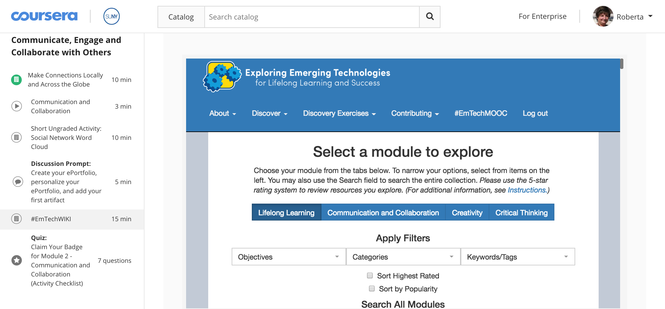

Slide 9
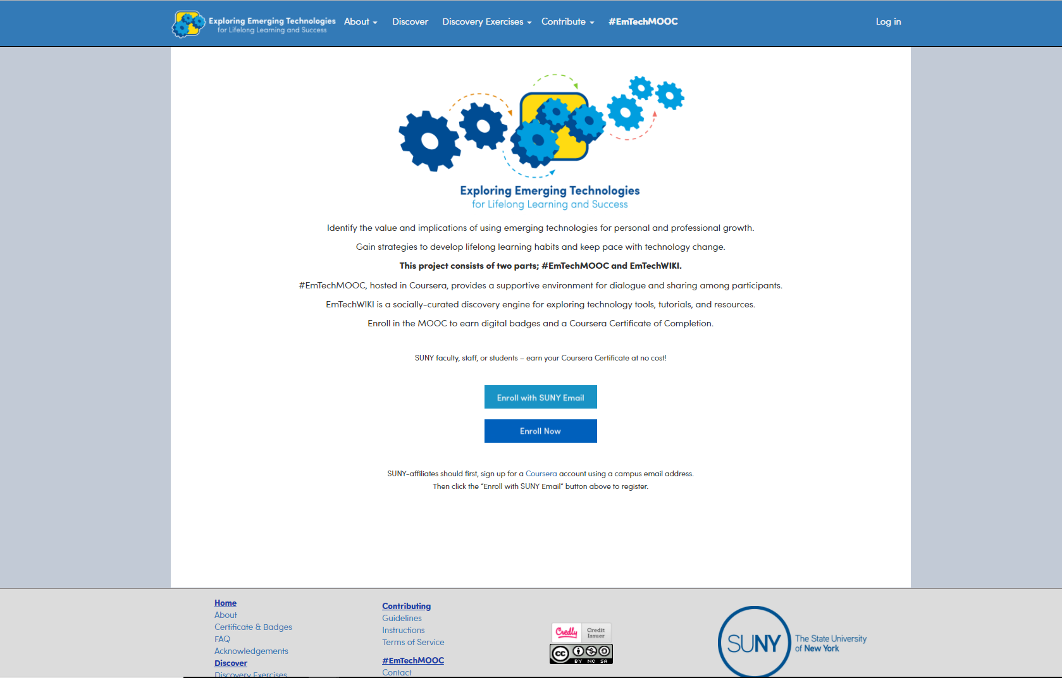
EmTechWIKI
Place your screenshot here
WIKI filled with many socially curated tools and resources
Also used in #EmTechMOOC to complete assignments
An open website available as a standalone resource
Notes:
Went to 150 to 315. 150 have been added by participants.

Slide 10
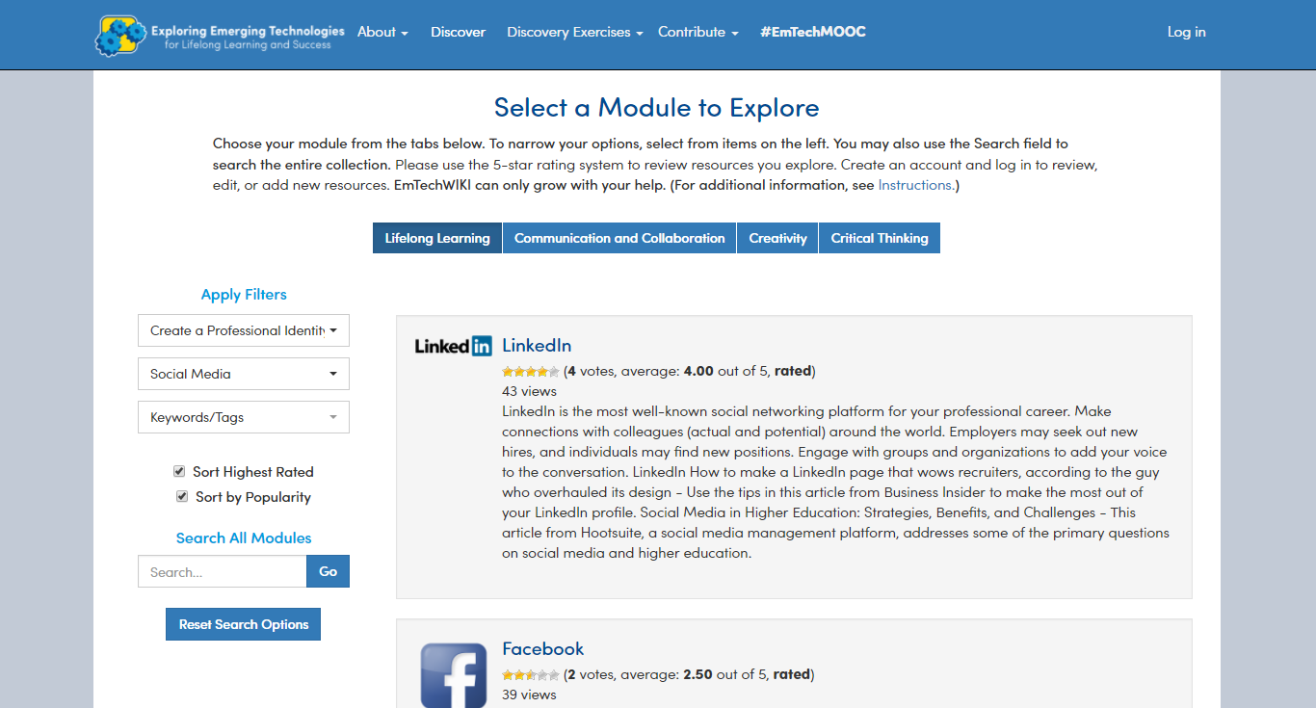
Want big impact?
Use big image.

Slide 11
Want big impact?
Use big image.

Slide 12
Learning process...
1. Read, view & participate with course materials
2. Explore
WIKI tools & resources
3. Complete
discovery
exercises & reflect in ePortfolio
4. Earn
badges & Coursera Certificate

Slide 13
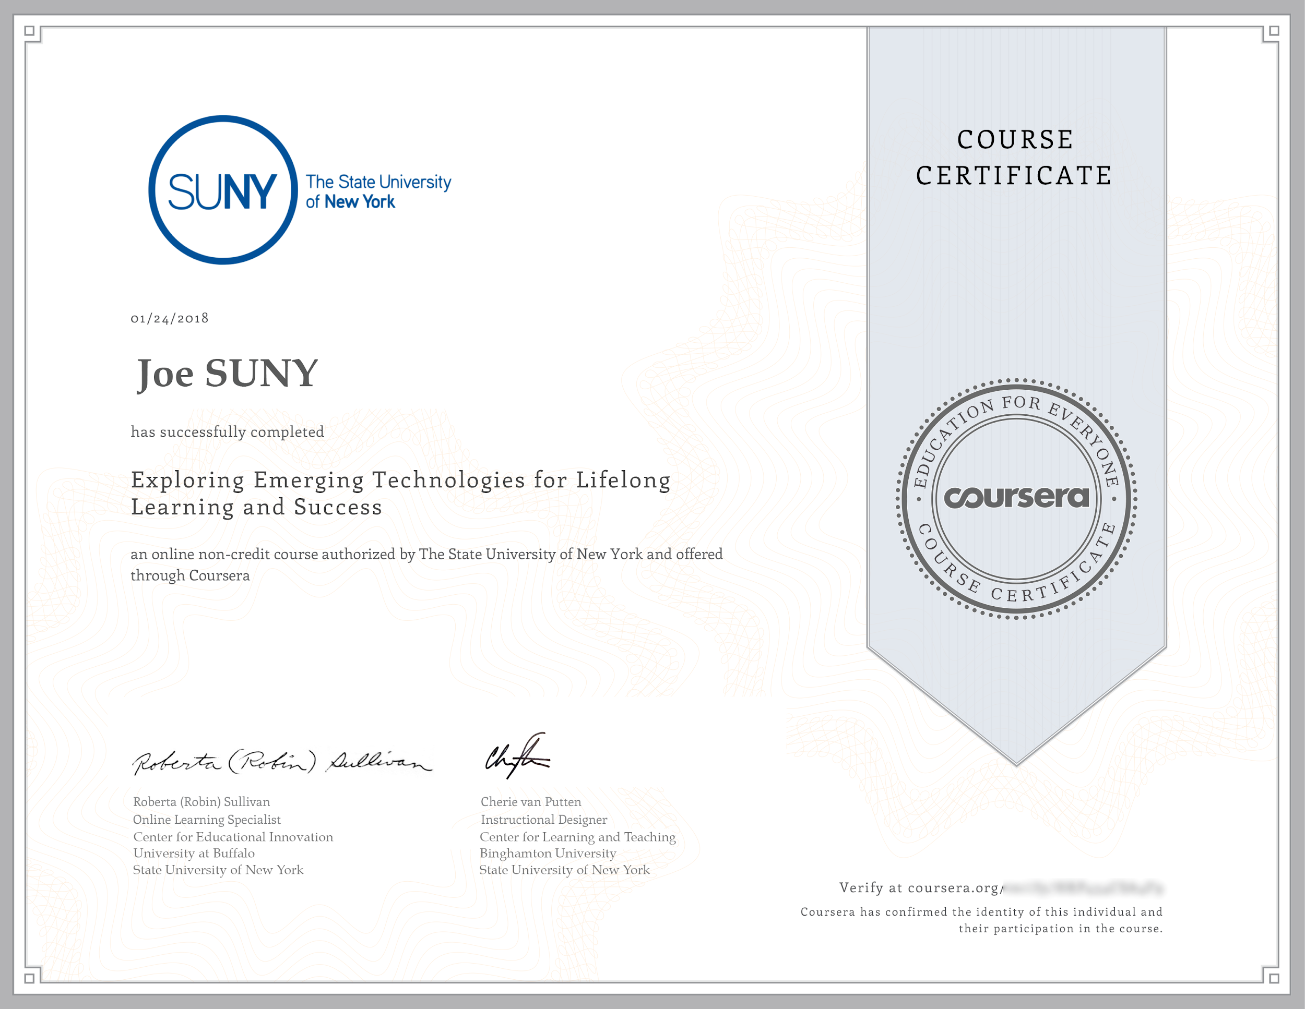
Learner Rewards
A Personal ePortfolio
Digital badges
Coursera Certificate of Completion
Intrinsic rewards of being a lifelong learner!

Slide 14
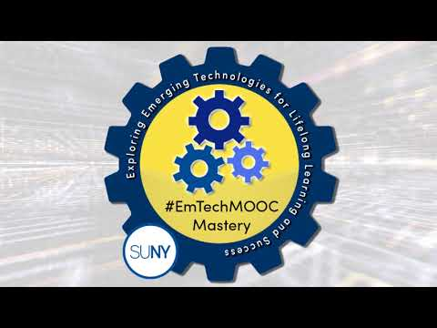
Share info with your campus about EmTech
Use this announcement to share with via email & social networks
Flyers
Small takeaways
Business cards
(1 min. video trailer)
http://bit.ly/emtech-trailer

Slide 15
Mapping #EmTechMOOC’s Global Reach
Non-scientific mapping of enrollments as of 5/18/19
3,697
Learners

Slide 16
Explore & Reflect
Go to http://suny.edu/emtech
Explore one or more of the “Discovery Exercises”

Slide 17
Students, faculty, & staff - learning together.
What a concept!

Slide 18
Thank you!
Questions???
#EmTechMOOC
EMtechMOOC@gmail.com

