Slide 1
Accessible Content Creation and Alternative Assessment for STEM Courses
Ed Beck & Chilton Reynolds
Teaching, Learning, & Technology Center (TLTC), SUNY Oneonta

Slide 2
Accessible Content Creation and Alternative Assessments for STEM Courses
Ed Beck & Chilton Reynolds

Slide 3
Accessibility
addresses discriminatory aspects related to equivalent user experience for people with disabilities.
Usability
is about designing products to be effective, efficient, and satisfying. Usability includes user experience design.

Slide 4
What are the top accommodations requested at SUNY Oneonta?
Exam accommodations (quiet spaces, extended time)
Notetaking accommodations or technology (Sonocent Audio Notetaker/ smartpen, peer note taker)
Exam accommodations (exam reader – all questions read aloud to student)
Alternate Format Textbooks (Accessible PDF, DAISY, Braille, etc)
Classroom accomodations (preferential seating, in-class FM system, laptop use, etc)

Slide 5
What is the foundational problem here?
Try it:
Write this down
X over 2
three plus X over two
The square root of x plus two
Say this out loud
$A=πr^{2}$
$\sum_{x=1}^{5}{x+1}$

Slide 6
Math needs special rules to understand order, meaning and significance
Two of the speech engines are “Mathspeak” and ”Clearspeak”
Above and beyond the capabilities of most screenreaders, tools need to be installed that recognize math, and employ these speech engine rules to convert whole equations to speech
These are complicated with there compatibility to different operating system, and there isn’t one solution that will work for every students.
Math Support Finder by Benetech

Slide 7
Speech engines can (and should) evolve over time Siri has stopped saying turn right on Bugbee road. Now he says, At the stoplight, turn right on Bugbee road.

Slide 8
MathML
MathML is a standard part of HTML5
MathML uses tags to define and render math, and also gives the background information that screenreaders (with extra plugins installed) can read math
The problems with MathML
MathML isn’t accepted across all of the major browsers
MathML renders (visually) natively in Firefox and Safari, but not in Google Chrome, Edge, and Opera.
That means for math on the web, the math has to be presented visually one way, but then in the background, they have to provide hidden mathml for screenreaders. (Kind of like alt text, but the alt text isn’t human readable, it’s only machine readable.)

Slide 9
How math is rendered vs the MathML markup
Content
MathML
$\cos{x^{3}}$
<math xmlns='http://www.w3.org/1998/Math/MathML'> <mrow> <mi>cos</mi> <mo>&#8289;</mo> <mo>(</mo> <msup> <mi>x</mi> <mn>3</mn> </msup> <mo>)</mo> </mrow> </math>

Slide 10
The (other) problem with MathML
Mathematicians don’t tend to like it!
Most math professors have learned a language called LaTeX. LaTeX for years has been the standard for print math.
<math xmlns='http://www.w3.org/1998/Math/MathML'> <mrow> <mi>cos</mi> <mo>&#8289;</mo> <mo>(</mo> <msup> <mi>x</mi> <mn>3</mn> </msup> <mo>)</mo> </mrow> </math>
$$ \sin x^3 $$
Accessibility advocates have an uphill battle to convince math experts to use MathML, but it is right thing to do!

Slide 11
What we need to make Math Accessibile
What we need is actually 4 parts
Write: We need editors that allow the user to handwrite, use a interface, or write LaTeX code in.
Display: For sighted users, we need these to display in ways that mathematicians find acceptable. Math is a precise profession and we have very precise people we work with.
Code: On the backend, the programs need to have the MathML that Screen Readers need
Train: Even with all the work on the backend by content creators, we need professionals that understand Math assistive technology to help our students understand what programs to use, what plugins to install, what versions they need.

Slide 12
Are there ways to make inaccessible math accessible?
Equatio seems to be one of the best at being able to take image only math and turn it into something that can be spoken.
This is a pro feature, and rely on using a mouse.

Slide 13
In Blackboard

Slide 14
In Google Docs

Slide 15
In Microsoft Word
In Microsoft Word, if you use the equation editor, your math can be read.
However, if you export your file to a PDF, you may lose the MathML markup.
Instructors making powerpoints and word documents should get used to keeping originals of everything, and be prepared to deliver that alternative format.

Slide 16
What are the top accommodations requested at SUNY Oneonta?
Exam accommodations (quiet spaces, extended time)
Notetaking accommodations or technology (Sonocent Audio Notetaker/ smartpen, peer note taker)
Exam accommodations (exam reader – all questions read aloud to student)
Alternate Format Textbooks (Accessible PDF, DAISY, Braille, etc)
Classroom accomodations (preferential seating, in-class FM system, laptop use, etc)

Slide 17
Alternative Assessment – Reframing the Conversation

Slide 18
Alternative Assessment – Characteristics
Continuation of Learning
Engaging and Highly Participatory
Authentic Application of Knowledge
Connects back to their own Experience

Slide 19
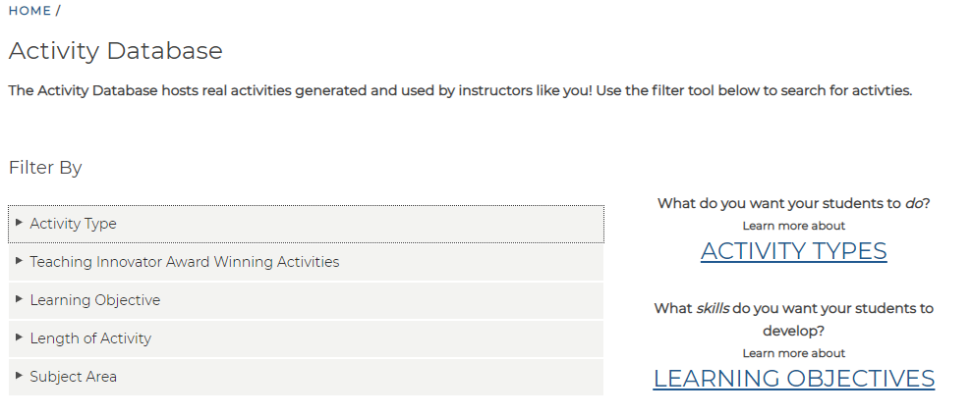
Alternative Assessment Options
Highly Participatory / Active Learning
Role Playing
Debate
Word Clouds
Jigsaw

Slide 20
Alternative Assessment Options
Highly Participatory - Role Playing
Example Situation.
Whether or not to add the Greater Sage Grouse to the federal list of endangered species
3rd generation rancher from Casper, WY
Employee of an oil & natural gas company working in Rock Springs, WY
Wildlife biologist from the University of Wyoming in Laramie, WY
World Wildlife Fund member from Denver, CO
Bureau of Land Management official from the district office in Cheyenne, WY
Notes:
Efforts toward environmental sustainability are rarely clear-cut. There are ecological, economic, and/or sociocultural benefits and drawbacks to each potential solution in any given situation. Different individuals with different perceptions and priorities favor different benefits and fear different drawbacks. When trying to develop policies or arrive at a decision that affects numerous stakeholders, in some situations, the stakeholders get so entrenched in their own positions that they can’t acknowledge others’ points of view; this, in turn, makes it very difficult to debate, much less make any progress toward, sustainability. In other situations, stakeholders are able to find areas of common interest and arrive at a consensus that’s acceptable for all.

Slide 21
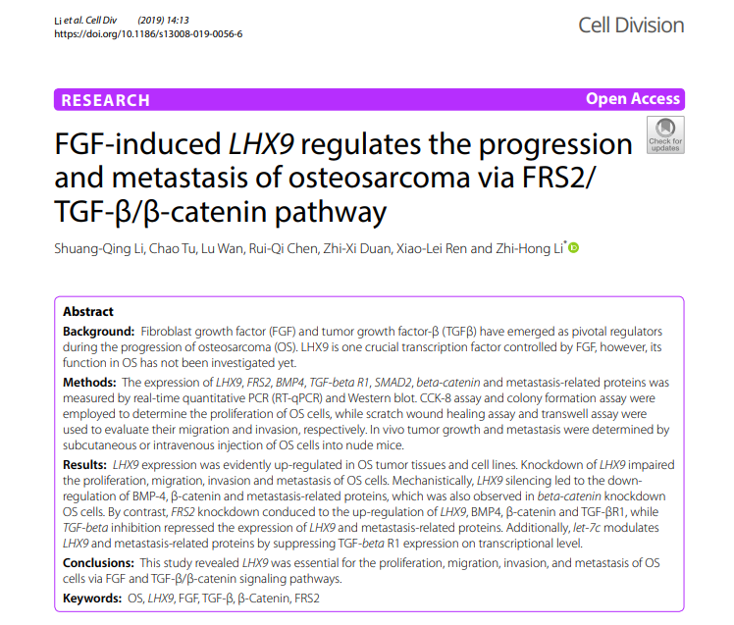
Alternative Assessment Options
Authentic Application of Knowledge
Creating an Abstract of an Experience
Notes:
Each week students would prepare a 250 word abstract describing the physiology experiment they performed. Summarizing the essence of their work in 250 words is a challenge and a skill scientists use all the time.
At the same time it limits the volume of student work you need to read and comment on.
In order to produce an abstract students first need a clear understanding of the science, find a way to present it in a logical fashion, and then polish their work into a concise paragraph.
It is an assignment where the product is much smaller than the student effort and cognitive processes required to produce it. (This gives less for the faculty member to grade.)

Slide 22
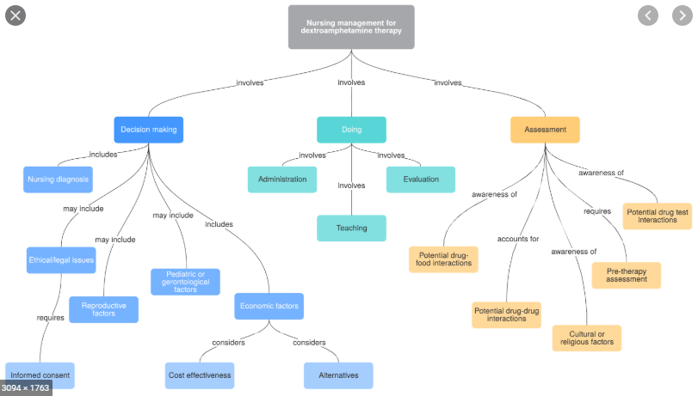
Alternative Assessment Options
Connects Back to Individual's Experience
Concept Maps
Wikis

Slide 23
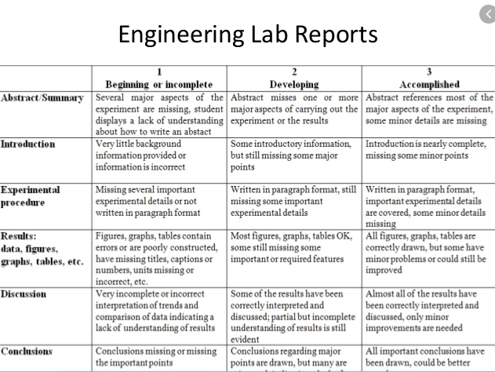
Alternative Assessment Recommendations
Use Rubrics

Slide 24
Alternative Assessment Recommendations
When Possible, keep the product small
"It is an assignment where the product is much smaller than the student effort and cognitive processes required to produce it."

Slide 25
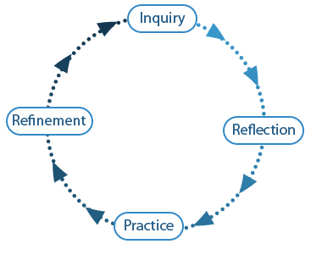
Alternative Assessment Recommendations
Allow multiple opportunities to practice and improve upon the skill you are assessing

Slide 26
Alternative Assessment Resources
Harvard's Activity Based Learning (ABL) Activity Database
IU's Authentic Assessment Teacher Resource - This has a great table showing different ways to reframe assessment
Lit Review on Alternative Assessment in Higher Ed - This provides a great list of online resources
SUNY's Applied Learning Initiative

Slide 27
Additional Links On Accessible Formulas from Ed Beck
Accessible Math: MathML, LaTeX, & Handwritten Math - http://ed-beck.com/2020/05/accessible-math-mathml-latex-handwritten-math/
Can-I-Use-MathML in browser: https://caniuse.com/#feat=mathml
Equatio: https://www.texthelp.com/en-us/products/equatio/
Mathjax: https://www.mathjax.org/
Math Type: https://gsuite.google.com/marketplace/app/mathtype/742924286153
Math Type Google Plugin: https://docs.wiris.com/en/mathtype/apps/mathtype-google

Slide 28
Other Accessibiliyt Suggestions From Participants
Virtual Whiteboard Solutions: https://teaching-learning-technology-center.sunycreate.cloud/tips-remote-instruction/virtual-whiteboard-solutions/
Miro (Virtual Whiteboard/Mind Mapping): https://help.miro.com/hc/en-us/articles/360017730533-What-Is-Miro-
Good Whiteboard Tool: https://whiteboard.fi/
Good tool for creating more accessible graphs:
https://www.desmos.com/calculator
https://www.desmos.com/accessibility
The American Mathematical Society is offering a webinar about accessibility in moving math online on July 13th. Not specifically about pedagogy, relevant to authoring as well: AMS webinar: https://ams.zoom.us/webinar/register/WN_BHijQmY0Ry2b-aabCYqSgw
Upcoming webinar on moving math online: https://ams.zoom.us/webinar/register/WN_BHijQmY0Ry2b-aabCYqSgw

Slide 29
Tools for Drawing Chemical Structures – from Participants
Molview is ChemDraw on a browser (so it's free): http://molview.org/
ChemSketch is free software from www.acdlabs.com to draw chemical structures, particularly for organic chemistry: https://www.acdlabs.com/resources/freeware/chemsketch/

Slide 30
Finding Examples of Alternative Assessments and Ways to Assess Student Work – from Participants
Online instructional activity index: https://www.uis.edu/ion/resources/instructional-activities-index/
active learning one-pager with explanation and examples: https://storage.ning.com/topology/rest/1.0/file/get/5848481059?profile=original
STEM related resources in a collaboratively created Gdoc: https://docs.google.com/document/d/1JNwf_4pjLQm0jo3p7Nh5XH6k25_wdxDFYXB2drbBda0/edit?usp=sharing
another good resource: http://www.facultyfocus.com/wp-content/uploads/images/AssessingOnlineLearning-OC.pdf
https://facultyforward.jhu.edu/learning-roadmap-for-new-online-instructors/assessing-student-learning-online/

Slide 31
Rubric Materials – from Participants
overview on rubrics: https://www.wwu.edu/teachinghandbook/evaluation_of_learning/rubric.shtml
using rubrics: https://teaching.cornell.edu/teaching-resources/assessment-evaluation/using-rubrics
rubric gallery of examples: https://www.rcampus.com/rubricshellc.cfm?mode=gallery&sms=publicrub&glid=4&sid=1000&
My discussion rubric :) https://etap640.edublogs.org/2008/06/02/reflections-blog-post-grading-rubric/

Slide 32
Questions?
Ed Beck & Chilton Reynolds

