Slide 1
Biography
Eddie is an Assistant Professor in the Security Systems and Law Enforcement Technology Department in the School of Engineering Technology at Farmingdale State College. Prior to being appointed as a full time faculty member in 2016, Eddie worked as an Adjunct Professor at Farmingdale since 2004. From 1983 to 2011, Eddie also worked at Verizon Communications where he held several positions at Verizon Information Technology including Project Manager, Technical Manager and Senior Member of Technical Staff. Eddie earned a Doctor of Professional Studies degree at PACE University in 2010; an MS in Telecommunications and Computing Management at NYU Polytechnic University; and a BS in Business Management and Economics at SUNY’s Empire State College. Eddie’s research areas of interest are measuring the success and accuracy of Network Security, Intrusion Detection systems and Cyber Security implementations.

Slide 2
Improving Student Learning through Classroom Engagement using Interactive Classroom Response Technology
presented by dr. eddie davis
Security system & law enforcement technology
Farmingdale state college

Slide 3
Project Background
CRJ307 introduces students to Database Operations which is often taught in Computer Science curriculums.
Due to the technical nature of the course material, some students can be overwhelmed.
The success of the Classroom Response Technology (CRT) implementation is assessed by both Qualitative and Quantitative methods.
Based on the results from Student Evaluations of the course in the Fall Semester 2017, 81% of students who responded strongly agreed that the Instructor encouraged student participation.

Slide 4
Analysis of current Classroom Response applications used in education.
There are currently three predominant Classroom Response System applications used in education.
Kahoot is primarily used in elementary and intermediate schools and is not ideal for higher education applications due to its lack of short response answer integration.
Socrative allows for Multiple Choice and True/False questions but it does not allow for short response answers nor does it provide anonymous analytic metrics. When results are displayed, the users name is displayed along with whether or not they answered correctly.
The Top Hat CRS has been available since 2009 and is established as a leader in the CRS space.
It has a robust User Interface and its anonymous analytical breakdown of each question makes it a prime candidate for our application.

Slide 5
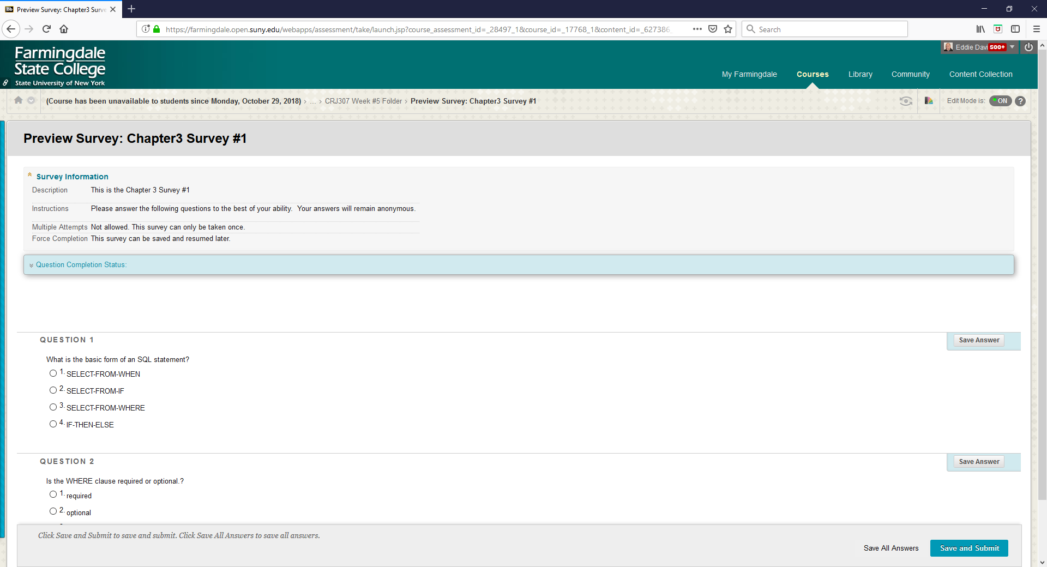
Blackboard Survey Question

Slide 6
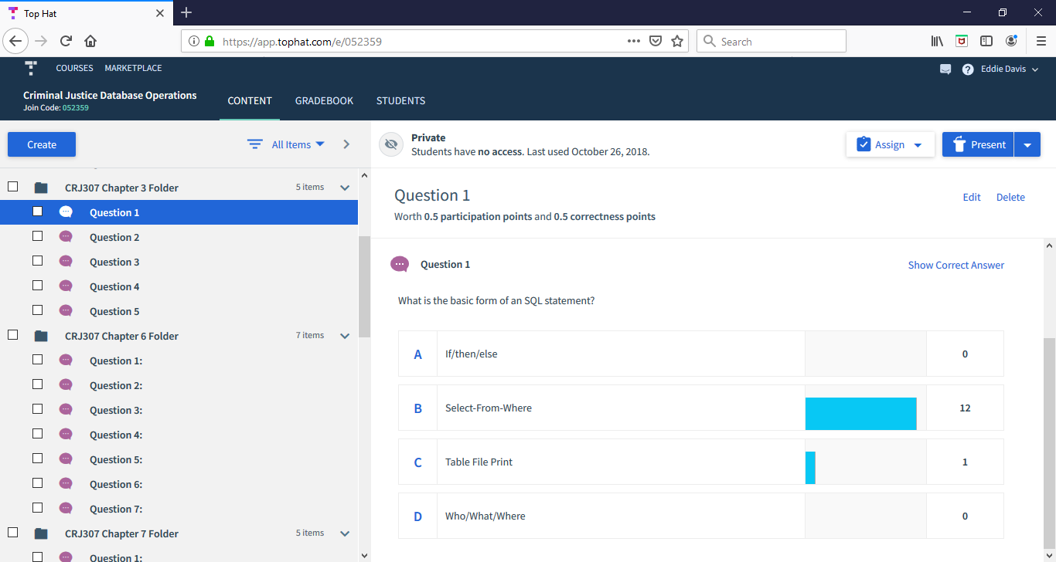
Top Hat Survey Question

Slide 7
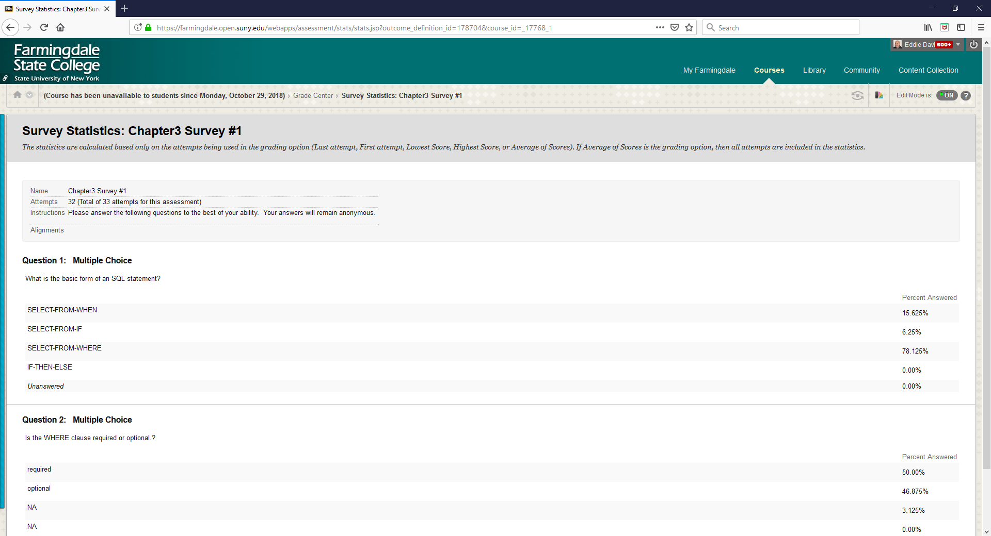
Blackboard Survey Statistics

Slide 8
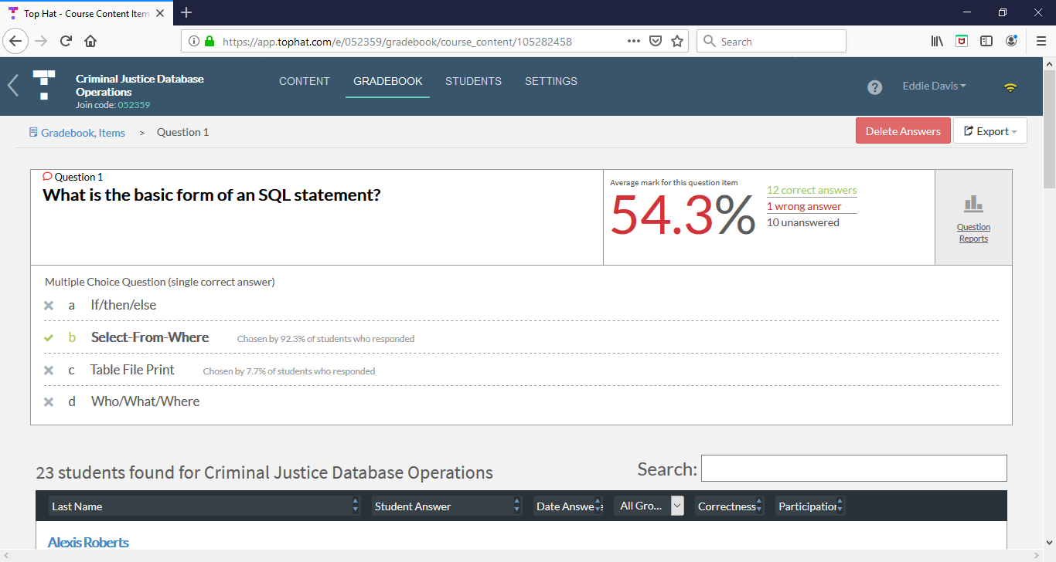
Top Hat Survey Statistics

Slide 9
Qualitative Measures (Spring semester 2018)
With the introduction of the Survey function in Blackboard during the lecture of Criminal Justice Database Operations.
88% of students responded that they Strongly Agreed that the instructor encouraged student participation.
4% of students responded that they Agree and
8% responded that they neither Agree Nor Disagree.
In their comments on the learning process, one student stated that. “I liked doing the in class quizzes/surveys. I think if there were more of those, it would help the class be more interesting and make people want to participate more”.

Slide 10
Phase I Pilot of the Top Hat application
There was one section taught online and another taught in the classroom where Top Hat was made available to all 24 students. The lecture was delivered in a classroom where all students had access to a computer and they all accessed Top Hat by logging on through the Top Hat Website.
81% of the students who responded Strongly Agreed that the instructor encouraged student participation.
12% Agreed and 6% Neither Agreed or Disagreed that the instructor encouraged student participation. In their comments on the learning process.
One student stated that “Top Hat was a great tool to use. Perhaps more time in class devoted to it may be more beneficial.”

Slide 11
Quantitative Measures
One of the primary expectations of this research was that if students participated in class more, their learning would increase and this would be reflected in their Final Grades.
An analysis of the Class Average grades before and during the Phase I pilot did not reflect an increase in student’s average grades.

Slide 12
Summary of Key Findings
Since the deployment, there haven’t been any significant quantitative impact achieved by using Top Hat.
Student participation in the end of semester surveys is not mandatory.
Even though students were strongly encouraged to participate. The participation during the Phase I Pilot ranged from 55% to 70% and only 2 of the students who participated made comments specifically related to Top and the Blackboard Surveys.
While the quantitative results did not improve, it can be concluded that the overall student participation did improve.
The Question becomes:

Slide 13
Future Research
From the beginning Top Hat was intended to be used as a supplement to Black Board rather than a replacement.
The Phase II Pilot was completed during the Spring Semester of 2019.
In Phase II, there was a continued emphasis on using Top Hat to allow all students to respond to every preplanned question.
There were also unplanned questions that were asked if there were no responses when asked verbally.
The Lecture Classroom was larger (40 Students) and there were no computers so students had the option of using their own laptops or their smartphones.
An additional piece of functionality that was also tested was taking attendance.
In order to assess the Top Hat Attendance functionality, the in class sign in sheet Attendance will be compared to the Top Hat Attendance.

Slide 14
Thank You for your attention
Questions and Answers:

