Slide 1
Otterly Amazing Tech: Teaching Technology Test Kitchen
Jamie Heron SUNY Online Program Manager, SUNY CPD

Slide 2
Agenda
Significant otter winners
Remind
Kahoot
Flipgrid
Menti.com
Canva
Open forum, please share the tech you use in your own classroom

Slide 3
Significant Otter Winners
Planning Committee Member – Tonka Jokelova!
Presenter – Donna Burke!
Attendee - Ronnie O'Neill!

Slide 4
Remind
Join the OTTER Remind classroom
Text @otter2021 to the number 81010
Remind tutorial

Slide 5
Kahoot
Quizzing
Engagement
Exam review
Kahoot Tutorial

Slide 6
Mentimeter
Lecture alternative
Exam preparation
Engagement
https://www.menti.com/yop4y8h4hb

Slide 7
Flipgrid
Engagement tool
Community Building
https://flipgrid.com/921d6163

Slide 8
Canva
Course content creation tool
Enhance your announcements
Liven up presentations

Slide 9
What's a technology we OTTER know about?
Share your favorite technology
In the chat
Use the mic
Or ask to screen share

Slide 10
That's all folks...

Slide 11
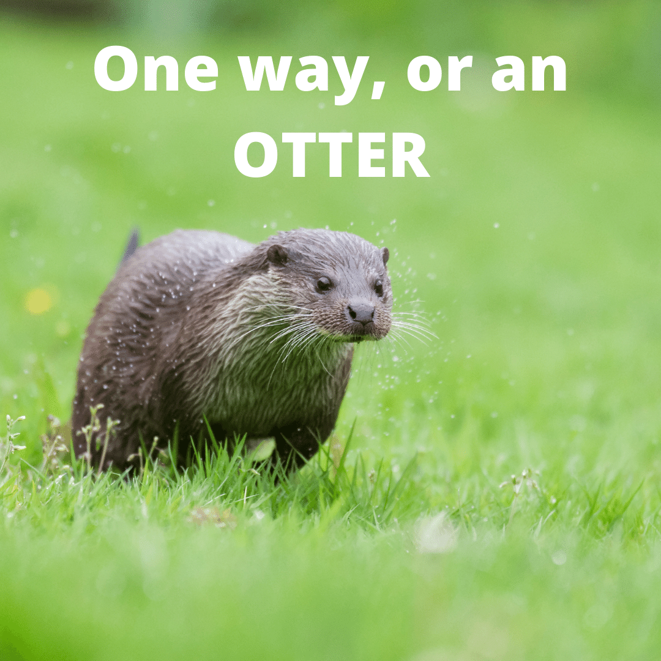
But don't worry, cuz...

Slide 12
August 9-13, 2021

Slide 13
For recordings and other resources, please visit:
suny.edu/OTTER

