Slide 1
Spring 2019 Changes

Slide 2
What should you expect?
A simpler, cohesive navigation
Improved performance
Deeper integration of Chat and Groups
A refined quick chat experience
Focus on Groups to the forefront
An inbox for all your notifications
Better customization of the platform
An upgraded Files experience
Granular Notification Settings
Continued familiarity with Facebook (but separate!)
Notes:
Carey Hatch

Slide 3
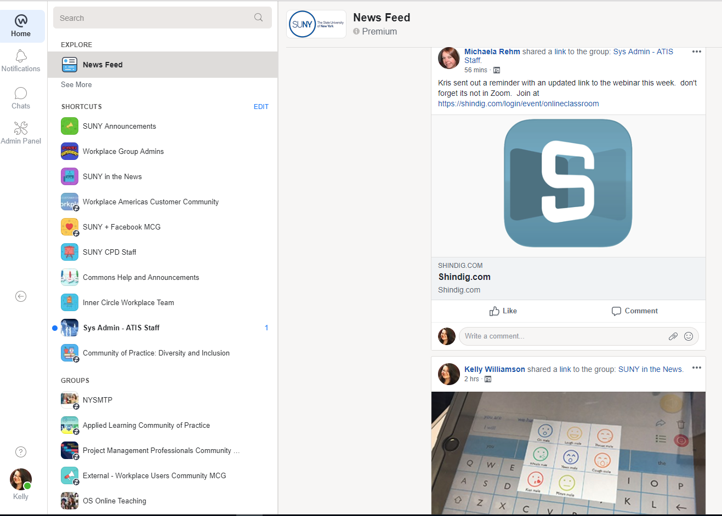
Specific elements to look for:
New left-hand side bar
Notification redesign
Notifications panel now has more options
Notifications are now on the left side
Chat functionality
Two ways to access chat
Less pop-ups
More white space
Faster loading
15% faster loading
35% faster notification
Notes:
Carey Hatch

Slide 4
When?
New platform is available for open access on JUNE 5
Users will be welcomed by a quick tour upon sign-on
You will be able to toggle between both experiences until AUGUST 5
AUGUST 5: Full Rollout
Everyone will be moved to the new Workplace experience, and won't be able to switch back
The app is not changing
Notes:
Carey Hatch

Slide 5
Preparing for the Change:
Take a deep breath!
Take time to explore the new layout starting June 5
Consider assigning shortcuts and edit notification settings now
Attend at least one webinar
Reflect on what is more functional and what you miss
Give me feedback that I can pass on to Facebook!
Email (Kelly.Williamson@suny.edu) or on Workplace
Notes:
Carey Hatch

Slide 6
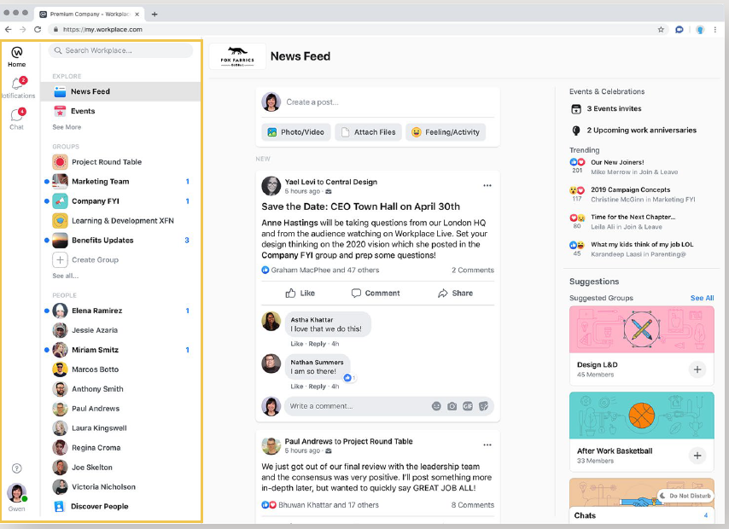
New Platform

Slide 7
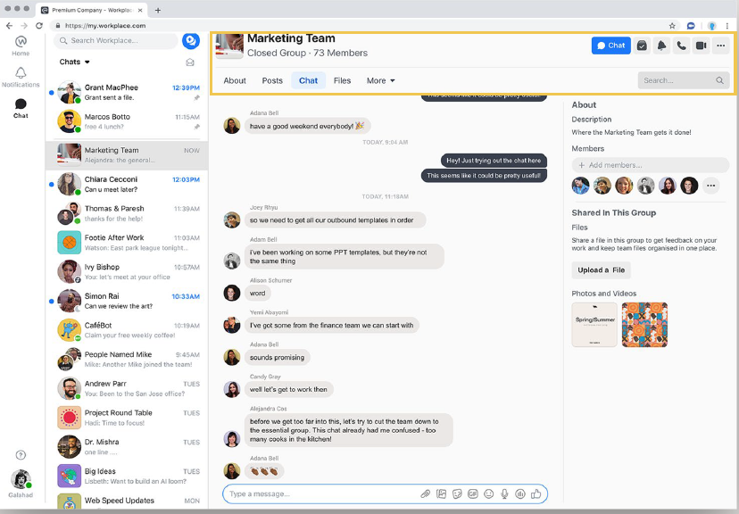
Chat Integration in Groups

Slide 8
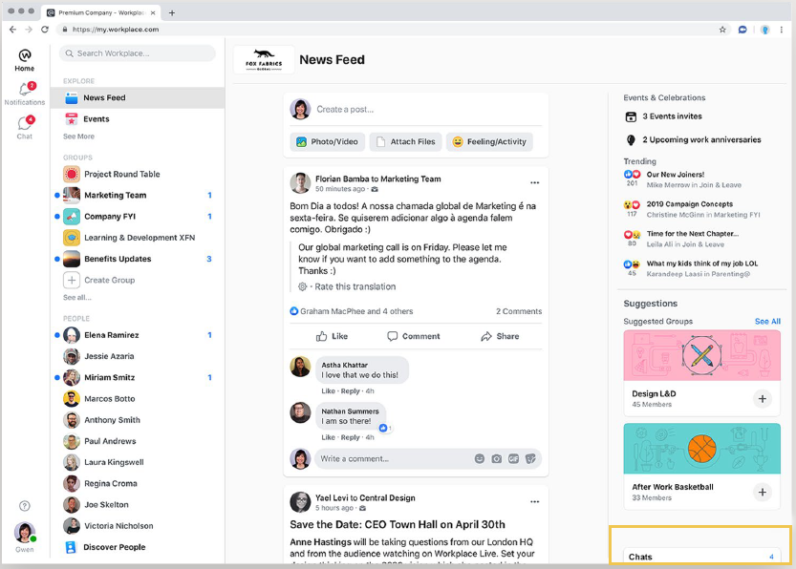
Better Quick Chat Option

Slide 9
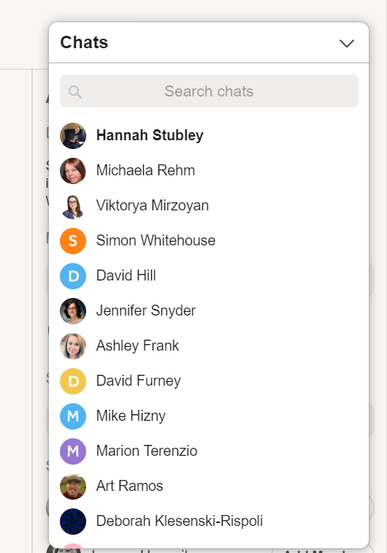
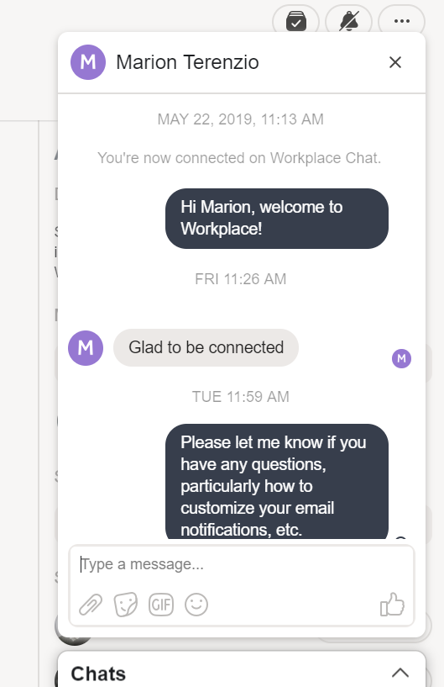
More Compact Quick Chat

Slide 10
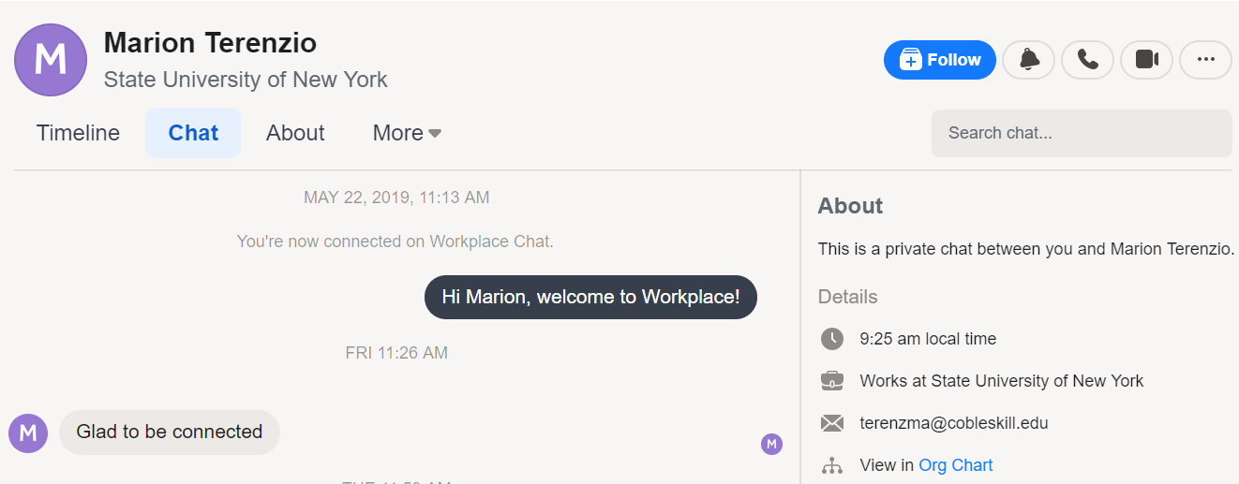
Chat Threads With More Info

Slide 11
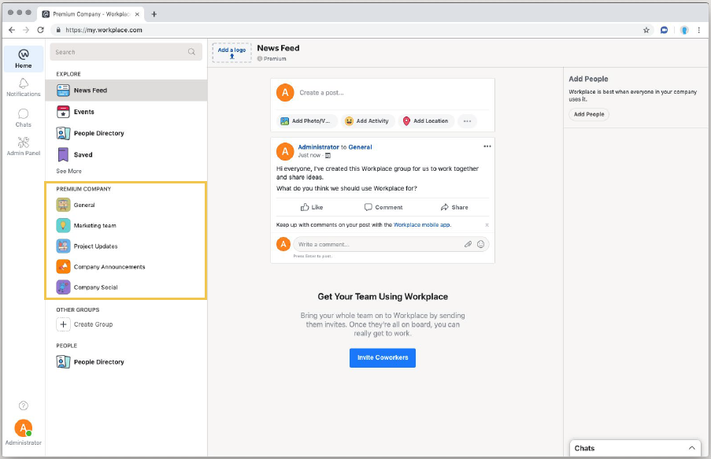
Pronounced Group Access

Slide 12
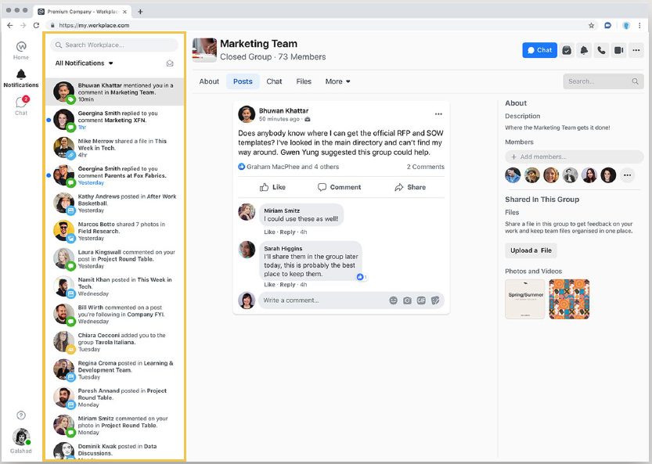
A New Notifications Inbox

Slide 13
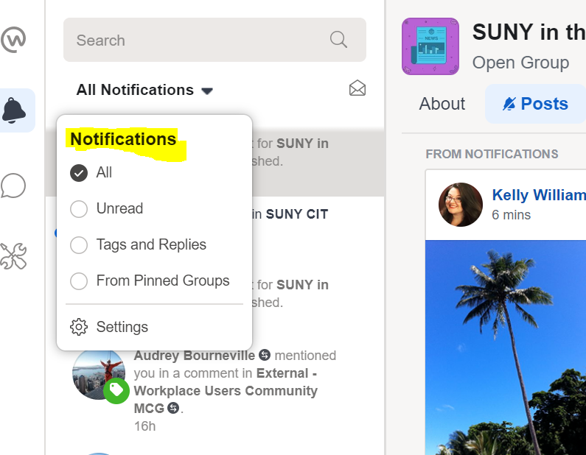
Filter Notifications

Slide 14
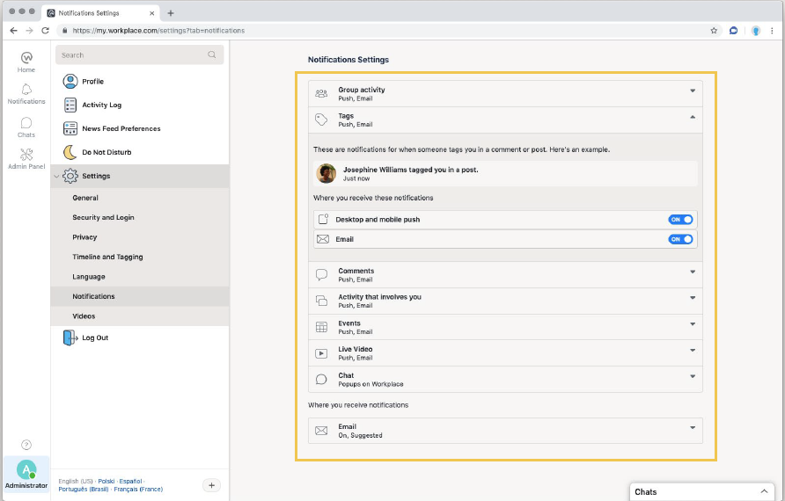
More Control of Notifications

Slide 15
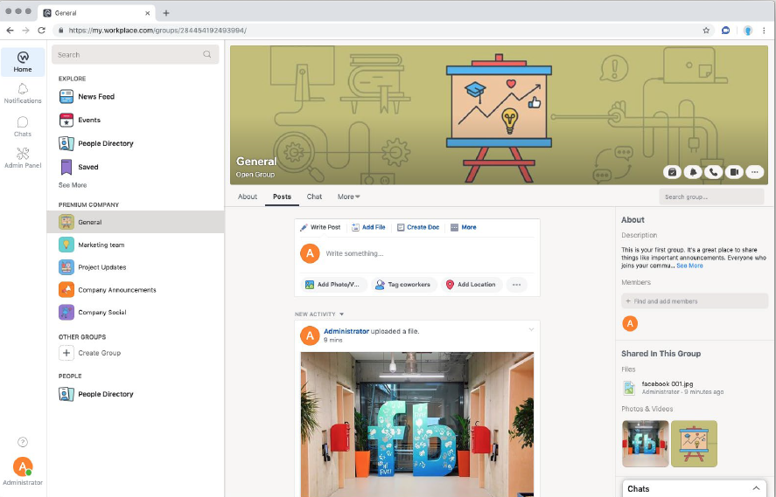
Control How Much You See

Slide 16
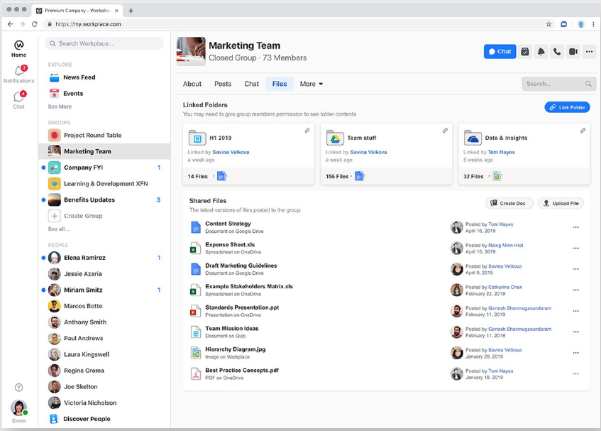
A Better Files Experience

Slide 17
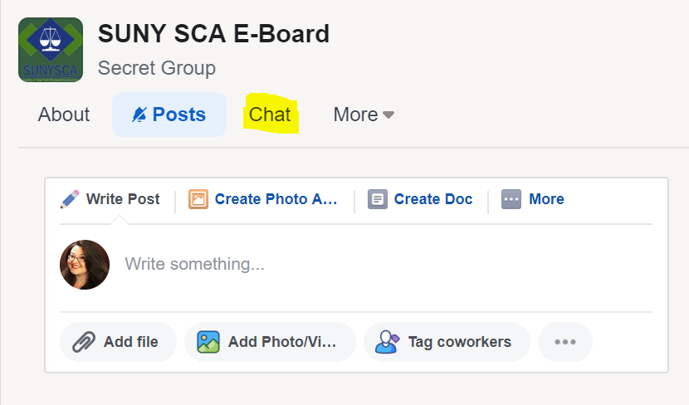
Condensed Group Info
Find the group chat in the group tabs

Slide 18
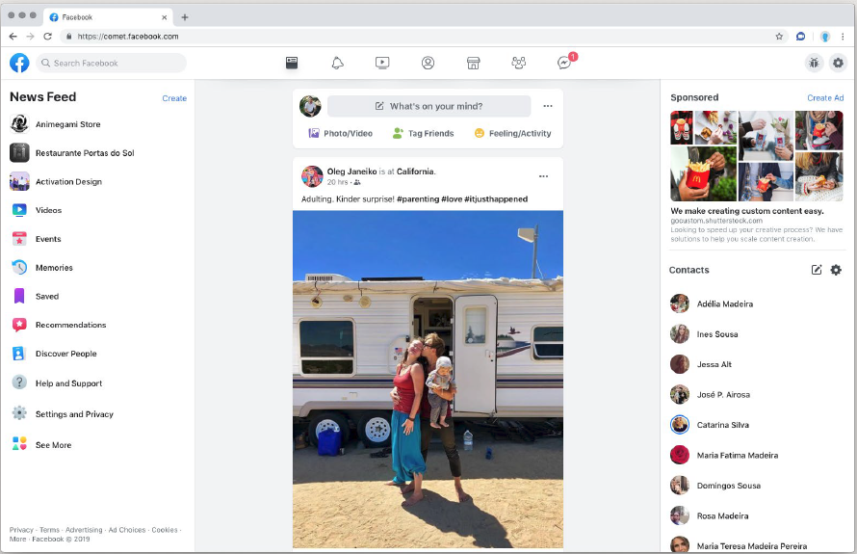
Mirroring the “New” Facebook

Slide 19
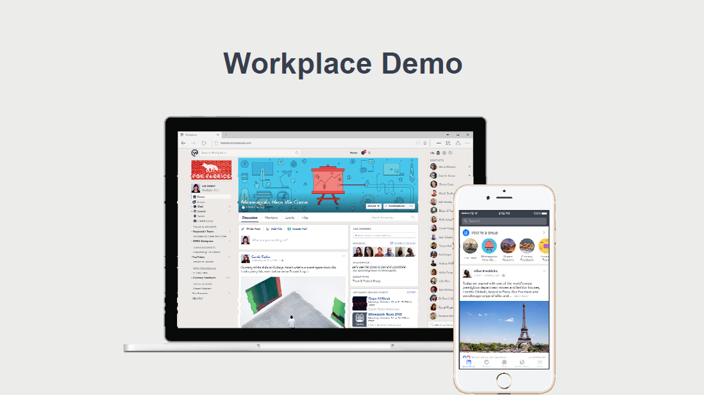
NEW

