Slide 1
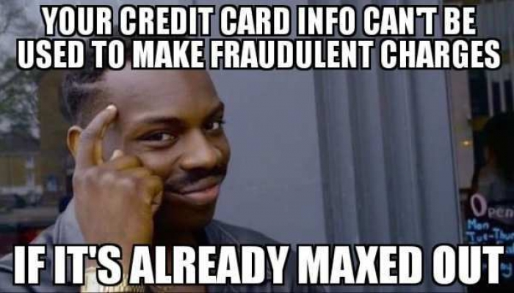
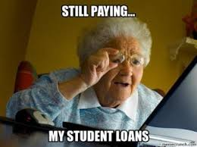
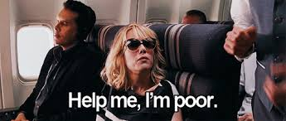
Enhancing and Scaling Financial Literacy Programs on YOUR campus

Slide 2
This Presentation:
Many Words on the Slides.
Hopefully, this helps when reviewing slides after leaving the session.
Some slides I will move through rather quickly for the sake of time.

Slide 3
What is Financial Literacy?
The ability to use knowledge and skills to manage financial resources effectively for a lifetime of financial well-being
Notes:
President Advisory Council definition

Slide 4
Our Mission
To provide timely and accurate financial information and counsel students, family members, faculty, staff, and the greater community. Through collaboration with faculty and staff, we are accessible to all students from the time of acceptance in development of their personal financial knowledge and skills to manage their financial resources effectively for a lifetime of financial well-being.
Our advisement philosophy:
Providing information that is free of personal bias so that students can make informed decisions and to assist in their holistic development of self.

Slide 5
Types of Financial Literacy Programs:
*This is by no means an exhaustive list.
Distinct Financial Literacy Department
Point-Person
Incorporated into existing duties
Committee-based format (typically for a specific event or small series of presentations)
Peer Led
We tend to think of this on a spectrum of what campuses can do with a lot of resources to what they can do with limited resources as it relates to what the outputs a financial literacy program can create.
This does not have to be the case!
Notes:
1 - For campuses with more resources, this model cements Financial Literacy as a mainstay on campus. Benefits include shared job duties and greater accessibility to meeting with students. This format typically requires years to build and is typically associated with larger campuses with greater student traffic. Occasionally, Financial Literacy is incorporated with campus Call Centers or “One Stop Shop” models, with all members being trained on core financial concepts. The drawback to this format is the risk of inadvertently creating a “silo” for financial literacy in the perception of other campus partners.
3 - As campuses begin exploring incorporating financial literacy onto their campuses, this model is emerging. Essentially, this is a watered-down version of the “Point Person” model with huge benefits in terms of financial resources for the campus. Incorporating financial literacy into existing positions without needing to create an entire “financial literacy” department ensures that students are receiving some aspect of financial education delivery. Typically, these programs offer office hours or are available to meet with students individually and present on relevant topics throughout the academic year. Schools have found more success in brand recognition for students and other campus partners to be aware of where to go for personal finance questions. Balancing the student demand for financial literacy with one’s existing job duties has arisen as a point of concern for some campuses.
4 - For campuses with limited resources, this format is a great solution. Typically, a cross-campus committee made up of individuals who feel financial literacy education is vital for a student’s education come together in the planning of an annual campus event or a semester presentation on a financial topic. Typically, these programs do not offer one-on-one student appointments and struggle with “brand recognition” yet receive extremely high positive feedback from students that participate in the ad hoc financial literacy event/presentations.
5 - This can be in the format of a student club, with a staff member acting as an advisor. This minimal time commitment and reliance on students to dictate what information they deem most relevant to them is a strong benefit. The challenge arises in the form of accountability and student turnover leading to inconsistencies in program offerings.

Slide 6
Where We Began
SUNY Grant: 16/17 Academic Year – 19/20 Academic Year
Initial Goals:
Decrease debt year-to-year
Decrease debt at graduation
Decrease financial-related stress
Increase financial knowledge

Slide 7
Evolution
Students need assistance navigating many areas relating to their own personal finance
This includes navigating certain processes on our campus that have a financial impact (beyond just financial aid implications), such as:
Taking a leave of absence
Studying abroad
Taking a summer class
Paid/unpaid internship experience
Students in these groups were referred to meet with the Financial Literacy Department.
Loan repayment and debt management emerged as a main focus, as opposed to simply decreasing debt upfront.

Slide 8
Loan Repayment and Debt Management
A main feature of our program is assisting students in setting up an account with their servicer.
Students bring their laptop to the office and are assisted in navigating the process in account set up with their servicer.
This is followed up with discussion on loan repayment plans
Then a 2-minute discussion that there are loan forgiveness programs available if enrolled in certain plans.
This concludes with an overview of various debt management strategies.
These appointments take ≈30-40 minutes.
Remembering log in info, contacting parents, etc. is the hardest part for most students.

Slide 9
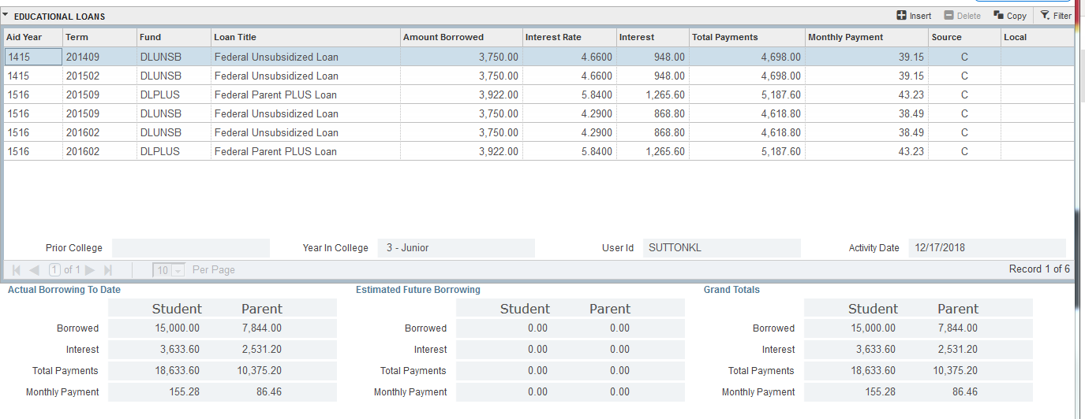
Loan Repayment and Debt Management
Notes:
Showing students a visual that each loan has a separate monthly loan payment amount is crucial in a discussion on debt management strategies. This discussion is what gives them hope and leaves them empowered that they can tackle their debt as quickly as possible.
If you do not have a screen, use the estimate that the monthly payment is roughly 1% of what was borrowed.

Slide 10
Campus Challenge: Reaching Students
We are all here to support students and seek to be a resource to assist in their collegiate experience
The students that utilize our resources attest to their benefit.
The challenge we face – reaching students
Solution: Offer as many different mediums to interact with students in the ways that THEY want to interact.

Slide 11
Points of Impact
1. One-on-one coaching sessions
Other elements of program:
2. One credit mini course (active engagement)
3. Campus-Wide Event each semester
Making Cent$ on the Move
Internship Opportunities
Peer-to-peer coaching
Faculty / Professional Development
Budgeting, Credit, Loan Repayment
4. Presentations – Residence Halls, Classroom, Clubs, etc.
5. Tabling/Campus Presence (passive engagement)
6. Debt Letters
(Bonus: they reach family too!)
7. Refund Emails
8. Social Media
(Insta: makingcentsoneonta)
Notes:
There’s space between each area as I am still searching for new ways to reach students

Slide 12
Our First Attempt (and it paid off!):
Making Cent$ on the Move
Partnered with school thrift shop and dining services to provide prizes
Extremely positive student feedback. Loved the risk of getting kicked out for incorrect answers.
Template for questions to ask

Slide 13
What’s For Dinner?
Check the menu! (target audience: student RAs that need to put on regular programming in the residence halls.)
Notes:
Picture is hyperlinked

Slide 14
Making Cent$: Some of our Campus Partners
Consider reaching out to the following areas:
Access Opportunity Programs
Eat lunch with them if you have a summer program, Train their counselors on what you do, Offer services to their department
New Student Services
Orientation – Present with other offices, Incorporate content into existing sessions, write skits for Orientation (Kevin has a theatre degree, but you can have the skits he wrote too if you want!)
Academic Advisement
Wants and Needs of their college experience, Graduating early discussion (remember, be unbiased and provide them with information!), How your gen eds. Can apply to your field of study conversation, etc.
Career Development
Cost of living and job offer comparison, LGBTQ Resumes and states with non-discrimination employment laws, Budgeting for internship experiences, etc.
Community Standards
Moving into the community (off campus): Be a good neighbor, things to look for in a lease, budgeting for off-campus expenses, paying utilities to build credit, parking laws in the community, how to pay parking tickets, what to do if your car gets toed, etc.
Sustainability
Bottled water vs reusable water bottle, buying the appropriate amount of groceries (reducing waste and wasted dollars), Thrift store locations in town, etc.
Residential Community Life
Offer services to their professional staff, Be incorporated into their RA training, Find out how they do programming and make it your goal to offer more presentations than any other office!
Alumni Association / Donor Relations
Provide alumni with a service to build and maintain their connection to campus in a positive way (not just asking them for money, but assisting them with budget sheets and information on loan repayment), Send mailing to students 5 months after graduation that have borrowed loans.

Slide 15
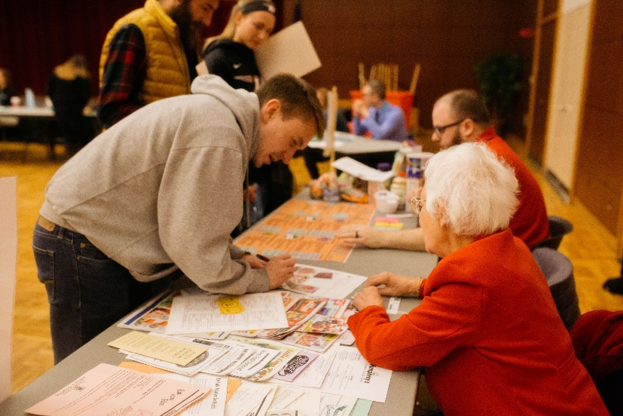
Making Cent$ of Life After College: A Campus-Wide Effort
What You Have Access To:
Suggested timeline on planning your event
18 Table Signs with price ranges and resources for calculations
Email templates for volunteers specific to each individual table.
Sample pre-registration form for student attendance
Table order/layout recommendation
Video with student testimonials of the event

Slide 16
Tracking Program Participation- Important!
Our Campus: Manually Monitored Attendance Tracking
An excel file with each student having their own, unique row.
Columns are for each “moment of impact” with the Making Cent$ program.
This includes each one-on-one meeting, attendance at each presentation done (aside from new student orientation), tabling interaction, and event attendance.
One day, this can be used to determine if students interacting with your program have a lower default rate, and what aspects of your program are the biggest predictive indicator for similar areas, such as retention, compared with the general student body.

Slide 17
Personal Financial Management Course
5-week, One-credit, Pass/Fail, “mini” elective, offered 3 times a semester.
Meet twice a week for an hour and fifteen minutes
Things you have access to:
Syllabus
9 Lectures
Final Exam
2 Quizzes
19 homework assignments
Sample Gradebook

Slide 18
YELP Reviews:
(SPI Reviews from past students)
“It was great, maybe fewer hand-outs. But I really liked the class and the professor[sic]. He also was very understanding[sic], which I really appreciated.”
- Spring 2019 Mini 1
“I am a graduating senior and I believe this course should be mandatory for students soon entering the real world. This has been my favorite course throughout my college career and wish it was longer!”
- Spring 2019 Mini 2
“I felt this was entirely too much work for a 1 credit mini.”
- Spring 2019 Mini 2
“The course is valuable experience when preparing students for being adults in the real world and I would really recommend the course to anyone. The homework that was given provided valuable experience that I will need in the future.”
- Spring 2019 Mini 3

Slide 19
Student Involvement
Student Internships
Currently offer 6 positions. Unpaid. Students can opt to get credit if they wish, but most solely want the experience.
Student interns have been primarily those in the Business Economics Department seeking relevant work experience prior to graduation, however we also have had Psychology majors express interest.
Students have frequently cited limited opportunity to work in any finance-related capacity to gain relevant experience while in school.
Tasks have been developed tailored to each student’s personal and professional goals including:
Marketing, Event Planning and Outreach
Counseling
Data analysis (student loan borrowing)
Content development and Presentations

Slide 20
Program Impact
Loan Borrowing:
Major reduction in Parent borrowing with initial “debt letter” outreach. As borrowing is commonly a “family decision,” the reduction in Parent Plus borrowing as opposed to a reduction in student borrowing is understandable.
Schools with higher family EFCs have been able to reduce student loan borrowing at a higher rate with these communications.
The unforeseen outcome in supporting students in understanding all aspects of student loan repayment and managing debt shifted to become primary aspects of the program.
Student Support:
The student feedback consistently recommends making aspects of the program (namely, the 1-credit class and the Life After College event) to be mandatory for all students and shows high levels of satisfaction. The student demand truly exceeds the supply of our campus resources.
Student Stress:
Since 2015, the number of students citing “financial stress” as a reason for visiting the campus health center saw a decrease of ≈20%.
Retention:
A 2016 study titled “Why Students Left College” by Neal Raisman found that major reasons students left college in 2016 was the belief that the college they attended did not care about them (20%), that it was not worth their time/money (19%), or directly tied to money issues (13%).
Comprehensive and accessible Financial Literacy Programs can make a positive impact in all three of these areas.
It has been difficult for programs to measure their specific impact on retention as it is often a campus-wide effort.

Slide 21
Join Us!
SUNY Oneonta is hosting the first SUNY Student Financial Wellness Conference on November 12th and 13th 2019.
You will have access to all our “plug and play” resources to choice which elements you believe would apply most to your student populations and the resources you have available.
To register:
Email Mary.Ballard@Oneonta.edu for the registration link
Or
Visit our conference page https://suny.oneonta.edu/making-cents/student-financial-wellness-conference
We encourage you to register ASAP. We are able to offer hotel reimbursement for the first 20 campuses that complete the registration survey.
Registration closes on November 1st

Slide 22
Hope I kept your “Interest”
Thank you for attending!
Contact me for access to Making Cent$ resources:
607-436-3021
Kevin.Sutton@oneonta.edu
(Will send you a link to a Microsoft SharePoint site.)
Now, some shameless plugs:
Check out our webpage: https://suny.oneonta.edu/making-cents
Follow our Instagram: @Makingcentsoneonta
(Our social media intern is quite funny)

