Slide 1
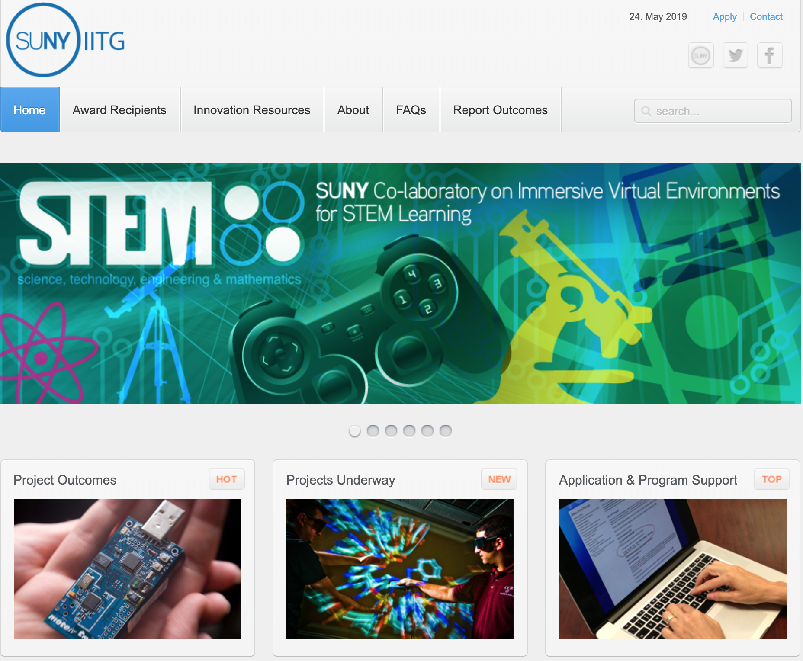
www.commons.suny.edu/iitg
Notes:
(Lisa) Welcome!
I’m Lisa Stephens, here with Chris Price, and new this year, we’re co-managing the IITG Program, We’re also happy to welcome our Business Manager, Sandy Cowin – who can help respond to any specific budget or finance questions you may have.
Thank you for joining today’s Webinar describing the eighth round of the SUNY Innovative Instruction Technology Grant Program!
Today’s session focuses on the Request for Proposals and orientation to anyone new to IITG.
A second session for Q&A is scheduled for Tuesday, Feb 12th at Noon
Both sessions are being recorded and will be posted on the Application Website along with annotated Powerpoint notes.
Please feel free to jump in and ask a question at any point, or use chat box if you prefer – we’ll keep an eye on it…

Slide 2
IITG Funding Source
State funds allocated to:
Replicate campus success, avoid pitfalls
Transcend campus boundaries
Build Communities of Practice
Demonstrate and share evidence of impact
Support Open SUNY related tools and services
Scale-Up success across SUNY
Notes:
Chris – RIF on PIF

Slide 3
Program Overview
Purpose of IITG: Experiment, Share and Scale-Up!
Provide Small Scale “Start Up” Funds Directly to Campus Faculty and Staff
Build on Prior Project Outcomes
Align to SUNY Priorities
Notes:
(Lisa)
We’ll start with context and “a big picture” view of how this SUNY program was launched
Then describe how the review process functions and what to expect if your proposal is funded.
Understanding the post award process in advance is important because some program elements may impact your budget planning – for example, conference and travel support.
Finally, we’ll describe expectations for how outcomes should be shared and how project outcomes become discoverable both SUNY-wide and to higher education in general.

Slide 4
Program Overview
SUNY Initiatives or External
Grant/Foundation Funds
Expectation for Collaboration
IITG One Time Renewal
can move to different funding tier
IITG Tier Three: Up to 60K with 50% in kind match
Individual > Department > Campus > System
IITG Tier Two: Up to 20K with 25% in kind match
IITG Tier One: Up to 10K
Notes:
(Lisa)
The IITG program was launched in 2012 as part of the Chancellor’s strategic plan. The RFP was developed by members of the SUNY Faculty Advisory Council on Teaching and Technology (FACT2).
Over the past 7 rounds, IITG’s have awarded 4.9M dollars and have proven to be highly effective in fostering cross-campus collaboration, expanding the objectives of Open SUNY and Open Education Resources, and seeding campus-based innovations that have scale-up potential throughout the system.
In a nutshell, the funding tiers were created to require more cross institutional collaboration the greater the funding request
(refer to graphic)

Slide 5
IITG
Funding Distribution to Date
Round Eight Funding Requests
87 proposals received for a total funding request of $2,692,442
Tier 3 (up to $60,000) (n=34) $1,914,600 - (9) Awarded: $390,410
Tier 2 (up to $20,000) (n=28) $ 498,656 -(11) Awarded: $215,800
Tier 1 (up to $10,000) (n=25) $ 240,835 - (6) Awarded: $ 58,790
Funding Ratio - Application to Awards
2019 = 30% award funding success (26 funded out of 87 proposed)
2018 = 43% award funding success (30 funded out of 69 proposed)
2017 = 42% award funding success (28 funded out of 67 proposed)
2016 = 45% award funding success (35 funded out of 78 proposed)
2015 = 60% award funding success (27 funded out of 45 proposed)
2014 = 40% award funding success (25 funded out of 63 proposed)
2013 = 35% award funding success (33 funded out of 93 proposed)
2012 = 41% award funding success (48 funded out of 117 proposed)
$5,560,380 total distribution (all rounds to date)
Notes:
(Lisa – for all process slides)
The opportunity to be funded for an IITG is much greater than more competitive federal or foundation grants.
And, an IITG may be a nice way, particularly for a junior faculty member to develop and explore a solution that has much greater funding potential

Slide 6
Innovative Instruction Technology Grants (IITG)
www.commons.suny.edu/iitg
What was seeded?
Open SUNY Textbooks and OER Services
MOOCs
Gaming Initiatives and Minecraft for Educators MOOC
Small Campus UG Access to Visualize Big Data
App Development
E-Portfolio Exploration and Adoption
Notes:
(Lisa)
Some highlights of what’s been funded… particularly as Open SUNY was being rolled out…

Slide 7
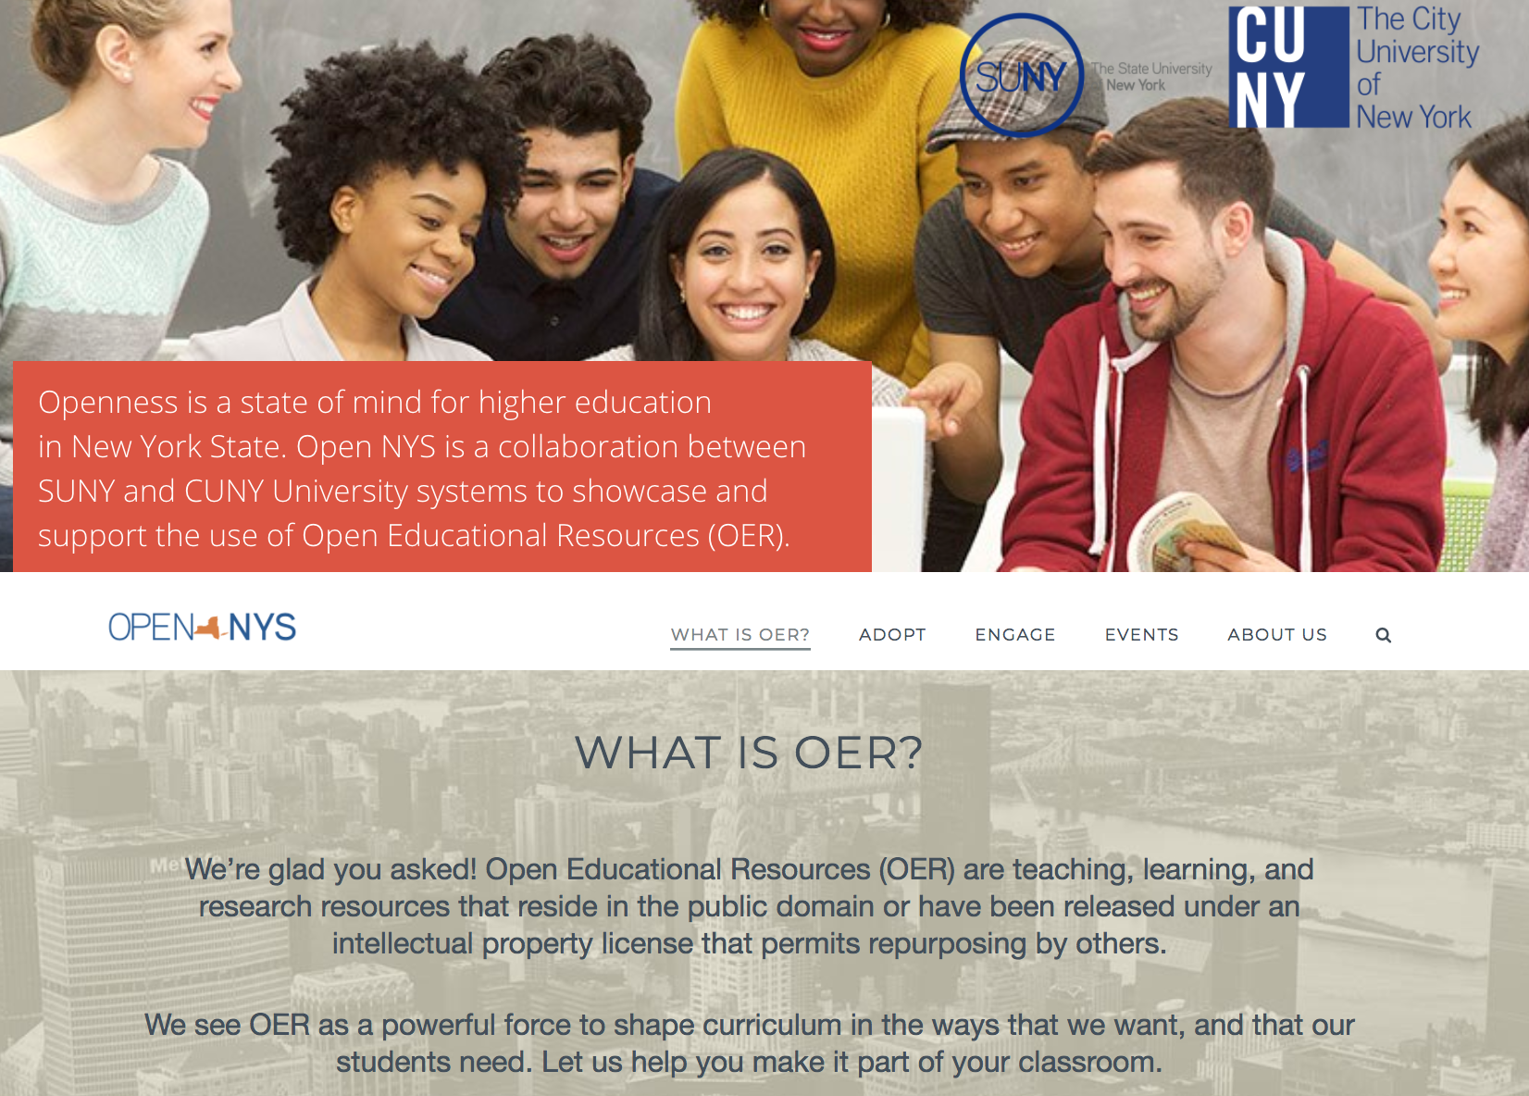
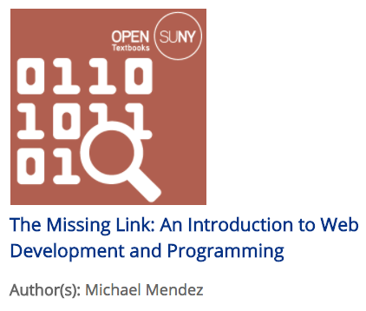
IITG Round 8
Experiment, Share & Scale-Up!
Notes:
The Governor provided SUNY and CUNY 8M each over the past two years to further develop Open Textbooks.
Obviously this is a huge example of scale up.
But just as IITG’s are meant to seed individual faculty and staff effort, we hope that outcomes will encourage campuses to consider leveraging these explorations through Performance Improvement Funds – PIF.
(Toss to Chris)

Slide 8
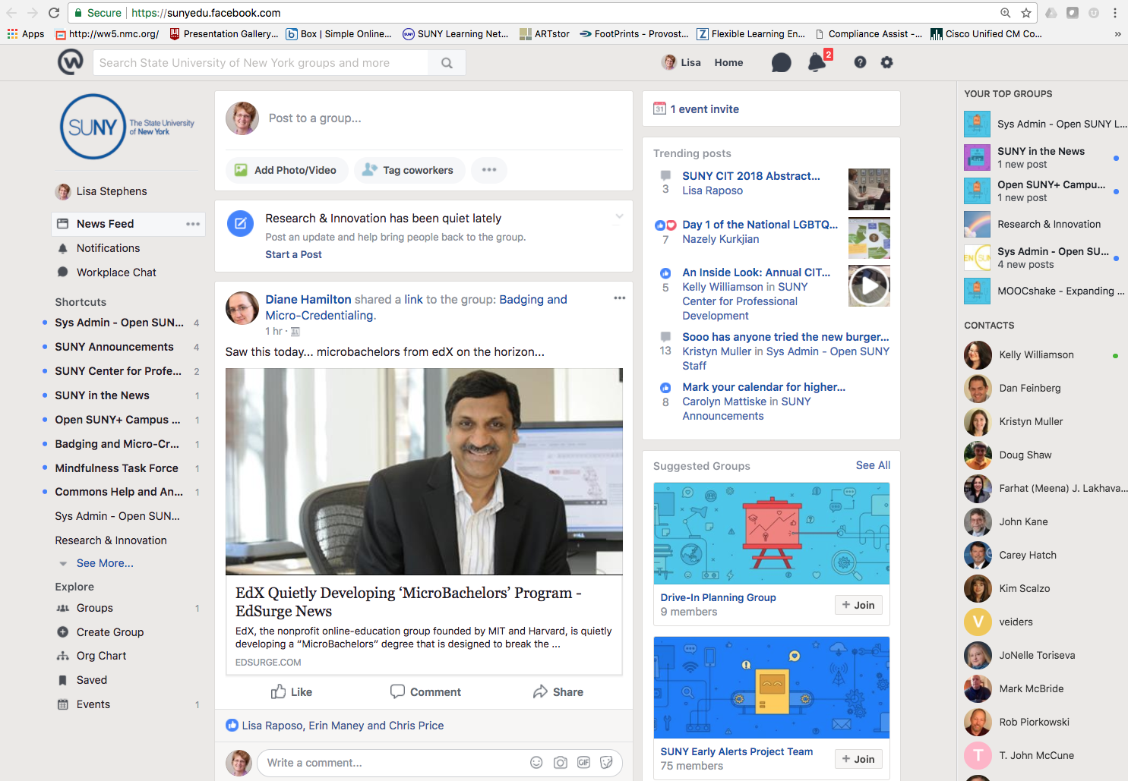
“All things Workplace!”
kelly.williamson@suny.edu
Notes:
(Chris) Workplace is Facebook for workplace environments
There is no relationship between your personal FB account and WP - but they function in the same manner.

Slide 9
Experiment, Share & Scale-Up!
New Models for Enrollment, Retention & Completion
Communities of Practice
Notes:
(Chris)
(Toss back to Lisa)

Slide 10
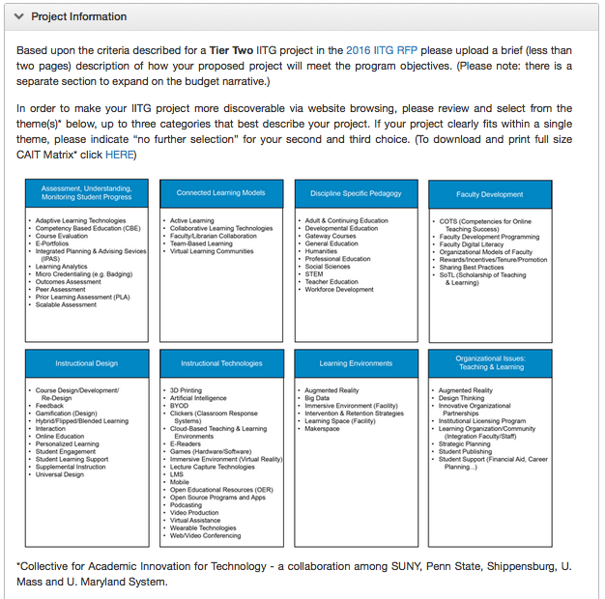
Elements of a
Strong Proposal
Notes:
A word about categorizing your project…
A few years back, a small group gathered from some NE campuses – Penn State, U Maryland, Shippensburg, and U Mass, along with some help from Malcolm Brown at ELI – to develop a taxonomy to help our us to identify and connect teaching and learning innovations across our campuses.
More importantly – we needed an organizational system to help people outside of SUNY search the IITG outcomes

Slide 11
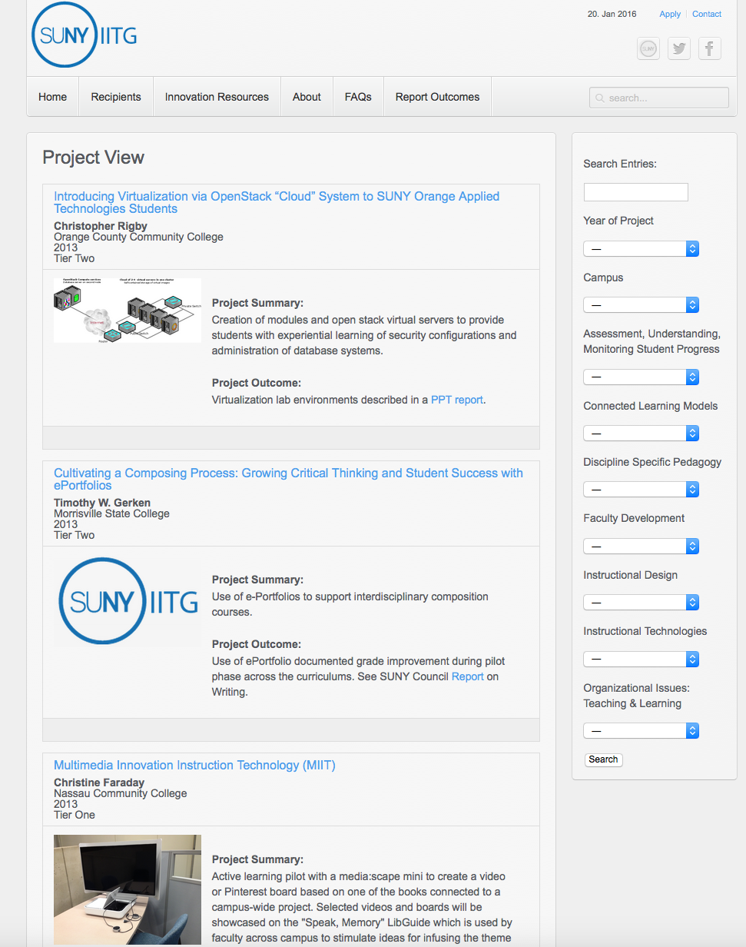
Elements of a
Strong Proposal
Notes:
And here’s what it looks like when you search and filter on those categories.
(Toss to Chris)

Slide 12
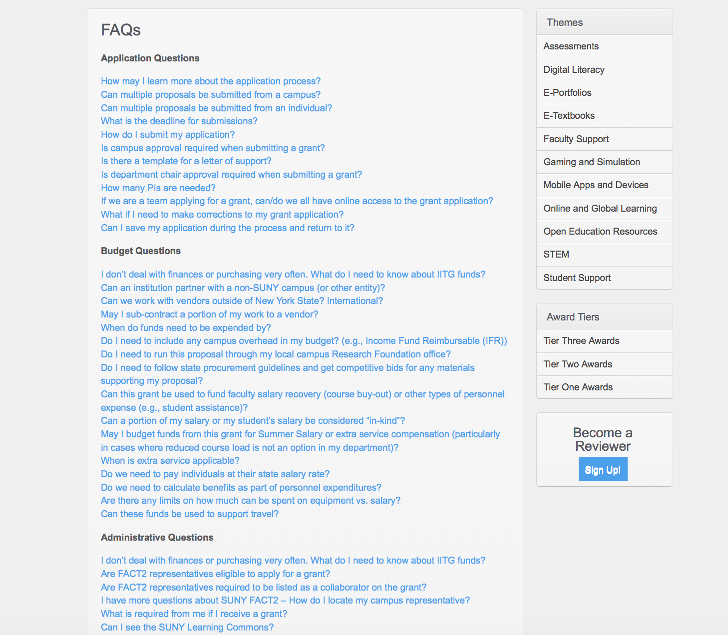
IITG Application Materials
http://commons.suny.edu/iitg/apply
Notes:
(Chris) Please check the FAQ section first if you have a question about the Application, Budget or Administrative processes – we think we’ve got most of the common questions and issues covered, but we’re happy to receive feedback and update more information on these pages – just let us know!
(back to lisa)

Slide 13
Questions?
IITGrants@suny.edu
Thank You!

