Slide 2
Creating a Culture of Leadership: Managing Large-Scale Retention Programs with Undergraduate Peer Leaders
Dr. Ashley Martin, Director of Student Achievement Programs
Dr. Heather Maldonado, Assistant Provost for Academic Success
SUNY Student Success Summit, October 2019

Slide 3
Session Agenda
Introduction of Presenters and SUNY Buffalo State
SUNY Buffalo State’s Student Achievement Programs
Student Achievement Programs’ Staffing Model & Recruitment Plan
Student Achievement Programs’ Staffing Model: Hierarchies of Support
Student Achievement Programs: A Dive into the Program Materials
Student Achievement Programs’ Staffing Model: The Power of Paraprofessionals
Questions & Contact Information

Slide 4
Introduction of Presenters
Dr. Ashley Martin
Director of Student Achievement Programs
Dr. Heather Maldonado
Assistant Provost for Academic Success

Slide 5
Introduction SUNY Buffalo State
Urban-engaged comprehensive college located in Buffalo, NY
Carnegie Foundation elective Community Engagement classification
9,516 students (F17)
8,527 Undergraduate
53.2% minority
56.2% female
30% residential
82% financial aid eligible
989 Graduate
22.1% minority
72.4% female
79 undergraduate programs and 64 graduate programs
NCAA Division III

Slide 6
SUNY Buffalo State’s Student Achievement Programs

Slide 7
Summer Bridge Program
The Summer Bridge program offers incoming first-year students a one-week transition to college experience. The program is open to general admit incoming first-year students.
The Summer Bridge program offers several benefits:
One free college credit toward Fall semester
Early residence hall move-in for residential students
Matched with a peer mentor who will provide year-long support
Build a connection to campus and develop a social network
Sessions on making a successful transition into college

Slide 8
Peer Mentoring Program
The Peer Mentoring program at Buffalo State connects successful upper-class students with first-year students to help them with the social and academic adjustment to college life. Peer Mentors connect with their first-year mentees the entire academic year to ensure they are finding their way to academic success at Buffalo State.
The Peer Mentoring Program offers several benefits:
Connection to a group of other first-year students who have similar majors or interests
Mentees receive guidance, support, and encouragement from Peer Mentors during the transition to college life at Buffalo State
Provides mentees with educational, campus resource, student organization, and team building opportunities
Connects mentees to other campus offices that may help them succeed

Slide 9
Supplemental Instruction
The Supplemental Instruction (SI) sessions are scheduled group meetings in which SI Leaders (who are academically successful Buffalo State students) help students in the SI course review notes, discuss readings, develop organizational tools, and prepare for assignments and examinations. Courses that included SI time have a required additional hour built into students' schedule.
The Supplemental Instruction Program offers several benefits:
Free peer-led sessions by successful Buffalo State upperclassman
An additional hour of support for challenging courses
Learn additional study techniques which will help in all Buffalo State courses
Better preparation for exams, quizzes, and homework
Students collaborate and engage more with their peers

Slide 10
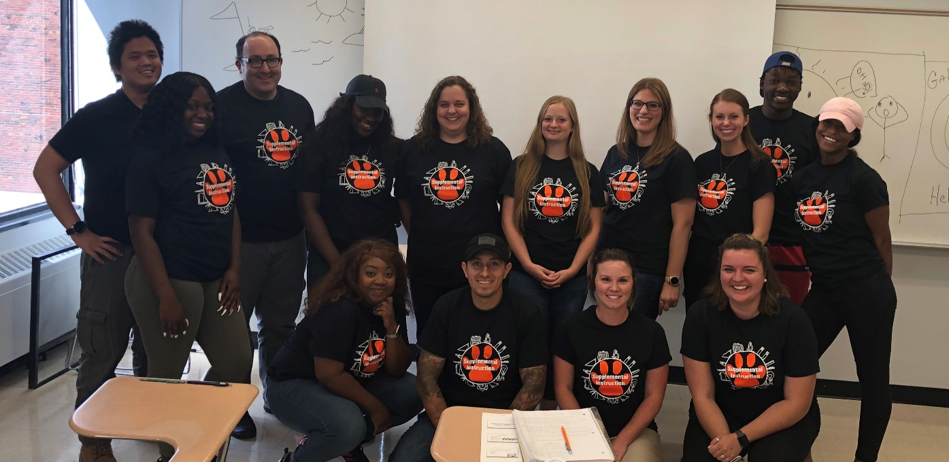
Student Achievement Programs’ Staffing Model & Recruitment Plan

Slide 11
Number of Students & Initial Program Staff
Summer Bridge:
14 Peer Mentors
Approximately 150 Students
25 Instructors
Peer Mentoring:
19 Peer Mentors
Approximately 250 Students
Supplemental Instruction:
10 SI leaders for 11 different courses
Approximately 250 Students
9 SI faculty
Additional Staff:
1 Office Assistant (CSEA)
2 Graduate Assistants
1 Work Study

Slide 12
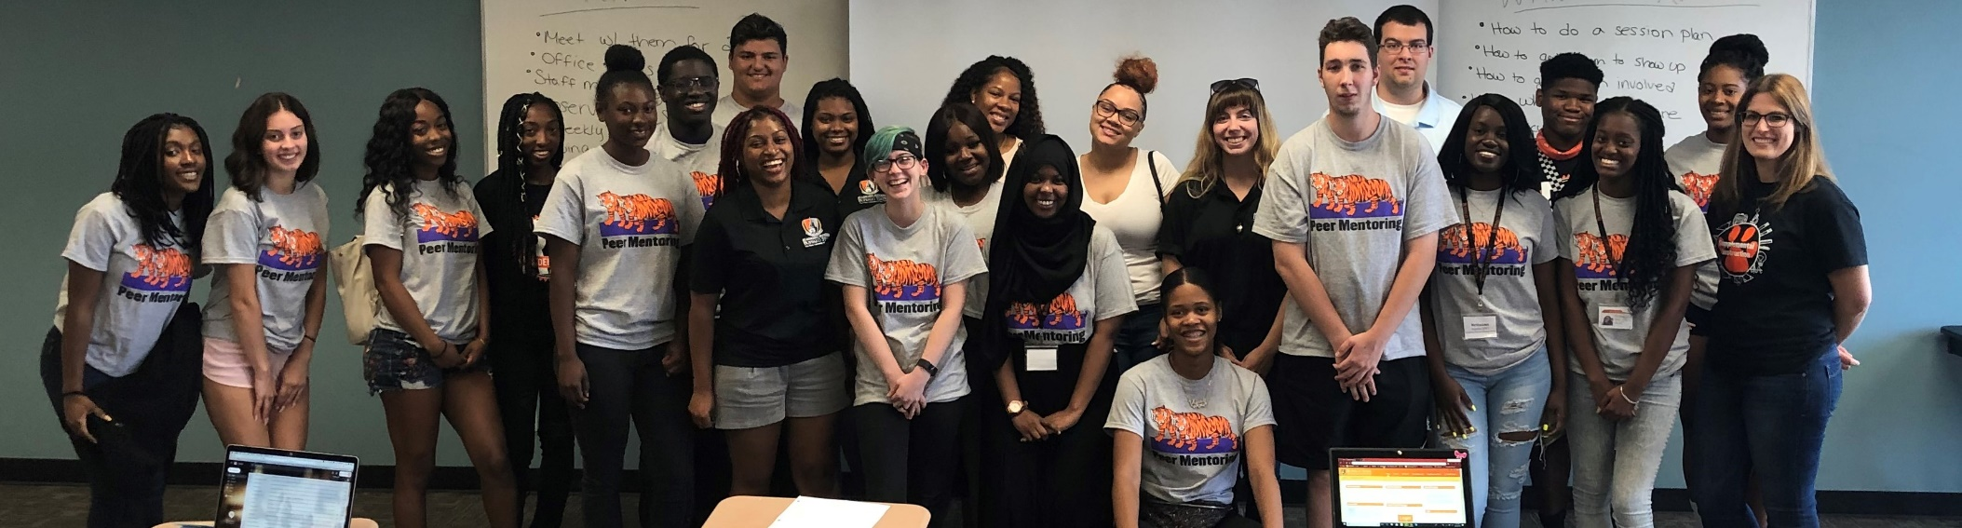
How can one Director provide support to all students and staff in large-scale retention programs?
By Creating a Culture of Leadership with Undergraduate Peer Leaders
-Senior Peer Mentors
-Senior SI Leaders

Slide 13
Number of Students & Program Staff for Each Program
Summer Bridge:
3 Senior Peer Mentors
14 Peer Mentors
Approximately 150 Students
Peer Mentoring:
3 Senior Peer Mentors
19 Peer Mentors
Approximately 250 Students
Supplemental Instruction:
2 Senior SI Leaders
10 SI leaders for 11 different courses
Approximately 250 Students
Additional Staff:
1 Office Assistant (CSEA)
2 Graduate Assistants
1 Work Study

Slide 14
Recruiting Summer Bridge Mentors/Senior Peer Mentors
Position Title: Summer Bridge Peer Mentor
Description: Summer Bridge Peer Mentors will be linked with a group of students they will work with first-year students throughout the entire week of the Academic Success Academy and will continue to mentor these students throughout their entire first year of college. The Summer Bridge Peer Mentor will assist the students to ensure they are finding their way to academic success at Buffalo State. Summer Bridge Peer Mentors have the opportunity to share what they know about being a successful student who meets their academic goals while living an engaged and exciting extra-curricular life at Buffalo State.
Qualifications: At least Sophomore Status & 3.0 GPA
Compensation: $11.10 Per Hour ($600 for the week)
Position Title: Senior Peer Mentor
Description: Senior Peer Mentors will be assigned a group of Peer Mentors who the Senior Peer Mentors will assist with fulfilling the responsibilities of the Peer Mentor position (e.g., answering questions, brainstorming ideas to engage students, supporting the Peer Mentor in their dual role of student-staff) and will observe their assigned Peer Mentors three times each throughout the semester to provide constructive feedback for performance improvement. Additionally, the Senior Peer Mentors will have additional meetings with the Director of Student Achievement Programs to discuss opportunities for program improvement.
Qualifications: At least Junior Status, must have been a Peer Mentor for the program in the past, & 3.0 GPA
Compensation: $11.10 Per Hour (Approximately $999 per semester)

Slide 15
Recruiting Peer Mentors/Senior Peer Mentors
Position Title: Peer Mentor
Description: Peer Mentors connect with their first-year mentees from the start of the fall semester through the end of the spring semester to ensure they are finding their way to academic success at Buffalo State. Peer mentors will create session plans that focus on educational, campus resource, student organizations, and team building opportunities at Buffalo State College.
Qualifications: At least Sophomore Status & 3.0 GPA
Compensation: $11.10 Per Hour (Approximately $666 per semester)
Position Title: Senior Peer Mentor
Description: Senior Peer Mentors will be assigned a group of Peer Mentors who the Senior Peer Mentors will assist with fulfilling the responsibilities of the Peer Mentor position (e.g., answering questions, brainstorming ideas to engage students, supporting the Peer Mentor in their dual role of student-staff) and will observe their assigned Peer Mentors three times each throughout the semester to provide constructive feedback for performance improvement. Additionally, the Senior Peer Mentors will have additional meetings with the Director of Student Achievement Programs to discuss opportunities for program improvement.
Qualifications: At least Junior Status, must have been a Peer Mentor for the program in the past, & 3.0 GPA
Compensation: $11.10 Per Hour (Approximately $999 per semester)

Slide 16
Recruiting SI Leaders/Senior SI Leaders
Position Title: Supplemental Instruction Leader
Description: Under the supervision of the Director of Student Achievement Programs, SI Leaders are trained in planning and facilitating collaborative and group learning in regularly scheduled study sessions (a.k.a., SI sessions) for Buffalo State students who are enrolled in targeted courses. The SI sessions are scheduled group meeting times in which SI Leaders help students in the SI session interact with the material in a more engaging way.
Qualifications: At least Junior Status, B+ or higher in the chosen course, & 3.0 GPA
Compensation: $11.10 Per Hour (Approximately $1332 per semester)
Position Title: Senior Supplemental Instruction Leader
Description: Senior SI Leaders will be assigned a group of SI Leaders who the Senior SI Leader will assist with fulfilling the responsibilities of the SI Leader position (e.g., answering questions, brainstorming ideas to engage students, supporting the SI Leader in their dual role of student-staff) and will observe three of their assigned SI Leaders each week to provide constructive feedback for performance improvement. Additionally, the Senior SI Leaders will have additional meetings with the Director of Student Achievement Programs to discuss opportunities for program improvement.
Qualifications: At least Senior Status, must have been a SI Leader for the program in the past, & 3.0 GPA
Compensation: $11.10 Per Hour (Approximately $999 per semester)

Slide 17
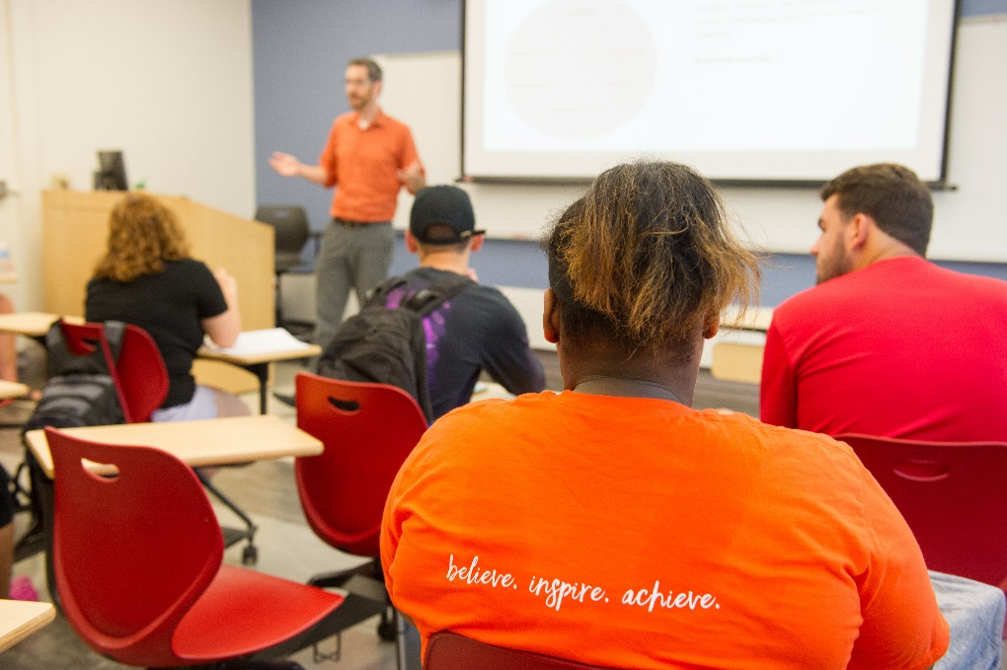
Student Achievement Programs’ Staffing Model: Hierarchies of Support

Slide 18
Summer Bridge Hierarchy of Support
Peer Mentors | Assigned 10-15 students to mentor throughout the summer bridge week and into the school year.
Senior Peer Mentors | Assigned 5-7 Peer Mentors to mentor throughout the week. Senior Peer Mentors helps with creating team building activities, ensuring each group is at their designated places at the correct time, and facilitating the group events.
Director & Graduate Assistants | Run the program, address questions and concerns, support the senior peer mentors, and teach courses alongside the faculty.
Everyone | An app, GroupMe, provides everyone with up to date information and a place to address concerns.

Slide 19
Peer Mentoring Hierarchy of Support
Each Peer Mentor is assigned 10-15 students to mentor throughout the school year. Peer Mentors work 4 hours per week:
-2 hours meeting with mentees (including 3 observations per semester)
-1 hour office hour/session planning
-1 hour staff meeting/meeting with Senior Peer Mentor
Each Senior Peer Mentor is assigned 6-7 Peer Mentors to mentor throughout the semester. Senior Peer Mentors work 6 hours per week:
-1 hour meeting with mentors during office hours/Senior Peer Mentor Meeting
-1 hour peer mentor staff meeting
-2 hours observing mentors
-2 hours of session plan review
Questions or concerns about office hours, scheduling meetings with mentees, turning in paperwork are brought to the Peer Mentoring Graduate Assistant.
Questions or concerns about mentees, mentors, supervision, or the program are brought to the Director.
A Group Me provides everyone with up to date information and a place to address concerns.

Slide 20
Supplemental Instruction Hierarchy of Support
Each Supplemental Instruction Leader is assigned to teach one session for a chosen course per week. SI Leaders work 8 hours per week:
3 hours course lecture
1 hour SI session including bi-weekly observations
1 office hour per week
1 hour every other week meeting with faculty member
1 hour every other week staff meeting (opposite week than the faculty member meeting)
2 hour lesson planning
Each Senior Supplemental Instruction Leader is assigned 5-6 SI Leaders to mentor throughout the semester. Senior SI Leaders work 6 hours per week:
-1 hour senior SI Leader/SI Leader staff meeting
-2 hours observing SI Leaders
-3 hours of lesson plan review/contacting SI leaders
Questions or concerns about office hours, lesson plan ideas, turning in paperwork are brought to the Supplemental Instruction Graduate Assistant.
Questions or concerns about students, classroom concerns, classroom management, supervision, or the program are brought to the Director.
A Group Me provides everyone with up to date information and a place to address concerns.

Slide 21
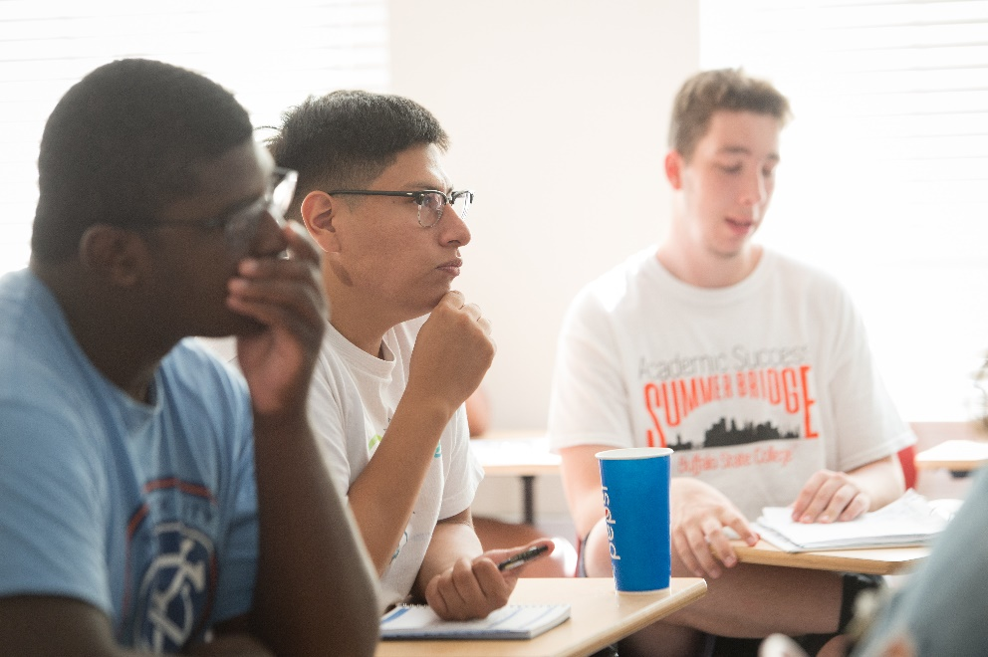
Student Achievement Programs: A Dive Into the Program Materials

Slide 22
Summer Bridge Materials
Group Lists
T-shirt Logistics
Summer Bridge Sign In Sheets
Summer Bridge Emergency Contact Lists
Evening Activities List
Summer Bridge Meals List
Room Reservation List
Summer Bridge Feedback from Students
Summer Bridge Feedback from Mentors
Blackboard Assignments
Guidebook
Syllabus
Summer Bridge Schedule for Program Staff
Summer Bridge Lesson Plan Template
Faculty & Staff Words of Wisdom Template
Summer Bridge Student Schedule

Slide 23
Peer Mentoring Materials
Mentee Progress Report
Mentor Progress Report
Peer Mentor Before Session Plan
Peer Mentor After Session Plan
Peer Mentor Observation Rubric
Peer Mentor Drop-In Office Hour Reflection
Peer Mentor 5 Week Evaluation
PM End of Semester Evaluation
SPM 5 Week Evaluation
SPM End of Semester Evaluation
Peer Mentor Online Training
Peer Mentor In Person Training
Peer Mentor Expectations
Prior Approval Form for Off Campus Peer Mentor Meetings
Peer Mentor Office Hours Sign-in Sheet
Office Hour Sign-in Sheet for Mentees
Peer Mentoring Feedback for PM
Peer Mentoring Feedback from Students

Slide 24
Supplemental Instruction Materials
SI Hour Lesson Plan (Before Session)
SI Hour Lesson Plan (After Session)
SI Leader Progress Reports Fall 2019
SI Drop-In Office hour Reflection
SI Observation Record
SI Leader 5 Week Evaluations
SI Leader End of Semester Evaluations
Senior SI Leader 5 Week Evaluation
Senior SI Leader End of Semester Evaluation
SI Leader Online Training
SI Leader & Faculty In Person Training
SI Leader Office Hour Sign-in Sheet
SI Student Office Hours Sign-in Sheet
SI Photo Release Form
SI Program Evaluation Sheets-SI Faculty
SI Program Evaluation Sheets-SI Leaders
SI Leader Student Evaluation & Program Feedback

Slide 25
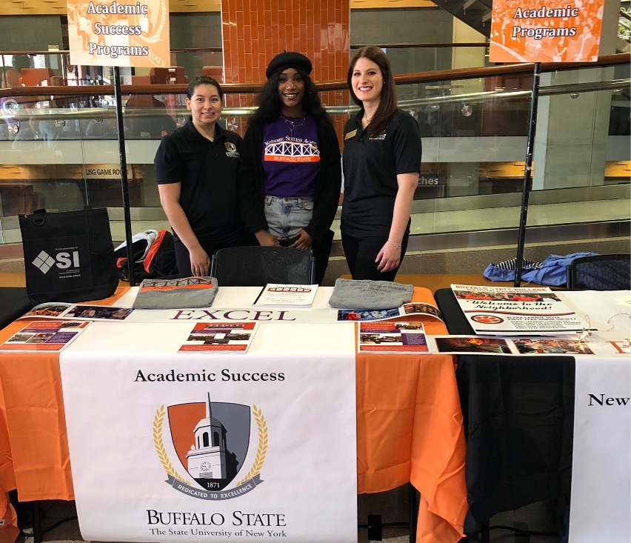
Student Achievement Programs’ Staffing Model: The Power of Paraprofessionals

Slide 26
Why is creating a culture of leadership with undergraduate peer leaders beneficial?
Employee Support:
All program staff get real time support
There is always someone to go to when there is a concern
The SPM/SSI pass down advice from their experiences and offer suggestions for improvement
SPM/SSI provide feedback for additional support needed, program improvement, and staff meeting ideas
Staffing Ratio:
The staff meetings are organized by which SPM/SSI they are assigned so there are less people in each meeting which provides more one on one support
Alternating office hour drop-ins with the Director, Graduate Assistants, or SPM/SSI provide each person with time to get one on one advice

Slide 27
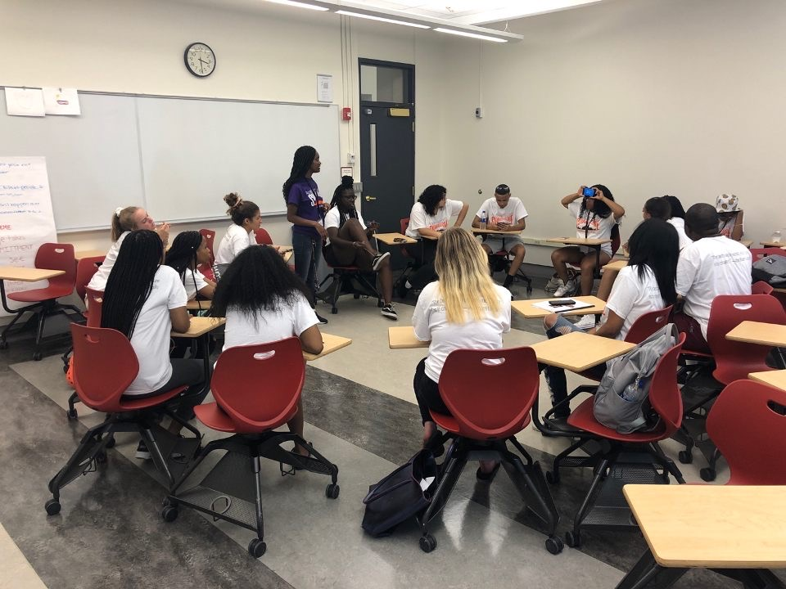
Why is creating a culture of leadership with undergraduate peer leaders beneficial?
Retaining Continuing Students:
Purposeful work related to mattering theory
Leadership opportunities
Giving back
Academic Success:
Paid on-campus work opportunities
Connections to faculty and staff
Community within the paraprofessional staff

Slide 28
Follow-up questions?
Please ask!
Dr. Ashley Martin, Director of Student Achievement Programs
martinar@buffalostate.edu
Dr. Heather Maldonado, Assistant Provost for Academic Success
maldonhd@buffalostate.edu
SUNY Student Success Summit, October 2019

