Slide 1
Rethinking the Syllabus
Chris Price
Academic Programs Manager
SUNY Center for Professional Development
chris.price@suny.edu

Slide 2
Rethinking the Syllabus
Which of the following best summarizes how you feel about your syllabi?
I love creating them! It is great way to see the course all in one place and I try to improve them every semester.
It’s just one of those things I need to do before the semester. I get more excited when the course actually starts.
It’s a necessary evil that students do not read. If the college didn’t require it, I would figure out another way to present this information to my students.
All of the above

Slide 3
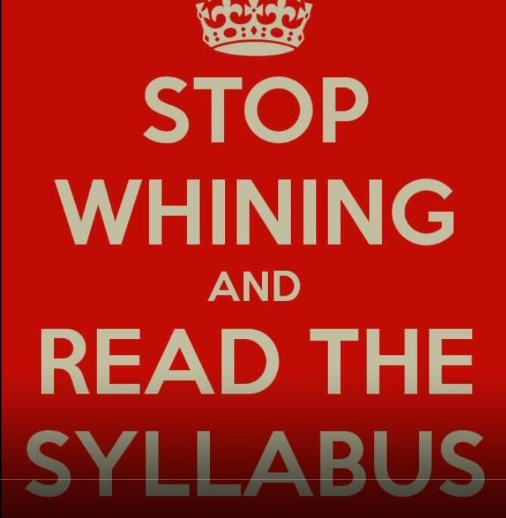
Rethinking the Syllabus
Purpose of the syllabus
Essentials for all syllabi
Syllabus format options
"Stop whining and read the syllabus," https://flic.kr/p/jqdDTu,
CC BY-NC-ND 2.0
Notes:
,

Slide 4
Rethinking the Syllabus

Slide 5
Purpose of the Syllabus
“A syllabus lets students know what the course is about, why the course is taught, where it is going, and what will be required for them to be successful in the course.” (Altman & Cashin, 2003, https://eric.ed.gov/?id=ED395539)
A primary purpose of a syllabus is to communicate to your students what the course is about, why it is taught, where it is going, and what will be required of the students for them to complete the course with a passing grade. (https://sc.edu/about/offices_and_divisions/cte/teaching_resources/syllabus_templates/docs/cte_syllabus_best_practices.pdf)
“When we think about what it is, a syllabus is most simply a document that expresses to the reader the intentions of the instructor regarding course content, learning goals, assessment approach, and expectations. It outlines for the reader what is expected to transpire during the course and what should be learned.” (https://teaching.utk.edu/teaching-resources/fundamentals/purposes-of-a-syllabus/)

Slide 6
Purpose of the Syllabus
The syllabus tells students who you are
Parker Palmer, The Courage to Teach, “Good Teaching is Not Just Technique” https://vimeo.com/155180127

Slide 7
Purpose of the Syllabus

Slide 8
Purpose of the Syllabus
Syllabus should communicate
Hospitality
Safety
Challenge

Slide 9
Essentials for all Syllabi
Equitable
USC Center for Urban Educaton Equity Minded Syllabus Review Tool: https://cue-equitytools.usc.edu/
Notes:
"With few exceptions (historically black colleges and universities being the most notable), higher education institutions were founded and designed to serve white students, particularly those who are male, middle- to upper-class, heterosexual, able-bodied, and Christian.
Despite the increasing diversity of the American college student population, many of higher education’s policies and practices have not been reconfigured to equitably support, affirm, and validate students from racially minoritized groups.
Syllabi are also learning tools that can help students develop effective learning practices and strategies, as well as communication devices that share how teaching will be approached. (Grunnert, 1997; Parkes & Harris, 2002)"
"This website is dedicated to helping instructors build a syllabus that plans for diverse student abilities and promotes an atmosphere in which students feel comfortable discussing their unique abilities. Countless instructors complain that students don’t read the syllabus. We believe students would use the document more effectively if it were designed more accessibly.
Accessibility is necessary for all learning, and disability studies provides a key lens through which to question our classroom practices and resources. To create more inclusive teaching, instructors must plan for diversity in the classroom and adapt to the immediate needs of students."

Slide 11
Essentials for all Syllabi
Inclusive
Help "instructors build a syllabus that plans for diverse student abilities and promotes an atmosphere in which students feel comfortable discussing their unique abilities." https://www.accessiblesyllabus.com/
Notes:
"With few exceptions (historically black colleges and universities being the most notable), higher education institutions were founded and designed to serve white students, particularly those who are male, middle- to upper-class, heterosexual, able-bodied, and Christian.
Despite the increasing diversity of the American college student population, many of higher education’s policies and practices have not been reconfigured to equitably support, affirm, and validate students from racially minoritized groups.
Syllabi are also learning tools that can help students develop effective learning practices and strategies, as well as communication devices that share how teaching will be approached. (Grunnert, 1997; Parkes & Harris, 2002)"
"This website is dedicated to helping instructors build a syllabus that plans for diverse student abilities and promotes an atmosphere in which students feel comfortable discussing their unique abilities. Countless instructors complain that students don’t read the syllabus. We believe students would use the document more effectively if it were designed more accessibly.
Accessibility is necessary for all learning, and disability studies provides a key lens through which to question our classroom practices and resources. To create more inclusive teaching, instructors must plan for diversity in the classroom and adapt to the immediate needs of students."

Slide 12
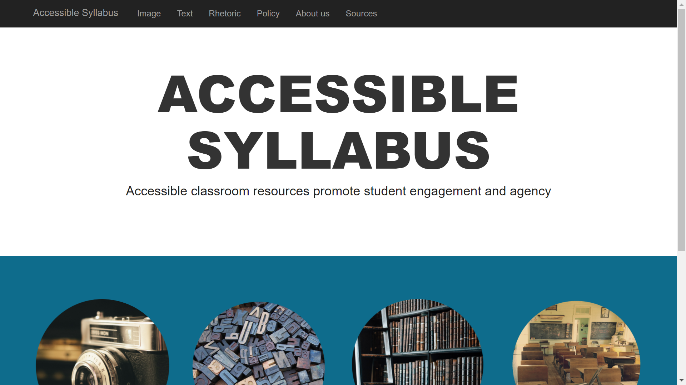

Slide 13
Essentials for all Syllabi
Lolita Paff, "Learner-Centered Syllabus"
https://www.facultyfocus.com/articles/effective-classroom-management/a-learner-centered-syllabus-helps-set-the-tone-for-learning/
A rationale for course objectives and assignments
Shared decision making
Warnings of potential pitfalls
Recommendations for staying on track

Slide 14
Essentials for all Syllabi
Kevin Gannon, "How to Create a Syllabus"
https://www.chronicle.com/article/how-to-create-a-syllabus/
Don’t think of it as a contract
Include nuts and bolts along with invitation to actively engage in the learning process
Avoid a scolding tone or putting something all in caps
Consider a brief bio about who you are and how you ended up teaching this course/subject
State course goals clearly as well as how they will be measured in assessments and practiced in activities
Highlight the reasons for policies more than the consequences
Clearly identify and explain reasons for the grading policy

Slide 15
Syllabus Format Options
Traditional Syllabus
LMS Embedded Syllabus
Liquid Syllabus
Course Map
Unsyllabus

Slide 16
Traditional Syllabus
Pros: Printable! Campus Approved! Easy to Create!
Cons: Bureaucratic/legalistic, visually unappealing, unengaging
Tone matters: Create a “welcoming” syllabus using a “warm” tone

Slide 18
LMS Embedded Syllabus
Pros: Information is presented in chunks
Cons: Templates lack personalization
Syllabus especially important in an online asynchronous course where there is no common first day of class

Slide 20
Liquid Syllabus
Formatted more like a website with a video and demystifying what it takes to be successful than a typical document
https://sites.google.com/view/hosp-welcome

Slide 21
Course Map
Would work in tandem with a more traditional syllabus but would ultimately be the weekly “go to” document for students during the semester
https://youtu.be/5NYPj_zwBtI?t=377

Slide 23
Unsyllabus
Death to the Syllabus!
Singham, 2007, reprinted in https://tomprof.stanford.edu/posting/834
"It is time to declare war on the traditional course syllabus. If there is one single artifact that pinpoints the degradation of liberal education, it is the rule-infested, punitive, controlling syllabus that is handed out to students on the first day of class."

Slide 24
Unsyllabus
Co-Create Syllabus with Students
Meet them halfway (Amy Nelson - http://openpedagogy.org/course-level/collaborative-syllabus-design-students-at-the-center/)
First day syllabus is "preliminary"- provides some learning objectives, requirements, and framework for evaluation
Spent 15% of class time first four weeks finalizing
A lot of time spent on expectations (students and instructor)

Slide 25
Unsyllabus
Co-Create Syllabus with Students
Give them the keys Kristin Blinne (2021) “Ungrading Communication”
Structure the syllabus as an interactive "course map" to allow students to customize the course according to who they are
Establish group consensus about course content and policies
No exams or quizzes - assessment criteria for each assignment are developed collaboratively with each student after work has been completed
No deadlines for assignments – just a date at the end of the semester when they need to be finalized
No grades during the semester – final grades established in end of semester meetings with students and based on student self-assessments and instructor feedback for each assignment

Slide 26
Rethinking the Syllabus
Is there a format not discussed so far that you would like to share?
What strategies do you use to make it more likely that students will read the syllabus?
What role do your syllabi play in reflecting on and improving your teaching?

Slide 27
For recordings and other resources, please visit:
www.suny.edu/OTTER

