Slide 1
ePATIENT

Slide 2
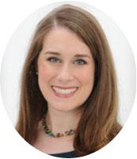
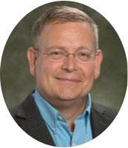
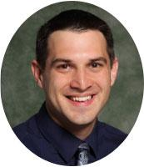
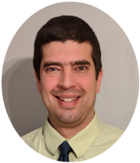
Introductions
Sarah Lynch
School of Pharmacy
Fritz Sticht
School of Pharmacy
Tim Cortesi
ITS
Adam Smallcomb
ITS
Patti Reuther, MS, RN, CHSE
Decker School of Nursing
Binghamton University
Andrew Symons, MD
Jacobs School of Medicine & Biomedical Sciences
University at Buffalo
Notes:
Sarah

Slide 3
Terminology
Electronic Medical Records (EMR)
Widely used in the healthcare setting
Play an important role in promoting communication about a patient through the sharing of diagnostic information, medication lists, and provider notes
Interprofessional Education (IPE)
New requirements from accrediting bodies require health science programs to educate their students in an interprofessional environment in order to learn “from, about, and with” other professionals
The majority of current IPE exercises occur “live,” with all healthcare professional students in the same place at the same time working through a clinical case
Notes:
Sarah

Slide 4
The Problem
Current training modalities are insufficiently preparing students for team-based care.
Notes:
Sarah
The goal is to create a new platform tailored to deliver IPE activities. There are several problems we have encountered: Getting students together (schedule, location), Existing systems are not suited for “mass consumption”. Commercial systems are not ideal for several reasons: time, records can not be altered so new patients have to be created for a new group, cost, maintenance. Educational EMRs don’t have IPE capabilities...etc. So should we list problems or change this slide?

Slide 5
The Solution
Notes:
Sarah
The goal is to create a new platform tailored to deliver IPE activities. There are several problems we have encountered: Getting students together (schedule, location), Existing systems are not suited for “mass consumption”. Commercial systems are not ideal for several reasons: time, records can not be altered so new patients have to be created for a new group, cost, maintenance. Educational EMRs don’t have IPE capabilities...etc. So should we list problems or change this slide?

Slide 6
What’s wrong with a classroom?
Scheduling
Notes:
Sarah
Current Options: Currently available educational EMRs are either costly, wieldy for faculty or students, or both (including heavy back-end management issues such as recreation of new cases for each student or solo activities only without team support)
Scheduling and geography: Interprofessional activities can be difficult to schedule and coordinate, especially if a campus has limited healthcare education programs

Slide 7
Why not use a Commercial EMR?
Commercial EMRs are very expensive!
software licensing
software management overhead
overhead of creating/re-creating “cases” for multiple users
“Time” is relative and counterintuitive in training scenarios. This isn’t possible with a Commercial EMR.
Notes:
Sarah
Current Options: Currently available educational EMRs are either costly, wieldy for faculty or students, or both (including heavy back-end management issues such as recreation of new cases for each student or solo activities only without team support)

Slide 8
Don’t Educational EMRs Exist?
Training EMRs are also very expensive, often passing on the costs to the students. ($100/year/student)
Training EMRs are typically not collaborative or team-based, and focus on an individual. (Not particularly realistic)
Notes:
Sarah
Current Options: Currently available educational EMRs are either costly, wieldy for faculty or students, or both (including heavy back-end management issues such as recreation of new cases for each student or solo activities only without team support)

Slide 9
The Vision
Create an online educational EMR platform where health science students can participate as part of a patient care team (interprofessionally(IP)) - effectively removing scheduling and geographical issues.
Overcome the limitations of existing Commercial and Training EMRs
Notes:
Sarah

Slide 10
Project Goals:
To develop….
A way for students to work in IP teams, but remotely (synchronously or asynchronously), on patient cases
A realistic way for faculty to share patient case information with students
An affordable, open-access platform, for widespread use by SUNY healthcare education programs
A platform to promote increased collaboration among SUNY healthcare education programs
Notes:
Sarah

Slide 11
IITG Grant: Project Goals Meets Reality
We asked for ~$60K
We were funded for $20K.
What do we focus on?
Build an interprofessional EMR
(ePATIENT)
Generate Patient Cases
Deploy at Multiple Schools
Notes:
Sarah/Fritz

Slide 12
IITG Grant: Phase 2 (Coming in 2019 - 2020)
$55K Funded in full!
Expand the interprofessional EMR
ePATIENT
Generate Patient Cases
Deploy at Multiple Schools
Notes:
Sarah/Fritz
Single Sign-on
Role assignment
Limits access to specific areas based on role
Reporting mechanism
Enhanced libraries
UI Templates
Scenario Development

Slide 13
Notes:
Fritz

Slide 14
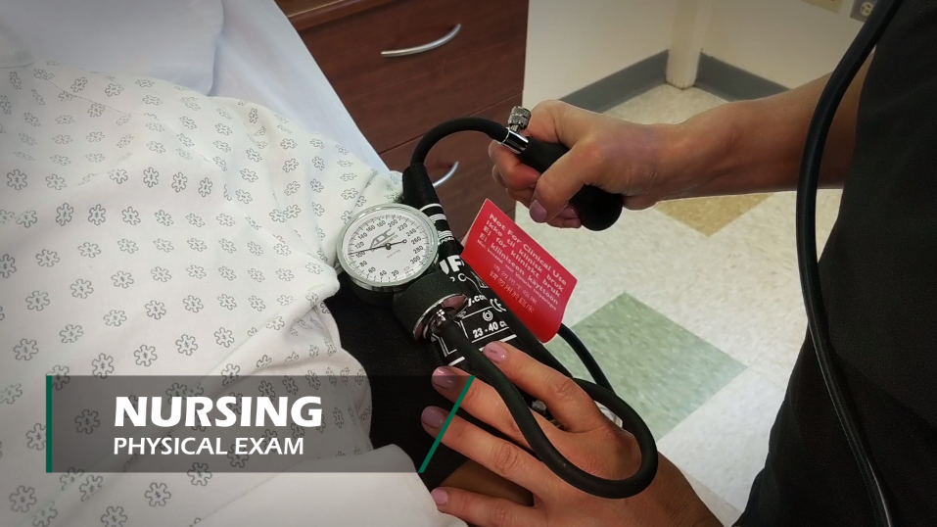
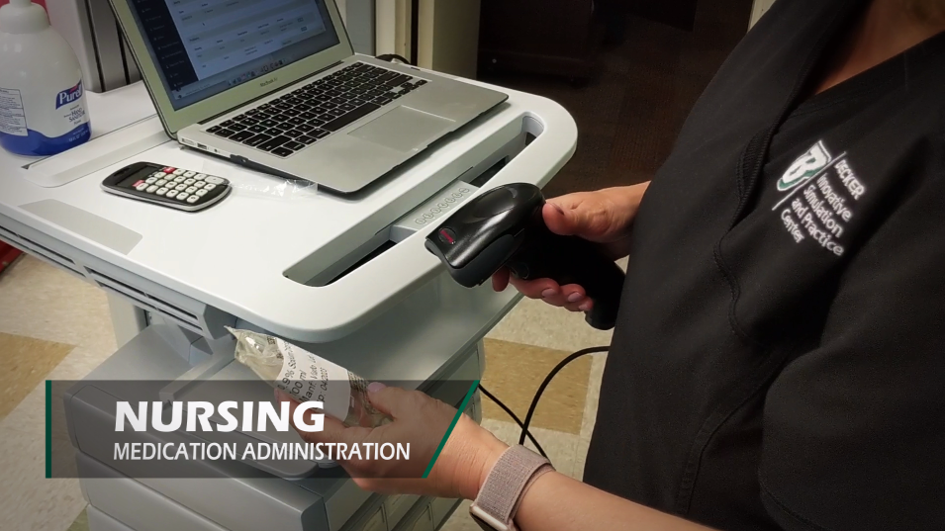
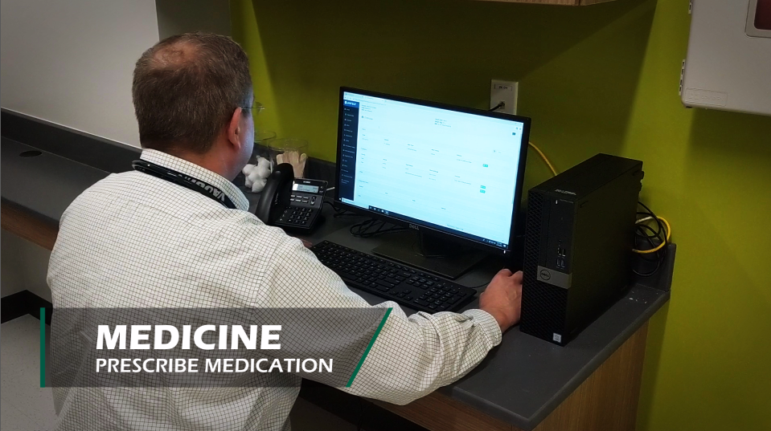
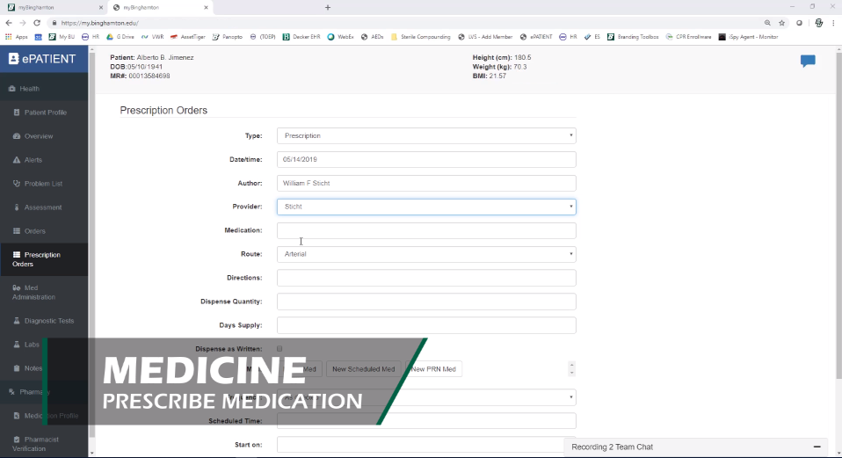
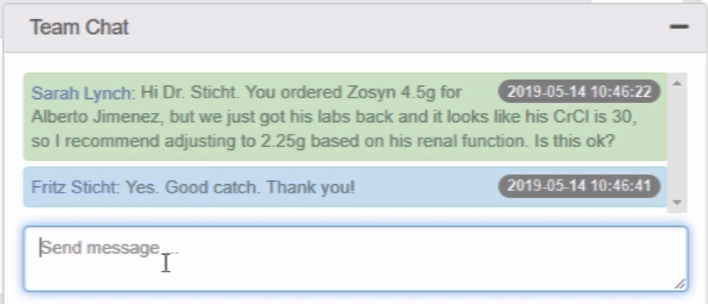
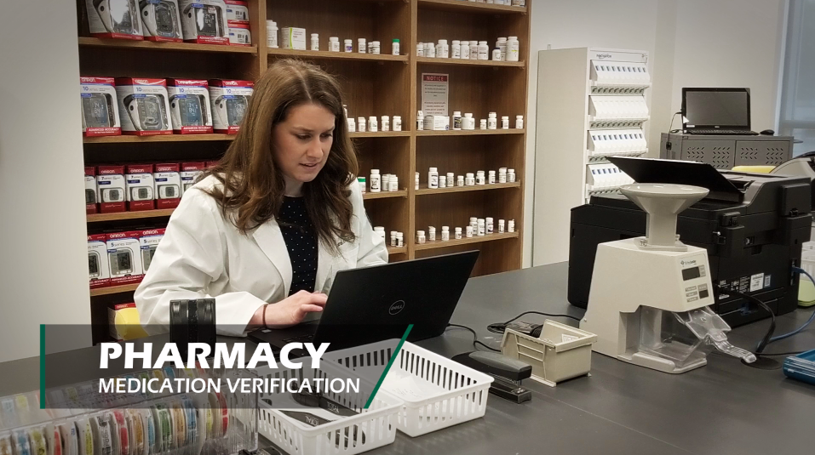
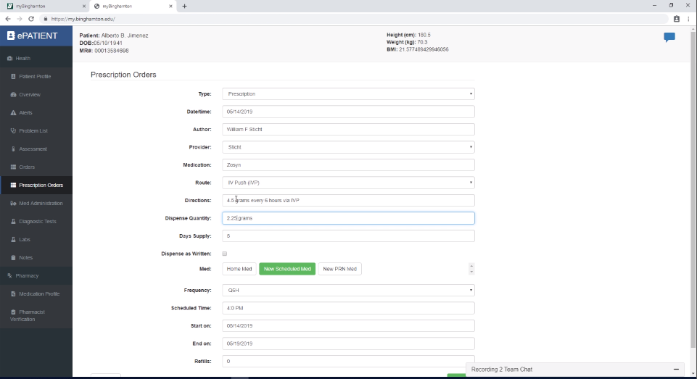
Flow Chart of Patient Care Process - Example
NURSING
Patient is admitted to the emergency room
MEDICINE
PHARMACY
Notes:
Fritz
Add Screen Grabs from the videos to each step.

Slide 15
How Did We Do It?
Notes:
Adam/Tim

Slide 16
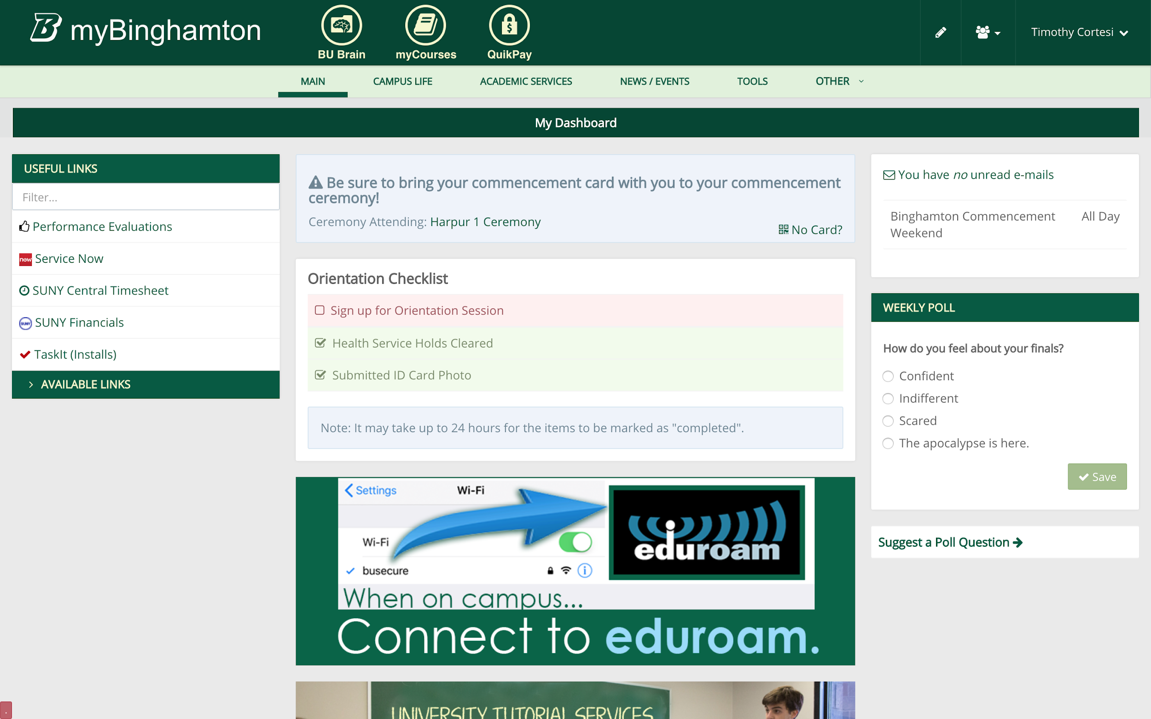
Some Background...
Binghamton University’s my.binghamton.edu “portal” is developed around a custom open source engine called “Graphene”.
Graphene allows for the rapid development and deployment of “Micro” Applications.

Slide 17
2018 - 2019: How do we build ePATIENT Training EMR?
 | Build ePATIENT in Graphene | Build ePATIENT as a fully custom standalone application
PROS | Development Time is DRASTICALLY Reduced The Infrastructure is already in place We can always migrate the code to a fully custom app at a later date. | We can theoretically make it do absolutely anything We can theoretically make it support federated Single-Sign-On for use at multiple schools.
CONS | Makes it harder to deploy at schools other than Binghamton University. (w/o Graphene) | $20K isn’t enough money to build a fully custom standalone EMR.

Slide 18
ePATIENT 1.0 Architecture
ePATIENT User Interface Runs as a MicroApplication within Graphene
Database
ePATIENT API Server
myBinghamton / Graphene
myBuffalo / Graphene??

Slide 19
2019 - 2020: NOW How do we build ePATIENT Training EMR?
 | Build ePATIENT in Graphene | Build ePATIENT as a fully custom standalone application
PROS | Development Time is DRASTICALLY Reduced The Infrastructure is already in place We can always migrate the code to a fully custom app at a later date. | We can theoretically make it do absolutely anything We can theoretically make it support federated Single-Sign-On for use at multiple schools.
CONS | Makes it harder to deploy at schools other than Binghamton University. (w/o Graphene) | $20K isn’t enough money to build a fully custom standalone EMR.

Slide 20
Database
ePATIENT 2.0 Architecture
(Coming Soon!)
ePATIENT User Interface Runs as a standalone application with Federated Single Sign On
Binghamton SSO
ePATIENT Application
Buffalo
SSO

Slide 21
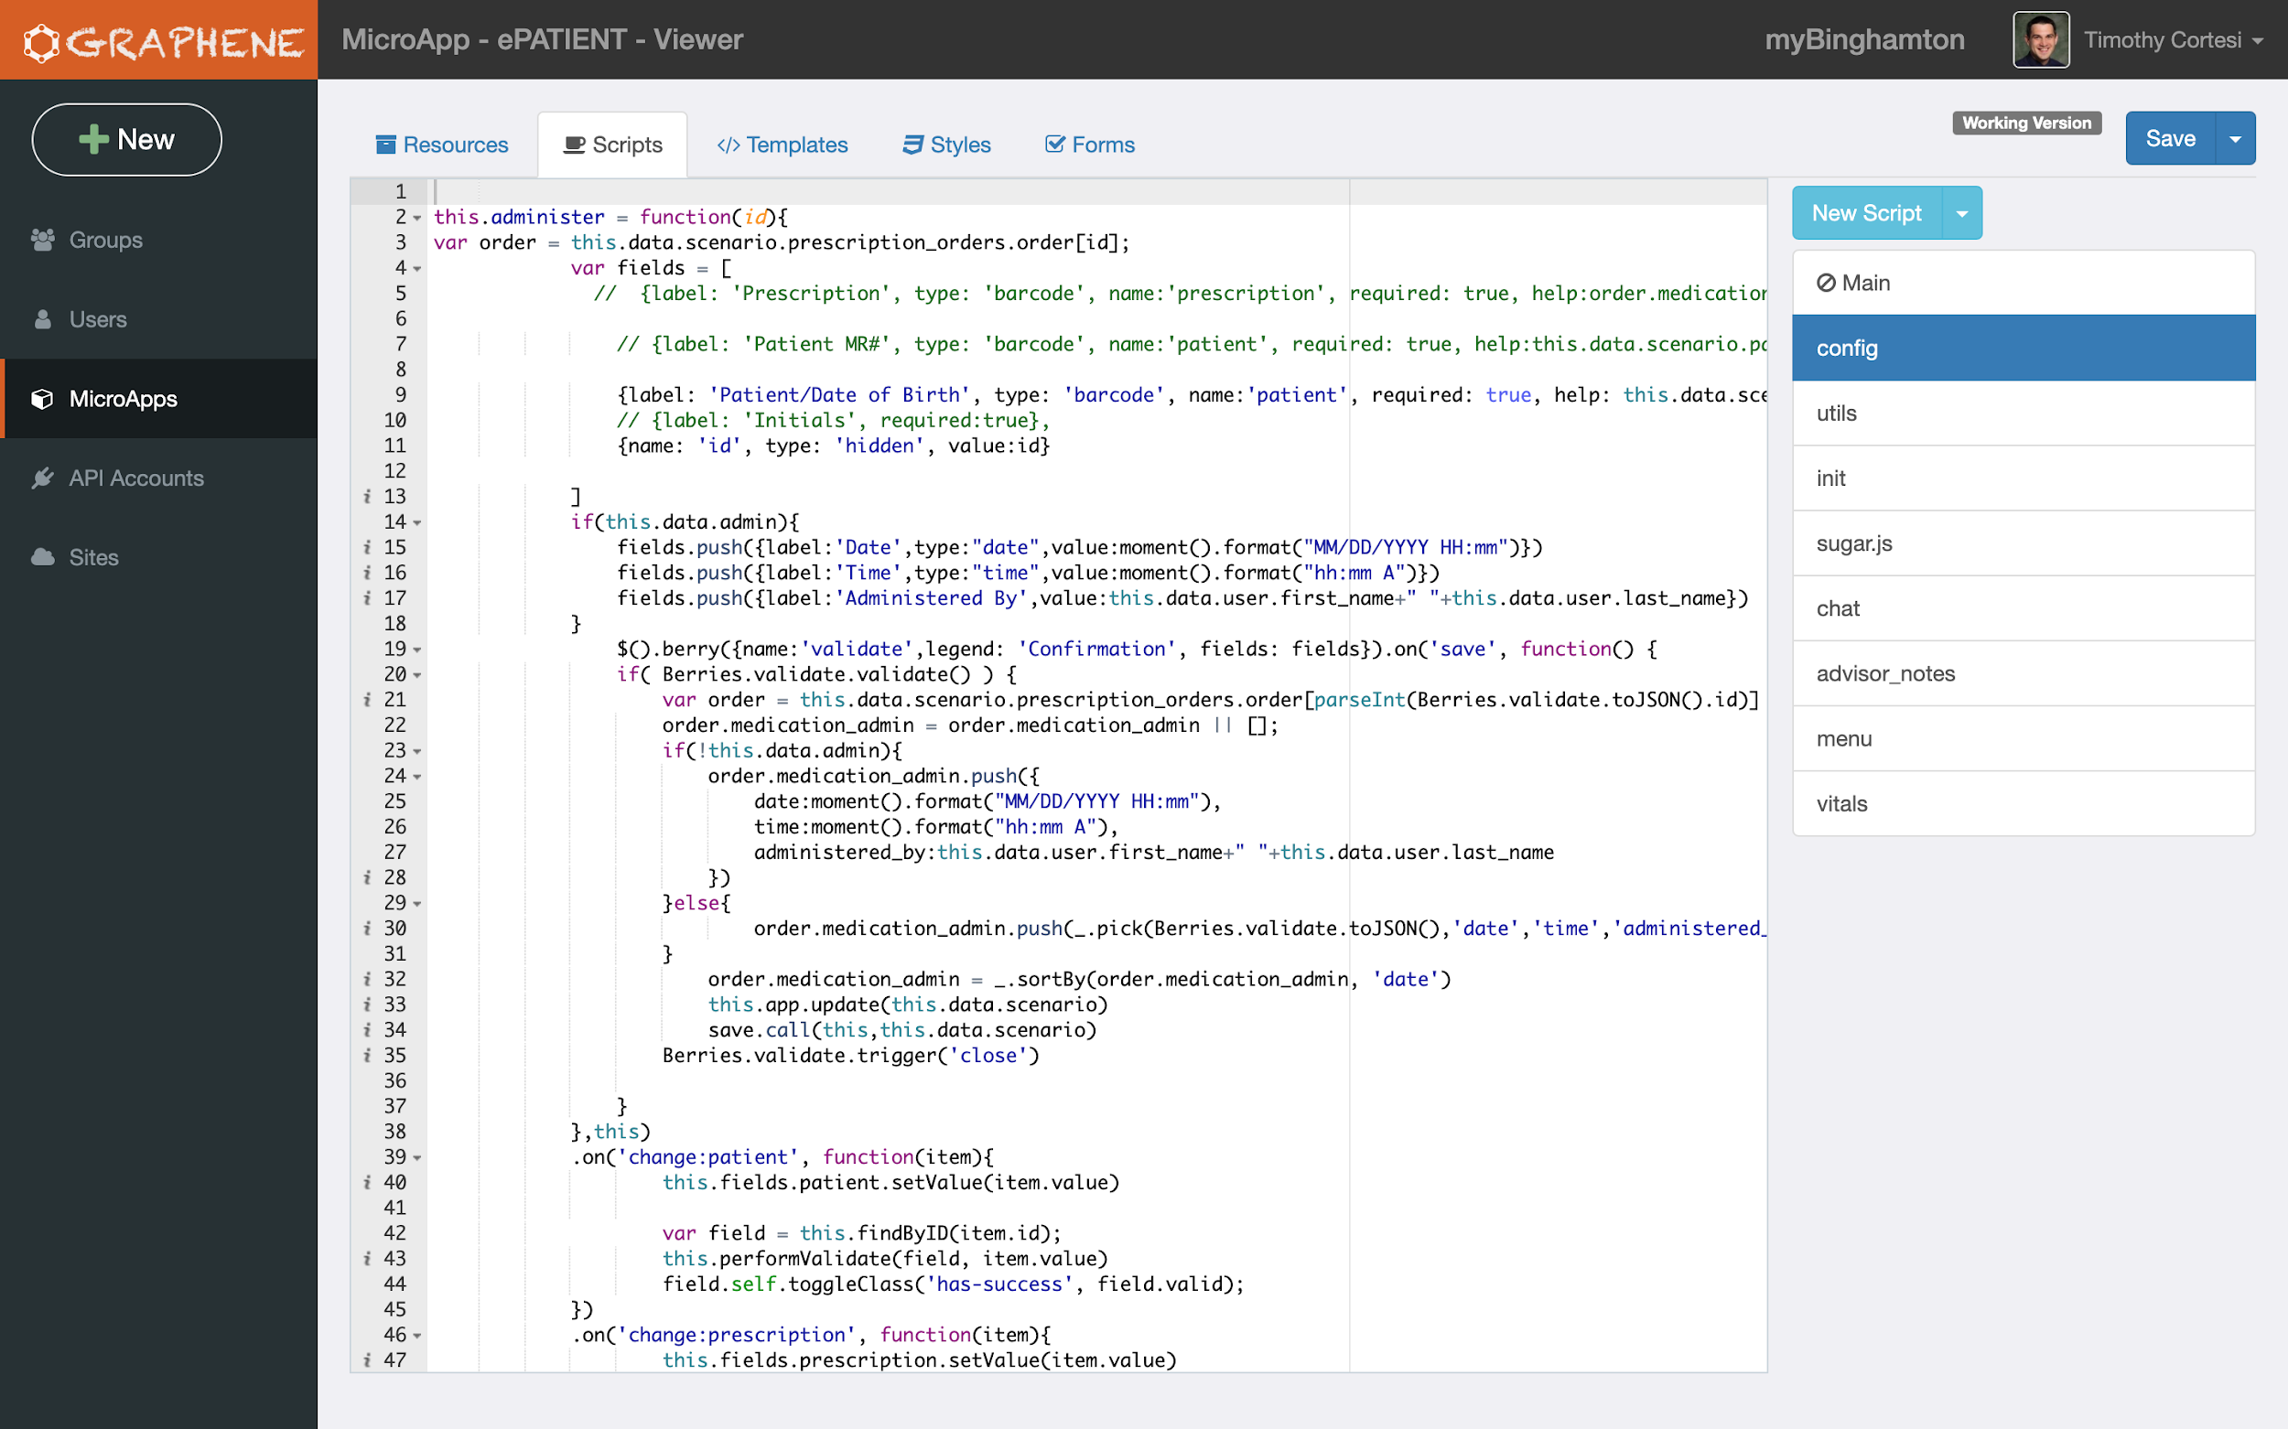
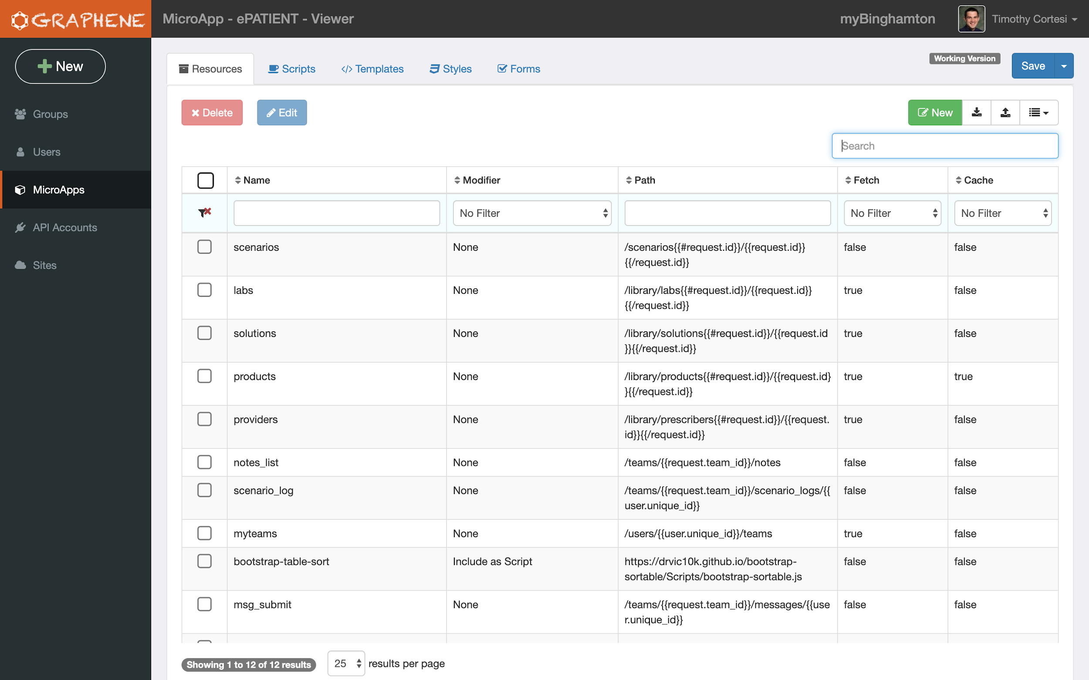
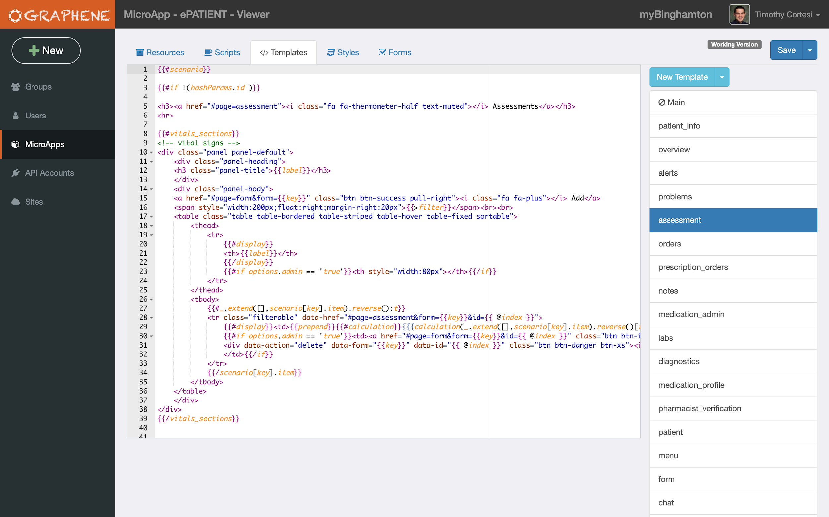
Also LOTS ...

Slide 22
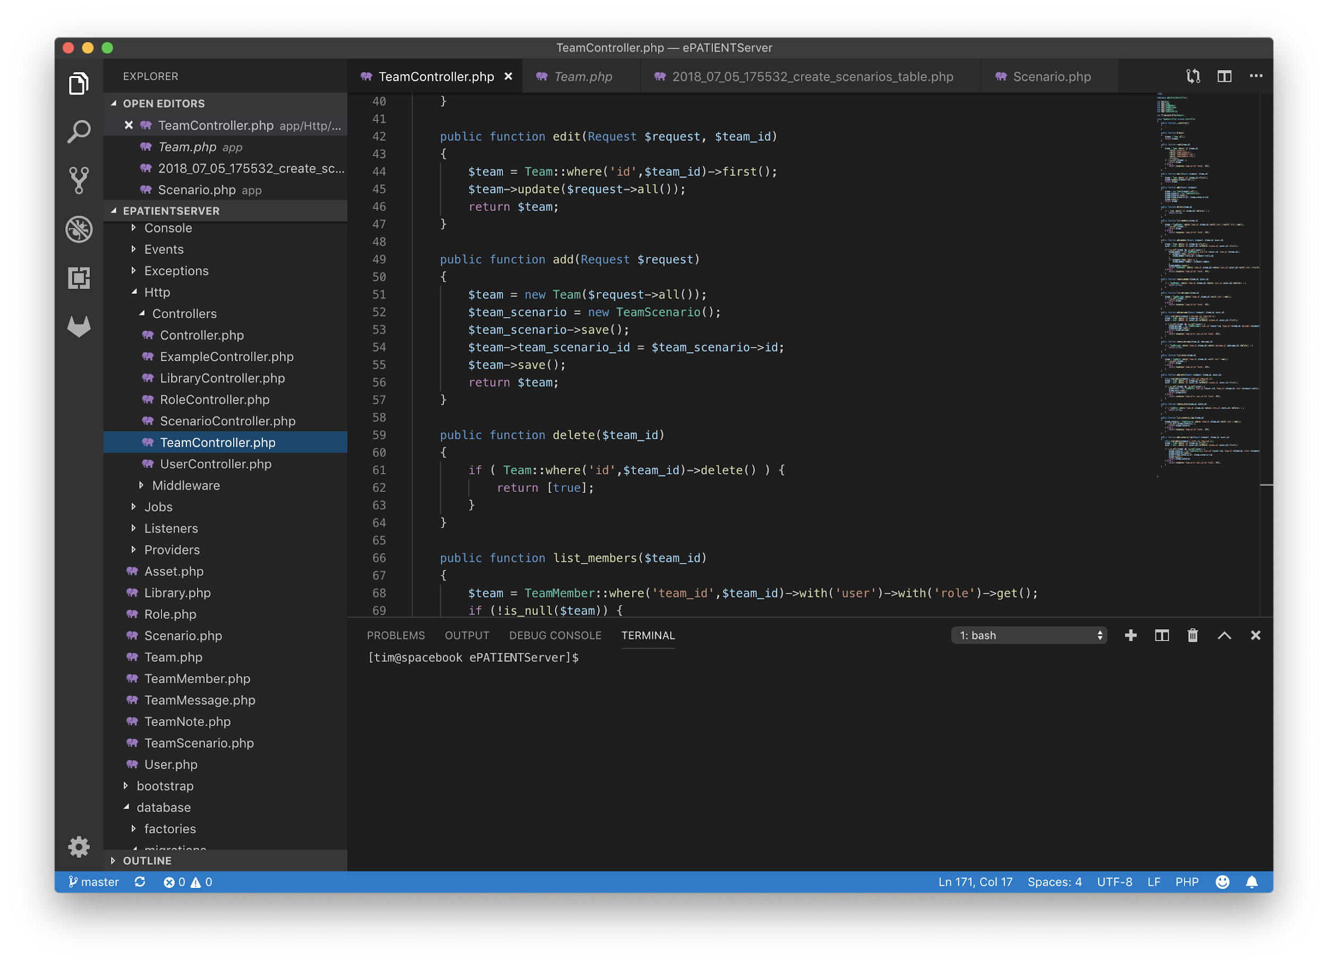
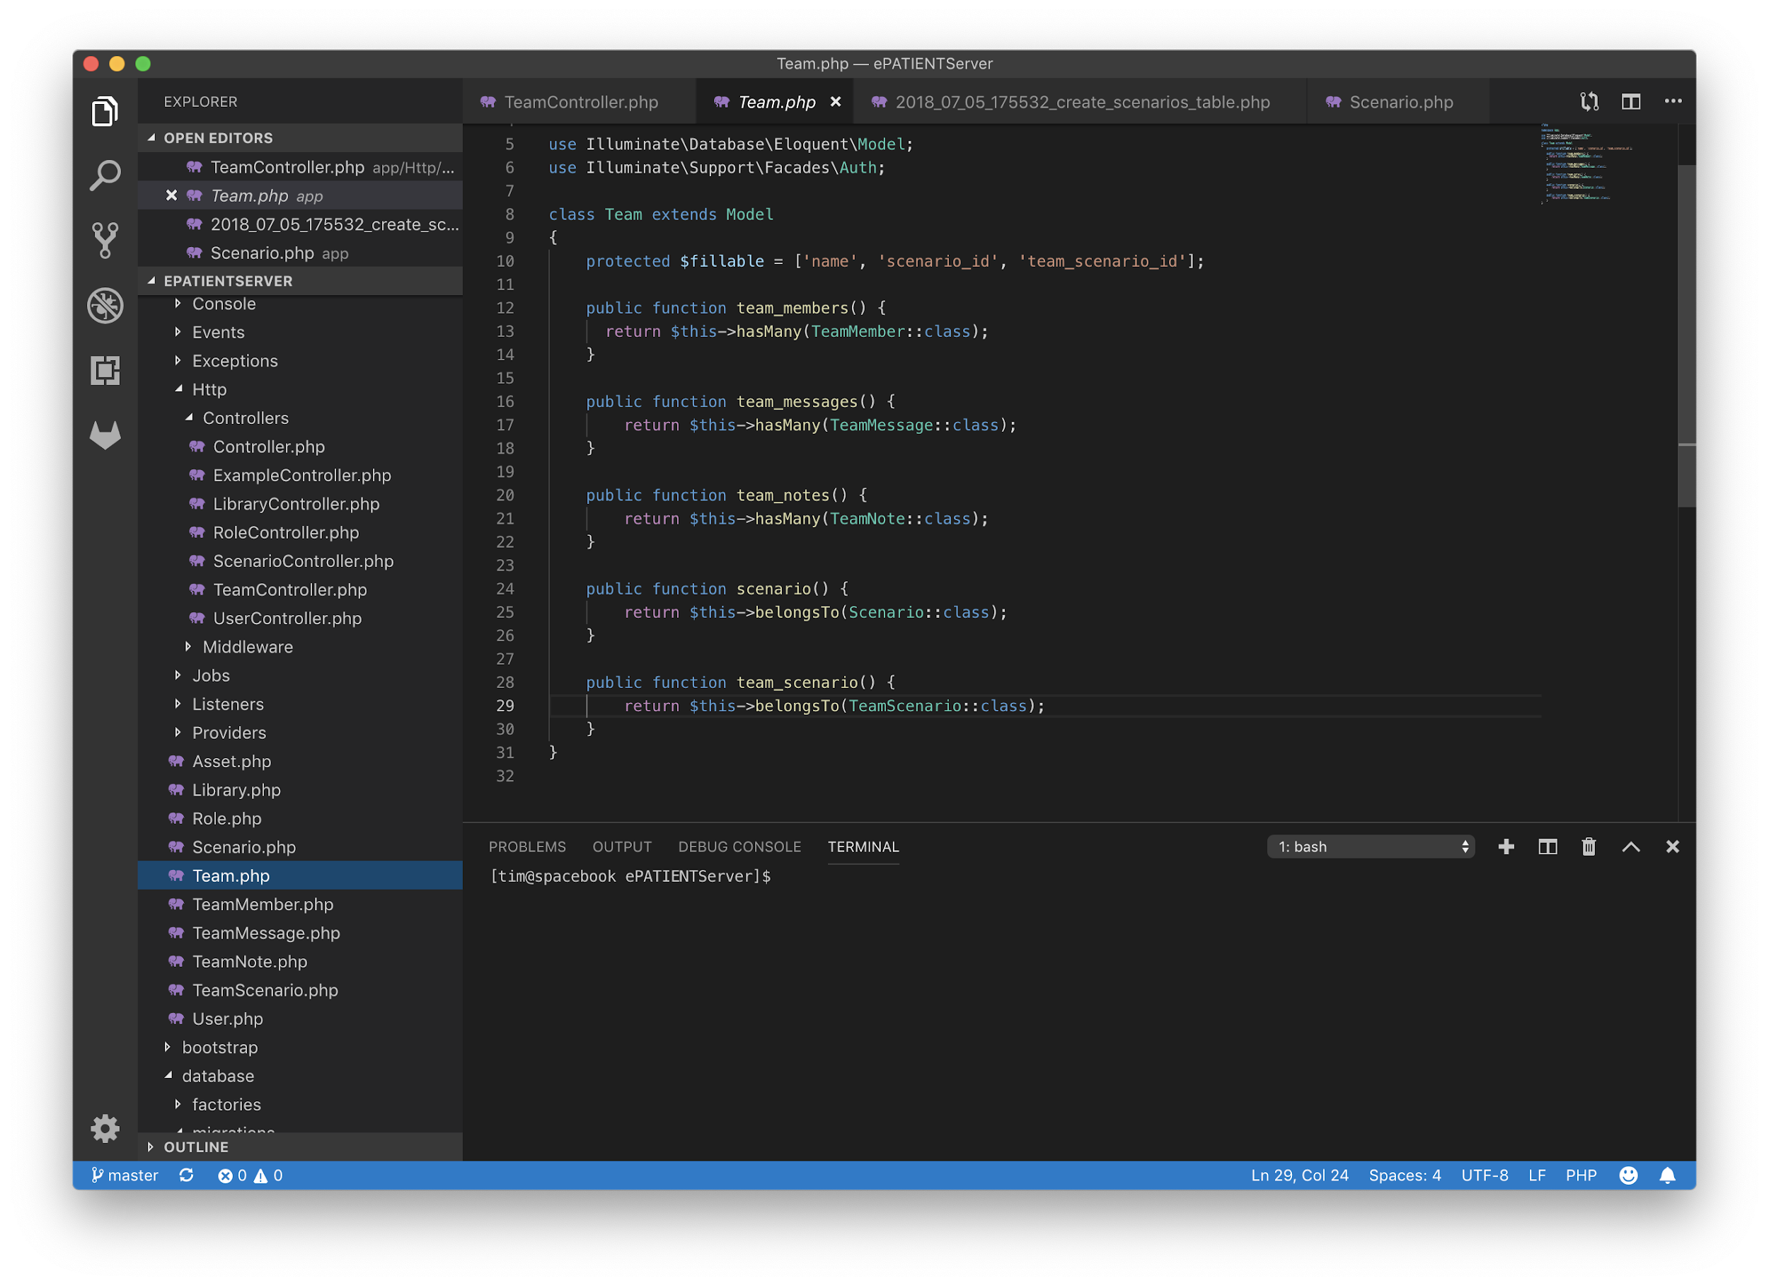
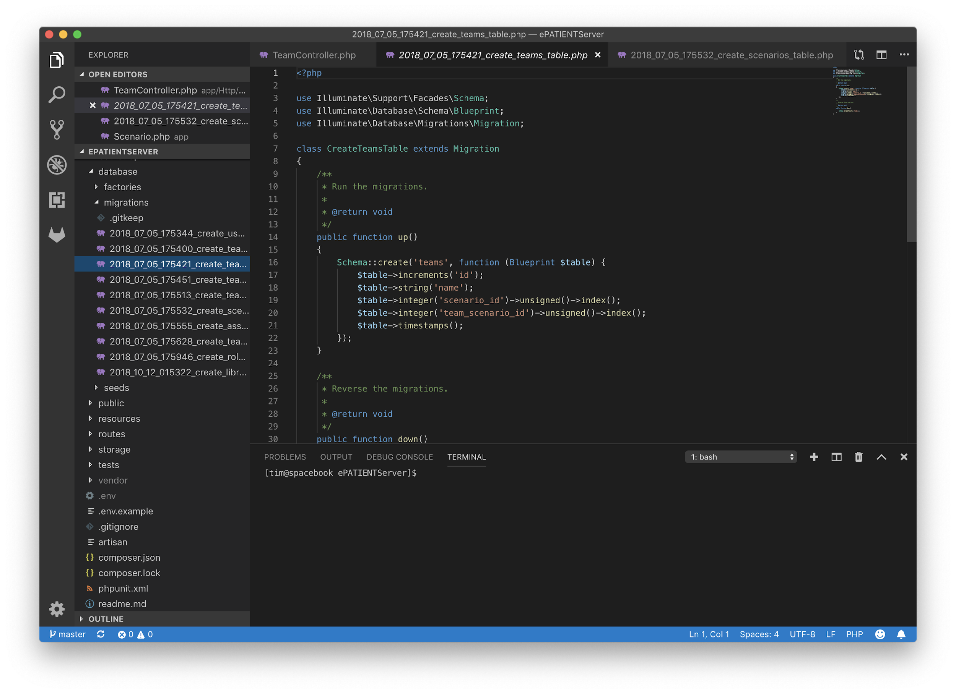
Also LOTS and LOTS ...

Slide 23
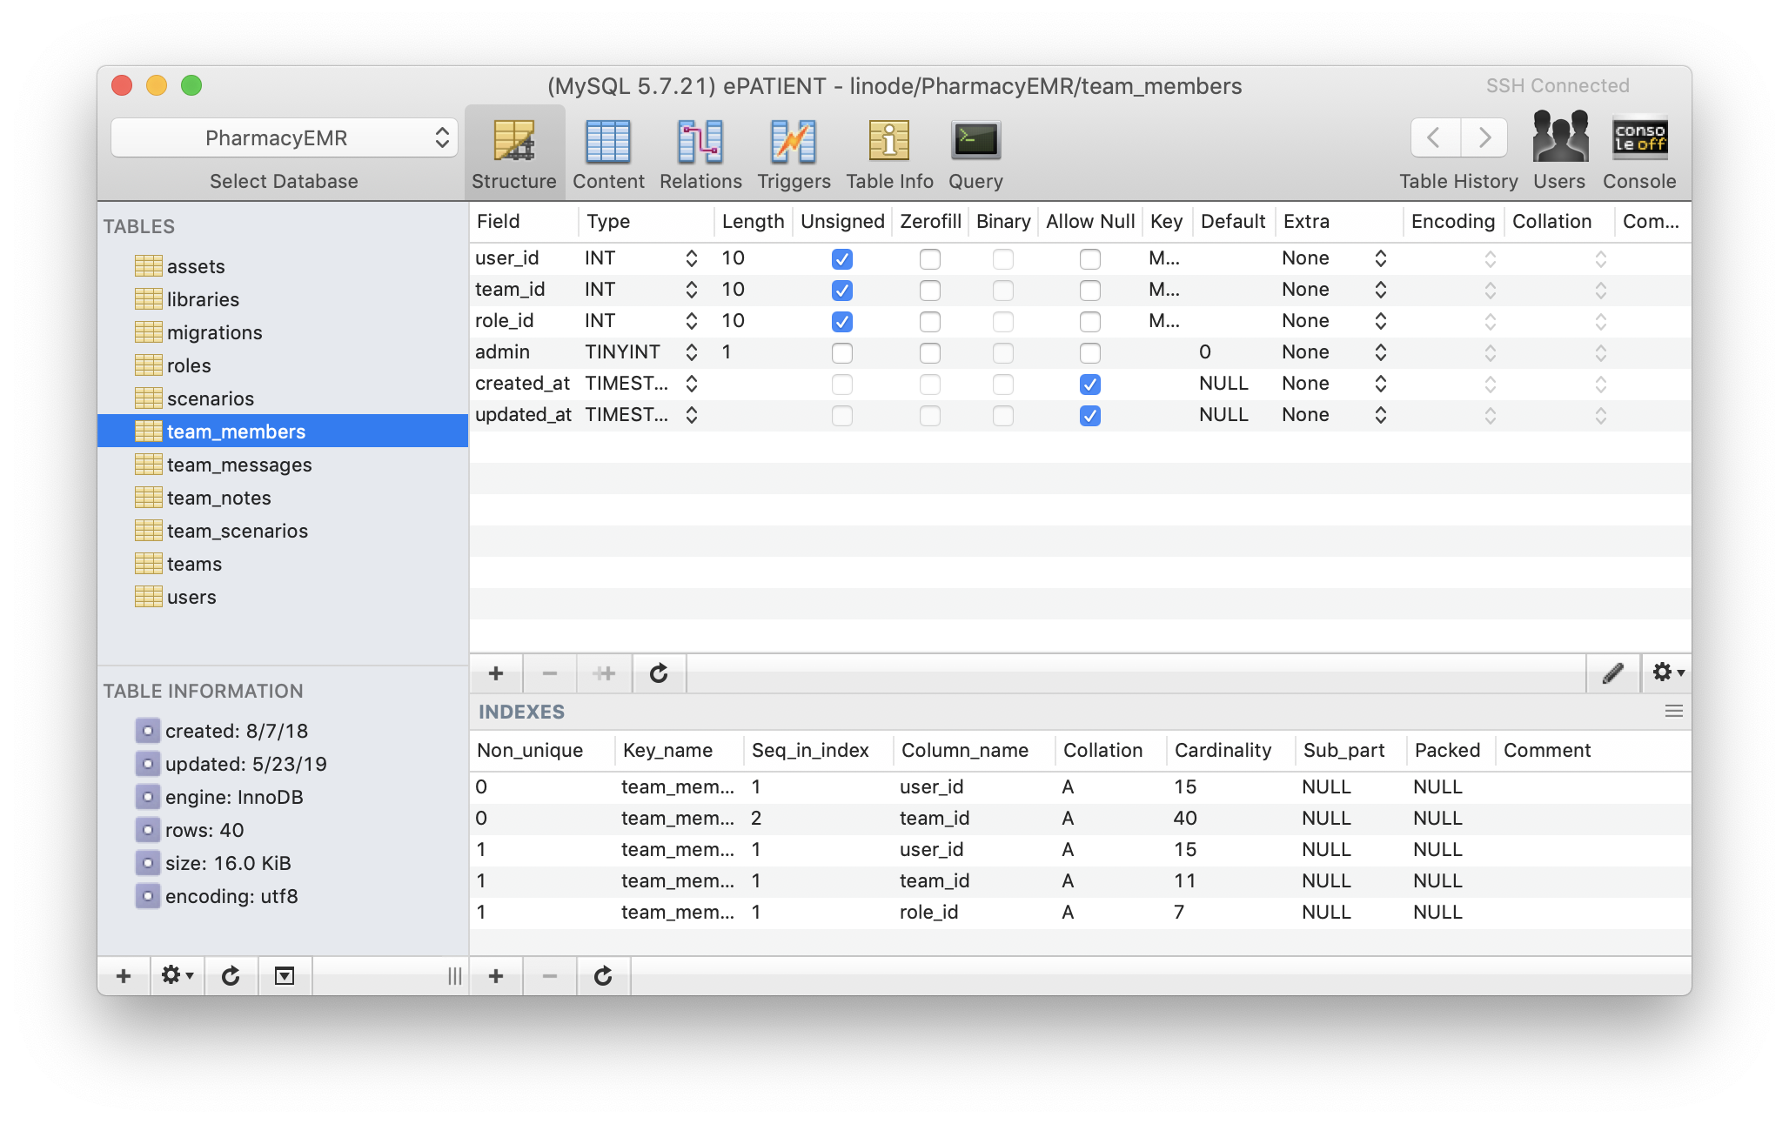
Also LOTS and LOTS and LOTS of ...

Slide 24
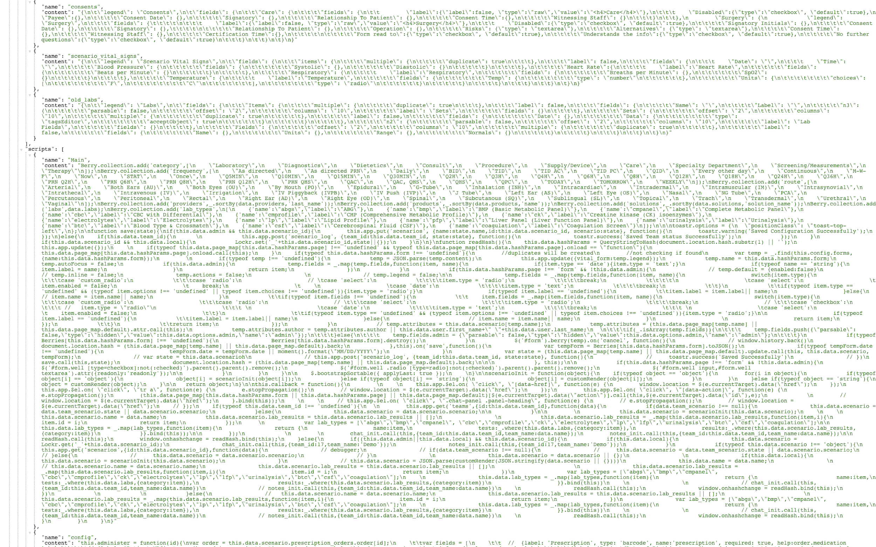
CODE!

Slide 25
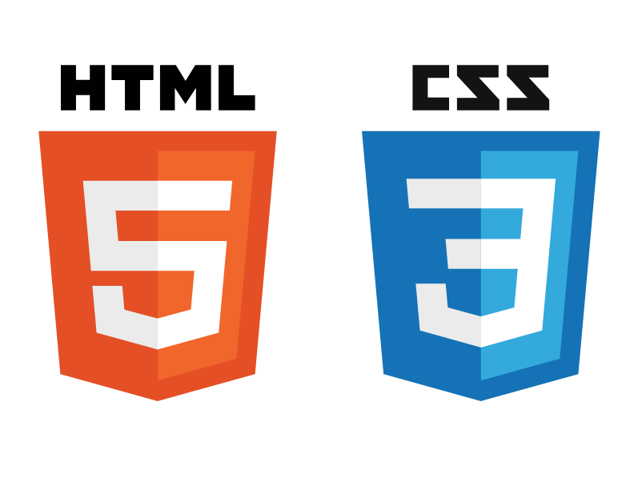
Other Technologies Used:

Slide 26
Highlights
Basic, intuitive EMR structure
Option to build case items on the back end, or have students work on the front end
Workflow mechanisms
Assign cases to a specific team to work together online
Accessible through single sign on (my.binghamton.edu platform)
Chat function
Notes:
Sarah

Slide 27
Target Audience
Dental Medicine
EMS (EMT, Paramedic)
Medical Assistant
Medicine (Graduate & Residency)
Nursing Programs
Occupational Therapy
Pharmacy
Physical Therapy
Respiratory Therapy
Social Work
Notes:
Fritz
Uni or interprofessional

Slide 28
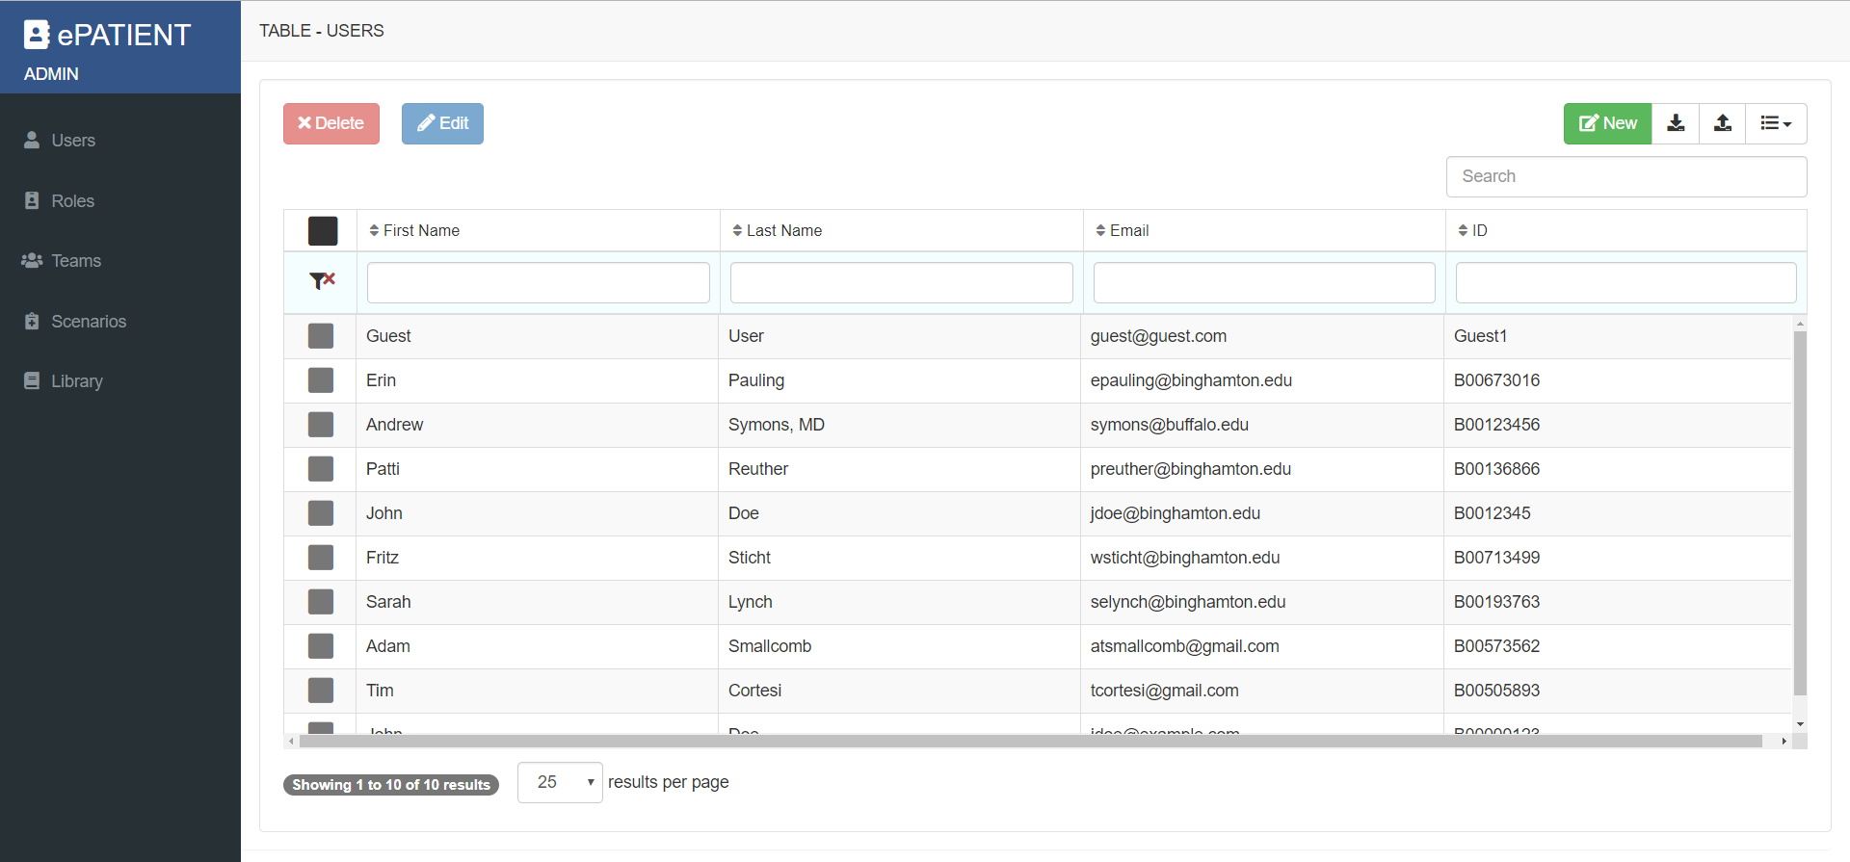
Back-end/Administrative - USERS
Notes:
Adam/Fritz
There are a few things needed to create a patient encounter: Users, a team, and a scenario. Here is the users screen. To create a new user click the “new” button

Slide 29
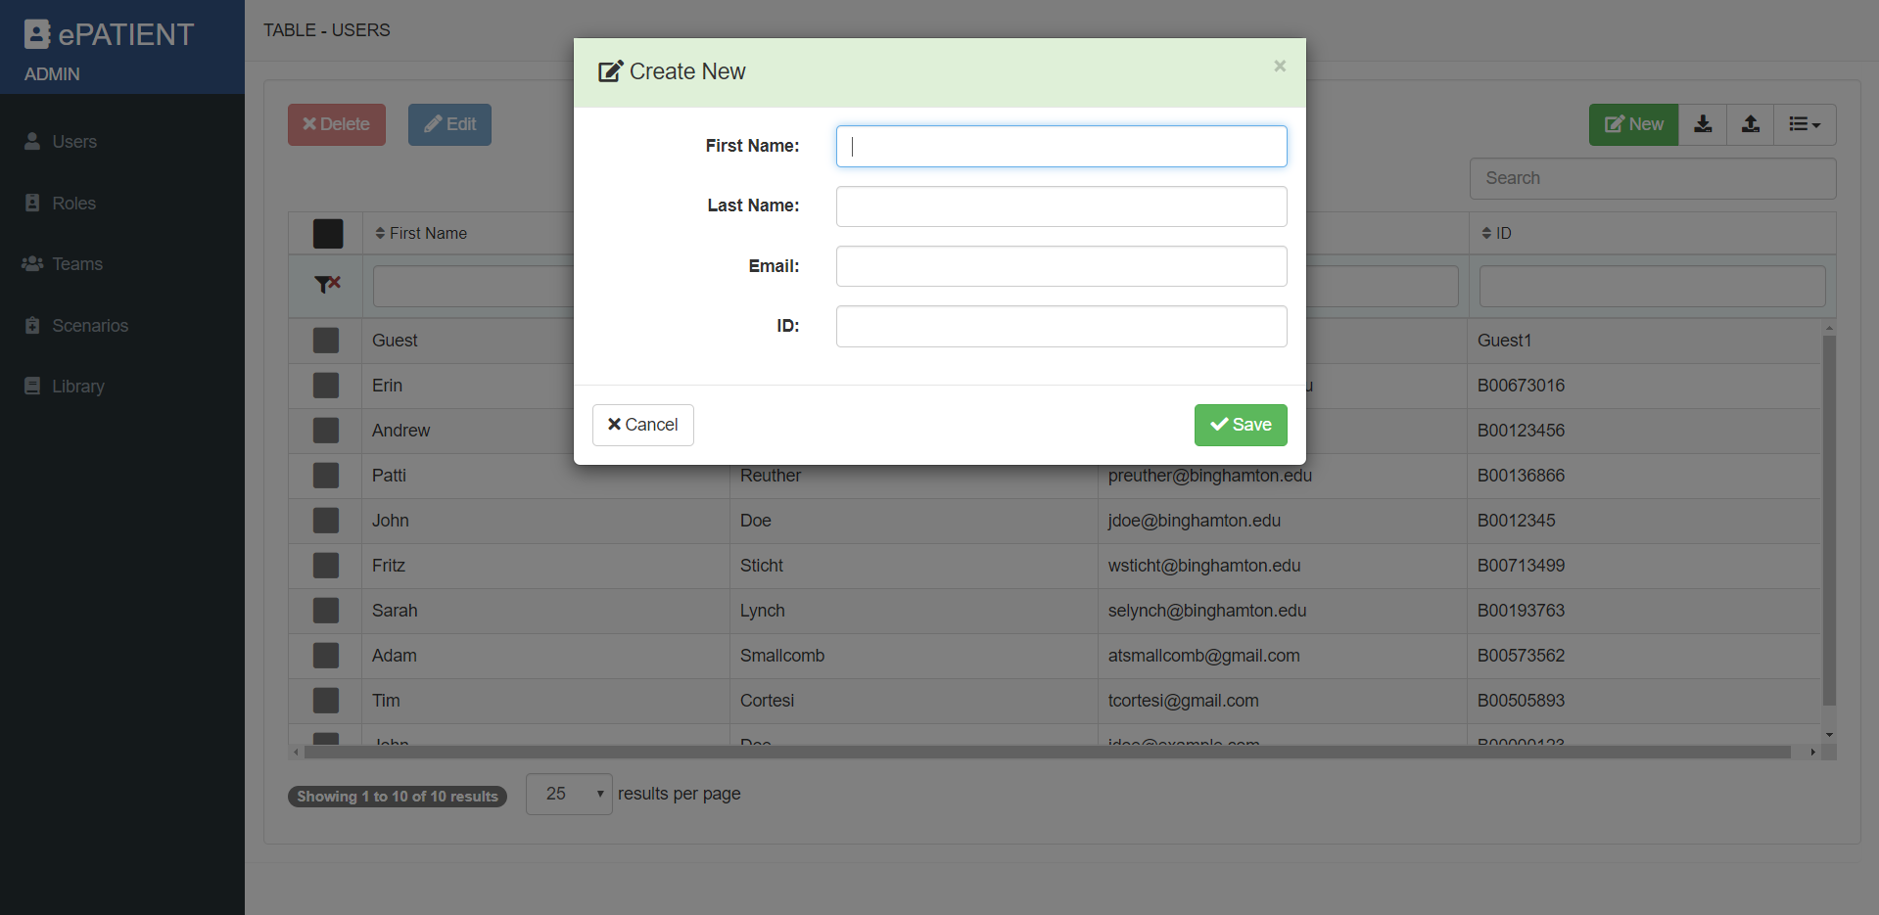
Back-end/Administrative - NEW USER
Notes:
Adam/Fritz
Only four pieces of information are needed to create your users.

Slide 30
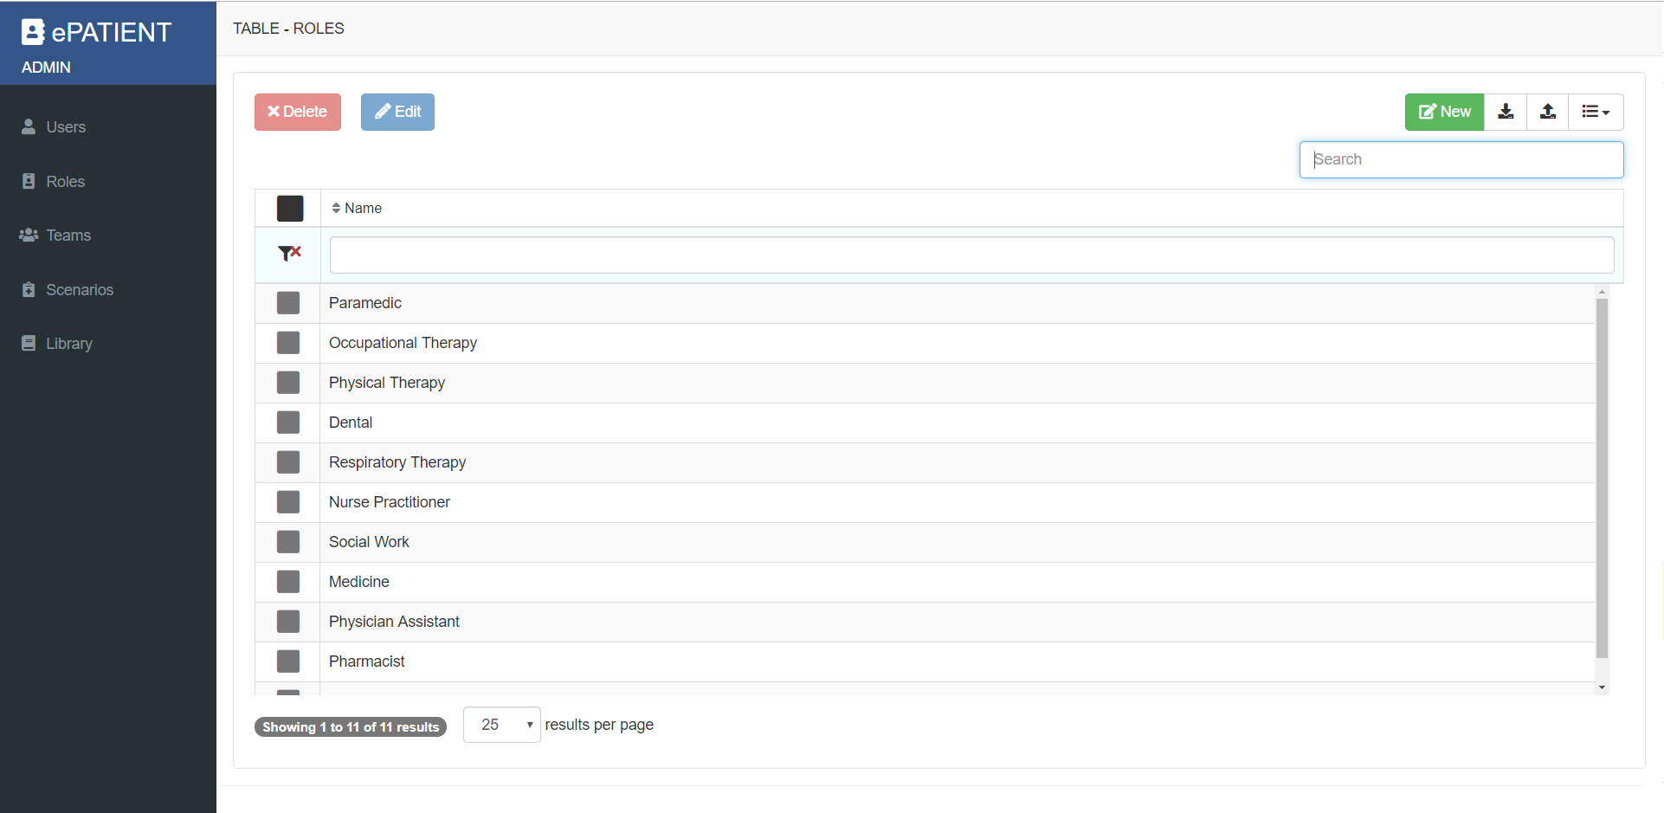
Back-end/Administrative - ROLES
Notes:
Adam/Fritz
Here are the learner roles that can be assigned.Currently a role is not necessary to the scenario but in phase 2 of ePATIENT they will play a larger role.

Slide 31
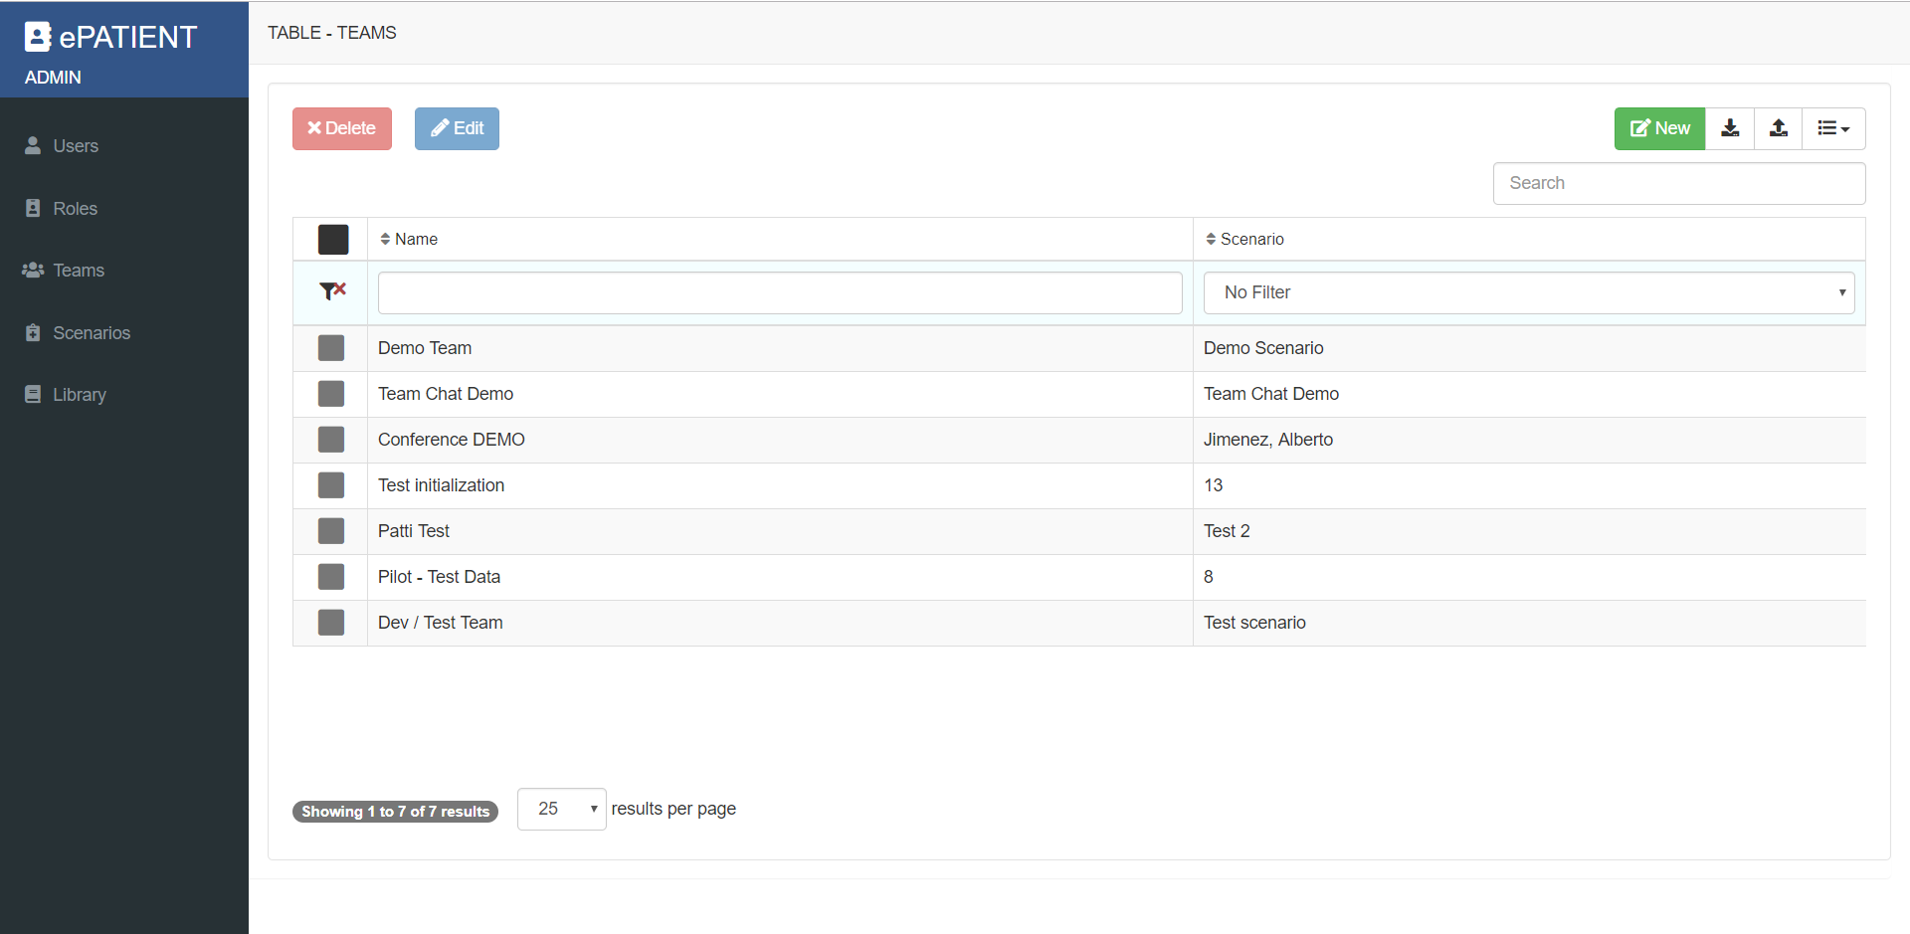
Back-end/Administrative - TEAMS
Notes:
Adam/Fritz
Here is where you can access all of your teams, edit and create new ones. To create a new one, again, click the “new” button.

Slide 32
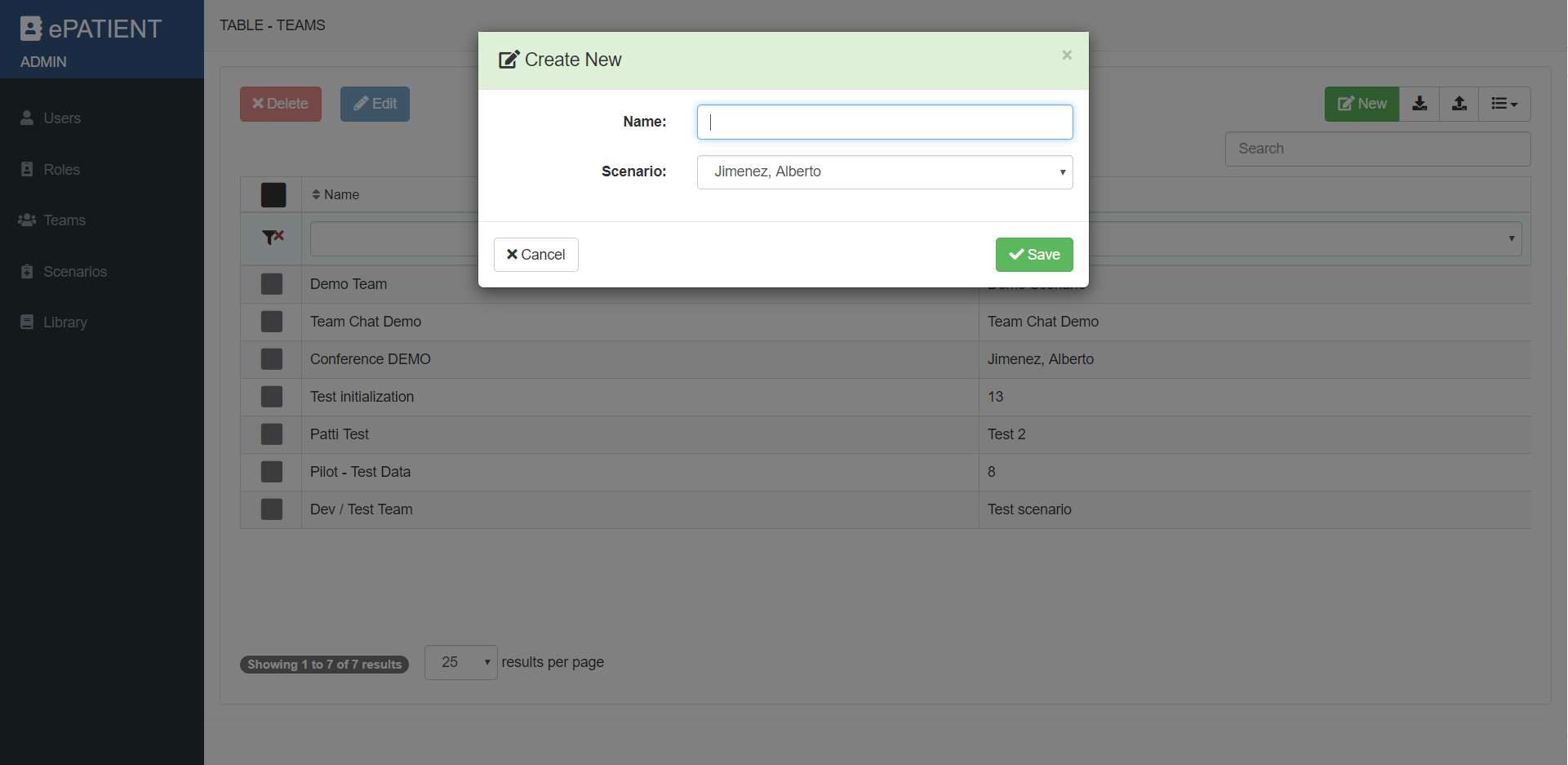
Back-end/Administrative - NEW TEAM
Notes:
Adam/Fritz
First you’ll create you new team by giving it a name and assigning it a scenario. Ideally you would have your scenario created even if was just a shell of a scenario, but it’s not 100% necessary.

Slide 33
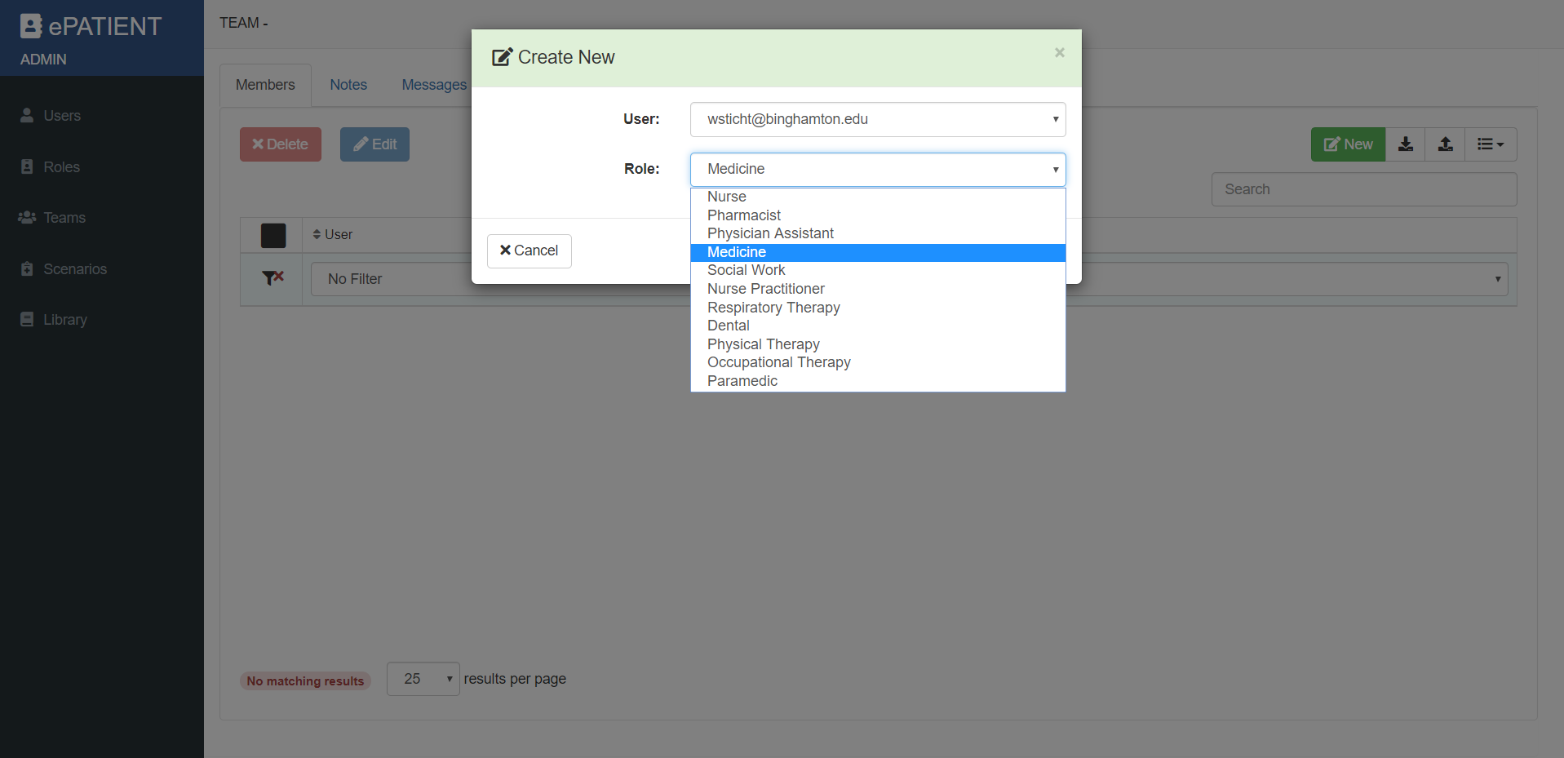
Back-end/Administrative - ADD USERS TO TEAM
Notes:
Adam/Fritz
Once the team has been created, you will need to add users and assign a role to that user.

Slide 34
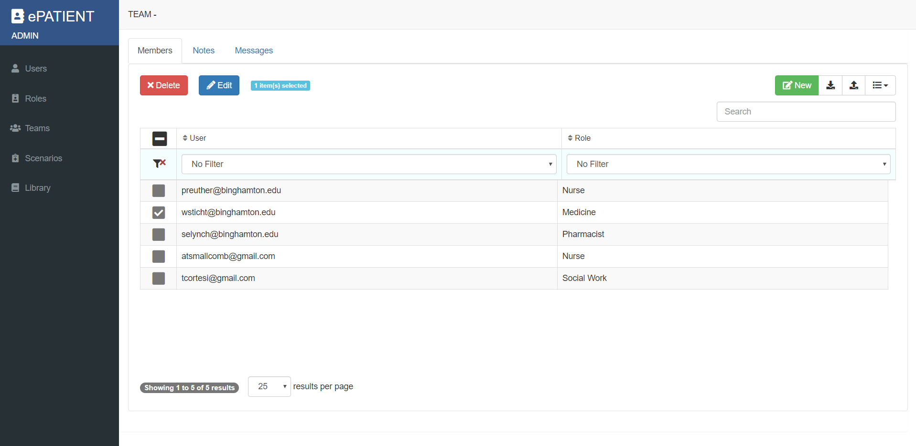
Back-end/Administrative - ADD USERS TO TEAM
Notes:
Adam/Fritz
Here is our team. again you can edit team members, delete or add new.

Slide 35
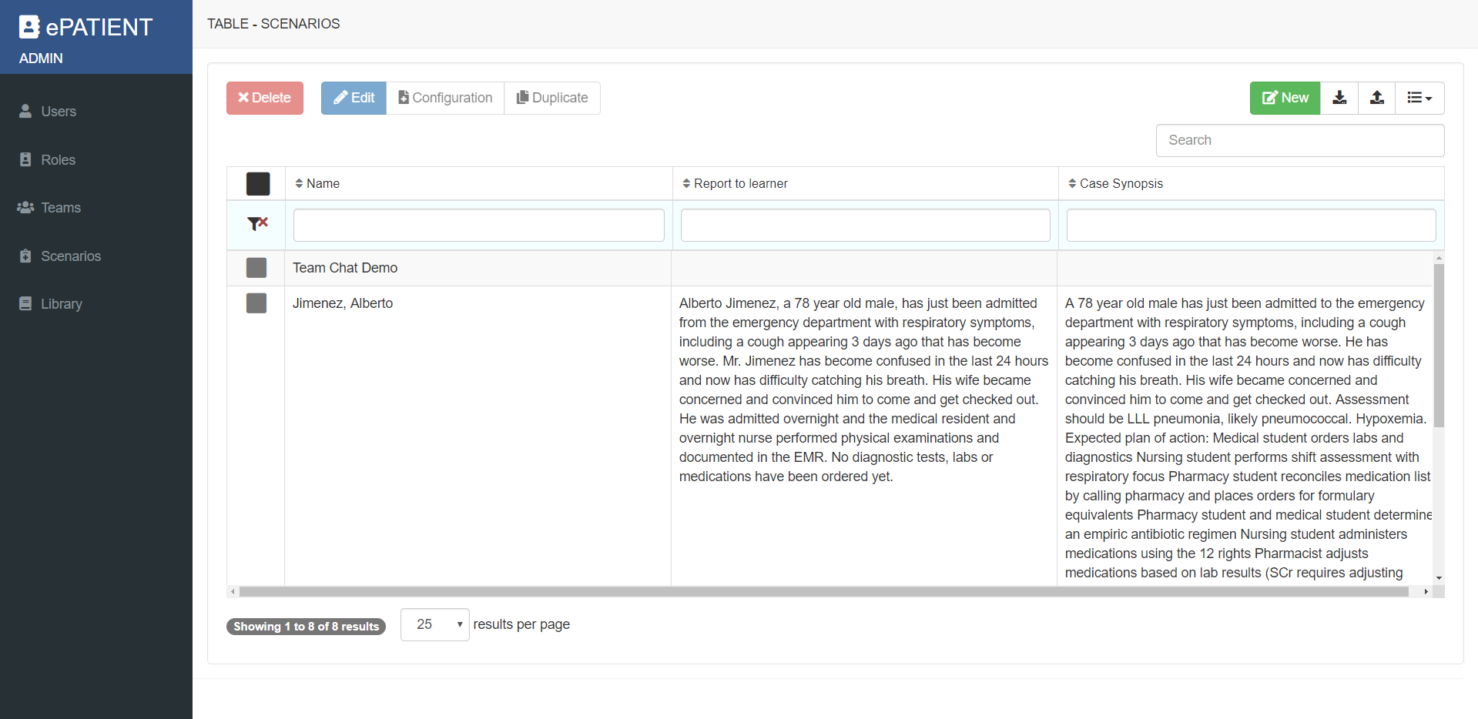
Back-end/Administrative - SCENARIOS
Notes:
Adam/Fritz

Slide 36
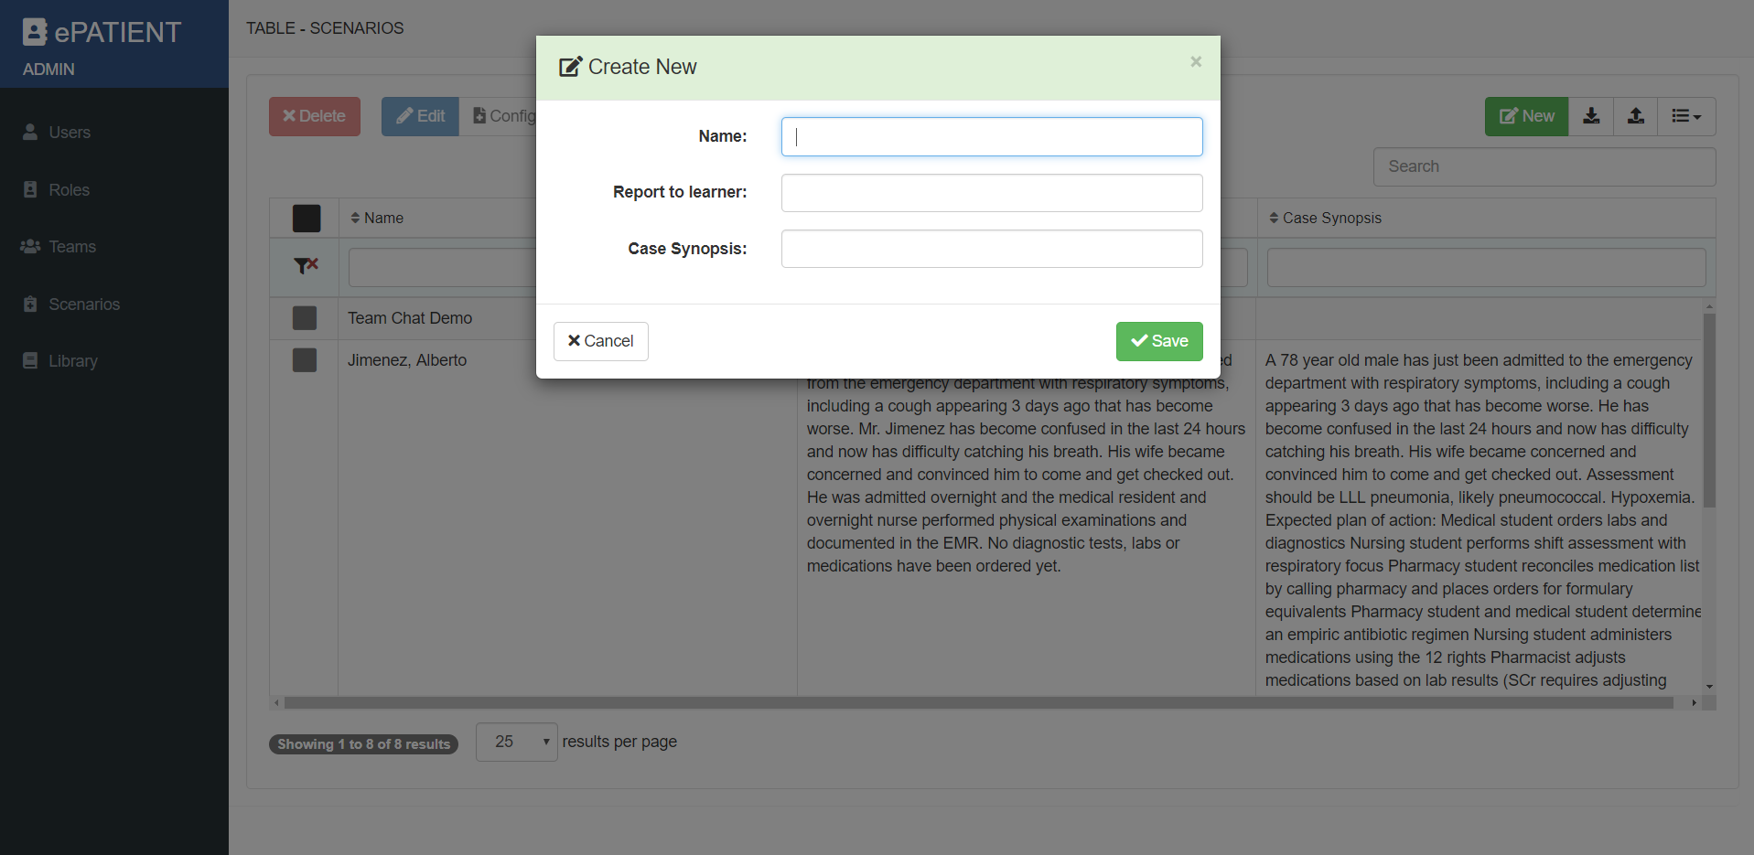
Back-end/Administrative - NEW SCENARIO
Notes:
Adam/Fritz
Creating a new scenario requires three pieces of information: 1. The scenario name. This can be anything but we suggest using the patient name as the learners will see this information. 2. The report to learner. 3. Case Synopsis available for faculty

Slide 37
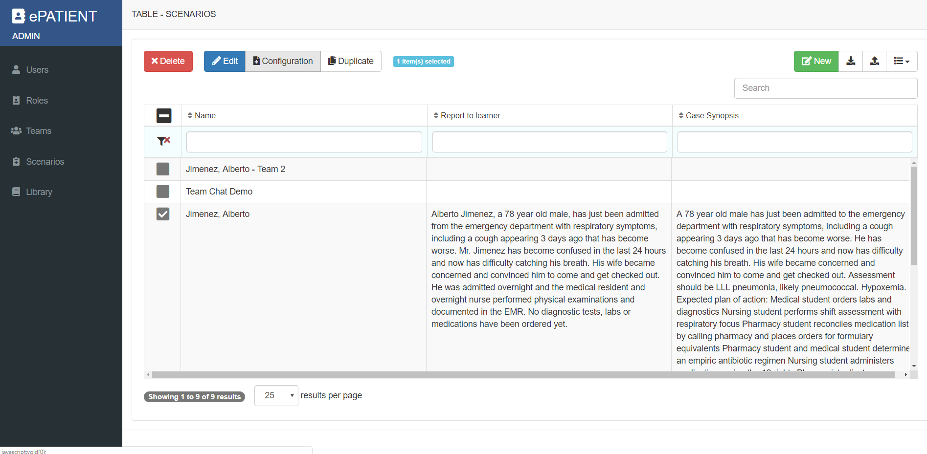
Back-end/Administrative - SCENARIO CONFIG.
Notes:
Adam/Fritz
Once the shell of the scenario has been created, you can now configure your scenario. Discuss duplication of scenarios as a valuable function

Slide 38
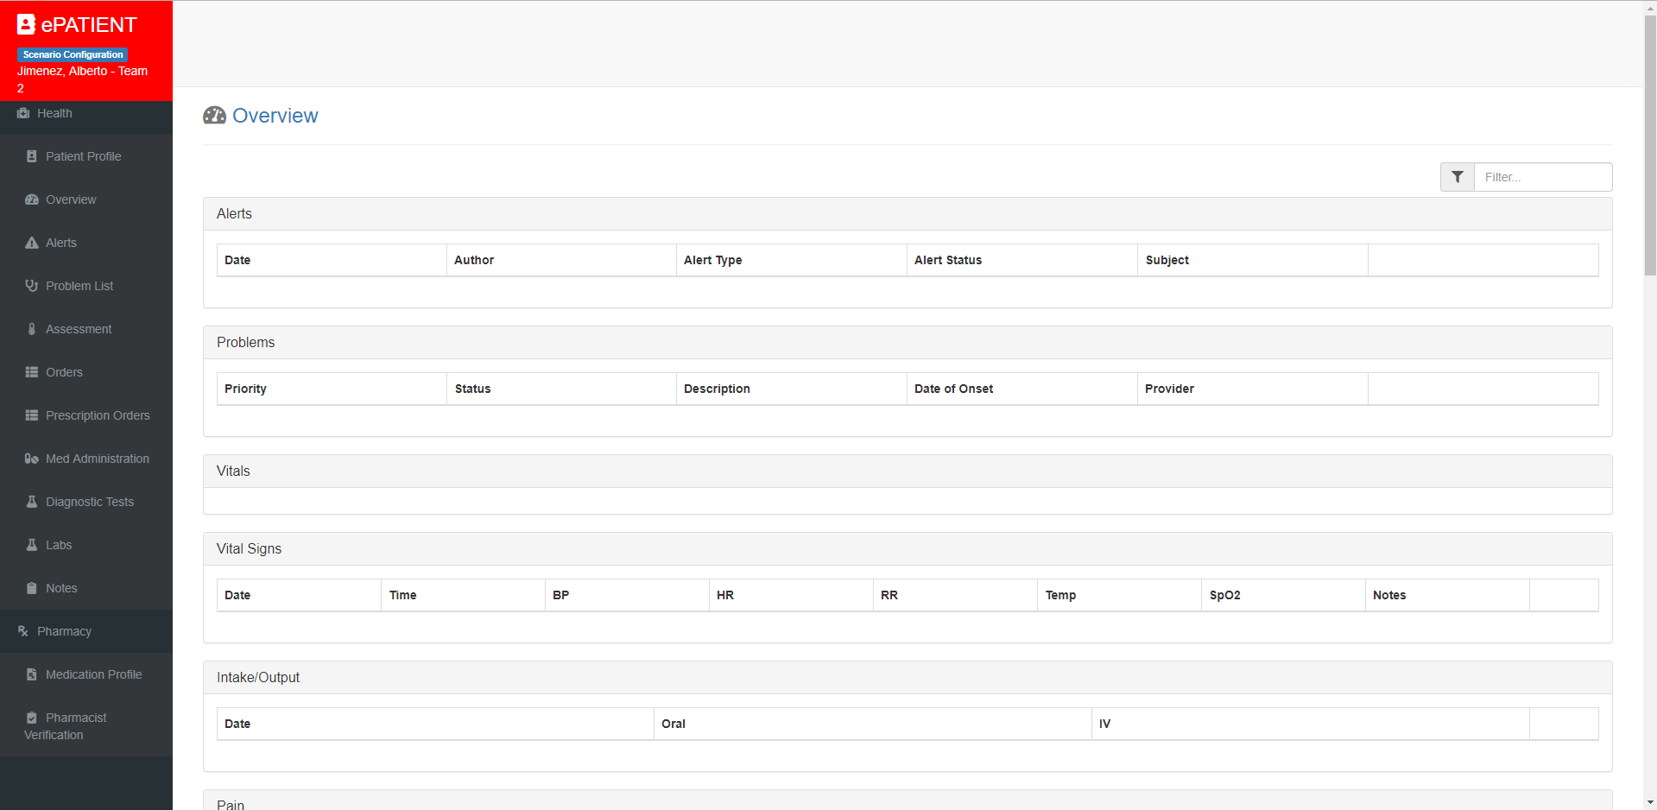
Back-end/Administrative - SCENARIO CONFIG.
Notes:
Adam/Fritz
Once in the scenario configuration tool, you have the ability to add the patient’s history, current vitals or whatever is required to at the start of the team’s encounter. This can be a very small amount of information or a long history.

Slide 39
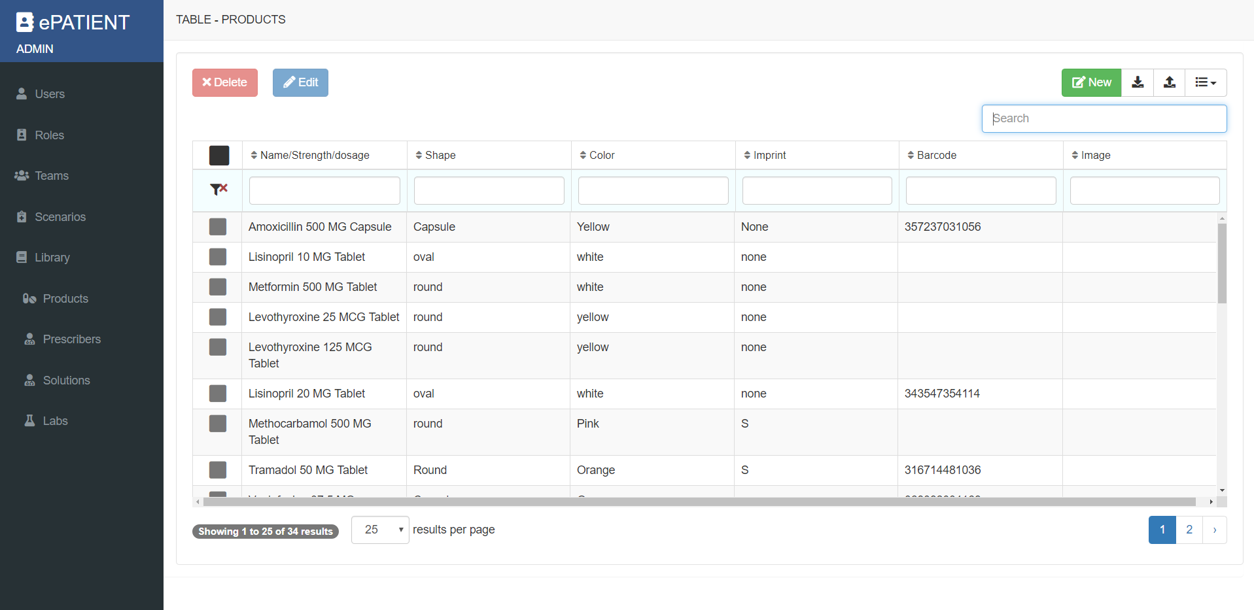
Back-end/Administrative - LIBRARY - PRODUCTS
Notes:
Adam/Fritz

Slide 40
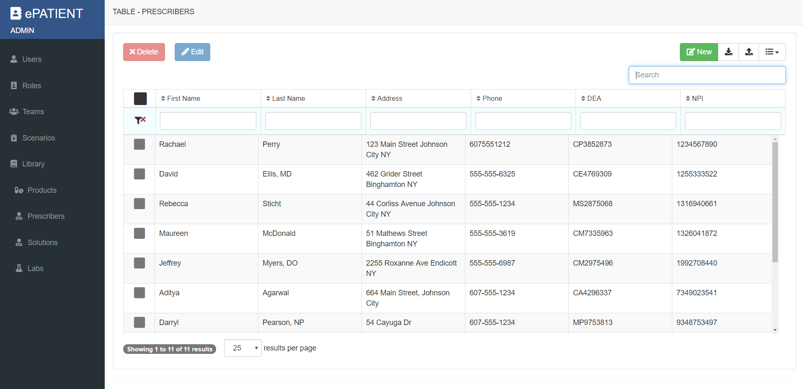
Back-end/Administrative - LIBRARY - PRODUCTS
Notes:
Adam/Fritz

Slide 41
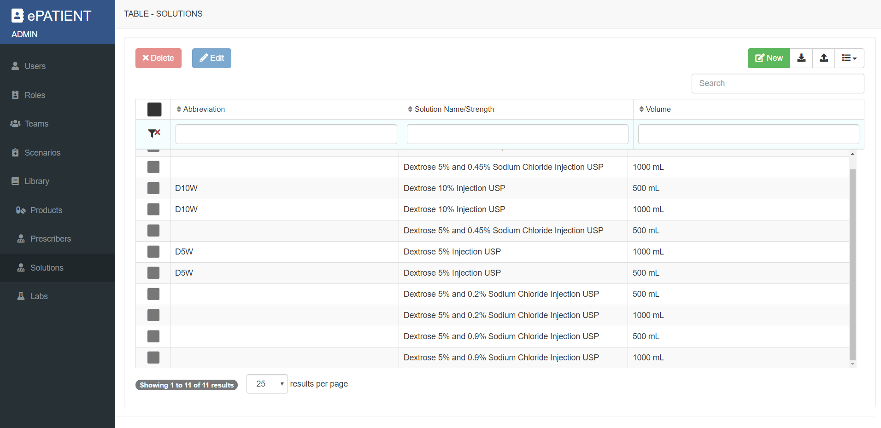
Back-end/Administrative - LIBRARY - PRODUCTS
Notes:
Adam/Fritz

Slide 42
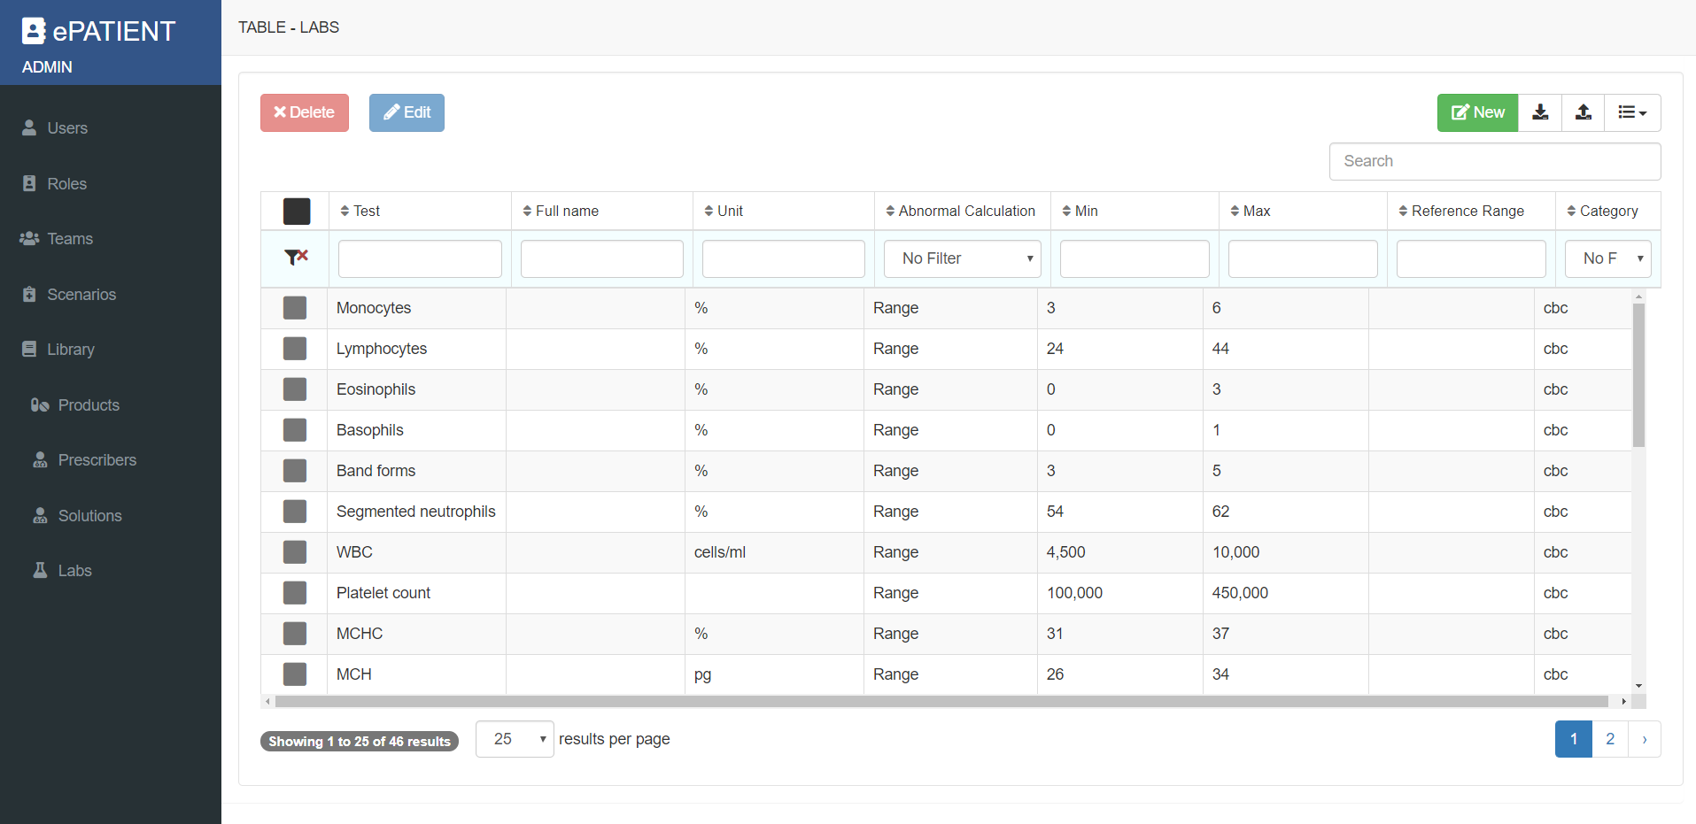
Back-end/Administrative - LIBRARY - PRODUCTS
Notes:
Adam/Fritz

Slide 43
ePATIENT Interactive Session

Slide 44
Nurse #1
Systolic = 112
Diastolic = 58
Location = RUE
Position = Supine
Beats per minute = 88
Location = Right Radial
Breaths per minute = 20
Sp02 = 92
Temperature = 100
Units = F
Route = oral
Click on “Assessment”
Type in the following data:
Click “Team Chat” tab at bottom right
Type the following: “To Physician: I have completed entering the patient’s vitals, he is ready for your assessment.”
Notes:
Sarah

Slide 45
Physician
Type = Prescription
Date/Time = Today
Author = Your Name
Provider = Any
Medication = Zosyn 4.5 grams
Route = IV Piggyback (IVPB)
Directions = Give every 6 hours via IVPB
Dispense Quantity = 4.5 grams
Days Supply = 1
“New Scheduled Med”
Frequency = Q6H
Scheduled Time = Any
Start on = Today’s date
End on = Today’s date
Refills = 0
Review the “Assessment” tab to see what Nurse #1 has entered
Click on the “Prescription Orders” tab
Click the green “Add” button
Type in the following:
Click “Save”
Click “Team Chat” tab at bottom right
Type the following: “To Pharmacist: I just entered a medication order for this patient. Please verify and dispense.”
Notes:
Sarah

Slide 46
Pharmacist
Wait for communication from Physician via the “Team Chat” tab
Click on “Pharmacist Verification Tab”
Click on the prescription order entered by the Physician author
Review the order
Click the “Pharmacist Verification Tab” again and select the green checkbox (“Verify”) to approve the order
Click “Team Chat” tab at bottom right
Type the following: “To Nurse #2: I just verified and dispensed the antibiotic. It is ready to be administered”
Notes:
Sarah

Slide 47
Nurse #2
Wait for communication from Pharmacist via the “Team Chat” tab
Click on “Medication Administration” tab
Select the “Zosyn” medication order
Review the order (assume it is correct)
Click the green “Administer” button (top right)
Enter the information in italics (copy/paste)
Click “Save”
Notes:
Sarah

Slide 48
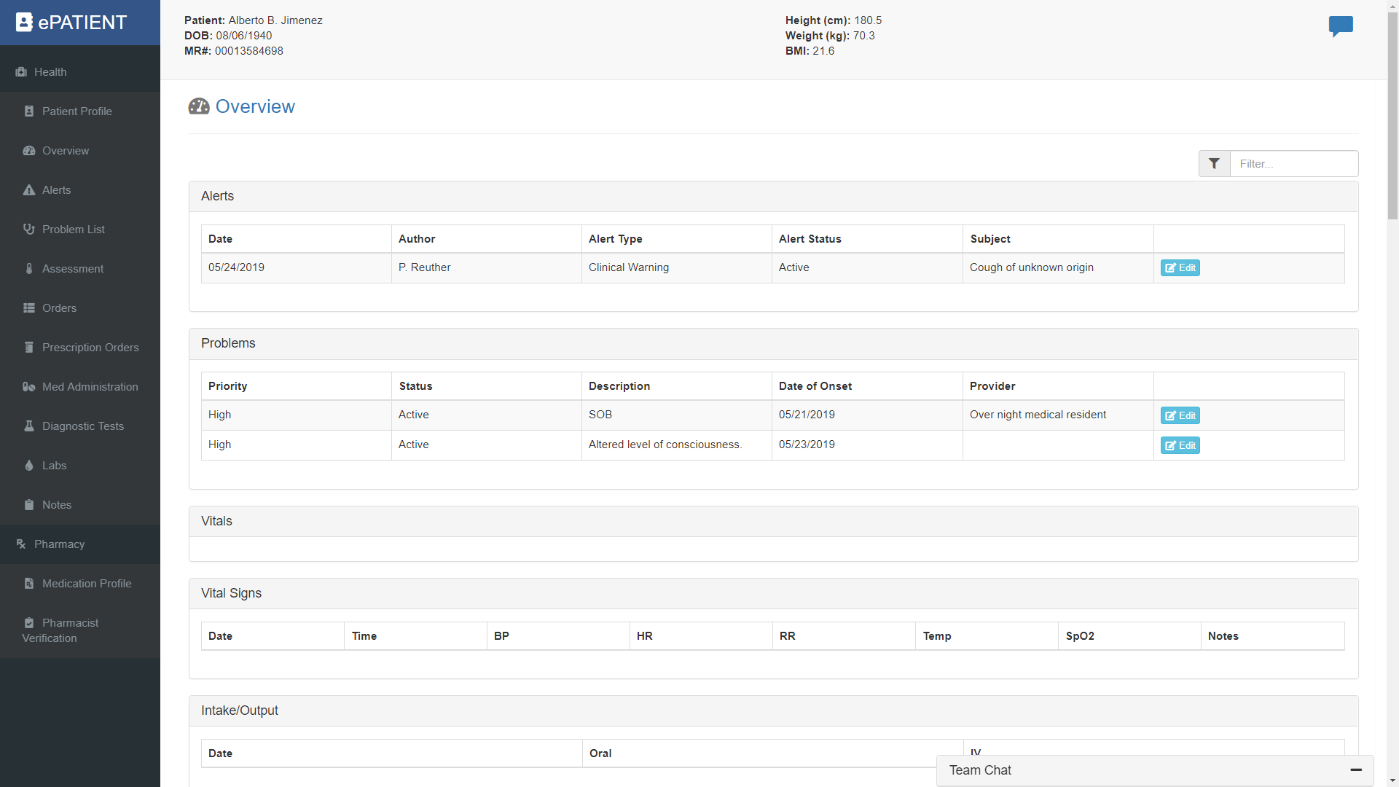
Front-End - OVERVIEW
Notes:
Fritz/Sarah

Slide 49
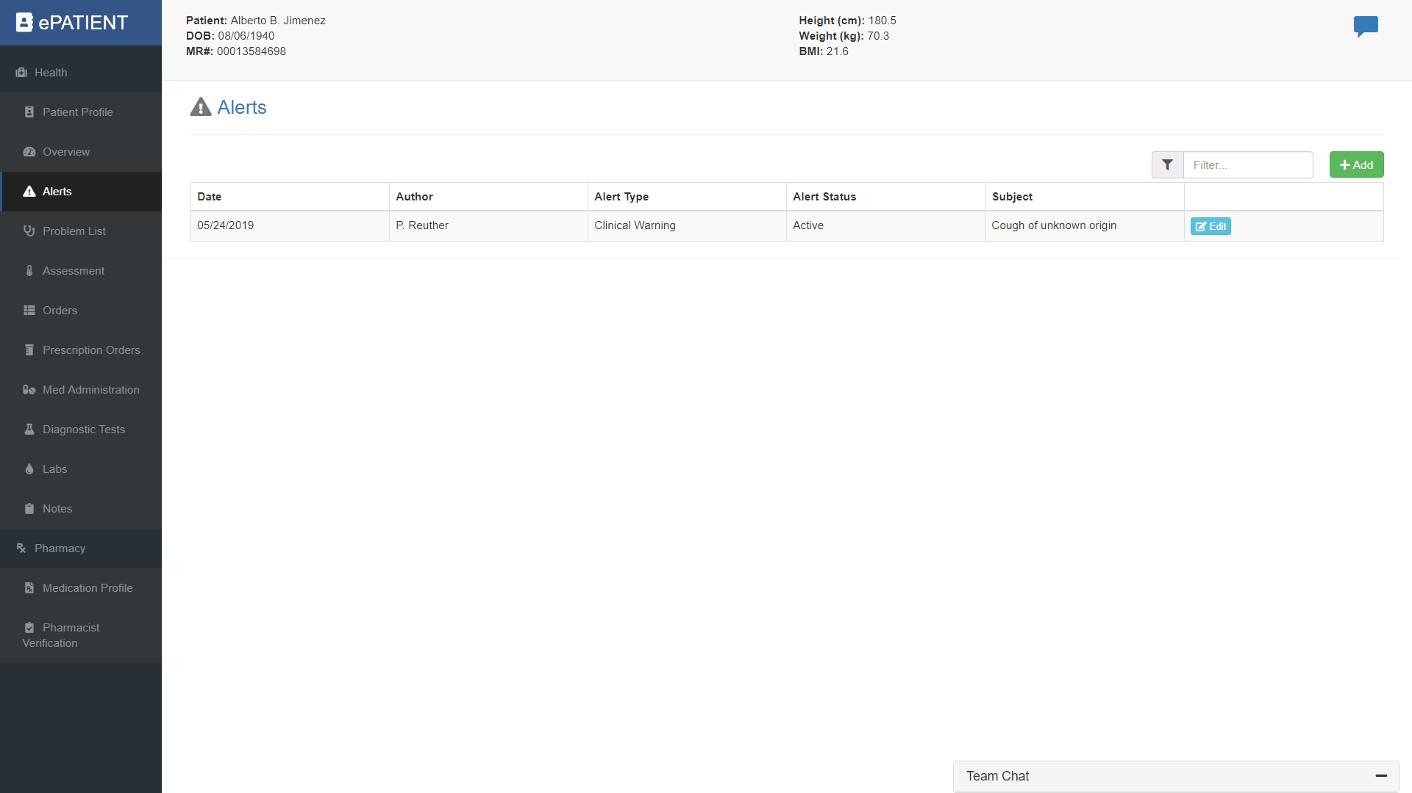
Front-End - ALERTS
Notes:
Fritz/Sarah

Slide 50
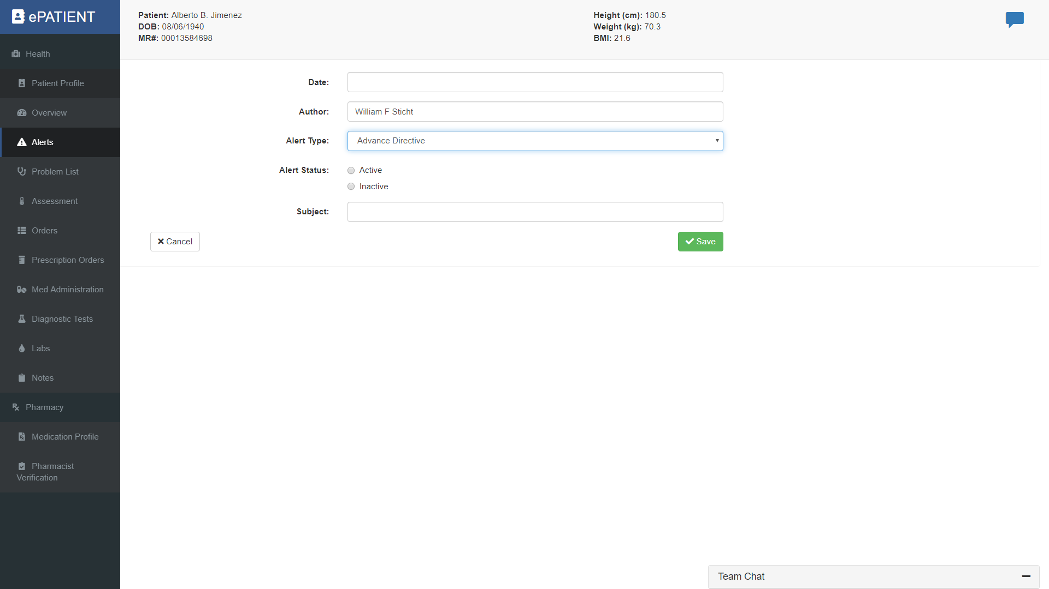
Front-End - ALERTS
Notes:
Fritz/Sarah

Slide 51
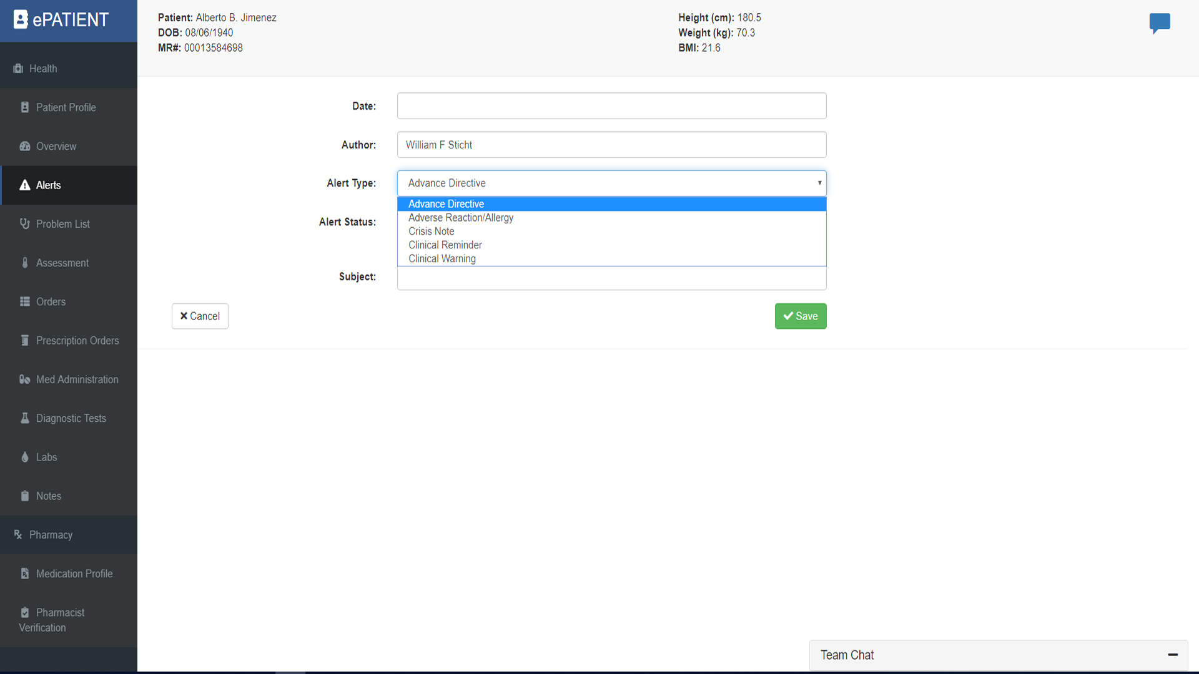
Front-End - ALERTS
Notes:
Fritz/Sarah

Slide 52
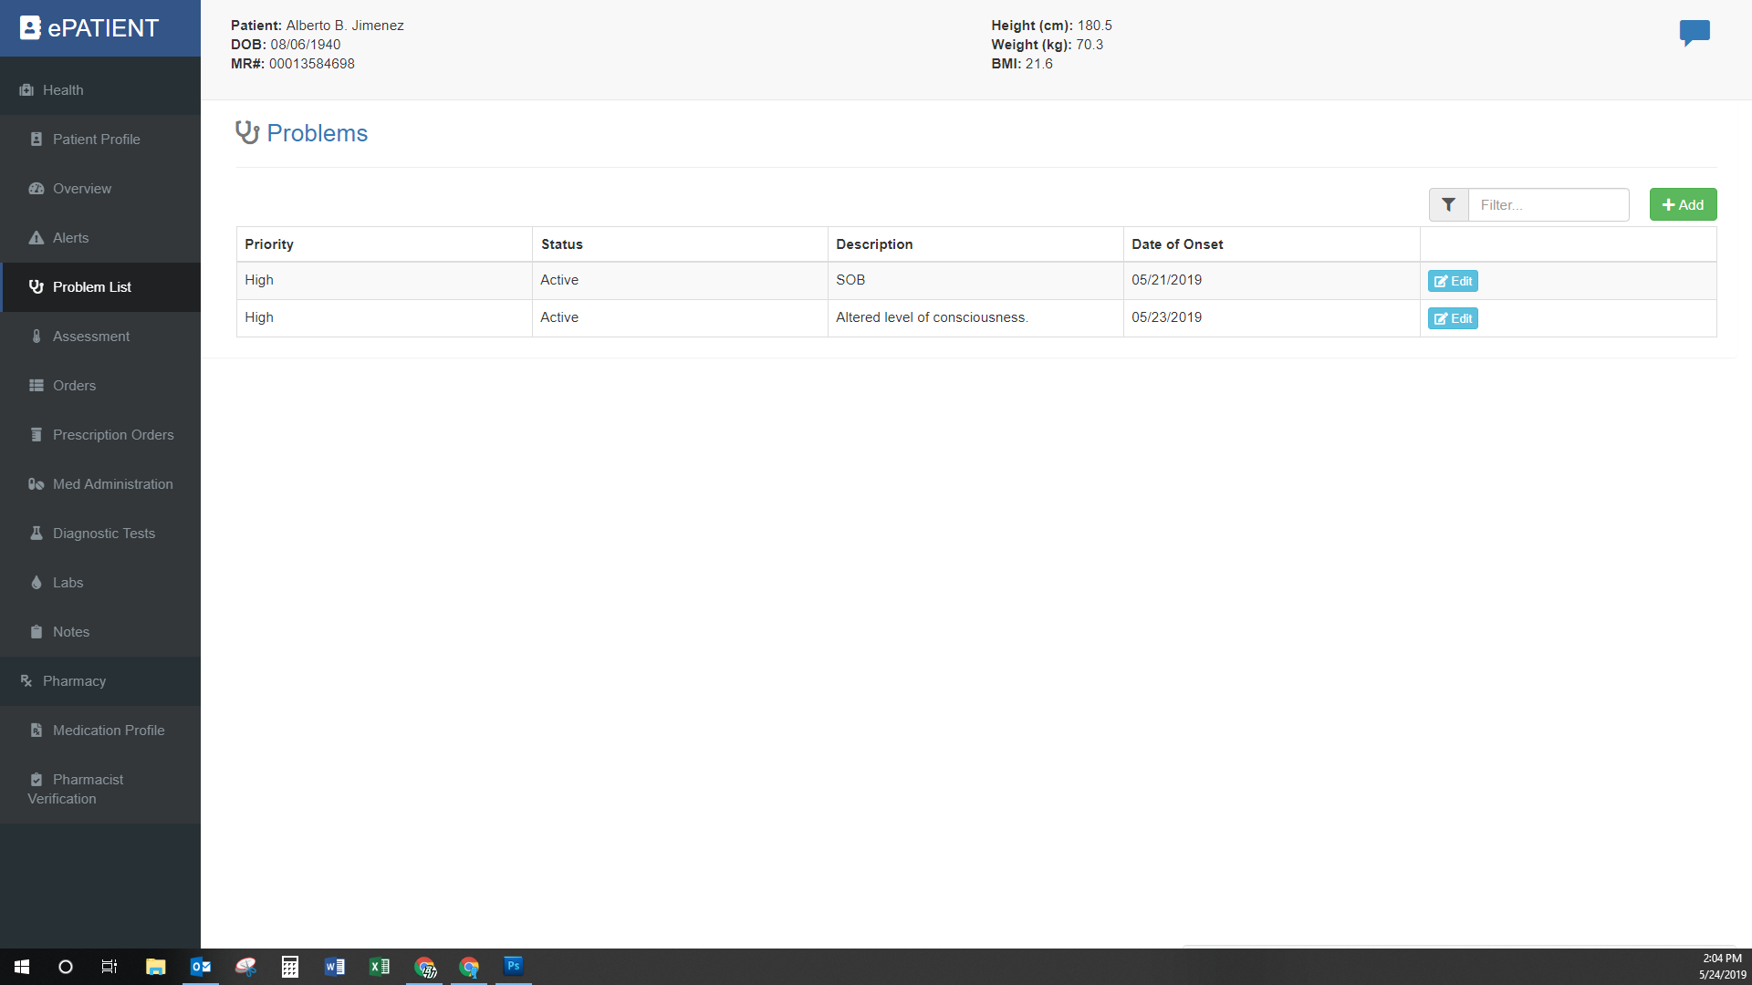
Front-End - PROBLEM LIST
Notes:
Fritz/Sarah

Slide 53
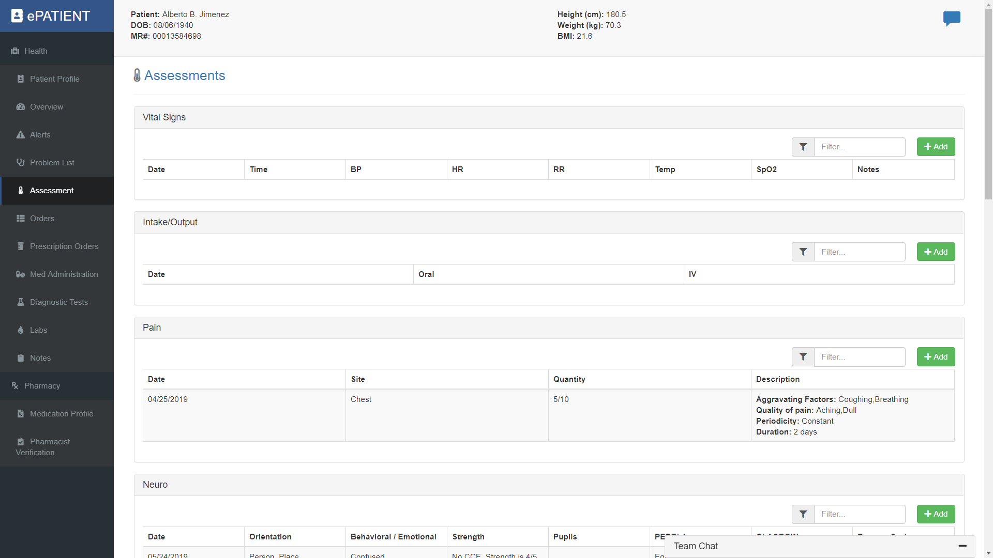
Front-End - ASSESSMENT
Notes:
Fritz/Sarah

Slide 54
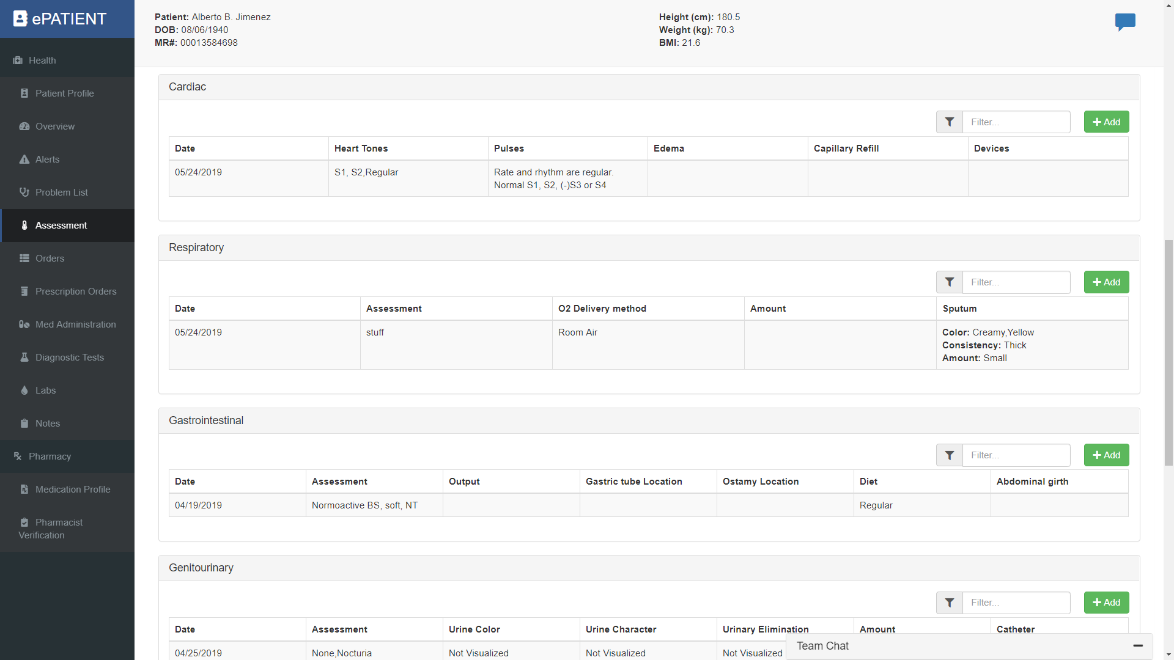
Front-End - ASSESSMENT
Notes:
Fritz/Sarah

Slide 55
Front-End - ASSESSMENT
Notes:
Fritz/Sarah

Slide 56
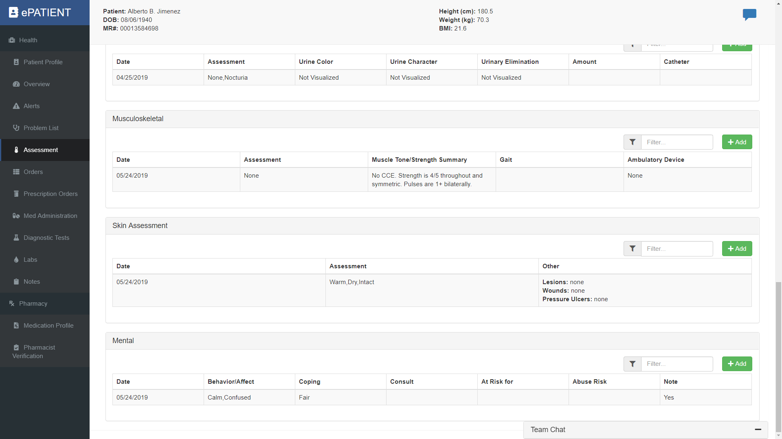
Front-End - ASSESSMENT
Notes:
Fritz/Sarah

Slide 57
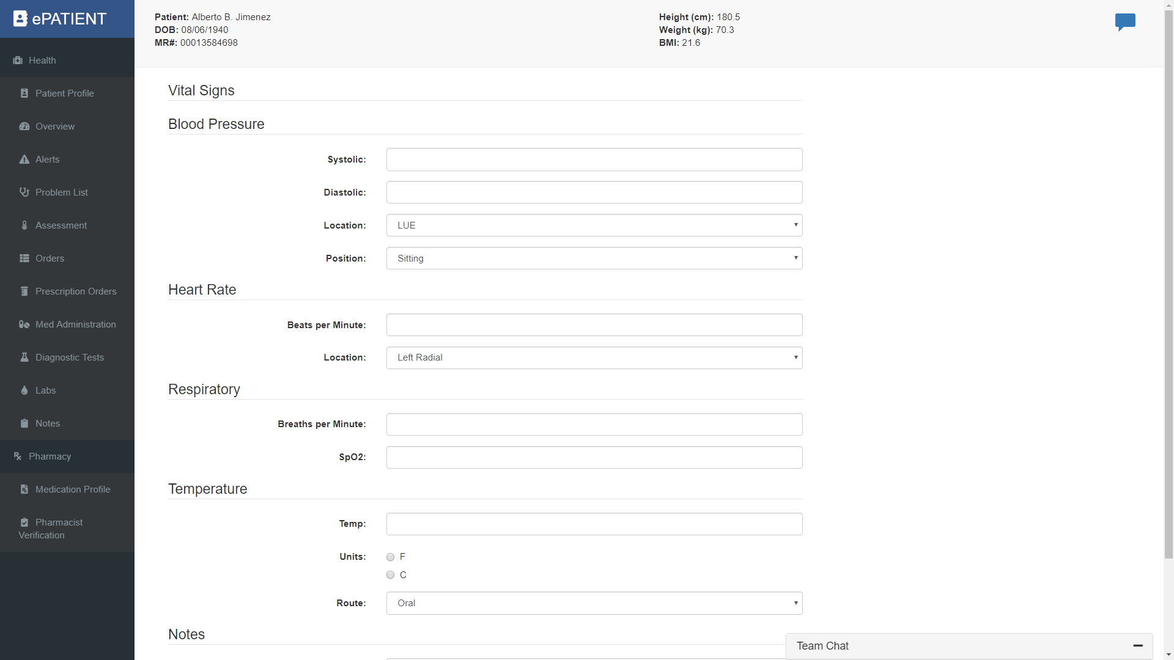
Front-End - ASSESSMENT
Notes:
Fritz/Sarah

Slide 58
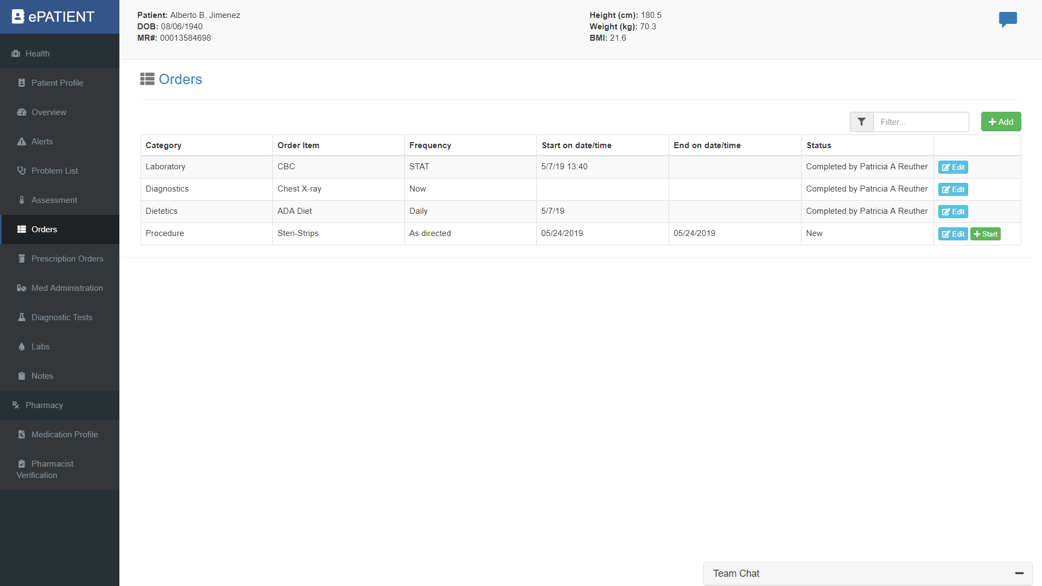
Front-End - ORDERS
Notes:
Fritz/Sarah

Slide 59
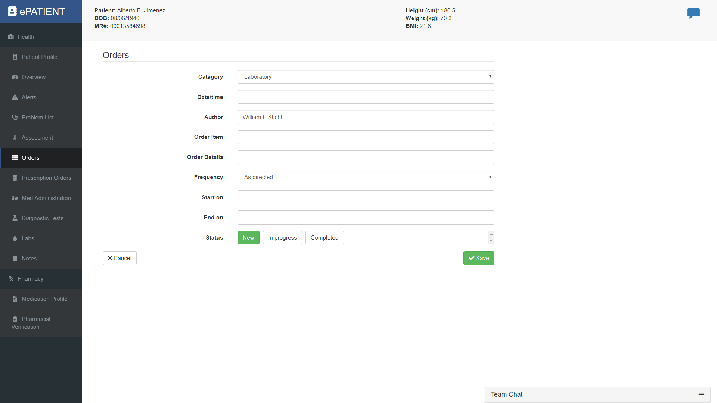
Front-End - ORDERS
Notes:
Fritz/Sarah

Slide 60
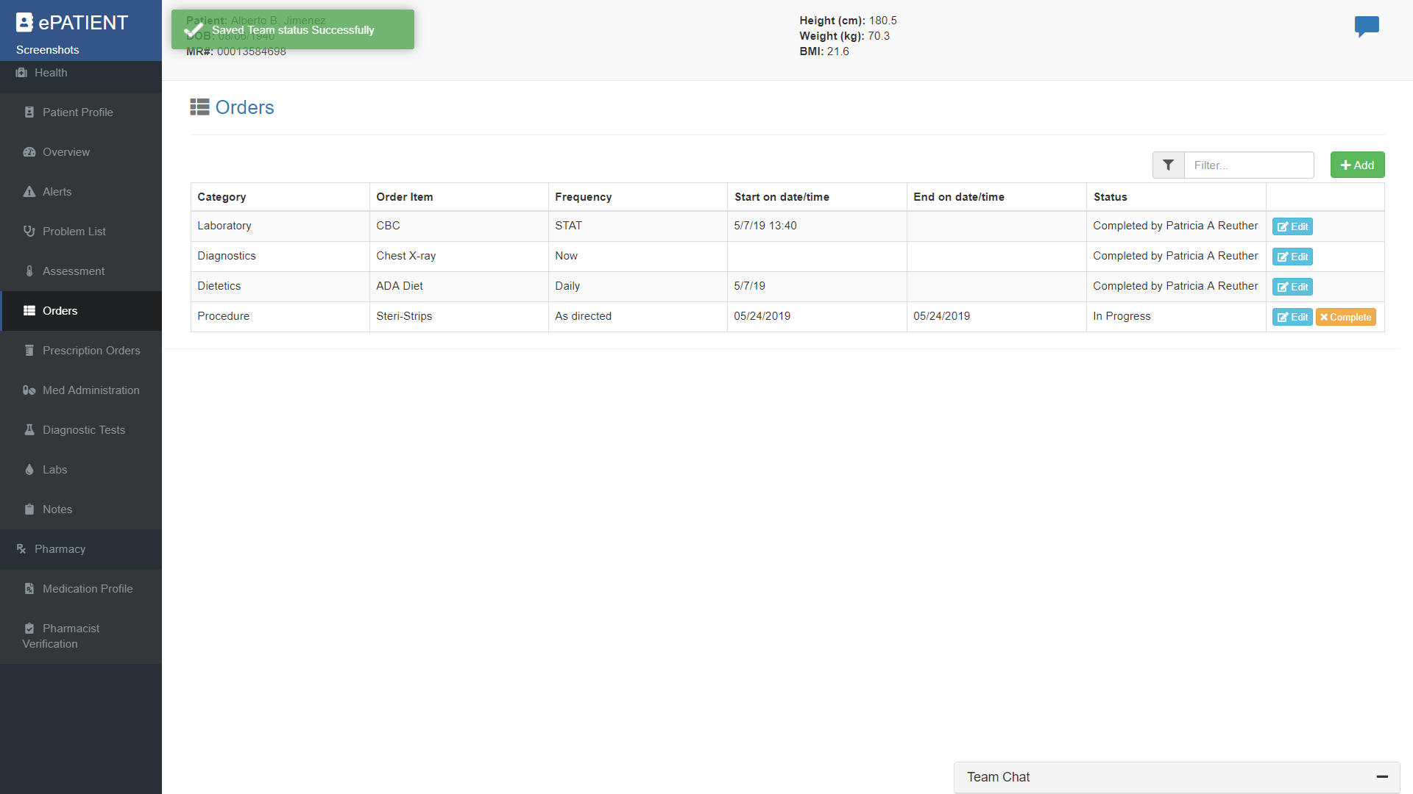
Front-End - ORDERS
Notes:
Fritz/Sarah

Slide 61
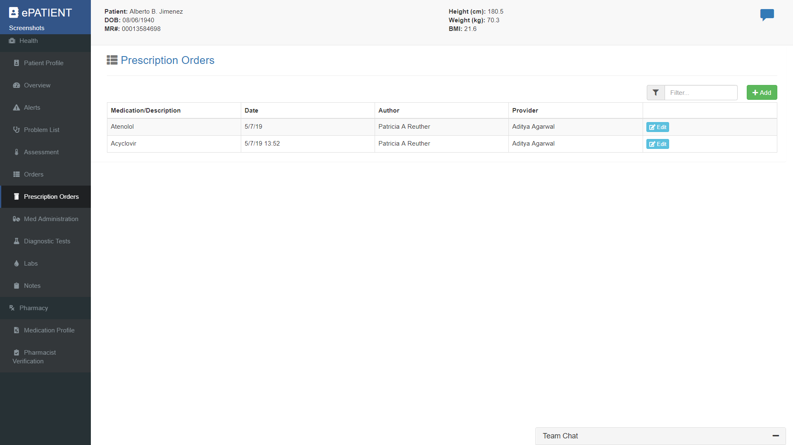
Front-End - PRESCRIPTION ORDERS
Notes:
Fritz/Sarah

Slide 62
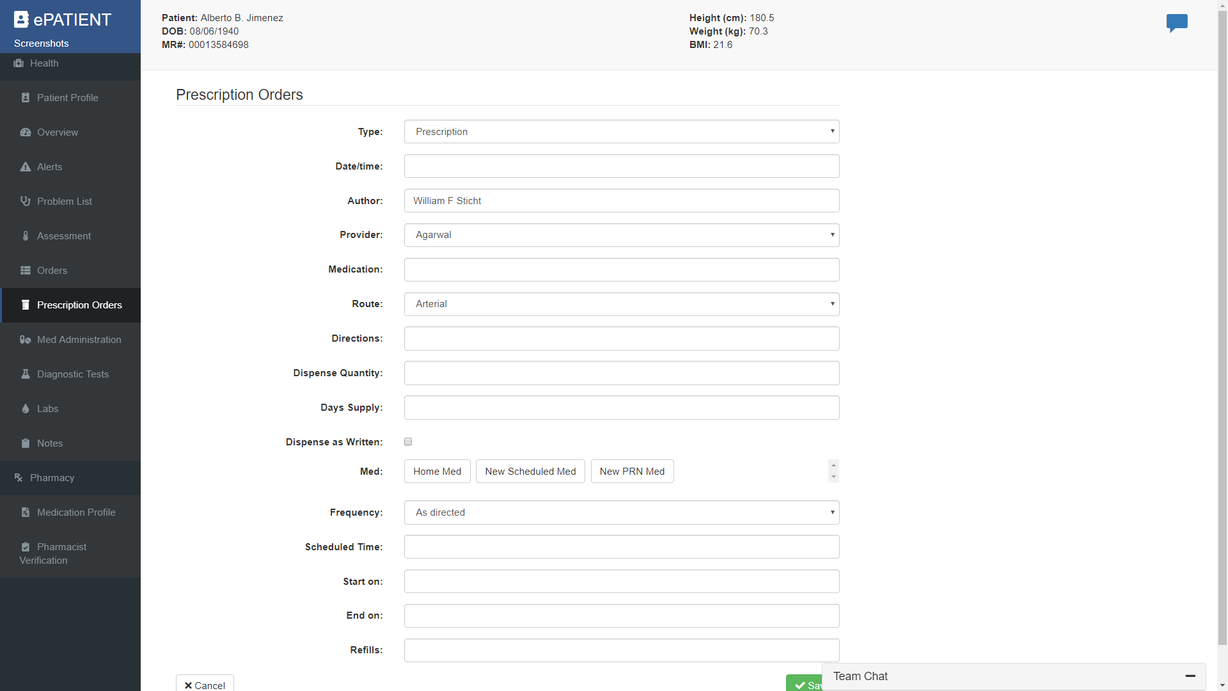
Front-End - PRESCRIPTION ORDERS
Notes:
Fritz/Sarah

Slide 63
Front-End - MEDICATION ADMINISTRATION
Notes:
Fritz/Sarah

Slide 64
Front-End - MEDICATION ADMINISTRATION
Notes:
Fritz/Sarah

Slide 65
Front-End - MEDICATION ADMINISTRATION
Notes:
Fritz/Sarah

Slide 66
Front-End - MEDICATION ADMINISTRATION
Notes:
Fritz/Sarah

Slide 67
Front-End - MEDICATION ADMINISTRATION
Notes:
Fritz/Sarah

Slide 68
Front-End - MEDICATION ADMINISTRATION
Notes:
Fritz/Sarah

Slide 69
Front-End - MEDICATION ADMINISTRATION
Notes:
Fritz/Sarah

Slide 70
Front-End - DIAGNOSTIC TESTS
Notes:
Fritz/Sarah

Slide 71
Front-End - MEDICATION PROFILE
Notes:
Fritz/Sarah

Slide 72
Front-End - MEDICATION VERIFICATION
Notes:
Fritz/Sarah

Slide 73
Front-End - MEDICATION VERIFICATION
Notes:
Fritz/Sarah

Slide 74
Front-End - MEDICATION VERIFICATION
Notes:
Fritz/Sarah

Slide 75
Questions

