Slide 1
Closing the Gap: Building Confidence and Success in Mathematical Performance in Today’s Students
Linda Blocker, CHE, Assistant Professor Amanda DeWald, Assistant Professor Elizabeth Frisbee, Associate Professor Dr. Monica Liddle, Professor Desiree Keever, JD, Associate Professor

Slide 2
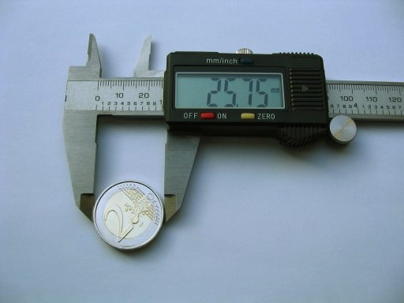
Drive for Change
Increasing numbers of students struggling with basic math concepts across Career and Technical Education (CTE) programs on campus
Poor performance in gateway math courses correlate with continued struggles in subsequent course
SUNY Delhi Applied Math Task Force created for collaboration with Mathematics and CTE faculty
Model of Additional Hour College Algebra

Slide 3
SETTING THE STAGE
Placement Challenges
Lack of Consistency in Advisement
Scheduling Issues
Shift from Placement Testing to Placement Based on Multiple Measures
Cross-Campus Collaboration
Admissions
Student Support Services
Program Directors and Deans

Slide 4
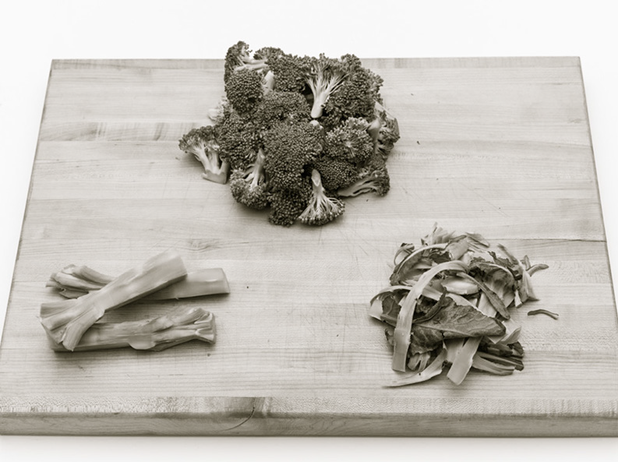
The Additional Hour Model for Applied Math Courses
Courses meet for an additional hour each week
Math faculty “co-teach” course with Applied Math faculty
Math faculty provide additional support
Emphasis on Study and Learning Skills
Models include:
Heterogeneous/Homogeneous Grouping Models
On-Line/Face to Face Models
Math infused in Applied Math Models/Applied Skills infused in Math Classes Models

Slide 5
Applied Technologies Applied Math 3 hours traditional math instruction 1 hour shop applications
Action items contributing to success
Team teaching theoretical paired with direct applications
Additional time
Hands on activities supported students’ kinesthetic learning styles

Slide 6
Veterinary Science Applied Math homogenous grouping face to face and online sections
Action items contributing to success
Time to link math with hands on applications & manipulatives
Allowed students to see multiple solution strategies
Students understand why instead of how

Slide 7
Business Applied Math heterogeneous grouping face to face and online sections
Project implemented in Fall 2018
Action items contributing to success
Guided practice
Linking concepts to applications
Scheduling and homogeneous grouping
Students who opted for additional support improved grades

Slide 8
Culinary Applied Math homogenous grouping
Action items contributing to success
More time led to more practice, repetition, slower pace
Homogeneous grouping helped students feel comfortable
Confidence building
Both sections improved so it leveled the playing field

Slide 9
Questions?

Slide 10
Linda Blocker blockela@delhi.edu
Amanda DeWald dewaldam@delhi.edu
Elizabeth Frisbee walkerea@delhi.edu
Dr. Monica Liddle liddleml@delhi.edu
Desiree Keever keeverdn@delhi.edu

