Slide 1
Displaying Transformation to the World
Global Learning Microcredentials and
Digital Badges
Susan Jagendorf-Sobierajski, SUNY Cobleskill, Allison Nyamuame, Binghamton University, Mary Lou Forward, SUNY COIL Center, Hope Windle, SUNY COIL Center
Notes:
Slides 1-4 : Mary Lou
Slides 5-9: Allison
Slides 10-21: Susan
Slides 21-End: Hope

Slide 2
What are Microcredentials/Badges?
Badges are generally used 3 different ways.
1. Recognize Mastery of “Chunks” of Content
= Academic microcredentials
Often stackable, leading towards course credit or onramp to a certificate/degree
2. Recognize Attainment of Skills
= Skills or Competency badges
Complementary to academic achievement, enhancement of formal education
3. Recognize Community Engagement
Examples: -Badge given to recognize frequency of contributions, leadership roles
- Badge given for participation in events, such as speaking at a conference
-Badge given for an award

Slide 3
What are Microcredentials/Badges?
Badges are digital tokens that visually display accomplishment.
They include additional data about the badge criteria, evidence of learning, issuer of the badge, etc.
This can include personalized, individual evidence by linking to learner created artifacts (such as e-portfolio, website, etc.)
To do this, badge criteria must be specific, clear, and measurable

Slide 4
What are Badges?

Slide 5
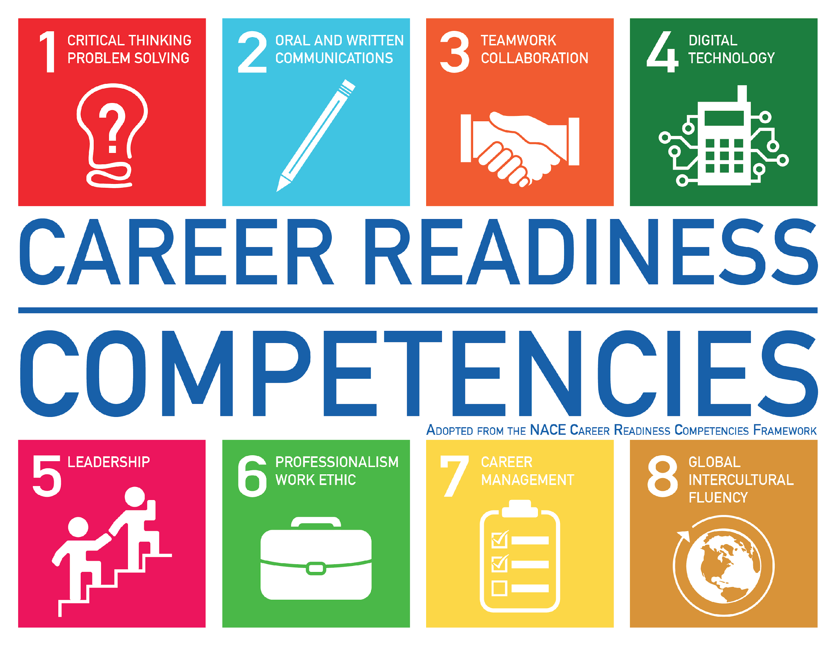

Slide 6
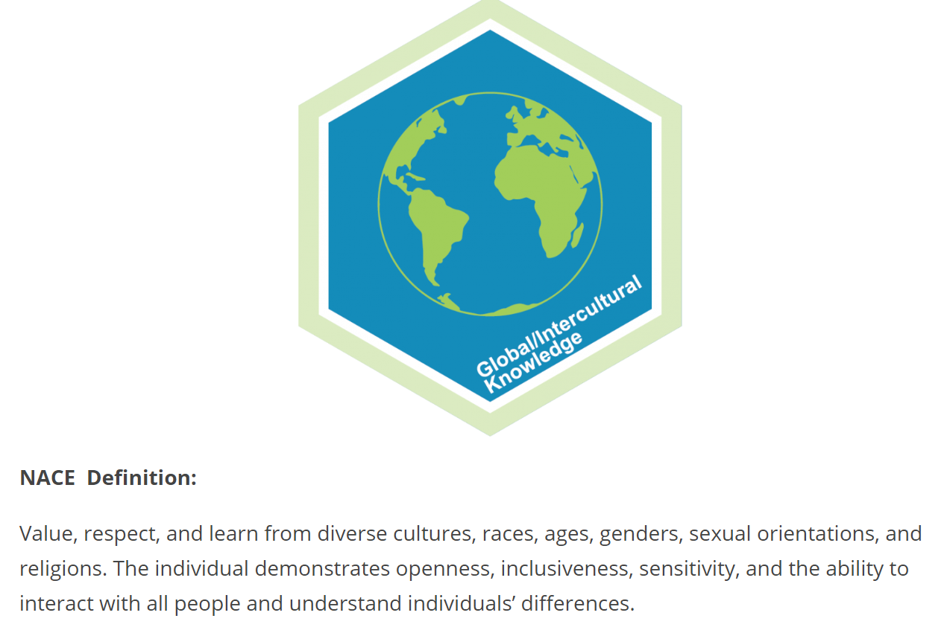
Badges for Global Learning
NACE Definition
Value, Respect, and learn from diverse cultures, races, ages, genders, sexual orientations, and religions. The individual demonstrates openness, inclusiveness, sensitivity, and the ability to interact with all people and understand individuals’ differences.

Slide 7
Concept for SUNY Global Learning Badges
Opportunity - Create a microcredential for global learning at a system level
Task - Define a set of competencies that students will demonstrate to earn the badge(s)
Guiding Concepts - Award badges based on demonstration of skill achievement, regardless of experiences used to gain the skill, making badge earning versatile across all campuses
A credential defined at the system level sets a state-wide standard for global learning as well as puts SUNY at the leading edge of certifying global learning competencies.

Slide 8
Time Line of Our Process
Developed a Steering Committee
representing all SUNY institutional types to guide the process
Developed a Process
recommended for demonstrating achievement of skills
Recruited Team Members
from CIE and COIL networks
Feb/March 2018
Oct 2018
April 2019
End of 2017
June 2018
March 2019
Wrote Grant Proposal
Wrote and received an IITG grant
Formed Badge Committees
from the larger group to help develop definition, criteria and characteristics
Created Badge Designs

Slide 9
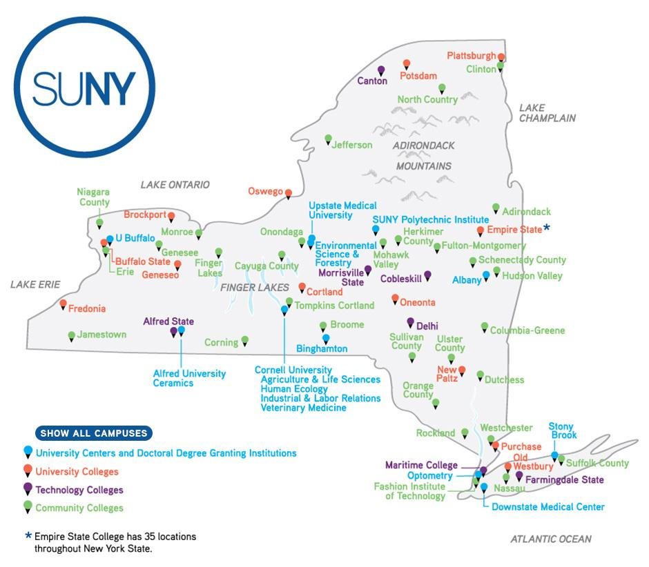
Badges for Global Learning
Steering Committee
Mary Lou Forward, COIL Center
Helen Gaudette, FIT
Susan Jagendorf-Sobierajski, Cobleskill
Jan McCauley, COIL Center
Allison Nyamuame, Binghamton
Ann Pearlman, Brockport
Hope Windle, Ulster
Badging Task Group
Sam Cardamone, Geneseo
Cyan Corwine, Alfred State
Erin Lassial, SUNY Canton
Jim Pasquill, Global Affairs
Chilton Reynolds, Oneonta
Cathy Roche, Rockland
Christian Speedling, Global Affairs
Christian Wilwohl, New Paltz

Slide 10
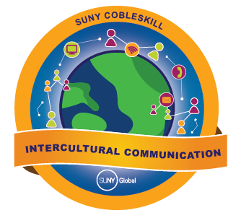
Intercultural Communication
Notes:
Susan

Slide 11
Intercultural Communication
Definition - Ability to communicate effectively across cultures, including the use of relevant technology.
Criteria to be assessed
Expresses thoughts and ideas clearly and effectively inside and outside one’s own culture (in written and oral communication).
Demonstrates ability to identify different cultural landscapes and communicate appropriately, both verbally and non-verbally.
Demonstrates ability to adapt communication style to a variety of modes of communication.
Notes:
Susan

Slide 12
Intercultural Communication
Criteria 1: Ability to express thoughts and ideas clearly and effectively inside and outside one’s own culture (in written, nonverbal and oral communication).
Highly Competent:
● Demonstrates sensitivity to cultural norms in written, visual and/or oral communication.
● Recognizes multiple cultural perspectives present in a situation.
● Uses appropriate body language, distance and physical interaction behaviors in other cultural contexts.
Competent:
● Recognizes and embraces cultural differences in verbal and nonverbal communication.
● Discerns two or more cultural perspectives reflected in a given situation (including one’s own).
● Analyzes the effect of body language and other non-verbal communications.
Notes:
Susan

Slide 13
Intercultural Communication
Criteria 1: Ability to express thoughts and ideas clearly and effectively inside and outside one’s own culture (in written, nonverbal and oral communication).
Developing:
● Identifies basic cultural differences in verbal and nonverbal communication; is aware that misunderstandings can occur based on those differences but does not adjust communication style.
Needs to Show Progress Towards:
● Improving communications in interpersonal communication by taking into account cultural differences.
Beginning:
Begins to recognize the existence of cultural differences in verbal and nonverbal communication.
Needs to Show Progress Towards:
● Developing a greater awareness of cultural differences.
● Recognizing an awareness that communication misunderstandings can occur based on cultural differences.
Notes:
Susan

Slide 14
Global Awareness and Self in the World
Notes:
Susan

Slide 15
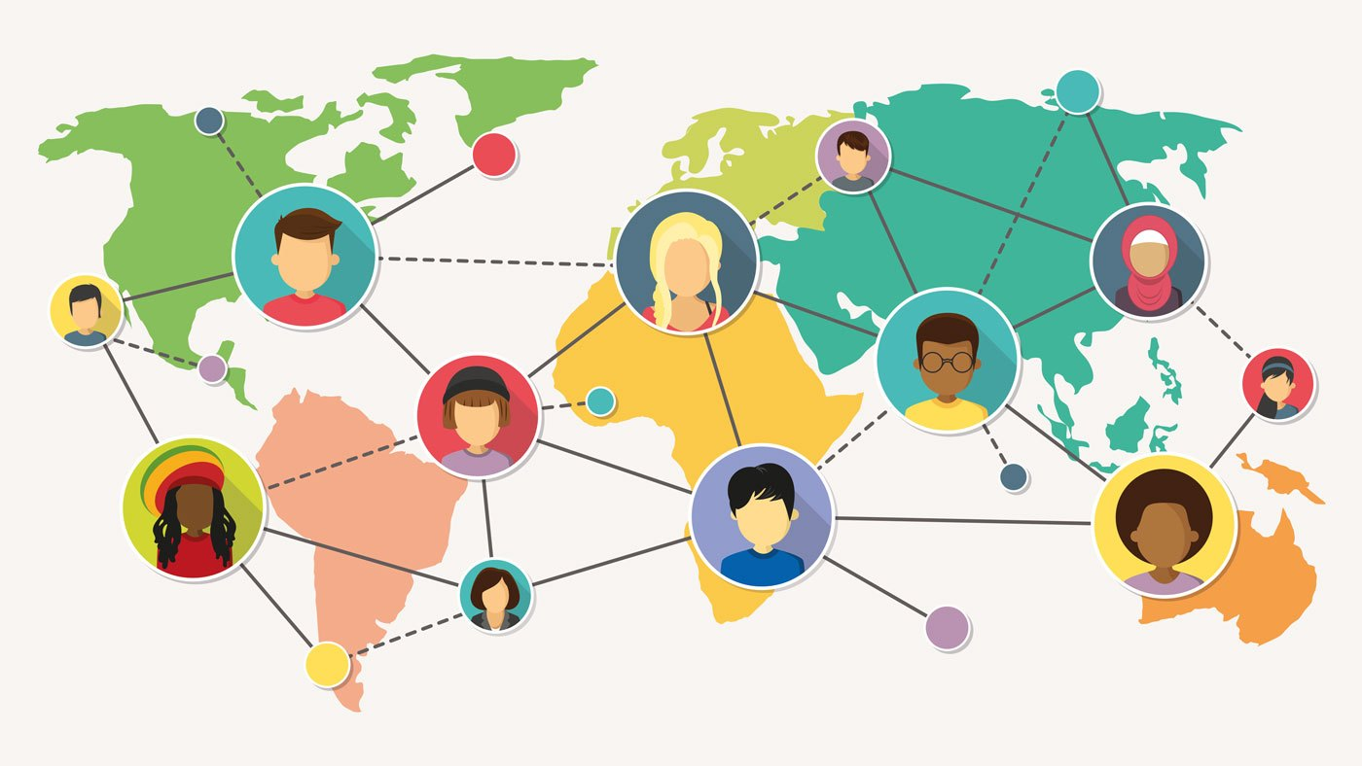
Global Awareness and Self in the World
Definition-- Capacity to operate in different cultural contexts with awareness of one’s own cultural background and characteristics.
Criteria to be assessed—
-Analyzes how culture contributes to one’s identity and view of the world.
-Demonstrates awareness of one’s own culture contributions to an intercultural situation.
-Demonstrates curiosity about one’s own and other cultures and desire to expand intercultural engagement.
-Incorporates diverse perspectives in decision making.
Notes:
Susan

Slide 16
Global Awareness and Self in the World
Criteria 2: Demonstrates awareness of one’s own cultural contributions to an intercultural situation.
Highly Competent:
Provides multiple complex and insightful examples with an integrated analysis of how one’s own cultural worldview contributes to an intercultural situation.
Articulates how one’s behavior has been modified for an intercultural situation.
Consistently adjusts behavior based on cultural context.
Recognizes when others are modifying their behavior in response to the cultural context.
Regularly seeks additional input/information in cases where appropriate behavior is unclear. Competent:
Demonstrates how one’s own cultural worldview contributes to an intercultural. situation by giving multiple examples.
Perceives that cultural norms dictate different behaviors.
Often adjusts behavior based on cultural context.
Usually seeks additional input/information in cases where appropriate behavior is unclear.
Notes:
Susan

Slide 17
Global Awareness and Self in the World
Criteria 2: Demonstrates awareness of one’s own cultural contributions to an intercultural situation.
Developing:
Has a developing awareness of how one’s own cultural worldview can contribute to an intercultural situation, and can give examples.
Needs to Show Progress Towards:
Demonstrating awareness of how cultural norms dictate behavior.
Seeking information about appropriate behavior in different cultural situations.
Modifying their own behavior based on cultural context.
Beginning:
Has rudimentary awareness of how one’s own cultural worldview can contribute to an intercultural situation, but cannot give any examples.
Needs to Show Progress Towards:
Recognizing that there are cultural differences and analyzing the impact of these differences on interactions.
Asking questions about appropriate behavior in new cultural situations.
Notes:
Susan

Slide 18
Cross Cultural Teamwork
Notes:
Susan

Slide 19
Cross Cultural Teamwork
Definition- Individual is able to build collaborative relationships and work within a team structure that includes persons from diverse backgrounds (cultures, ages, genders, religions, lifestyles and/or viewpoints).
Criteria to be assessed—
Demonstrates awareness of different work styles and their cultural underpinnings.
Builds collaborative relations and manages conflicts within a team.
Actively contributes to meeting a diverse team’s goals.
Notes:
Susan

Slide 20
Cross Cultural Teamwork
Criteria 1: Demonstrates awareness of different work styles and their cultural underpinnings.
Highly Competent:
Identifies and clearly articulates multiple work styles and the basis for these styles.
Recognizes when different cultural styles impacts teamwork and is able to explain how.
Analyzes how team dynamics are affected by different work styles.
Competent:
Identifies multiple work styles and the basis for these styles.
Recognizes when different cultural styles impacts teamwork.
Identifies how team dynamics are affected by different work style.
Susan

Slide 21
Cross Cultural Teamwork
Criteria 1: Demonstrates awareness of different work styles and their cultural underpinnings.
Developing:
Recognizes that there are different cultural styles but not yet able to identify how it impacts teamwork.
Needs to show progress toward:
Identifying more work styles
Understanding more consistently when different cultural styles affect teamwork.
Articulating how cultural differences affect teamwork.
Beginning:
Begins to recognize that there are different cultural styles, but have not yet been able to apply this awareness to teamwork.
Needs to show additional progress toward:
Identifying different work styles
Understanding when different cultural styles affect teamwork.
Articulating how cultural differences affect teamwork.
Notes:
Susan

Slide 22
Process
Student completes intercultural experience(s) such as COIL, study abroad, or intercultural community involvement.
Student completes online form with reflective evidence, with guidance from faculty or coordinator.
Point person on campus reviews materials, completes and signs off on the assessment form.
When process is complete, campus point person sends to either campus or SUNY global point person for badge award
Notes:
Hope
Candidates must demonstrate the characteristics described under “competent” or “highly competent” for the established criteria to earn this badge. Students will need to describe how and why they believe they meet the criteria, and provide additional evidence, such as coursework and/or projects completed; reflective essay, blog post, video or other piece; testimonials or excerpts from interactions with others; professor, supervisor, colleague or classmate assessments of skills; or other appropriate demonstration of mastery.
https://docs.google.com/document/d/1JKwwfT0lAlJN-StxHxjJsPVQolKAZcoxgSCKtn6mrbE/edit

Slide 23
Next steps
Identify campuses to pilot these badges in 19-20 academic year.
Work with the identified campuses to develop pathways of skill development for badges.
Develop guidelines for campus review/endorsement and for campus processes.
Train campus point person/people.
Workshops to promote and educate.
Gather feedback, analyze and modify.
Scale.
Notes:
HOPE
Soliciting feedback and input from the wider CIE and COIL networks
Refine badges, criteria and process
Seek pilot campuses to develop pathways to achieving the badge

