Slide 2
Sharing a Pragmatic Networked Model for Open Pedagogy: The Open Hub Model of Knowledge Generation in Higher Education Environments
Lee Graham, Ph.D.
Verena Roberts Ed.D. Candidate

Slide 3
It all started with a tweet
Exploration - 2013:
MOOCMOOC
ETMOOC
cMOOCS & Connectivism
Communities of Practice: #edchat #ntchat #edtechchat
#diffimooc 2014
Varied Projects
Students self-chose
Organization through Google Sheets
Express Content Knowledge in any way possible

Slide 4
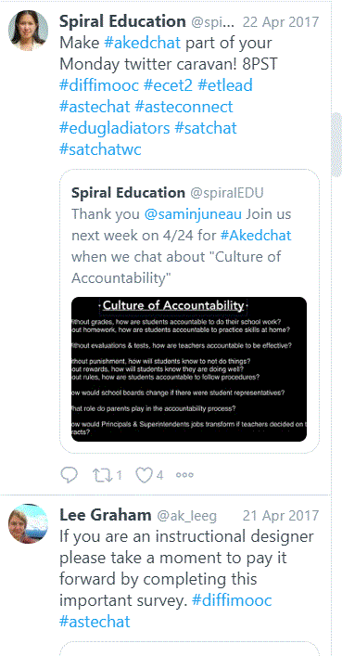
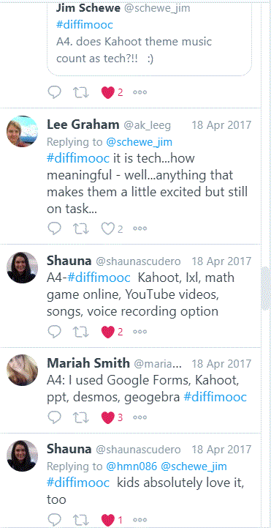
Twitter: optional and highly utilized
Student Hosted
Communities of Learners
Content Focused

Slide 5
Modifications
Set of tools for each week to complete project
Blogroll on the side of the anchor page rather than in the Google Sheet
Use of Tweetdeck/Hootsuite for Twitter
Eliminated assumption that tools were intuitive and ss didn’t need direct instruction
Twitter/Tweetdeck
Wordpress
Youtube
Screencast-o-Matic
Linking social media to maximize amplification of postings
Provided extra credit for use of and participation in twitter
Required the creation of a blog in preferred format (Wordpress, Weebly, Google Sites) - direct instruction in Wordpress
Incorporated more modeling of tools/projects

Slide 6
Maintained
Hashtag for organization of the various media
Use of Google Sheets for initial collection of blog addresses
Videos for explanation/direct instruction
Twitter (students saw this as the anchor of the experience)

Slide 7
Moving Away from Connectivism to Open Learning Design Principles
Control the space
Learn
Grow into new roles and responsibilities
Practice oral and written language
Express self and cultural identity through multimodal forms
Develop resources for other learners
Engage with the world (Kral and Schwab, 2012)

Slide 8
Safety, Copyright & Creative Commons
Thorough instruction on what might be shared openly/reworked/remastered and what can not be.
Thorough understanding of the licenses and which they may choose from to share their work.
Thorough understanding of strategies for avoiding viruses & malware as long as effective anti-virus and anti-malware programs.
Privacy of their own students and conditions for displaying these images.

Slide 9
Preconditions for Open Learning
Cronin (2017) examined the relationship between openness and praxis in university educators by identifying four levels of OEPs that determine the extent and manner of OEP praxis:
Macro: Global level (will I share openly?)
Meso: Community/network level (who will I share with?)
Micro: Individual level (who will I share as?)
Nano: Interaction level (will I share this?)

Slide 10
Teacher Awareness
The Residents and Visitors map (White and LeCornu, 2017) provides educators a highly visual tool to determine the extent to which students use social media tools for work-related or productivity purposes.
Alternative to Digital Native/Digital Immigrant

Slide 11
Co-Learners
Educators situate themselves as co-learners
Students move between teaching/learning as do Faculty
Accept we will not know everything about the internet or our students - , and be receptive to student knowledge/culture/ways of being
Engage in activities that are required of students.

Slide 12
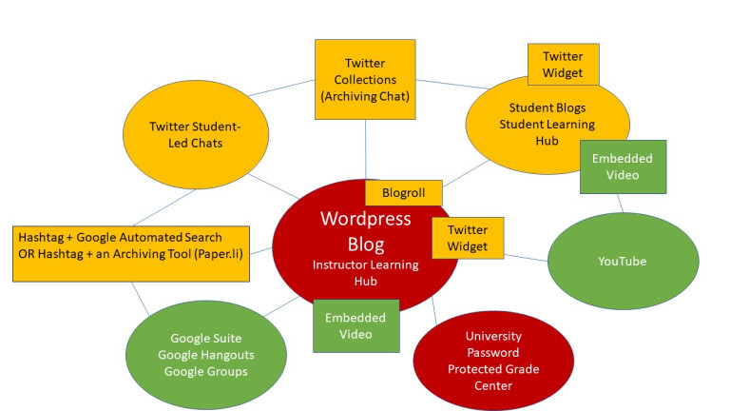
Open Hub Model

Slide 13
FERPA
NO evaluative statements made other than in the secure gradebook.
Students are fully aware that hey should not disclose their address, place of employment, telephone number or other identifying information.
Students are given a choice of whether to use their real name.
Students may choose levels of sharing so that they are allowed to move through stages in order to find their comfort level for openness.

