Slide 1
Creating Accessible
Word Documents
(Microsoft Word 2016)
Nazely Kurkjian
Notes:
Microsoft Word is a common authoring program for creating accessible documents. Today, I will discuss MS Word 2016. Please note, I am presenting this webinar through the lens of a PC (Windows) user. Nevertheless, the same accessibility principles apply across different versions of Word and operating systems (such as Mac).
Microsoft Word has accessibility features built into it. What this means is, accessibility is not automatic. Rather, Microsoft Office products, like Word, provides the infrastructure for you - the content creator - to make it more accessible.
Ultimately: you need to know about the accessibility principles and how to incorporate them in this tool.
In this presentation, I will introduce common errors and review basic steps to add to your workflows that will make your document more accessible to users with different disabilities.
Before I begin - I’d also like to add: both this software and our awareness of accessibility techniques has evolved greatly over time. Most especially in the last decade. Truthfully, I did not learn this in high school or college. I doubt many of us did. We learned it when we found out about it. So I hope that eases any anxiety, especially if you don’t feel particularly tech savvy. It’s something that will feel normal after doing it a few times.

Slide 2
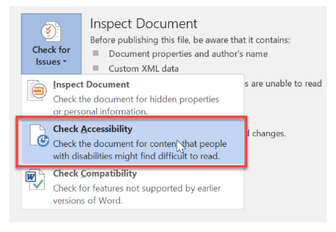
Accessibility Checker
Tip: Use from the beginning
Types of issues:
Error
Warning
Tip
Note: cannot catch everything; use human judgment
Notes:
The Accessibility Checker is a great place to start with a blank document. It checks the file for a range of issues impacting the accessibility and ease of use for individuals with disabilities. You can use this with existing documents too. It will tell you what the issue is, why it’s important, and how to remediate it. It will not fix it for you though. You need to understand the core accessibility principles to enhance the accessibility of the document.
To locate the Accessibility Checker, select the File tab and click Check for Issues > Check Accessibility
Errors are the most serious issues, and should always be fixed. This means there is a significant barrier to users with disabilities
Warnings can also pose problems to users with disabilities, making it difficult to access aspects of the document
Tips are potential problems that are not earth shattering but would improve the usability of the document
Unfortunately, artificial intelligence can only go so far. Human review is necessary for certain things such as checking color contrast. If words are emphasized using bold but should be headings, it won’t catch that either. The checkers can’t tell if the image descriptions are inaccurate or badly written.

Slide 3
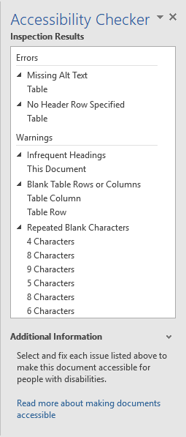
Common Issues
Use of headings
Spacing
Alt text
Images inline
Contextual links
Font type, size
Use of color/contrast
Table headers
Columns
Notes:
These considerations require some additional attention to your workflows, but most of it is not substantially time consuming. It’s just knowing they exist and using them. It’s easier to address these issues from the beginning than go back and retroactively fix them.

Slide 4
Navigation and Readability
Font
Font size: 11 pt. (paragraph) - 14 pt. (headings)
Recommended | Reasonable | Avoid
Verdana | Comic Sans | Curlz MT
Tahoma | Calibri | American Typewriter
Notes:
Designing clear and consistent navigation in your document will allow users to focus on your content and improve user experience. As we learned in numerous presentations this week, whitespacing and using headers can make it easier for people to consume digital information.
For Word documents that are intended to be read online, Sans-serif fonts have been found easier to read on devices. Serif fonts have hooks at the end of letter strokes that can cause letters to run together, which can be challenging for users with visual impairments and dyslexia.
At minimum, use an 11 point font for paragraph text, and use a minimum 14 point font for headings. Making fonts easier to read can support individuals to take in the information quicker

Slide 5
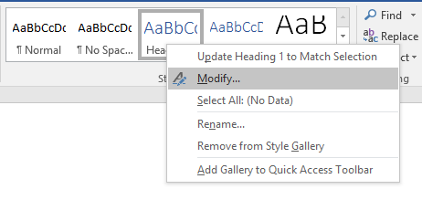
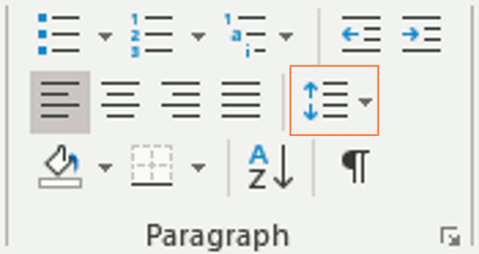
Navigation and Readability 2
Built-In features:
Styles (headings)
Paragraphs (spacing)
Lists
Simple and clean is best!
Notes:
Use built in features wherever possible. This includes headings, paragraphs and lists. All of these can be found on the Home ribbon. Headings are located in the Styles pane
Adding headings to your documents provides important semantic structure. This is important for consistency and ease of navigation. Ultimately, this improves attentiveness, reduces anxiety, and enhances accessibility for screen reader users. Assigning headings also creates a table of contents, which benefits all users. Once you assign headings, you can find the headings in the Navigation Pane. Or, if you create a table of contents, it will generate one from the headings.
Screen reader users navigate the document by jumping from heading to heading using keyboard shortcuts. Assign headings based on their hierarchy in the document. If it’s a title, it should be assigned as Heading 1. Only one heading should be designated as Heading 1. Sub-headings with importance should follow as Heading 2. Remaining headings can continue in this pattern (heading 3, 4) and so on. Don’t skip a heading level. Simply modify it to look how you want. To do this, go to the Home ribbon, and modify headings in the Styles pane.
The same rationale for headings applies to paragraphs and lists. The built-in paragraphs and lists features in Word will maintain their structure if you export the document to HTML or save it as a PDF document. And using the ordered lists will tell a screenreader user it is a list, so they can tell how many items are in the list, should they choose to continue reading. Lists are also beneficial for dyslexic users who may have difficulty reading blocks of text
To allow sufficient white space, avoid using the space or tab bar to achieve this. I know this is what people were used to doing, before MS Word added all these structuring features and fancy ribbons. This is what that warning “Repeated Blank Characters” means. To get rid of this warning, use the Paragraphs pane to adjust spacing. Otherwise, screen readers will read aloud “blank, blank blank” while the user tries to navigate through the document.

Slide 6
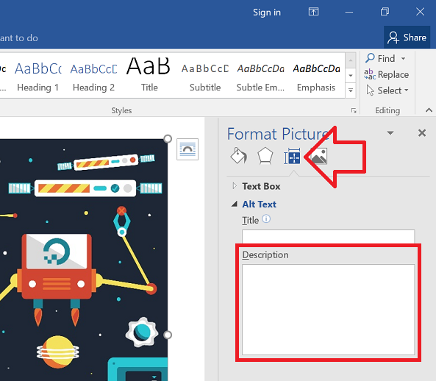
Alternate “Alt” Text
Notes:
Any element in your document that is not text based needs to have alt text associated with it
This includes images, shapes, graphs, charts, multimedia and so on
Alt text is a description of the image that conveys the meaning of it, so someone who cannot see the image can still understand what it represents
To locate the alt text feature, right click the image, select format picture, and enter a description
Alt text should be written based on the context of the graphic
It can be purely decorative or more specific
In older versions of Word like 2016, it’s not simple to silence a decorative image. Microsoft recommends putting two quotation marks “” in the Descriptive field. Screen readers will still read it has a graphic, and the accessibility checker may still say the image needs alt text, but you can ignore the checker’s warning for that image.
For graphics that require alt text for context, write a description in the Descriptive field that accurately reflects what you intend to convey

Slide 7
Basic Image
Description 1: A photo of modern day downtown Louisville, Kentucky.
Description 2: A photograph of modern day downtown Louisville, Kentucky at dusk shot from across the Ohio River, with a view of a cable-stayed bridge in front of tall city buildings lit up. The river reflects a purple sky along with a freeway and tall city building lights.
Making Images Accessible - Diagram Center
Notes:
For basic images, think about the image in context
The photo is used at the beginning of the unit to introduce the topic.
The goal of the image is to help students get a modern picture of Kentucky but the image is decorative beyond that idea. Describe setting and main elements.
In context, Description 1 is the best fit.

Slide 8
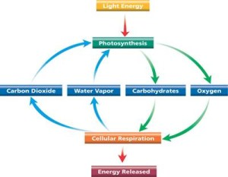
Complex Images
A diagram shows the process of photosynthesis and cellular respiration.
Light Energy leads to photosynthesis.
Photosynthesis leads to carbohydrates and oxygen.
Carbohydrates and oxygen leads to cellular respiration.
Cellular respiration leads energy released, water vapor and carbon dioxide.
Water vapor and carbon dioxide lead back to photosynthesis, and the cycle continues.
Making Images Accessible - Diagram Center
Notes:
For complex images, which may require more than 120 characters to provide an adequate description, you may need to include a longer description in the document’s visible text.
It is not necessary to describe visual characteristics (e.g., green arrow).

Slide 9
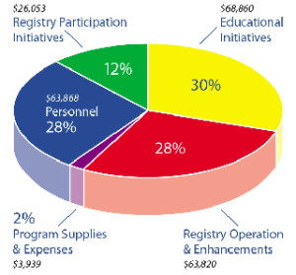
Charts and Graphs
Expense | Percent of Total | Dollar Amount
Program Supplies & Expenses | 2% | $3,939
Registry Participation Initiatives | 12% | $26,052
Registry Operation & Enhancements | 28% | $63,820
Personnel | 28% | $63,868
Educational Initiatives | 30% | $68,860
Making Images Accessible - Diagram Center
Notes:
Provide a text alternative that summarizes the content of each chart or graph. At minimum, provide a title and description.
Charts and graphs could be converted into accessible tables. This is easier to understand for everybody. In this pie chart, you can barely tell the yellow pie is 2% greater than the red pie. It’s visually difficult to understand the difference between two groups.
Title: Program Expenses
Description: This figure is a pie graph that can be shown in the following table.

Slide 10
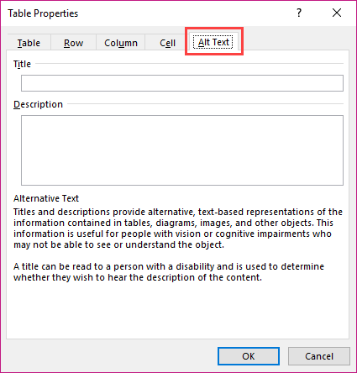
Tables
Notes:
To add the title and description to the table, right click on the table and select Table Properties
This is where you will find Alt Text for tables

Slide 11
Tables 2
Notes:
If your table spans across multiple pages, you need to select Repeat the Header Row so that the header row maintains across page breaks. This marks the first row as a heading
You should avoid merged and split cells, because they make it difficult to decipher audibly

Slide 12
Tables 3
January 19 through 23: Photography for Social Reform, the Early Days
Photographers Jacob Riis and Lewis Hine.
Read pages 95 through 120.
Take Module 3 Quiz.
January 26 through 30: Twentieth Century Reformers
Photographers W. Eugene Smith and Sebastião Salgado.
Read pages 143 through 187.
Take Module 4 Quiz.
Accessibility for Online Course Content
Notes:
Lastly - Instead of using tabs or tables, you could simply redesign your documents by using headers to accomplish the same thing

Slide 13
Columns
Notes:
If you use the tab key to create what appears to look like two or more columns, simply use the accessible columns feature in MS Word. Otherwise, screen readers will read from the left column to the right column, and not in the way you intended
Columns may be located in the Layout tab on the ribbon.
Select Columns in the Page Setup Group, and choose the number of columns

Slide 14
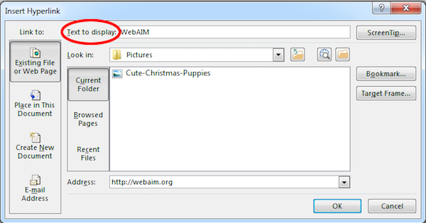
Hyperlinks
Notes:
When you copy and paste a URL into a document, it automatically creates a hyperlink. To change the URL into a meaningful hyperlink, right click the link and change the text to display

Slide 15
Original Example | Problem | Corrected Example
Article 1 | Link titles are not descriptive of the underlying content. | Article: The College Where Students Can Minor in Craft Beer
http://www.theguardian.com/media/greenslade/2014/sep/12/coffee-south-carolina | The hyperlink is too long and not contextual. | Journalists Drink More Coffee than Anyone
Google search engine, click here | The link titles are not unique. | Google
SUNY Electronic & Information Technology (EIT) Accessibility Committee Final Report and Recommendations | If the browser does not alert the screen reader user that the link is a non-HTML link, it can cause confusion. It assumes that individuals have the program (e.g., Acrobat) installed, to open the content. | SUNY Electronic & Information Technology (EIT) Accessibility Committee Final Report and Recommendations (PDF)
Notes:
On this slide is a table detailing numerous examples of how hyperlinks may be posted in problematic and accessible examples, with descriptions of the underlying issues
Hyperlinks should be understood out of context. Meaning, the text should concisely describe where the link goes.
When hyperlinks display vague or non-descriptive text (such as “click here”), it doesn’t tell the user where they are going or what they are opening. This creates a barrier for screen reader users who use keyboard shortcuts to quickly find the link they are looking for. Descriptive text also helps users on the Autism Spectrum, to help them know what to expect and give them a sense of control.
For links that open documents, such as Word, PDF, PPT, it is important to identify the application within the description of the linked text.

Slide 16
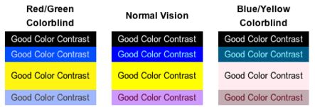
Color
WebAIM Color Contrast Checker
Colour Contrast Analyser
Notes:
The examples on this slide show how difficult it may be to read content with poor color contrast for red/green colorblindness, normal vision, and blue/yellow colorblindness. Use common sense. This is something that must be checked in Word manually. If you publish the document to the Web, there are free color contrast checkers online.
Using color as the only method of conveying information is problematic for users who may be color blind, blind or have low vision. Of course you can use color, but if you’re using color to convey meaning, use other signifiers in addition, such as asterisks, for students to ascertain the information.

Slide 17
More Complex Elements
Text wrapping/In-line with text
Floating elements, such as SmartArt, text boxes, shapes, etc.
Data tables with multiple layers of headers
Math expressions
Headers & footers
Notes:
I will not get into these more complicated elements in MS Word.
Truthfully, making these accessible in Word is challenging or impossible. These may require additional plug-ins or enhancements in another authoring tool (like Acrobat) to provide optimal accessibility functionality

Slide 18
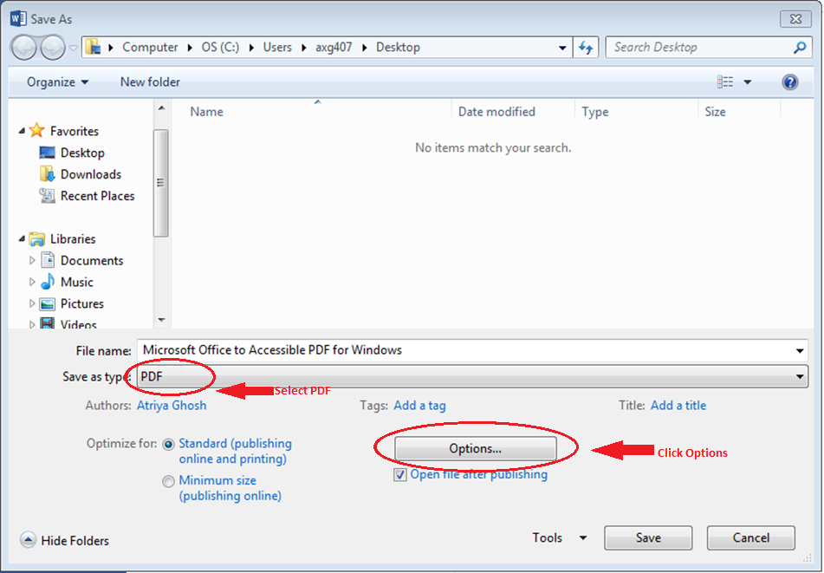
Final Recommendations
Keep the original source document
Do not Print to PDF! Save as PDF
Notes:
You never know when you’re going to need to update information in the original source document. Plus, typically screen readers are better at reading word documents than remediated PDFs. So a student may ask if you have a Word version of the PDF you made from it some time ago
If you must - once you make your document as accessible as possible, save the document as a PDF. This retains the accessibility features. Do not Print to PDF. That removes all the great accessibility work you just did. There’s a few ways to save as a PDF, depending on if you have Acrobat installed on your computer. Even if you don’t, you can still

Slide 19
Additional Resources
Designing an Accessible Online Course, Explore Access
SUNY Electronic & Information Technology (EIT) Accessibility Listserv
SUNY-EIT-subscribe-request@LS.SYSADM.SUNY.EDU
Facebook Workplace: Web Accessibility Group
SUNY’s EIT Accessibility implementation guidance for web, digital, procurement, libraries, and classroom accessibility may be found on SUNY Blue: blue.suny.edu
Self-paced accessibility training is freely available through Deque University.
Notes:
Microsoft Office’s website is a great resource, and is generally easy to find the answers you’re looking for.
If you’d like to learn more about MS Word at your own pace, Deque University offers an online course. It typically takes 1 hour to complete and there is a certificate of completion at the end.

Slide 20
Contact Information
Nazely Kurkjian
Coordinator of Disability, Diversity & Nontraditional Student Services
Nazely.Kurkjian@suny.edu

