Slide 1
Aligning Reality with Opportunity
Adaptive Program Development for Learning, Engagement, and Completion

Slide 2
Introductions
Dante Cantu, Executive Director of Academic Advising & Student Success
Jessica Delaney, Coordinator of the Center for Student Success

Slide 3
How can we do more with less?
How will we know if it's working?

Slide 4
Critical Self-Reflection
Mission
Data
Campus-wide Partnerships
Resources

Slide 5
CSS Mission
The Center for Student Success promotes student learning, academic engagement, and timely degree completion through the coordination of peer-based academic support programs and the management of the College’s Student Success System, Starfish.

Slide 6
Peer-to-Peer Model
Subject Tutoring
Writing Support
Academic Coaching
Online Tutoring
Excel

Slide 7
Data-Informed Model
Course | Title | Enrolled | DFWU% | # of semesters | Most recent semester
BIO201 | General Biology 1 | 157-232 | 30-45% | 6 | Fall 2018
BIO202 | General Biology 2 | 98-132 | 21-28% | 3 | Spring 2017
BIO320 | Genetics | 124-154 | 36-50% | 6 | Fall 2018
BUS201 | Financial Accounting | 128-220 | 15-20% | 5 | Fall 2018
BUS309 | Stat Business and Economics 1 | 118-214 | 15-25% | 6 | Fall 2018
CHE201 | General Chemistry 1 | 239-318 | 19-26% | 6 | Fall 2018
CHE202 | General Chemistry 2 | 152-171 | 15-24% | 3 | Spring 2018
CHE318 | Organic Chemistry 1 | 110-175 | 22-46% | 6 | Fall 2018
CHE319 | Organic Chemistry 2 | 68-90 | 21-34% | 4 | Spring 2018
CPS210 | Comp Sci 1 Foundations | 52-108 | 17-40% | 10 | Fall 2018
ECO206 | Principles of Microeconomics | 139-197 | 15-23% | 9 | Fall 2018
ECO207 | Principles of Macroeconomics | 135-228 | 14-18% | 5 | Fall 2018
FRN101 | Elementary French I | 49-123 | 23-38% | 10 | Fall 2018
ITA101 | Elementary Italian 1 | 46-130 | 15-26% | 6 | Spring 2018
MAT120 | College Mathematics | 60-286 | 15-37% | 9 | Fall 2018
MAT140 | Math for Elem Teachers I | 49-62 | 15-30% | 9 | Fall 2018
MAT152 | College Algebra | 81-219 | 25-48% | 10 | Fall 2018
MAT181 | Precalculus | 91-224 | 34-67% | 10 | Fall 2018
MAT241 | Introduction to Statistics | 58-83 | 18-34% | 10 | Fall 2018
MAT251 | Calculus 1 | 135-186 | 33-50% | 10 | Fall 2018
MAT252 | Calculus II | 87-128 | 28-45% | 10 | Fall 2018
MAT260 | Intro to Proof | 47-52 | 15-38% | 6 | Fall 2018
PHY201 | General Phy 1 | 103-129 | 14-26% | 9 | Fall 2018
PSY272 | Introductory Psychology | 168-256 | 15-23% | 7 | Fall 2017
PSY275 | Psychological Statistics | 69-109 | 14-21% | 8 | Spring 2018
SPA101 | Elementary Spanish 1 | 97-192 | 15-30% | 7 | Spring 2018
SPA102 | Elementary Spanish 2 | 99-152 | 16-35% | 8 | Fall 2018
SPA201 | Intermed Spanish 1 | 96-155 | 14-25% | 5 | Spring 2018

Slide 8
Marketing
Utilization Reports
Open Communication with Faculty Partners
Class Visits
Syllabus Blurbs
Starfish
Social Media
Emails
Orientation

Slide 9
Assessment Model
Student Feedback Survey
Reflection with Student Staff
Office of Institutional Research
Online Scheduling & Attendance Tracking

Slide 10
Skills & Competencies for College & Career
NACE: Career readiness & competencies
Critical Thinking/Problem Solving
Oral/Written Communications
Teamwork/Collaboration
Digital Technology
Leadership
Career Management
Global/Intercultural Fluency

Slide 11
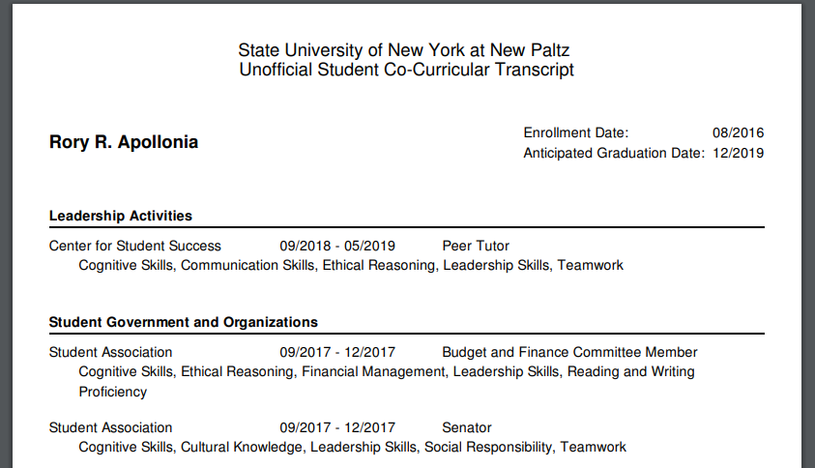
Co-Curricular Transcript

Slide 12
Are students learning? How do we know?
Assessing Mission Effectiveness

Slide 17
Data-Informed Next Steps
Peer Advisor Program
Remote Programming
Expanded Subject Tutoring
Assessing Student Learning through SLOs
Excel Program Pilot

Slide 18
New Student Learning Outcomes
Tutees
Tutors

Slide 19
Adaptive Program Development Through Critical Self-Reflection
Mission
Data
Campus-wide Partnerships
Resources

Slide 20
Preliminary Data from Excel
First Test: Class average was 56%, students who came to Excel 3+ times scored 65%
Second Test: Students who did not attend Excel and/or Tutoring scored 55%, students who came to Excel 3+ times scored 66%
From the first test to the second test, students who came 3+ times to Excel improved their scores by 18 points compared to 7 points from peers who did not attend Excel

Slide 21
Questions to Consider
What opportunities do you see for a data-informed, peer-based model?
What challenges do you see for a data-informed, peer-based model?

Slide 22
Questions

