Slide 1
Math Pathways:
Why Advise Quantway?
Jessica Joyce- Suffolk County Community College
Kate Taylor- SUNY Broome Community College

Slide 2


Developmental Courses
Gateways or Gatekeepers?
Notes:
According to a study of more than 250,000 students done by the Community College Research Center at 57 Community Colleges in the Achieving the Dream Initiative found that 59 percent of entering students were referred to developmental math and 33 percent were referred to developmental reading.
Another study from the Federal BPS (Beginning Postsecondary students) data from 2009 indicate that 69 percent of students beginning at public two-year colleges in 2003-2004 took one or more remedial courses in the six years after their initial enrollment; 59 percent took at least one course in math and 28 percent took at least one course in English.

Slide 3

“Think of academic advising as a course offered to our advisees. We should think of ourselves as teachers, our advisees as students, our offices as classrooms, and student growth- along several dimensions- as the learning outcomes of the class” (Ramos, 2004).

Slide 4
What is Quantway?
Quantway is a set of quantitative reasoning course options designed to promote success in community college mathematics and to develop quantitatively literate students.
  Promotes collaborative learning
  Addresses socio-emotional factors that affect student success
  Integrates algebraic and quantitative skills and reasoning
  Teaches students how to use quantitative tools intelligently in their daily lives
  For students on the non-calculus track

Slide 5

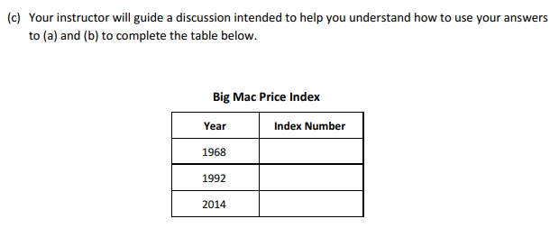
Sample Lesson

Slide 6
Statistics about Quantway
Huang, M. (2018). 2016-2017 Impact Report: Six Years of Results from the Carnegie Math Pathways. 2016-2017 Impact Report: Six Years of Results from the Carnegie Math Pathways. Standford, CA: West Ed.
Notes:
According to Carnegie Math Pathways, the pathways program continues to outperform traditional developmental

Slide 7

Quantway Math at Suffolk County Community College

Slide 8

Growth Mindset
Fixed Mindset
“…growth mindset is based on the belief that your basic qualities are things you can cultivate through your efforts” (Dweck, 2006).
“…everyone can change and grow through application and experience” (Dweck, 2006).
“Believing your qualities are carved in stone” (Dweck 2006).
“Every situation is evaluated: Will I succeed or fail? Will I look smart or dumb? Will I be accepted or rejected? Will I feel like a winner or a loser?” (Dweck, 2006).
Notes:
Growth mindset cope directly with a situation. They do not throw their hands up in the air. Ready to take risks, confront the challenges, and keep working at them. “Nothing ventured, nothing gained” They see setbacks as part of the learning process. They tend to embrace lifelong learning.
People with a growth mindset, embrace challenges, persist in the set of setbacks, see effort as the path to mastery, learn from criticism, and find lessons and inspiration in the success of others. They create an internal monologue of judgement of themselves.
People with a fixed mindset, avoid challenges, get defensive or give up easily, see effort as fruitless, ignore useful negative feedback, and feels threatens by others.
Fixed Mindset- They see what happens as a direct measure of their competence and worth. Creates the feeling of utter failure and paralysis. “Nothing ventured, nothing lost.”

Slide 9

Thriving
People with a growth mindset are thriving when they are stretching themselves (Dweck, 2006).
People with a fixed mindset are thriving when they feel in control and things are not overwhelmingly difficult (Dweck, 2006).
Notes:
The Carnegie Foundation for the Advancement of Teaching has piloted the pedagogy and curriculum of the Quantway course, MAT 009. Growth Mindset is an important facet of the course. Growth mindset is fostered in the course. Many students do not feel they are, “Math People” and they will never get math. When students grow their mindset, they are more apt to want to keep challenging themselves rather than giving up.

Slide 10

Potential- Can one test define a person’s potential? Or can someone develop their skills with effort over time?
Fixed Mindset: It’s because one test-or one evaluation- can measure your forever.
Students with a growth mindset do not allow one test to define who they are. It does not define their overall intelligence.
Notes:
I have been guilty of using empathy with a student who did not do well on the math portion of the CPT- telling them my struggles with mathematics. One thing I always left out was that I had the potential and was able to complete my math courses to obtain my degree- but it took concerted effort. And that they had potential and they may not be at the college level yet!
Looking at multiple measures can help place students more effectively.

Slide 11
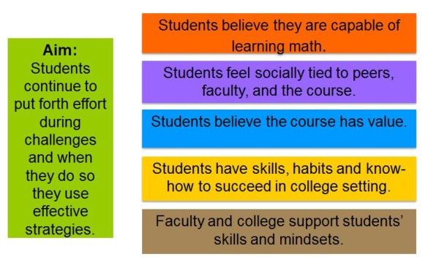
Productive Persistence
Productive Persistence - Carnegie Foundation for the Advancement of Teaching. (n.d.). Retrieved February 21, 2019, from https://www.carnegiefoundation.org/our-work/carnegie-math-pathways/productive-persistence/
Notes:
Combination of tenacity and good strategies. Productive Persistence, focuses on the non-cognitive elements of learning.

Slide 12
Strategies for Growth Mindset in Advising
Avoid language that implies a fixed mindset about your/their abilities.
Reframe deficits as opportunities for growth.
Use the word YET!
Focus on the student’s efforts then the outcome.
Encourage students to think of learning as a challenge.
Let a student know that an ability can be learned, and college (task) will help them accomplish that.
Notes:
Avoid using phrases such as, “No one is good at everything, but just try to get through this. Can say, “Struggling doesn’t mean you won’t get it. It means you are learning and making connections that are not yet strong.”
Praising a student’s intelligence or talent sends a fixed mindset. Instead focus on a student’s strategies, efforts or choices

Slide 13
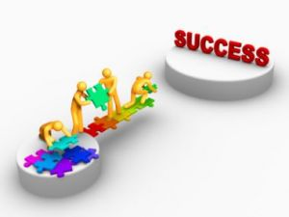
The Power of Yet!
I cannot do this... yet!
I don’t know… yet!
It doesn’t make sense… yet!
I don’t get it… yet!
I’m not good at this… yet!
Notes:
Compensate for negative associations with immediate failure is one of the first steps students can take to develop a sense of personal growth, and achievement potential.

