Slide 1
A Better Way Forward: How Onondaga Community College Is Approaching Large-Scale Transformative Change
OCTOBER 28, 2019

Slide 2
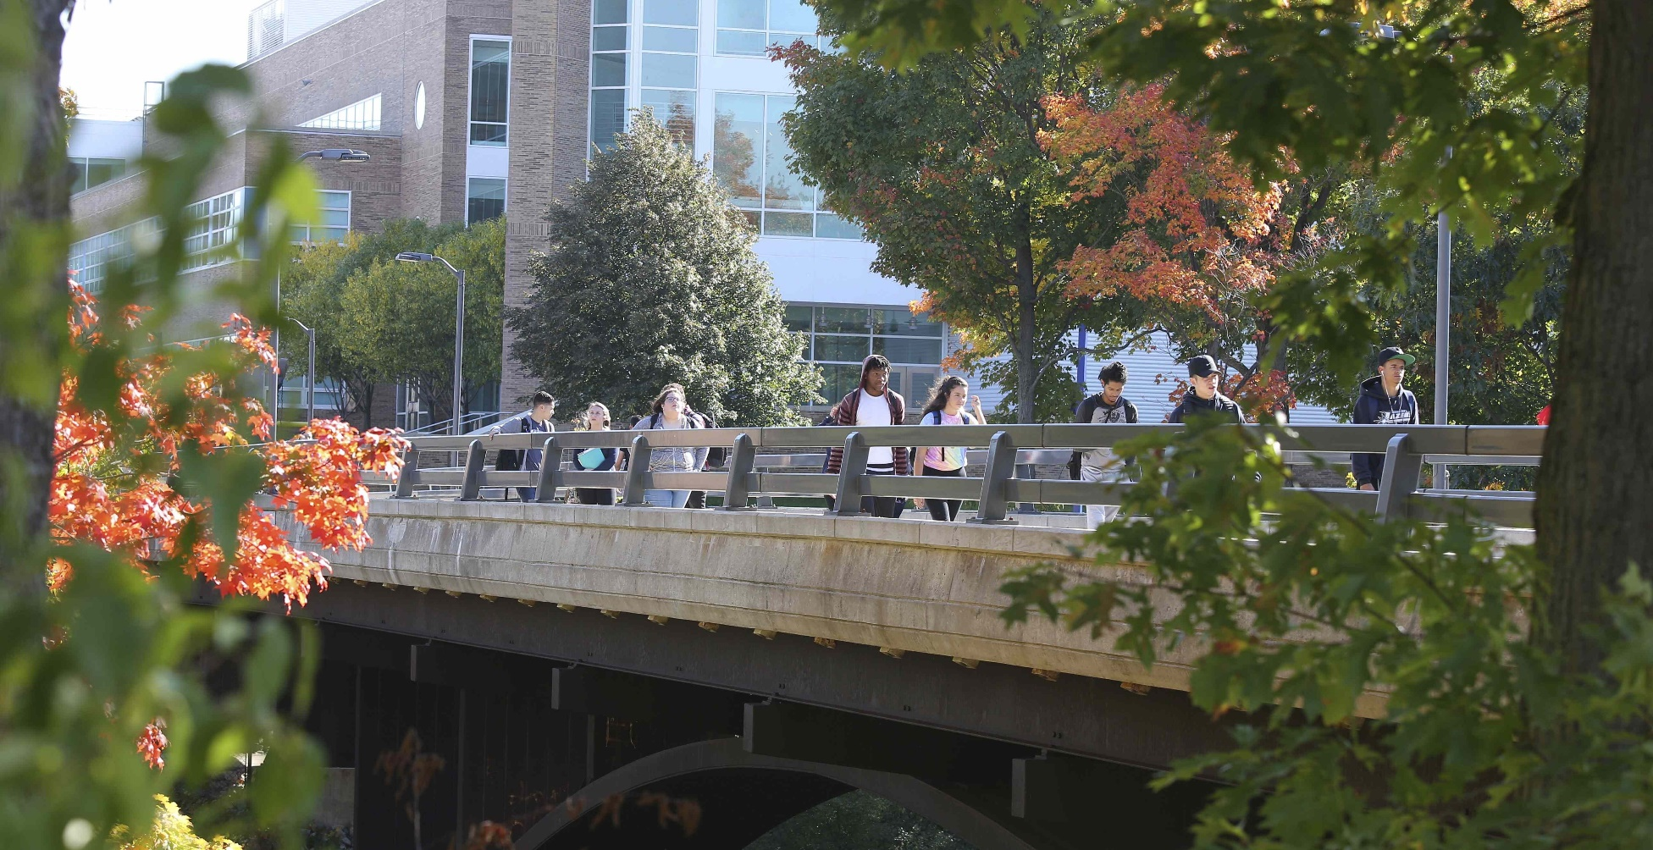
Our Mission and Vision
Onondaga Community College is Central New York’s partner in education for success.
Achieving our mission through:
Student Access, Retention, Completion, Transfer
Academic Excellence
Student Engagement and Support
Career and Workforce Advancement
Responsible Stewardship of Resources
Community Engagement

Slide 3
Equity
EQUALITY
EQUITY

Slide 4
Why we need to do things differently

Slide 5
Syracuse has the highest concentration of Black and LatinX poverty in the nation
Syracuse's poverty rate remains among worst in nation, Census finds
http://www.syracuse.com/news/index.ssf/2016/09/syracuses_poverty_rate_remains_among_worst_in_nation_census_finds.html
How to Decimate a City
https://www.theatlantic.com/business/archive/2015/11/syracuse-slums/416892/
Architecture of Segregation: Civil Unrest, the Concentration of Poverty, and Public Policy
https://tcf.org/content/report/architecture-of-segregation/
Notes:
Do we want to show these or maybe print and hand out? Handout with links or send follow up email or something with links.

Slide 6
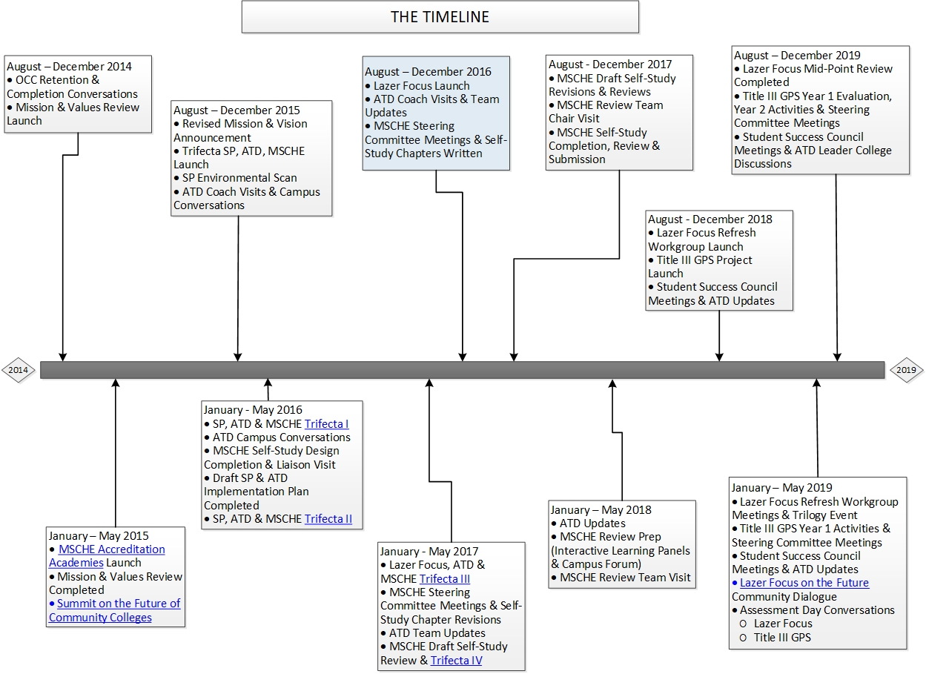
Footnote: Principles of Community include campus-wide conversations and activities, governance presentations
Notes:
Wendy this one and the next; using the timeline to show the complexity and amount of work, projects and sub-projects, etc. required by all of this. Transformative change, culture shifts, take planning, lots of hard work, and time.
If you think this looks bad, think about these boxes having its own project plan and numerous additional boxes……..

Slide 7
Title III: Guided Pathways to Success
U.S. Department of Education, Title III Strengthening Institutions Grant - $3M over 5 years
Informed by Redesigning America’s Community Colleges: A Clearer Path to Student Success (Bailey, Jaggars, Jenkins, 2015)
OCC will improve its capacity to help students earn postsecondary credentials
Structured pathway maps
Common first-year learning outcomes
Structured non-academic support system and intake processes
Advising
Accelerated pathways to completion for developmental students

Slide 8
OCC’s Guided Pathways to Success (GPS) Design
Fully mapped programs
Clear paths to completion, transfer and careers
Course sequences, progression and completion with milestones documented
Delivery of first year learning outcomes within each path
Accelerated developmental paths as students progress through degree programs
Structured Pathway Supports
New intake process using non-cognitive assessments
Predictive analytics
Research-validated coaching protocol
Referrals to existing services
Quasi-Experimental Design – formative and summative evaluation study

Slide 9
Faculty Senate: Model & Agent of Change
Spring / Summer 2016
Fall 2016
November 2016
December 2016
January 2017
February 2017
March 2017
April 2017

Slide 10
Faculty Senate: Model & Agent of Change
1962
2015
2016
2017
1963
1964
1965
1966
1967
1968
1969
1970
1971
1972
1973
1974
1975
1976
1977
1978
1979
1980
1981
1982
1983
1984
1985
1986
1987
1988
1989
1990
1991
1992
1993
1994
1995
1996
1997
1998
1999
2000
2001
2002
2003
2004
2005
2006
2007
2008
2009
2010
2011
2012
2013
2014

Slide 11
Faculty Senate: Model & Agent of Change
Spring / Summer 2016
Fall 2016
November 2016
December 2016
January 2017
February 2017
March 2017
April 2017

Slide 12
Meta-Majors/Schools
Senate is Created
Senate Creates Student Affairs Committee
Committee’s First Charge: Advising
Notes:
Dave – these are just the notes I took today – edit or ignore! ☺
Student affairs committee (new committee of our Senate ) before pathways
Student affairs was charged to work on advising
More about process with the report that went to CLC, then on to pathways and TIII
Whaddya know here comes pathways
Leads into conversation in pathways about meta majors.
Dovetails with advising, our advising team was recommending high touch advising and early connection to faculty, this is perfect fit for meta majors
Other benefits of meta majors
Talk about meta majors work group – formed by Senate, included lots of folks including TIII leads (i.e., pathways leads)

Slide 13
Meta-Majors/Schools
Closer relationships with advisees
More big picture career/transfer talk and less course selection
How to Improve Advising?
Closer relationships between faculty & professional advisors

Slide 14
Meta-Majors/Schools
SUNY GPI
Meta-Majors
Thoughts about improving advising

Slide 15
Meta-Majors/Schools
Establishing schools can help with the advising changes
But it can do much more:
Make students choices easier
Give students (and faculty) an academic home and identity
Provided smaller, content-based communities within the larger college
Help students avoid wasting credits upon switching majors
Help to support faculty and students forming meaningful relationships
Valuable in and of itself
Also high-impact practice for improving student success

Slide 16
Paradigm Shift
Transformative Practices
Service to others
Social interaction and relationship building
One-to-one communications
Problem-solving skills

Slide 17
Developing strategic partnerships is key

Slide 18
Introducing the InsideTrack Coaching Methodology

Slide 19
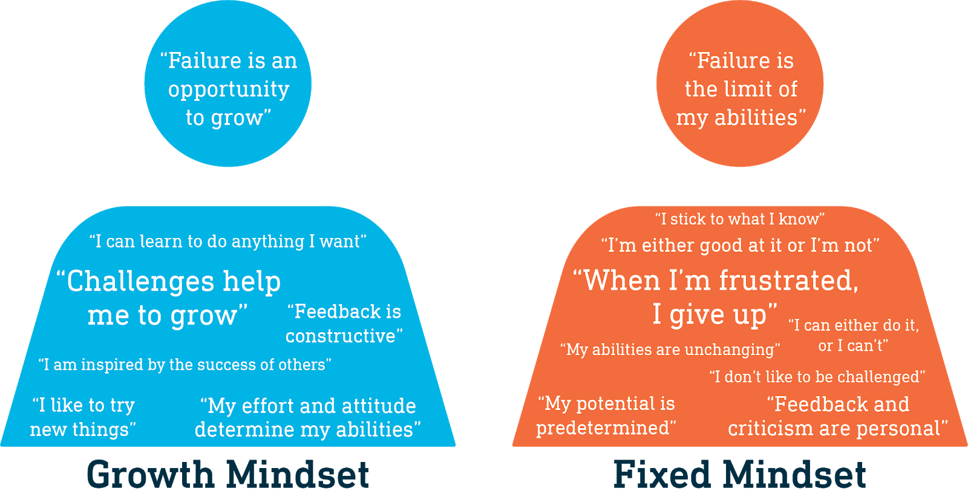
Fixed and Growth Mindset: how we view ourselves impacts our learning
Notes:
Source: http://big-change.org/ 2015

Slide 20
The Strategic Inflection Point
A strategic inflection point is a time period when an organization must respond to disruptive change in the business environment effectively or face deterioration. An inflection point, in general, is a decisive moment in the course of some entity, event or situation that marks the start of significant change.

Slide 21
Strategic Inflection Point in Higher Education

