Slide 1
ALL TEXT SHOULD BE ARIAL FONT IN BOLD. DO NOT LEAVE THE DEFAULT CALIBRI.
SUNY FACULTY DEVELOPMENT COMMUNITY OF PRACTICE

Slide 2
Goals
Create a network of SUNY colleagues who are involved in faculty development/teaching and learning efforts and identify a plan for sustaining this network
Create a foundation for collaborating on future, system-wide faculty development efforts
Create awareness of faculty development best practices in the context of current trends in higher education
Inform participants about the many excellent faculty development opportunities and efforts both system-wide and on SUNY campuses

Slide 3
SUNY Faculty Development COP
Annual Meeting/ Conference
Webinars
Workplace

Slide 4
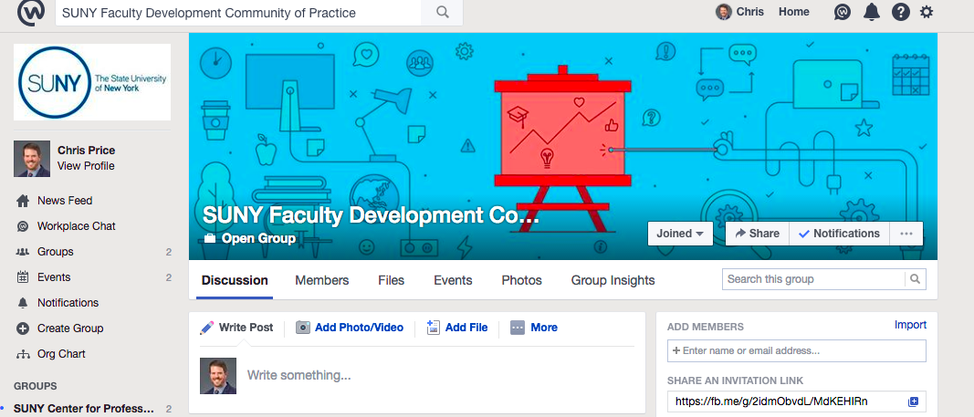
https://sunyedu.facebook.com

Slide 5
Introductions
Campus
Name
Where/what/How You Want to Connect
What You
Do

Slide 6
Discussion
What are the top academic initiatives on your campus and how do they impact faculty and other professional development needs?
What faculty development needs can you handle “in house” and what do you need help with from outside?
What faculty development topics would you like to see addressed in webinars and meetings?
What questions/concerns/ideas would you like to ask the group?

