Slide 1
Financial Coaching:
Helping Students Become Financially Empowered
Student Success Summit
October 30 , 2019
Suzanne Matthews
Westchester Community College

Slide 2
Center for Financial and Economic Education
Provides a range of financial education resources to help students learn to manage money and make smart financial decisions.
Founded in 2011.
Program within Workforce Development & Community Education
Served over 4,000 students with workshops, classes, and other activities.
Grant funded by JPMorgan Chase

Slide 3
The Money Smart Forum
Started as a pilot program five years ago.
Provides one-on-one financial coaching
The ultimate goal: to help students build healthy financial behaviors around saving, budgeting, managing money, and building credit.
We help students to set measurable financial goals and track those goals over time.
Over five years, we have collected data to show that financial coaching is an effective way to help students build financial health

Slide 4
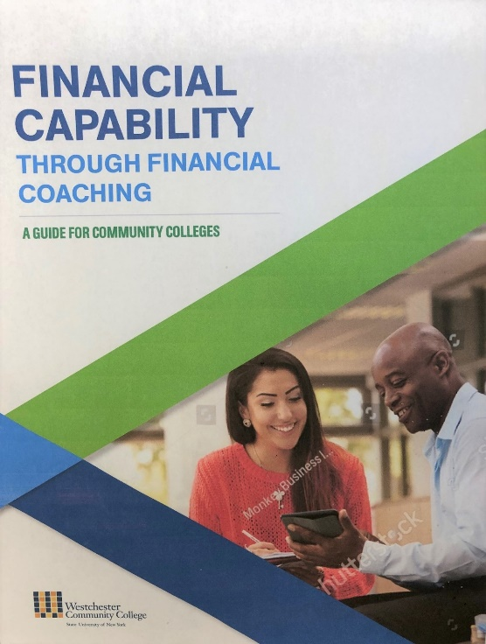
The Money Smart Forum
We are receiving new grant funding from JPM Chase to replicate what we do and to share our knowledge and best practices with other colleges.
We will be publishing a guide to financial coaching.
We hope other colleges here today will be motivated to join our initiative by providing feedback & participation.

Slide 5
Goals for Today:
Highlight the importance of financial capability and show how financial coaching can be an important component of strategies for student success.
Discuss how the Money Smart Forum financial coaching program works
Review our program outcomes, in terms of financial goals and student success
Discuss what financial capability is and why it is important
Ideas for implementing financial coaching on your campus
Next steps: Student Financial Health Initiative – Please join us!

Slide 6
What type of financial education programs do you have on your campus?

Slide 7
Research on Benefits of Coaching
According to research in behavioral economics*, personal finance workshop and classes are not likely to change habits and build long-term behaviors.
If information is not timely or relevant, the student will not act on it or remember it.
One-on-one coaching is a more effective way to change behavior, because the student identifies the financial goals and issues that are affecting them at the time.

Slide 8
The Coaching Process
The Money Smart Forum is not a club or a class; it is a service that any student can take advantage of.
Our coaching process is data-driven.
We help students to set measurable financial goals and track those goals over time.
The ultimate goal: change habits and build healthy financial behaviors.

Slide 9
The Money Smart Forum
Over 5 years we have served over 600 students in the coaching program, about 100-125 students each year.
In 2018-19 we conducted 450 coaching sessions.
The focus of coaching is on financial issues where students are the most vulnerable:
Income
Savings
Debt
Credit

Slide 10
How Does Financial Coaching Work?
We have a team of three people, including two professional financial coaches.
Students have an initial meeting to discuss their financial picture, financial goals, and career goals.
Participants will meet with coach every other week for 30 minutes.
Students meet on average 5-6 times over course of semester.

Slide 11
Student Outcomes
In the past four years we have exceeded our goals every year. In 2018-19 our participants achieved:
Total savings of over $152,000
Average savings of $1,642
Average debt reduction of $2,453
Average credit score improvement of 37 points
Students getting new/higher-paying jobs: 20%
Graduation rate: 29%*
Persistence rate (fall to fall) : 92%
* Graduation rate = percent of credit students graduating

Slide 12
Certificate Award Winners- Students Achieving Financial Goals

Slide 13
Money Smart Forum -Success Stories
Curriculum Award Winners
SUNY Chancellor’s Award Winners
Accounting Graduates

Slide 14
Why Does Financial Capability Matter?
Research* shows that there is a connection between financial capability and a student’s ability to succeed in college, in terms of continuation and graduation.
When students face financial difficulty, it hits their academics first.
Students who are financially fragile are more likely to drop out.
*Federal Reserve Bank of Boston, 2015

Slide 15
Why Does Financial Capability Matter?
Only 28% of Americans are classified as financially healthy*
44% of Americans cannot afford a $400 emergency expense**
Millennials have the lowest level of financial literacy across all age groups in the U.S., and the trend is continuing.***
The wealth gap is getting bigger
*Center for Financial Services Innovation (CFSI) 2017
**Federal Reserve System, 2017
***FINRA Financial Education Foundation 2018: www.usfinancialcapability.org

Slide 16
What is the State of Financial Capability in the U.S.?
In 2018 the Financial Industry Regulatory Authority (“FINRA”) conducted its national survey consisting of five questions about basic personal finance and economic concepts.
The average score for all adults: 2.7 out of 5 = Low
The average score for ages 18-34: 2.4 out of 5 = Low
Levels of financial literary declined over the past 10 years.

Slide 17
How do we Define Financial Capability?
“Financial capability is a multi-dimensional concept that encompasses a combination of knowledge, resources, access, and habits”. (FINRA 2019)
It is not intuitive.
It involves a body of knowledge that is changing and becoming more complex all the time.

Slide 18
How do we Define Financial Capability?
Knowledge + Habits
Financial Knowledge
2. Making Ends Meet
Planning Ahead
Managing Financial Products

Slide 19
What is a Financially Capable Student?
The financially capable student will be able to:
Create and utilize a college budget
Manage expenses and prioritize limited resources
Understand options to pay for college (financial aid, student loans, etc)
Take appropriate steps to build credit
Learn to advocate for themselves

Slide 20
How Can You Implement Financial Coaching?
Advocating for financial capability and making the case for financial coaching on your campus is an educational process.
Support for financial coaching starts at the top.
Solicit support from key leaders: college president, provost, director of student involvement or financial aid, etc.
Identify advocates on campus: faculty, staff or administrators
Partner with organizations or groups already delivering financial education. (TRIO, Student Clubs, Financial Aid)

Slide 21
How Can You Implement Financial Coaching?
Identify organizations outside your campus who may be able to provide financial support and/or professional resources:
Local banks – may have some funding and professionals who want to volunteer.
Professional organizations, such as the Financial Planning Association, may be eager to work with colleges.
Community organizations and nonprofit organizations that provide financial coaching

Slide 22
Toolkit for Financial Coaching

Slide 23
Why Does Financial Capability Matter?
The majority of college students have never had financial literacy education, and most of them will leave college without adequate financial skills to navigate an increasingly complex financial world.
It’s about giving students the mind set and knowledge to understand how they can build wealth and financial security for themselves.

Slide 24
Why Does Financial Capability Matter?
We have many initiatives for student success. We are failing our students if we do not include financial capability in our programs.
Financial capability should be a part of the college’s strategy for graduation and retention.
It should be a part of our mission to assure that our students can rise to a higher level of economic prosperity.

Slide 25
Next Steps:
Later this year we will be launching the Student Financial Health Initiative:
Will form a community of practice
Will establish best practices and interventions that can be replicated and disseminated.
Please join our initiative! Contact me at:
Suzanne.Matthews@sunywcc.edu
Suzanne Matthews, Director, Center for Financial & Economic Education, Westchester Community College

Slide 26
Final Takeaway:
Financial Capability is not just a nice idea. It should be an essential component of every college’s strategy to help students succeed and achieve their academic goals.

