Slide 1
Implementing a Writing Fellows Program for Undergraduates
SUNY Faculty Development Conference: “Answering the Chancellor’s Call for Innovation & Entrepreneurship, Individualized Education, Sustainability, & Partnerships.” SUNY New Paltz April 5, 2019
Nicola Wilson Clasby
Joann Deiudicibus
Matt Newcomb
Rachel Rigolino

Slide 2
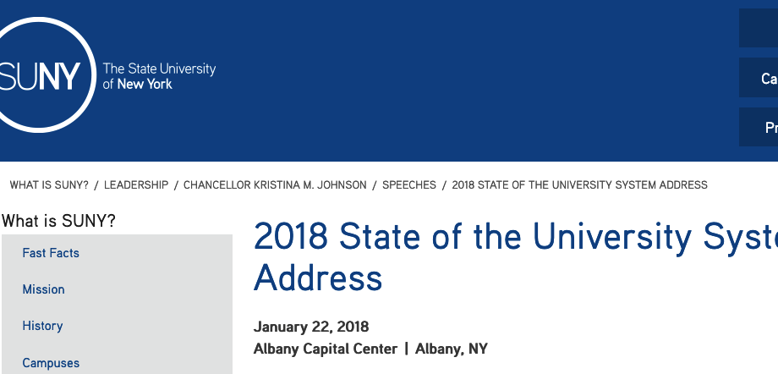
Text of Address

Slide 3
What is a writing fellow?

Slide 4
Writing Fellows
Writing Fellows are typically undergraduate students
Can be aligned with introductory writing courses such as Composition but are also aligned with upper-division courses (see below)
Often used to bolster Writing Across the Curriculum courses: curricular-based
Fellows receive either course credit or internship credit
Training for Fellows and Tutors may overlap but is usually overseen by different programs or departments

Slide 5
Sample Student Profile (Fall 2018)
•Freshman Class 1,190
•Traditional Freshmen 1,036
•Freshmen HS Average (mid 50%) 90.0 - 95.0
•SAT (EBRW & Math) (mid 50%) 1150 - 1300
•ACT (mid 50%) 24 - 29
•EOP Freshmen 154
•EOP Freshmen HS Average (mid 50%) 82.0 - 88.0
•EOP SAT (EBRW & Math) (mid 50%) 940 - 1060
•EOP ACT (mid-50%) 19 – 22
From the SUNY New Paltz Admissions website, https://www.newpaltz.edu/admissions/freshmen.html

Slide 6
About the SUNY New Paltz Composition Program
Mission: First-year writing courses offered by the Composition Program assist students in developing the capacities to think critically and to expand their depth of knowledge in order to become lifelong learners as well as productive citizens and members of society.
Courses: Composition I and II, Composition I and II Supplemental Writing Workshop (SWW), Composition I and II English as a Second Language (ESL/SWW), General Honors English II, and Intermediate Composition courses. All matriculated students complete a two-course Composition sequence in order to graduate (unless they have AP or transfer credit); this is a university policy.
First-year enrollment is, on average, 1,150 students each Fall
1 Honors English and 1 Intermediate Composition course; 23 Composition I courses per semester; 18 Composition II courses on site; 8 HS Program sections
10-12 additional Composition I and II sections of Supplemental Writing Workshop Program Courses per semester (2-3 of these are typically ESL/SWW, for multi-language learners and international students)
These figures were compiled from a Fall 2018 English Department Enrollment Report

Slide 7
About the Supplemental Writing Workshop Program
Founded in 1996 by Dr. Jan Schmidt, along with Rachel Rigolino, Sarah Gardner (Composition) and Lisa Chase (EOP)
Same required learning outcomes, assignments, course objectives, and earned credits (3) as other composition courses
Additional required workshop hour(s) and tutoring for students who need extra assistance; the workshop is non-credit
In-class tutor attends the workshop to support the instructor, and meets with students one hour outside of class per week
Tutoring Center hires and assigns tutors
The core program model remains unchanged
Center for Student Success (Tutoring) no longer hires or assigns tutors
Educational Opportunity Program hires and assigns tutors
Non-EOP students may not have a dedicated tutor outside of the course but may seek additional assistance at the CSS/Writer’s Studio
Writing Fellows Program supplements tutoring, but there are not always a eligible or interested student interns to match the program’s needs for a given semester

Slide 8
Supplemental Writing Workshop Program

Slide 9
The Writing Fellows Program
At New Paltz

Slide 10
Background
Loss of tutoring for SWW and ESL composition courses
Lack of tutoring/teaching opportunities for (non-Ed) English majors
Requirement to use currently existing courses/resources
No system set to vet/select tutors

Slide 11
Structure: Writing Fellows in Class
Assigned (typically) to specific instructor/section
May work as tutor with students from multiple sections
Attend lab class (if applicable) and tutor individuals/pairs; other work negotiated with instructor
Instructor reports out attendance and work quality
Prioritized ESL sections, then Supplemental sections, then standard sections

Slide 12
Credit and Administration
Earn 400-level English elective credit (typically 3 credits) for “Fieldwork”
May repeat for credit
Composition Coordinator and/or Chair serve as Fieldwork instructors
Midterm and Final reflective essays (graded by Composition Coordinator/Chair)

Slide 13
Eligibility
Take Theories of Writing (300 level) course
B or better in course
3.0 GPA
Writing sample
Open to all majors
Reviewed by Comp Coordinator

Slide 14
ENG 385: Theories of Writing
An existing composition theory course (no new course needed)
Has significant pedagogical elements
Not always full due to major plans it does and doesn’t serve
Writing Intensive course
*Includes a new unit on writing centers and writing tutoring
Advertised to English majors as prerequisite for tutoring fieldwork

Slide 15
Integration
An Enrolled ENG385 Student
Has completed the Comp 1 and Comp II sequence
Moves on to Theories of Writing
Applies for Writing Fellows Program
Tutors in Comp I or Comp II
Applies for TA program as an MA student (now has insights and tutoring experience as initial preparation for teaching courses)
Teaches Composition I and II

Slide 16
Results/Experiences

Slide 17
Writing Fellow: Model 1 One-on-One Tutoring
Nikki want to work on this?

Slide 18
Writing Fellow: Model 2 Seminar Leader

Slide 19
Observations:
Two students have completed all the integrated steps (from taking Comp to teaching Comp)
Two more are likely to be TAs (hiring this month)
Strong numbers our first semester piloting the program
Significantly low number of students the second year
Instructors can’t plan to have a tutor or not from program
Many students take the prerequisite course fall senior year, so only have one semester left

Slide 20
Next Steps at New Paltz
Training Fellows: *Partner with our Center for Student Success for tutor training. Use as alternate eligibility pathway.
Consider 1-credit co-requisite for tutors as eligibility pathway
Consider ESL/ENL training as important next step
Recruiting Fellows: through entry-level English major courses
Placing Fellows: Create system for matching students for tutoring, seminar leader, and ESL/ENL specific courses
Models that Work: Further research on alternate training models

