Slide 1
Advancing Metaliteracy in a Post-Truth World through the Design of a Global MOOC
SUNY CIT 2019 Conference on Instruction & Technology
SUNY Purchase May 29, 2019
Thomas P. Mackey, SUNY Empire State College
Trudi E. Jacobson, University at Albany
Kelsey L. O’Brien, University at Albany
Alena Rodick, SUNY Empire State College
Christine Paige, SUNY Empire State College
#metaliteracy
Notes:
Christine introduces (give us a 2 minute warning after 20 minutes so we have 7-8 minutes for Q&A)
Have promo video running as they walk into room (Right click video and select Loop. Click on cog to set to HD 1080 quality): https://youtu.be/-3D-nKu-lJA

Slide 2
What we’ll talk about
•IITG Project on Open edX
•What is Metaliteracy?
•Open edX
•Learner Engagement
•Project Outcomes
•Next Steps
•Q & A
Notes:
Tom

Slide 3
SUNY 2018 IITG Tier 3 Round 7
IITG Goals
Apply lessons learned to design a hybrid MOOC
Prepare participants for the challenges of the Post-Truth world
Infuse metaliteracy goals and learning objectives
Leverage MOOC environment to create communities of trust
Notes:
Tom

Slide 4
Why Open edX?
Prior experience with cMOOC, Coursera, and Canvas
Hybrid approach to combine cMOOCs and xMOOCs
Flexibility of MOOC platform
Explore features for content development
Expand metaliteracy to a broader audience
Opportunity to try platform via UB instance of Open edX
Notes:
Tom

Slide 5
Post-Truth MOOC
MOOC logo by Alena Roddick
Empowering Yourself in a Post-Truth World
Notes:
Tom (have video running as they walk into room)
Grant-funded MOOC in Open edX
6 modules: post-truth, experts and expertise, constructed media, communities of trust, learner empowerment, building a truthful world.
Videos, resources, definitions, word clouds, surveys, and discussions
Final project supporting learner as producer
Certificate available
Over 200 registrants
Wrap-around course for-credit
MOOC transitioned to self-paced format

Slide 6
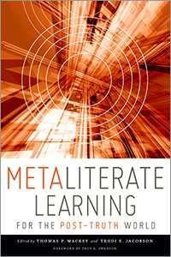
“Striving toward learner empowerment through metaliteracy is especially vital in a post-truth world when the distinction between truth and deception has been intentionally blurred and distorted.” (p. 2).
Metaliterate Learning for the Post-Truth World (Mackey and Jacobson, 2019).
Notes:
Tom

Slide 7
What is metaliteracy?
Notes:
Trudi

Slide 8
Promotes critical thinking and collaboration
Provides a framework to effectively participate in social media and online communities
Supports acquiring, producing, and sharing knowledge in collaborative online communities
Thomas P. Mackey and Trudi E. Jacobson. “Reframing Information Literacy as a Metaliteracy.” College & Research Libraries. January 2011 72:62-78. http://crl.acrl.org/content/72/1/62.full.pdf
Notes:
Trudi

Slide 9
The Metaliteracy Learning Domains
Metacognitive: what learners think about their own thinking - a reflective understanding of how and why they learn, what they do and do not know, their preconceptions, and how to continue to learn
Cognitive: what students should know upon successful completion of learning activities - comprehension, organization, application, evaluation
Affective: changes in learners’ emotions or attitudes through engagement with learning activities
Behavioral: what students should be able to do upon successful completion of learning activities - skills, competencies
Mackey and Jacobson (2014). Metaliteracy: Reinventing Information Literacy to Empower Learners.
Notes:
Trudi

Slide 10
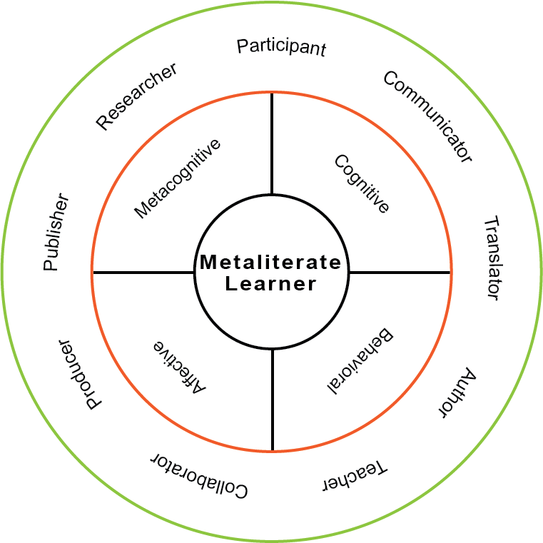
Metaliterate Learner Roles
Mackey and Jacobson (2014). Metaliteracy: Reinventing Information Literacy to Empower Learners
Notes:
Trudi

Slide 11
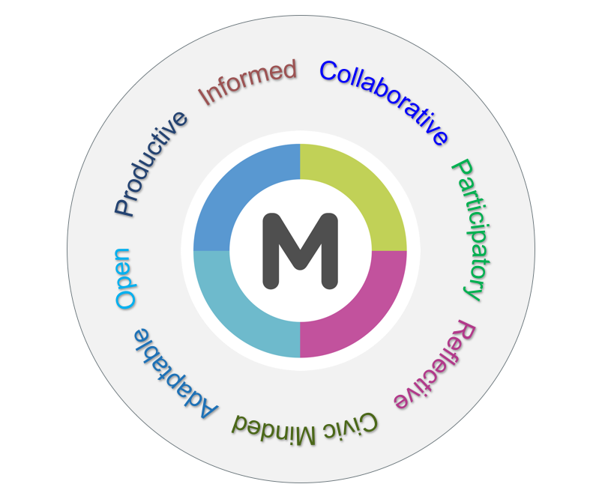
Metaliterate Learner Characteristics
Mackey and Jacobson (2019). Metaliterate Learning for the Post-Truth World
Notes:
Trudi
https://metaliteracy.org/ml-in-practice/metaliterate-learner-characteristics/

Slide 12
Open edX
Notes:
Alena

Slide 13
Open edX Features We Appreciated
Video
Surveys
Word clouds
Discussions
Self-check questions
Platform user-friendly during development process, thanks to the support of our instructional designer!
Notes:
Alena

Slide 14
Big Picture Challenges
Open edX courses are not listed in EdX Catalog
Institutional branding
Unable to integrate digital badging
Third party tech support not always seamless
Confusion over the type of support provided
Notes:
Alena

Slide 15
Learner Experience Challenges
Each learner started their own discussion thread
Last-minute technical problems with final project submissions
Limited functionality of course Wiki
Lack of access to instructor email until the last few modules
Notes:
Alena

Slide 16
Learner Engagement
Notes:
Tom

Slide 17
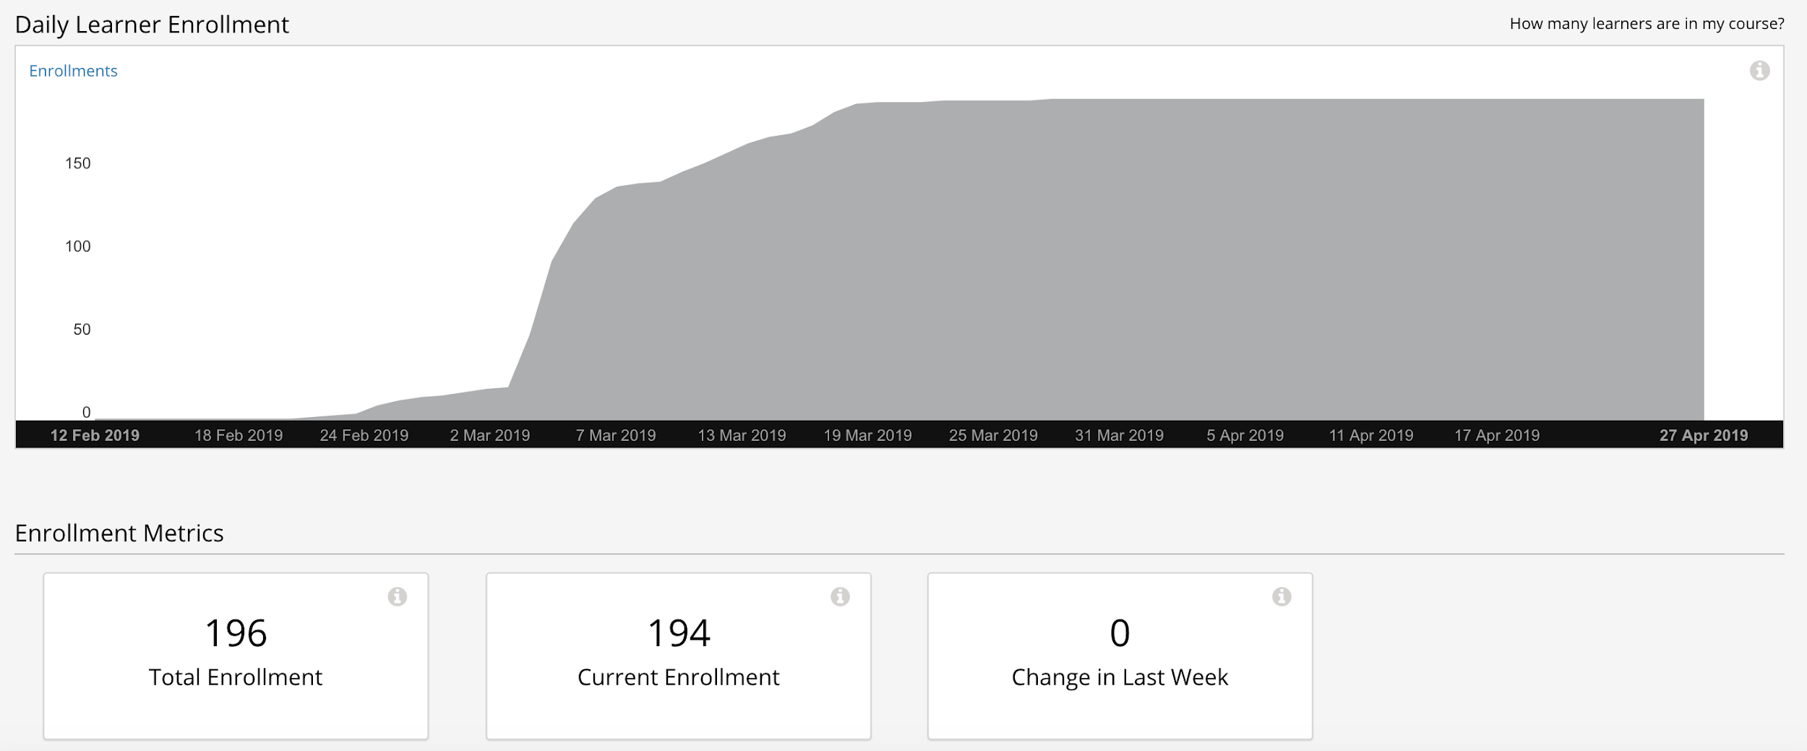
Total Enrollments
Notes:
Tom

Slide 18
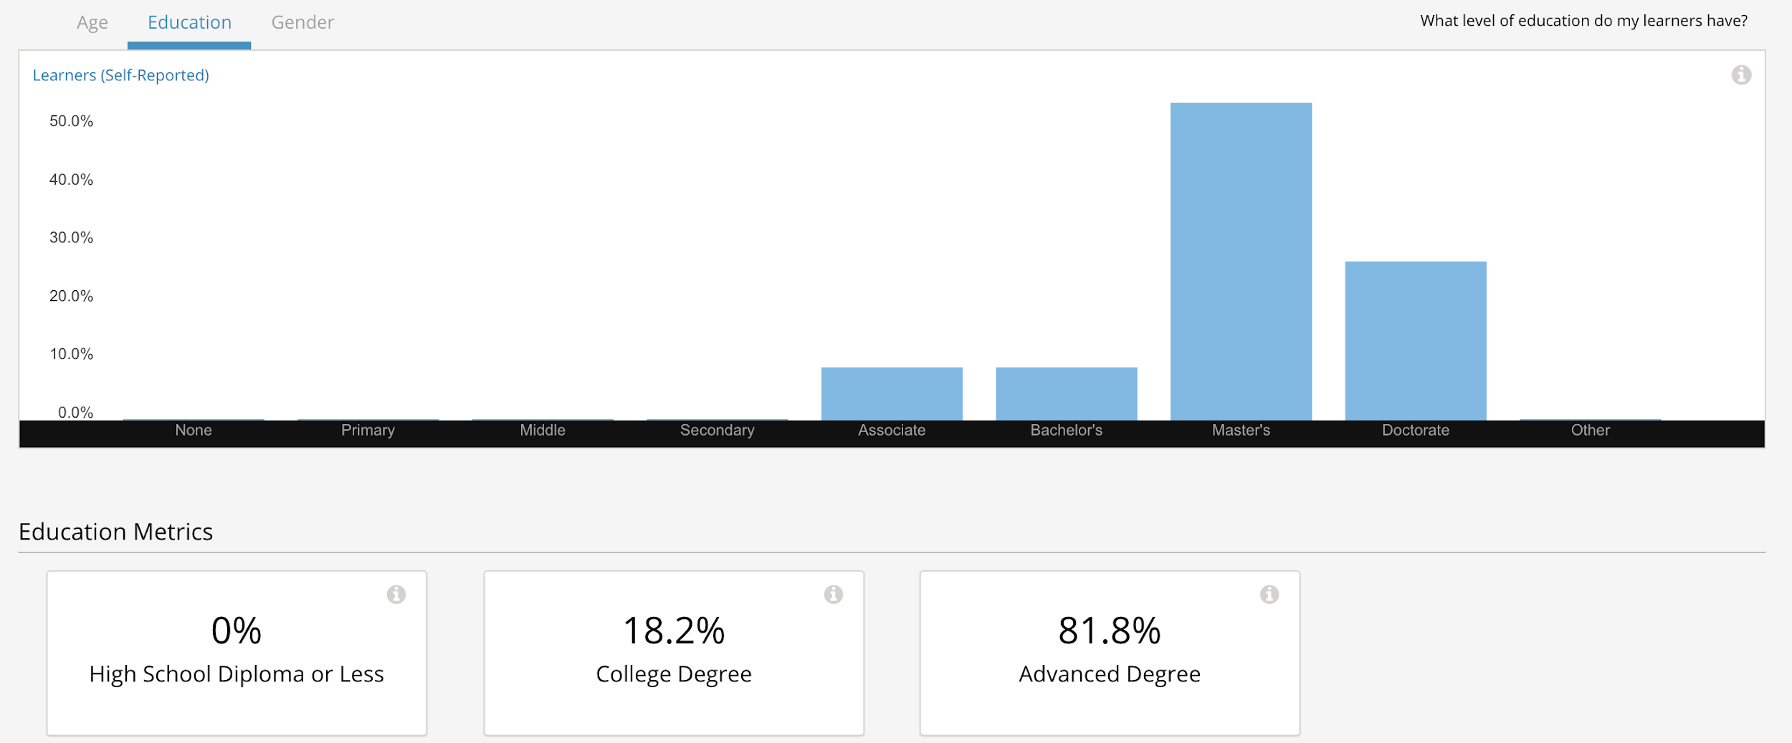
Learner Education
Notes:
Tom

Slide 19
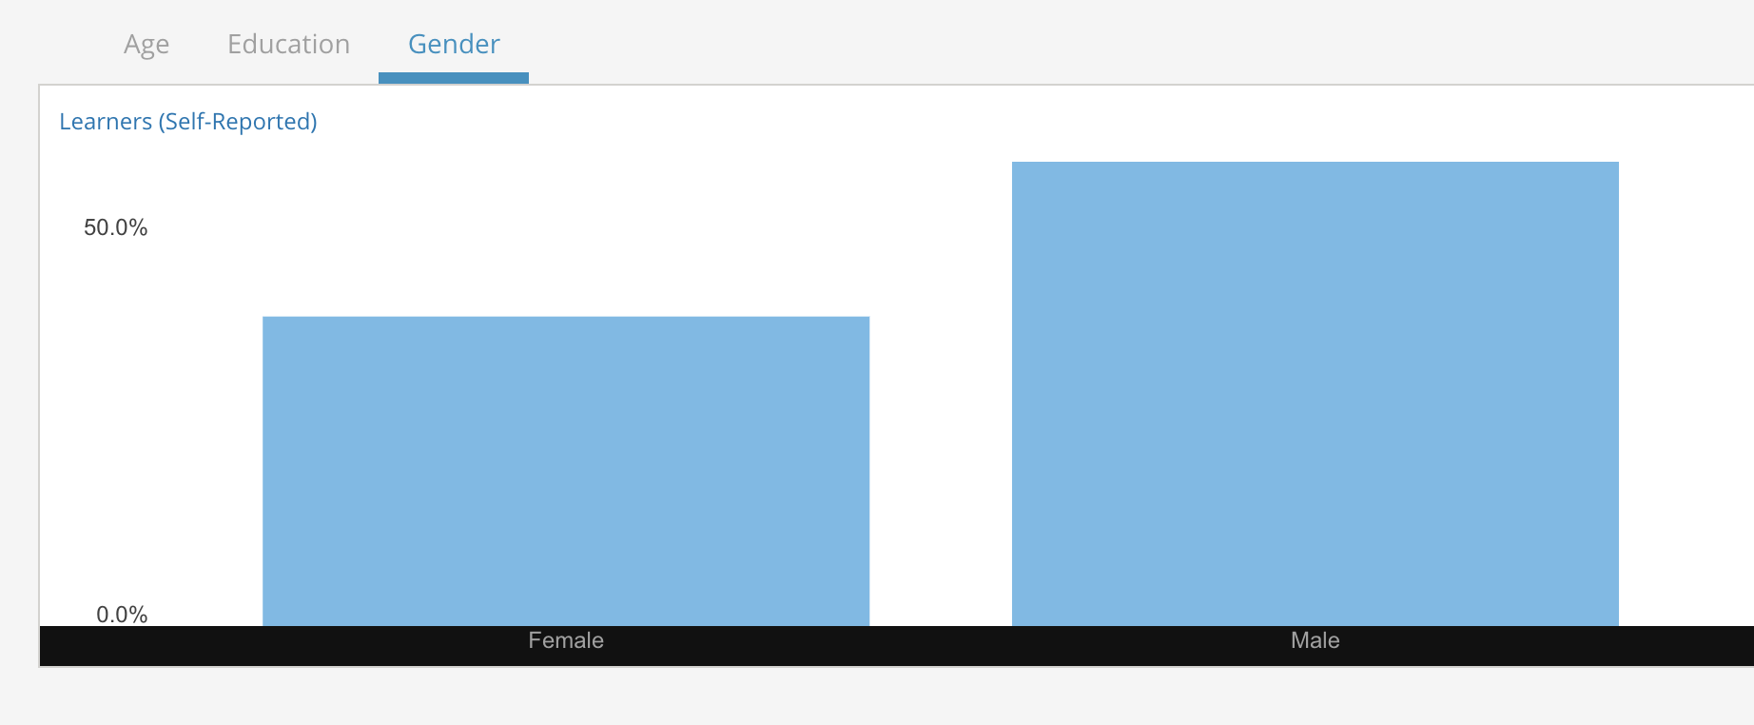
Learner Gender
Notes:
Tom

Slide 20
Learner Engagement with Videos
Notes:
Tom

Slide 21
Project Outcomes
Notes:
Tom

Slide 22
Developed New Metaliteracy MOOC Focused on Post-Truth Issues
Module 1: Empowering Yourself for the Post-Truth World
Module 2:
Who Are the Experts?
Module 3:
Can We Build Trust Online?
Module 4:
False Representations in Constructed Media
Module 5:
Raising and Sharing Our Voices
Module 6:
Reinventing a Truthful World
Notes:
Tom -6 modules - titles

Slide 23
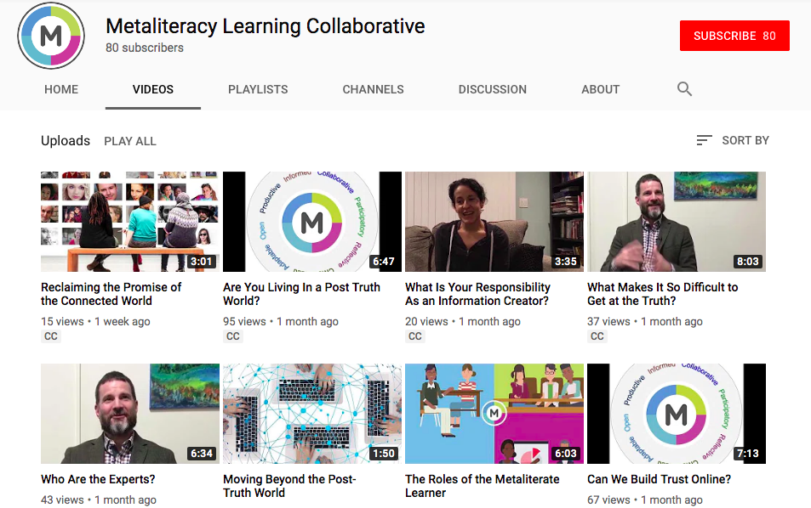
New metaliteracy videos available on the Metaliteracy YouTube Channel
Notes:
Kelsey
Enrollment was rather low for a MOOC (due to limited reach of platform) but the project generated several reusable learning objects that extended the reach of the content beyond the MOOC environment
The main products we created were videos - explanatory metaliteracy animations, interview montages, studio-produced lectures featuring MOOC contributors

Slide 24
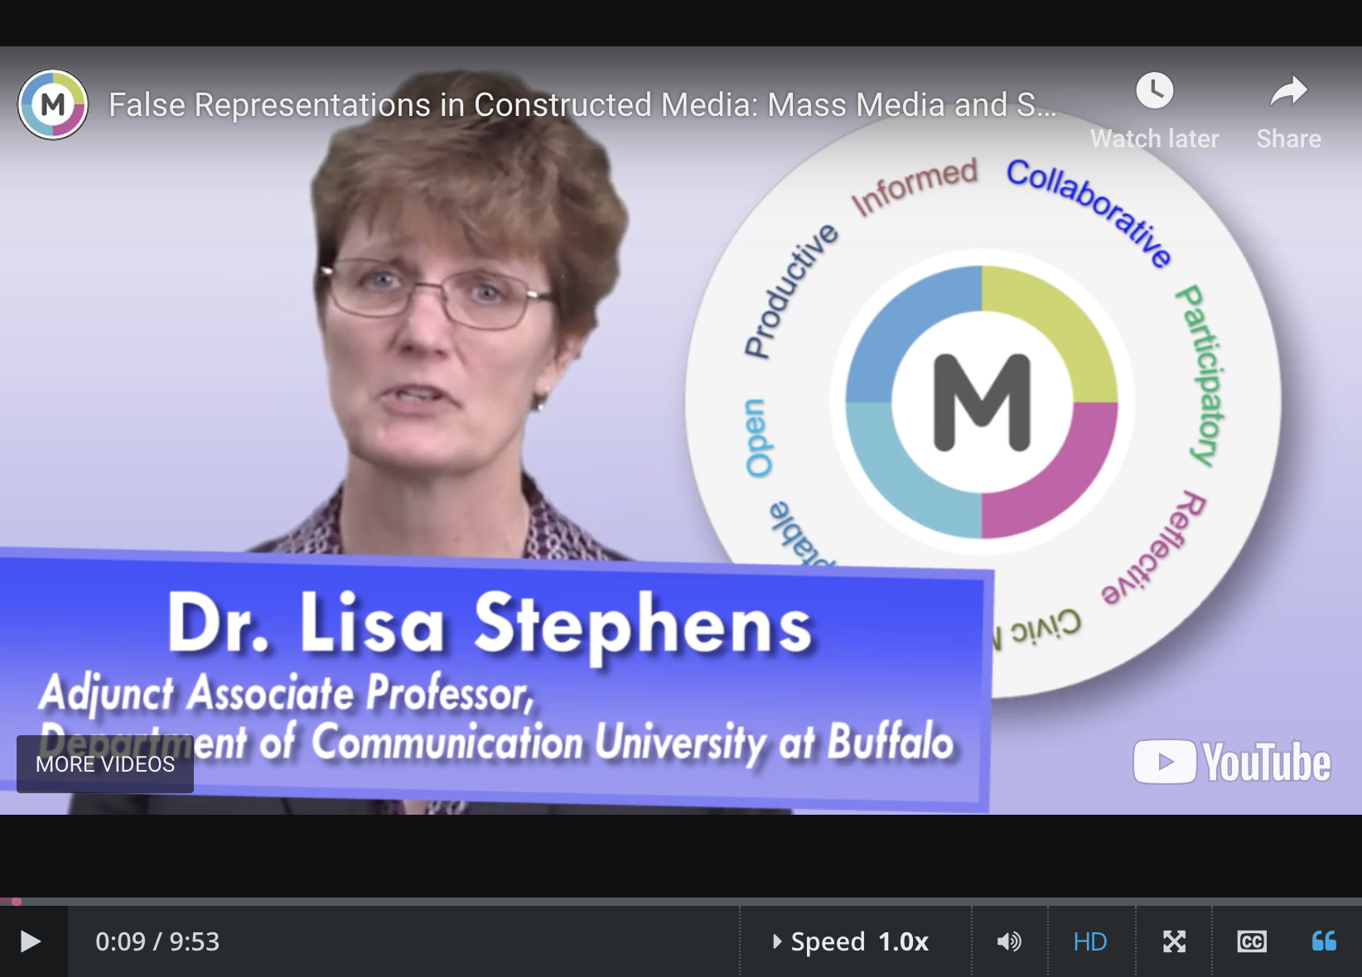
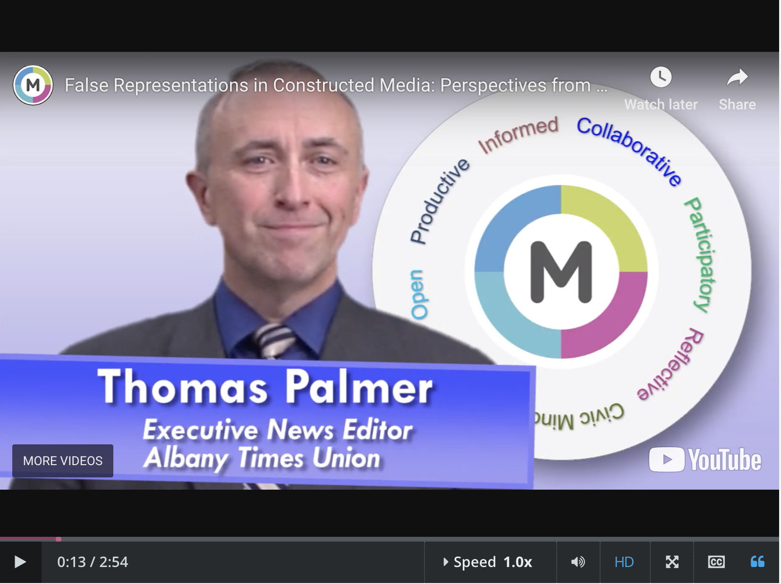
Shared YouTube videos through Twitter and Linkedin
Notes:
Kelsey
Videos are openly available on our YouTube channel and have also been shared via our networks on Twitter and LinkedIn

Slide 25
Developed Interactive Learning Objects
Notes:
Kelsey
Interactive learning objects to illustrate metaliteracy concepts - Alena developed based on the ml learner roles. Expand on static images. Anticipate using in a variety of different environments.

Slide 26
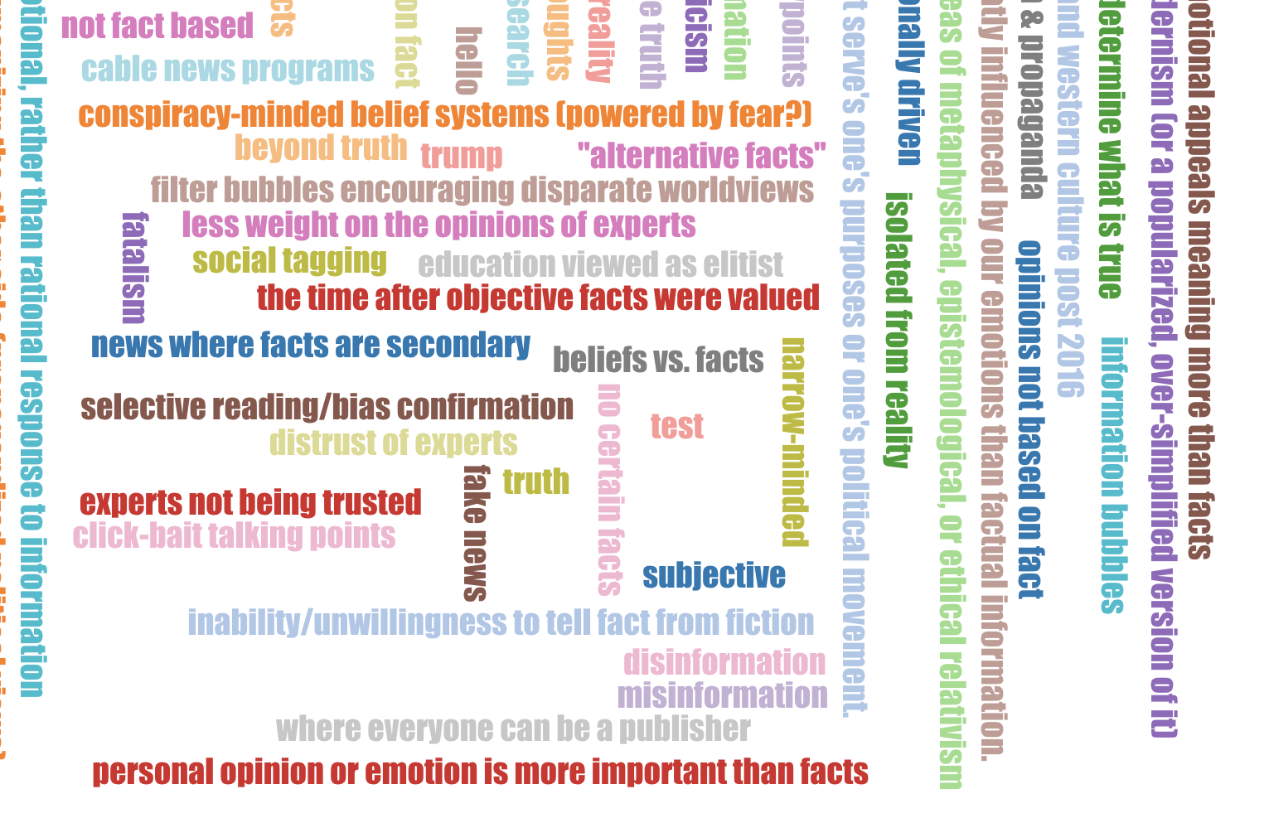
Engaged mostly teachers and librarians in metaliteracy
Notes:
Kelsey
Student-generated content e.g word clouds that evolved throughout the MOOC (post truth cloud, hashtags cloud). Visual representation of participation in the MOOC. New hashtag to promote communities of trust.
Participants were mostly librarians and other educators

Slide 27
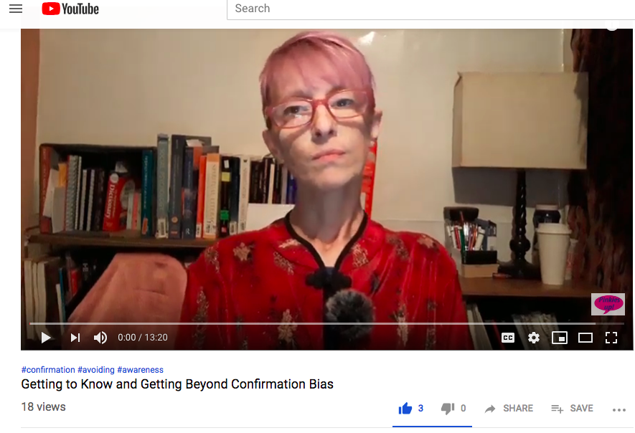
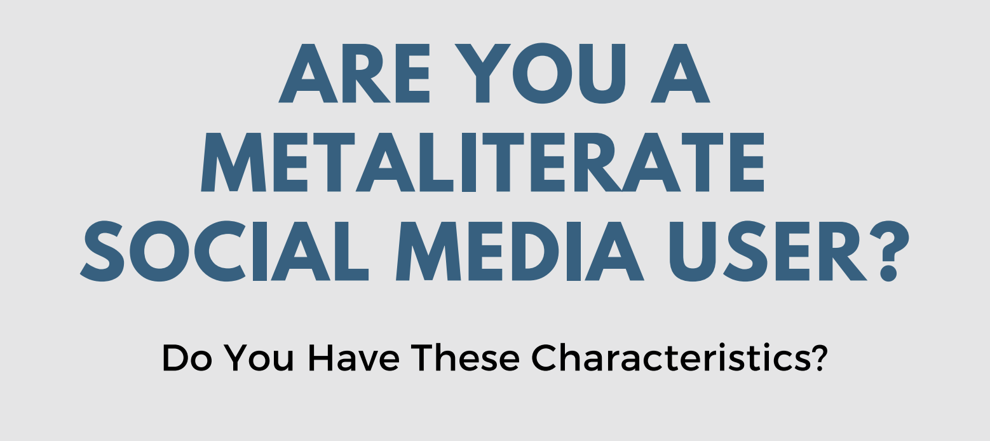
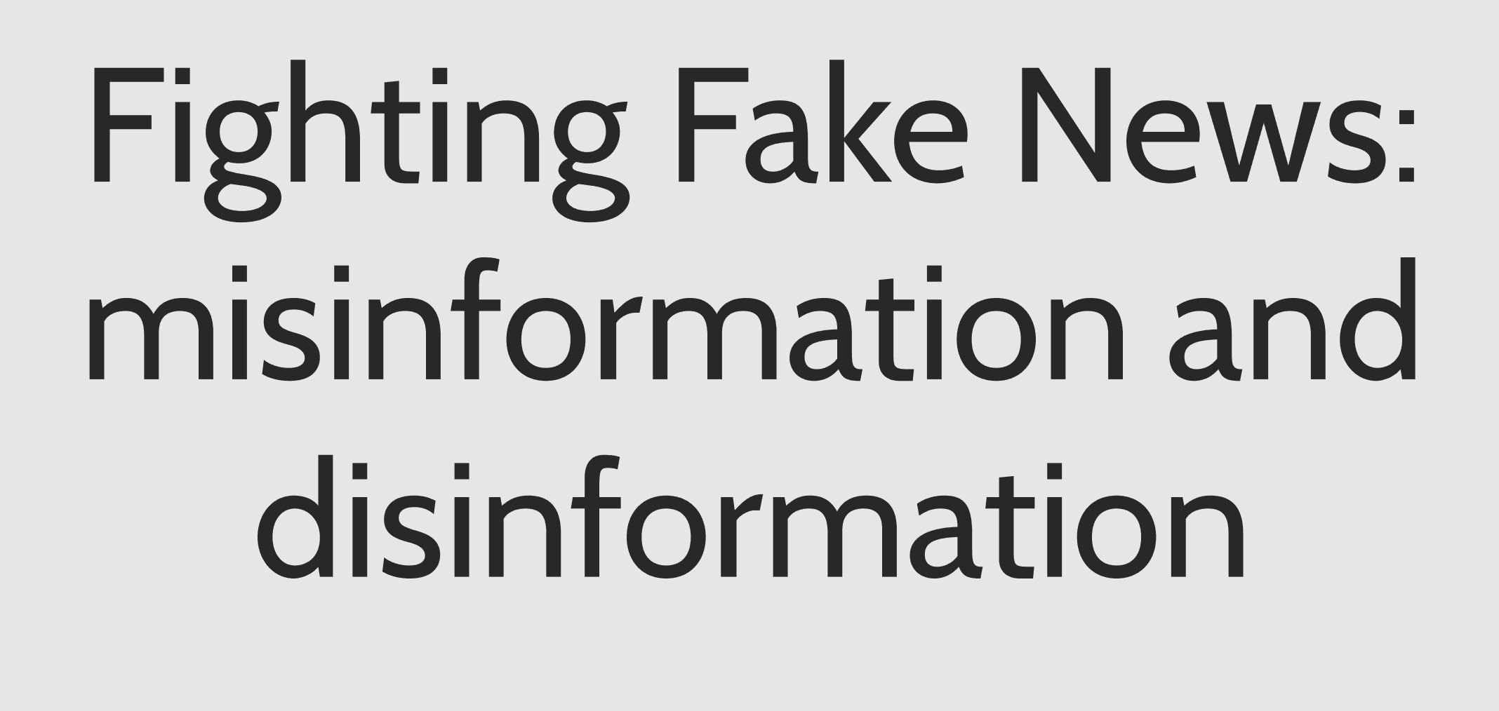
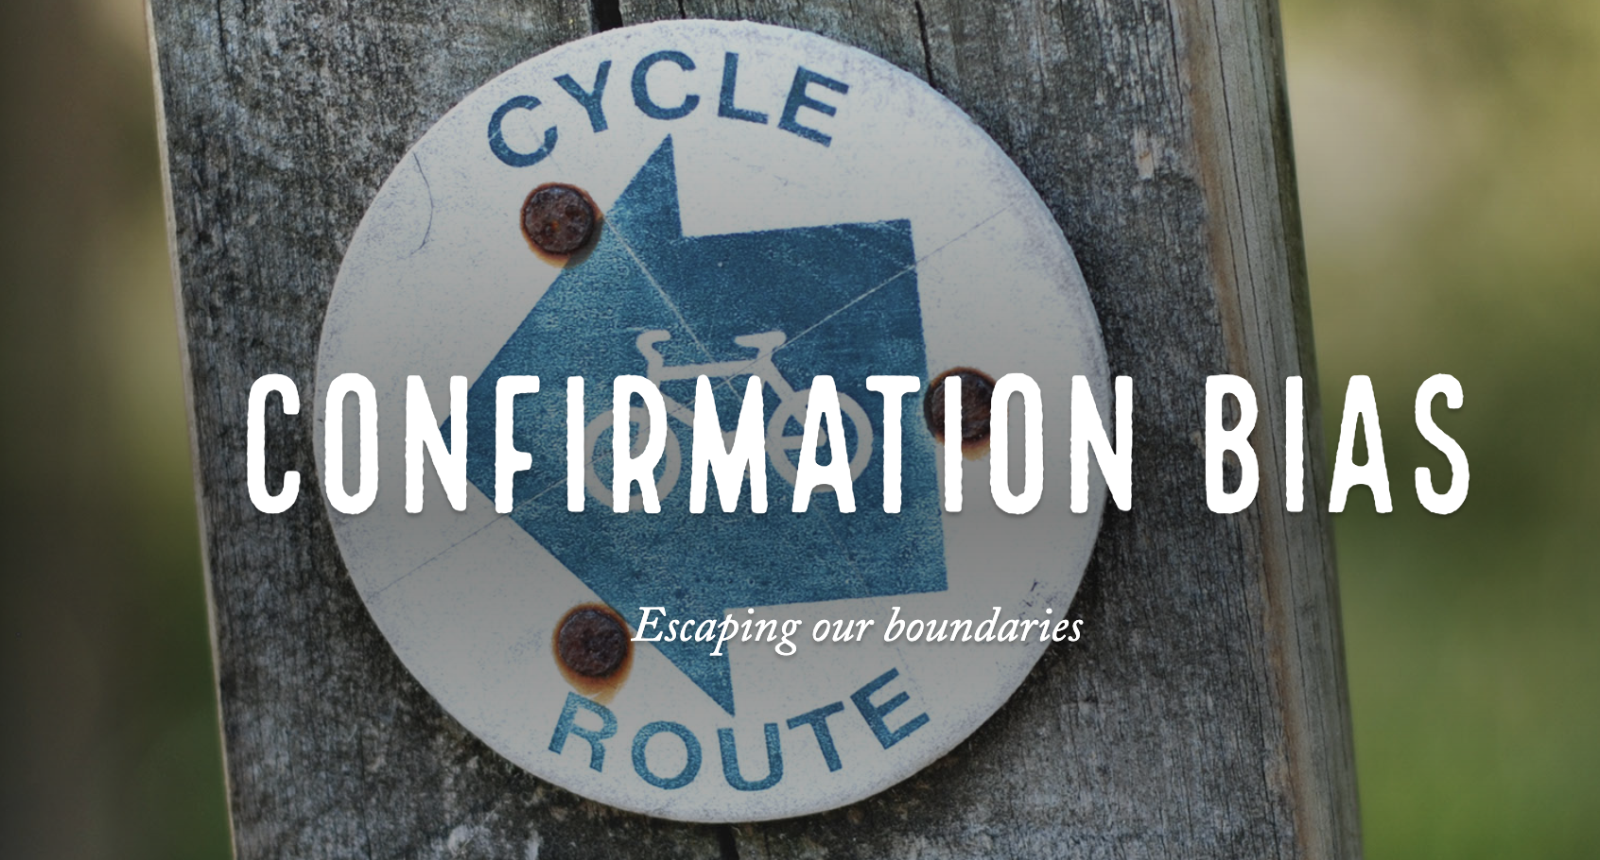
Participants took on the role of metaliterate producer
Getting to Know and Getting Beyond Confirmation Bias
Confirmation Bias Curation Site
Metaliteracy Infographic
Fighting Fake News Prezi
Confirmation Bias
Notes:
Kelsey - one of our main goals and challenges in creating MOOCs - Demonstrated that requiring MOOC participants to take on the key metaliterate role of information producer is possible but challenging (some projects were uploaded and posted in wiki but technical problems disrupted the momentum). Only a few but the ones that were produced were really good (see links)
Students expand our reach by teaching metaliteracy concepts - that has been one of the really interestingoutcomes of this MOOC
Project Wiki: https://learning.buffalo.edu/courses/course-v1:UBx+IITG.Sp19.1x+Sp2018/wiki/UBx.IITG.Sp19.1x.Sp201

Slide 28
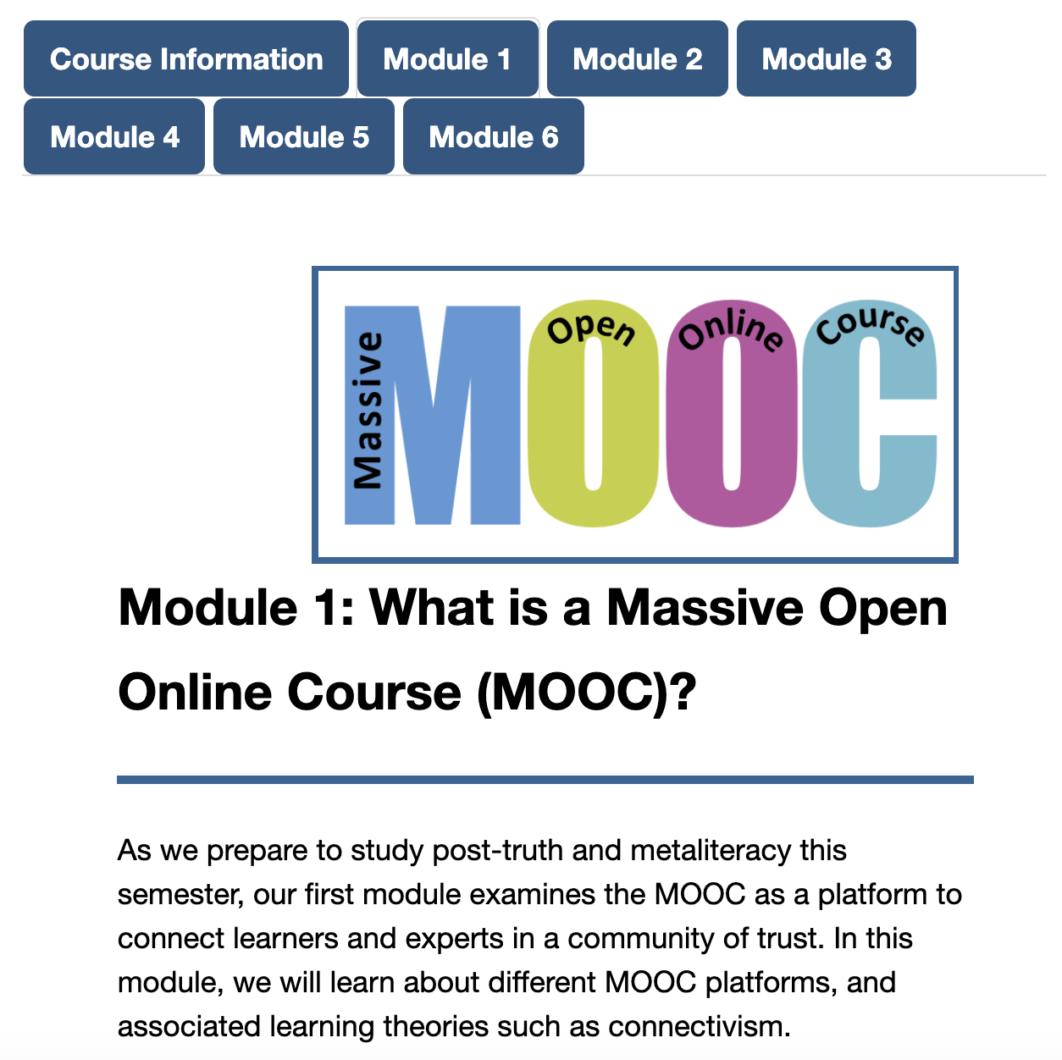
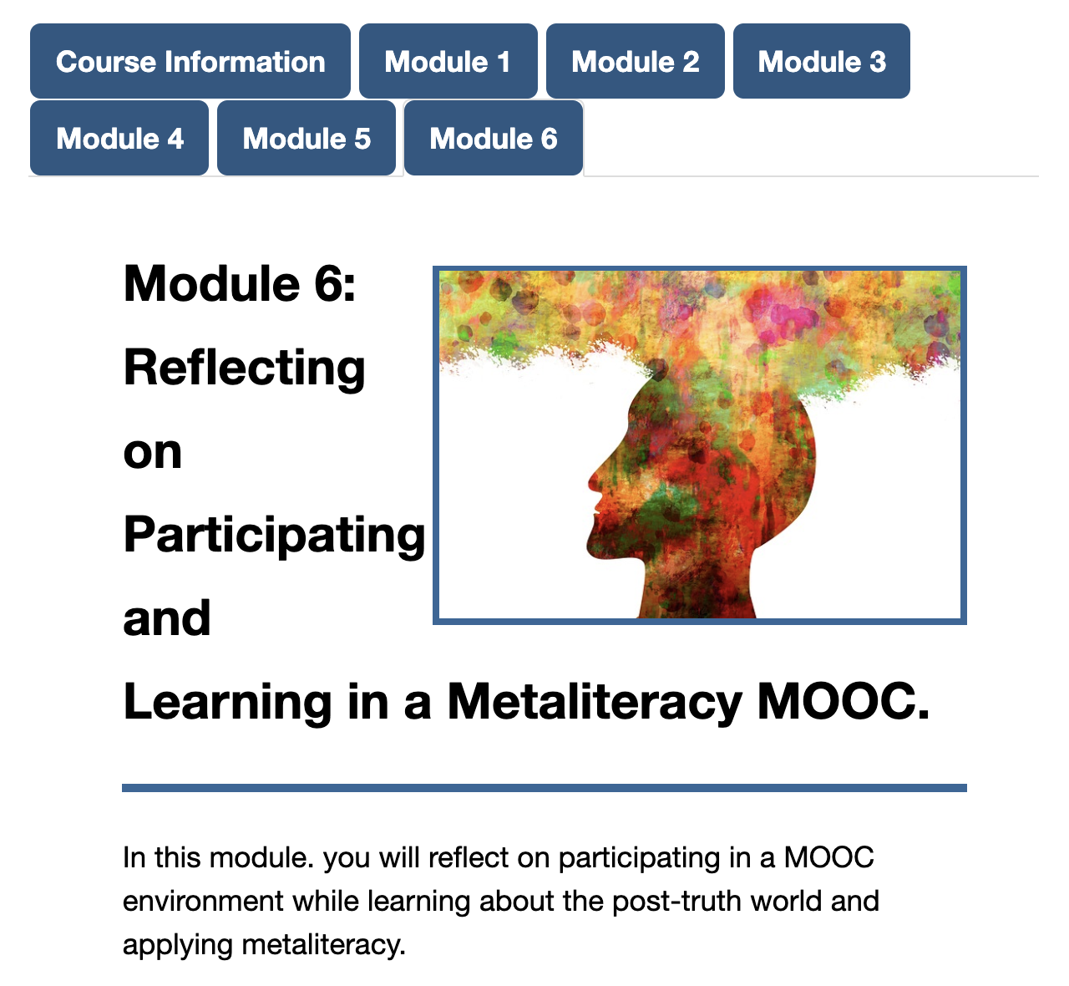
Developed Wrap-Around course for credit at SUNY Empire
Notes:
Tom and Alena Developed a for-credit “Wrap-around” course at SUNY Empire - “meta’ course In that it prepared learners for success in a MOOC environment while also having them go through the post-truth MOOC. Provided opportunities to reflect on the MOOC learning experience while also completing additional learning activities that supported the learning objectives. In spring 2019 3 learners took this course for credit and in a revised summer session 3 undergraduatesand 1 graduate student registered.

Slide 29
Next Steps
Evaluate transition to self-paced format
Revise as Coursera Course
Revise our other Coursera MOOC Empower Yourself in a Connected World and consider a Coursera specialization?
Analyze MOOC experience for further research, publications, and presentations
Repurpose videos for other purposes such as iSucceed
Develop digital badging pathway related to post-truth issues
Notes:
Trudi
Expand Open Praxis

Slide 30
Student Quote
...one of the most important courses that I have taken...Thinking about what we know, thinking about what we take in as information, and what we put out as information is what we need to start doing. This course has really made me think...It’s not only the knowing of it, it’s being aware and taking responsibility for it… (Chris, Empowering Yourself in a Post-Truth World MOOC)
Notes:
Student who participated in post-truth MOOC and wraparound course https://www.youtube.com/watch?v=gLikomsoMqo

Slide 31
Student Quote
I want to share with you how happy I am. Today I received my statement of accomplishment…It was my first MOOC ever, and prior to the start of the course I knew nothing about Metaliteracy. I am thrilled I can apply most of the content to different areas of my life such as work, language learning, and practically most of my everyday activities online. I am a non-native and some weeks were more demanding but thanks to all the hard work and thinking I am certain I learnt a lot. Thanks so much! (Metaliteracy: Empowering Yourself in a Connected World MOOC)

Slide 32
Student Quote
I would like to offer my deepest gratitude in you taking the time to teach me and many others what it truly means to be a digital citizen. I would also like to thank you, for you have provided me with education that I would not have had access to if I had not taken this course. You have been an excellent professor. (Empowering Yourself as a Digital Citizen MOOC)

Slide 33
Student Quote
I have been preaching this to my friends and family.
I rarely use social media, but the students I teach are addicted…This class helped me learn some of the protocol I'd like to pass on to the students. (Empowering Yourself as a Digital Citizen MOOC)

