Slide 1

Introduction to Accessible Online Learning
Nazely Kurkjian
Notes:
This webinar is intended to help faculty and staff understand the barriers that exist at the intersection of one’s disability and online course design/delivery. Useful tips will be shared to improve the accessibility of digital content.
Greetings everyone. My name is Nazely Kurkjian and I am the Coordinator of Disability, Diversity & Nontraditional Student Services within the Office of University Life at SUNY Administration.
As campuses prepare for Summer and Fall semesters, it is prudent for faculty and staff to be aware of the potential barriers of digital participation, and accessibility concepts to enhance inclusive teaching. While this presentation is intended for faculty, instructional designers, and distance education professionals, the recommendations apply broadly to other college departments creating, purchasing and maintaining electronic information and technologies.
Additional webinars offered throughout SUNY Accessibility Week will cover in-depth, technical how-to’s for commonly used tools and digital media.

Slide 2
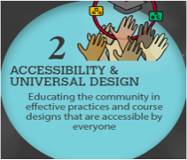
Online Learning Accessibility: A Growing Concern
Increasing enrollment of college students with disabilities.
The way that colleges and universities conduct business is changing.
Technology and websites are presenting new barriers to access for students with disabilities.
Compliance with ADA/Section 504
Key Issue in Teaching and Learning, EDUCAUSE 2015-2019
Notes:
1 in 5 Americans has a disability that impacts access to websites and mobile.
According to the National Center for Education Statistics, 19% of college students self-identify as having a disability (up from 11% several years ago). This does not take into account students with disabilities who have not disclosed to the institution. In fact, numerous literature estimates 70% of college students who have a disability do not disclose or request accommodations. Knowing this information makes proactively creating accessible online environments even more important!
Colleges and universities were increasingly using technologies and the Internet to deliver education, even before the pandemic. Now, we’re in a critical moment where we’re scaling remote teaching and need to quickly learn and adapt to ensure our students can persist and complete their educational goals.
Technology has been a game changer, expanding access to people with disabilities that was previously impossible. There are numerous advantages to online learning. That being said, technology can be a barrier or the solution. Poor design can exclude people to equal opportunities to participate in campus programs, services, and activities. This is, at its core, an equity issue. Accessibility is an act of social justice, and is the right thing to do.
It’s also the law. Institutions have a shared responsibility to provide access.

Slide 3

Ability-and-Functional Diversity
Neurodevelopmental
Sensory
Mental Health
Physical
Intersystem
Temporary
Multiple
New York State Education Department
Notes:
Access can become a barrier to anyone at any time. People can be born with disabilities, acquire a disability, or be in situations that create functional limitations.
Limitations can interfere with one’s ability to walk, hear, talk, learn, etc. These limitations can be visible or invisible (hidden), and people can have multiple disabilities.
While disability remains the legal/policy term, it is important to understand how we’ve come to understand that ability and functions can be limited by social and environmental design.
When preparing an online course, think about the diverse characteristics of your audience. Students may not have the same learning or communication styles, and may have difficulty seeing, moving, hearing, processing, or speaking.
Source: https://exploringyourmind.com/functional-diversity-perspective-on-disability/

Slide 4
The Big Picture
Inclusion
Accessibility
Accommodation
Notes:
The concepts of accessibility and inclusion minimizes the barriers for everyone. In order for students to truly feel like they belong, and their learning needs are attended to, they need to have supportive interactions and informed, responsive professors and staff. Cultivating a an inclusive campus climate reduces the work of being a disabled student on campus, and reduces stigma.
Accessibility is a proactive approach that is welcoming and accessible to individuals with different disabilities. It requires intentional design and development decisions. Accessibility lessens the need for students to ask for accommodations, so they can focus on their schoolwork seamlessly.
Accommodation is not the same as accessibility. Whereas accessible systems are designed to be usable by as many people as possible, regardless of disability or assistive technology, accommodations are reactive, and may not effectively address everyone’s access requirements.
Of course, even when environments are designed with accessibility in mind, there may still be a need for accommodations and remediation in certain instances. Accommodations are applied retroactively to mitigate barriers in the environment or system. When a student faces barriers in their living and learning opportunities, they should feel empowered to request accommodations. One of the easiest things you can do is include a statement in your syllabus that provides students with disabilities the pertinent information necessary to request disability-related accommodations. Make reference to it, and make it available in multiple places (such as the Learning Management System).

Slide 5
How Students with Disabilities Navigate Online World
Assistive Technology
Alternative Formats
Auxiliary Aids & Services
Screenreader
Screen Magnification
Text-to-Speech
Literacy Software
Speech-to-Text
Alternative hardware
Electronic text
Word
PDF
EPUB
Audio
Electronic Braille
Closed captioning
Sign language interpreting
Computer aided real time transcription (CART)
Audio descriptions
Notes:
Like all students, students with disabilities learn in various ways and comprehend information differently.
Assistive technologies, auxiliary aids and alternative digital formats ultimately provide individuals with disabilities independence to complete their academic endeavors (equity!).
Assistive technologies are technologies used by individuals with disabilities to access technology and digital information. How you design your content makes a difference to individuals using AT. Assistive technologies that people use to access information works seamlessly when content is accessible.
Screenreader: a software that can navigate and read everything on the computer screen to you.
Text to Speech: when your computer recognizes text and reads it aloud to you
People with disabilities may use accessible digital formats to consume traditional print content (such as electronic Braille or a tagged PDF)
Electronic Braille
Tagged PDF
Word doc
Students with disabilities may also use auxiliary aids and services (such as closed captions or note taking software) to provide effective communication for those with hearing loss or auditory processing impairments. Transcripts also benefit individuals who would learn better by reading rather than listening.
Captions - text versions of spoken words in video
Audio Descriptions - describe what’s happening in video
It’s important to note: some students with disabilities do not use any assistive technology or alternative formats. Still, there are challenges and benefits of online learning for neurodiverse students (ASD), other students with cognitive disabilities (ADHD), and students with mental health disabilities (OCD, Anxiety)...Some prefer comfortable, distraction reduced settings.

Slide 6
Accessibility Principles
Perceivable
Operable
Understandable
Robust
1
2
3
4
Introduction to Web Accessibility (WebAIM)
Notes:
Considerations for students with disabilities are grounded in effective practices for all learners.
The Web Content Accessibility Guidelines (WCAG) serve as the technical standards for web and mobile accessibility.
On this slide are the four principles (POUR)
Perceivable: Available to the senses (vision and hearing primarily) either through the browser or through assistive technologies (e.g. screen readers, screen enlargers, etc.)
Operable: Users can interact with all controls and interactive elements using either the mouse, keyboard, or an assistive device.
Understandable: Content is clear and limits confusion and ambiguity.
Robust: A wide range of technologies (including old and new user agents and assistive technologies) can access the content.

Slide 7

Accessible Online Course Considerations
Digital Content
Platform
Delivery
Notes:
For the remainder of the presentation, I will provide an overview of accessible online course considerations pertaining to digital content, platforms, and recommendations for delivering accessible instruction

Slide 8
Disclaimer
There is no “one size fits all” solution
Notes:
Multiple approaches may be necessary
Over the next several slides, you will see, many of the same accessible design principles benefit numerous subpopulations of users with disabilities and users without disabilities, such as non-native English speakers

Slide 9

Designing for users of screen readers
Describe images and provide transcripts for video
Follow a linear, logical layout
Structure content using headings and labels
Build for keyboard use
Write descriptive links and headings
UK Home Office
Notes:
People with severe sight impairments need a way of getting the information that visual elements on a page try to convey. They also need to know if there are any additional details they are missing. Provide text content and/or descriptions of: photos, illustrations, diagrams, graphs, animations and videos so a screenreader can read it aloud. This is good for informing search engines too. Also use audio-description in videos, either as a natural part of the narration or additional to it.
Designing clear and consistent navigation in your course/website will allow viewers to focus on your content rather than on how to find it. Screenreaders navigate the web and digital content the order in which the structure of the code or elements like headers, structured lists, and more are marked correctly. This may not be the same as how they visually appear on the page, document or presentation slide. They can miss valuable information if it is not designed with this in mind. When designed correctly, the screenreader can audibly read out loud in the correct reading order and jump around to headers, links, buttons, and more actionable items. That’s also why it’s important to craft meaningful file names and titles to help users find the files and understand what decisions need to be made it one is required.
Don’t force mouse or screen use a screen reader users who are blind cannot see the mouse pointer. Make sure all actions on the page can be completed using a keyboard alone

Slide 10

Designing for users with low vision
Use good color contrasts and a readable font size
Publish all information on web pages
Follow a linear, logical layout
Use a combination of color, shapes and text
Put buttons and notifications in context
UK Home Office
Notes:
Making the default appearance of text easy to read will mean that people with visual impairments can take in the information (quicker), particularly if assistive technology is not available.
Burying information in downloads can be difficult to navigate multiple use of technologies (screen magnification)
HTML is the most accessible format because users can change the appearance of web pages to meet their needs - for example using high contrast colours or large fonts. The text can also be read aloud. Other formats often require extra steps and software to open, and can be harder to navigate and have less flexible display options.
Users of screen magnifiers can miss content like side columns if they are not expected or well sign posted. Particularly if they use the tab key to move between links and form elements. - Place features in a logical order where users would expect them to be.
Some users choose to enlarge text as well as or instead of using magnification features. The design should flex accordingly, showing a mobile, single column layout
Avoid using color to convey meaning
Colour vision deficiency (colour blindness) is a common condition which makes it difficult to identify certain colours. This can make it hard to understand elements like buttons and graphs which rely only on colour to convey information. Use other signifiers like text labels or different styles of dashed lines in those cases.
Don’t separate the actions too far away, if you can help it
When using a screen magnifier, it is disorientating for a user to hunt around the page for an element. Put things like help text, error messages, submit buttons and notifications close to the thing they relate to.

Slide 11
Designing for users with dyslexia
Use images and diagrams to support text
Align text to the left and keep a consistent layout
Consider producing materials in other formats (e.g., audio)
Keep content short, clear and simple
Let users change the contrast between background and text
UK Home Office
Notes:
These students are typically more visual learners. Providing options is optimal to reach all students
Some people with dyslexia have trouble focusing when reading on a screen. They can experience visual distortion where letters and words get jumbled. Large blocks of content can be intimidating, use images to help illustrate the point and break up copy.
A consistent layout will help someone with dyslexia navigate a screen. It will help draw their eyes to relevant content and build familiarity and confidence as they go. Serif fonts have hooks at the end of letter strokes that can cause letters to run together - the same is true for italics.
Many people with dyslexia experience anxiety about being able to read and retain the information given to them. They may feel pressure if they are presented with lots of information on separate screens. Some people are able to remember information better if have listened to it or watched on a video. Video, graphics and photos help to create a visual memory.
Fewer words are better for someone who has trouble reading. Use bullet points to help guide a dyslexic user through your content.
People with dyslexia may find spelling and words order challenging. Tools like predictive text, autocorrect and speech recognition can help them get things right.
Many dyslexic users are sensitive to the bright, high contrast colours. They can make words swirl and blur together. Many users adjust their screen contrast or use coloured filters on their screen to help ease this symptom.

Slide 12
Designing for users with physical/motor disabilities
Make large clickable actions
Give form fields/clickable elements space
Design keyboard or speech only use
Design with mobile and touchscreen in mind
Provide shortcuts
UK Home Office
Notes:
Again, don’t require a lot of mouse movement
Buttons with a small hit area can be frustrating for motor disability users who may not be able to control a mouse or keyboard very well.
Having lots of actions near each other increases the risk of a user taking the wrong action by mistake.
Some motor disability users may not use a mouse or may use an assistive technology that functions like the tab key on a keyboard. Make sure all your content is accessible by keyboard only.
Using a computer can be tiring for motor disability users and they may need to take frequent breaks. A short time-out period means they will probably have to start again after taking a break.
It can be difficult for users who find controlling a computer hard to keep their place on long pages and form fields.
Don’t have short time out windows

Slide 13

Designing for users who are deaf or hard of hearing
Write in plain language
Use subtitles or provide transcripts for videos
Use a linear, logical layout
Break up content with subheadings, images and videos
Let users ask for their preferred communication support
UK Home Office
Notes:
People who use American Sign Language may consider this to be their first language. They may consider English to be their second language. Sentence structure differs between these two languages and therefore content should be kept simple to make it easier for ASL users to read.
Users who are Deaf, deaf or hard of hearing will need to access your videos in a visual way. Do not rely on the user’s ability to lipread to understand what is being said.
Users who have English as their second language may find it tiring or difficult to read lots of text. A logical layout can help users judge what content they need to read in order to complete their task.
Long blocks of text are difficult to read for those whose first language is not English. Headers help to explain the purpose of the copy that follows.
llow for people to specify how they want to be contacted. If you service requires a face to face interaction, design the interface to allow for the user to request communication support (and what kind of support that needs to be). Don’t make telephone the only means of contact for users

Slide 14
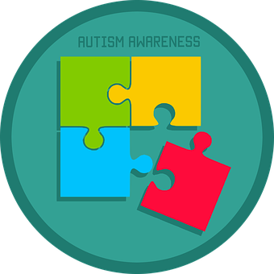
Designing for users on the Autism Spectrum
Use simple colors
Write in plain English
Make buttons descriptive
Build simple and consistent layouts
UK Home Office
Notes:
Some users may experience sensitivity to sensory information such as colours which can cause anxiety or pain.
Users on the spectrum perceive language differently and might take figures of speech and idioms literally. Writing in clear, plain language will mean your content is understood by more people.
Lots of unbroken text can be hard to focus on making it frustrating to read. Breaking text down into simple sentences and using bullets for important points will make your content easier to understand.
Not knowing what will happen after clicking a button or link can cause users stress and anxiety. Descriptive buttons and links will help users know what to expect and give them a sense of control.
Complex and cluttered layouts can be overwhelming for users to process. Make your layout predictable and consistent. Put common components such as navigation and search on the top of a page in a highly visible area.

Slide 15

Designing for users with anxiety
Give users enough time to complete an action
Make important information clear
Explain next steps or timeframes
Let users check their answers before they submit them
UK Home Office
Notes:
People with anxiety might take longer to complete something because they are cautious or fear getting it wrong. Make sure any time limits on actions are generous.
People will become more anxious on services that have consequences for them personally. Clear, simple information is important. If your service needs to warn users about the consequence of their actions, make sure you give them enough information to make the correct decision, so they can continue confidently.
Services that end without any concrete guidance on what will happen next can increase users anxiety. For example if someone submits an assignment, tell them how long it may take to share grades.
We can reassure users by giving them the opportunity to check and change their answers before they submit. Without this step, users are less informed which could increase anxiety.

Slide 16
Platform
Does the website for the platform you are considering have information about accessibility and compatibility with assistive technology?
Does the platform offer:
  Accessible navigation and keyboard shortcuts?
  Built in caption support?
  Multiple ways to participate, such as dial-in by phone and connecting by computer?
Are the accessibility features built into the main platform? If not, does it require a change in the settings or a separate software version?
The Hub, Issue 4 (AHEAD)
Notes:
Regardless of the platform being used, the design of the course and how the platform is incorporated play a large role in determining the accessibility of the course.
Being proactive and checking for accessibility of applications and web resources will improve the experience of your students and reduce the need for retrofitting.
Not all learning management systems (LMS) have the same level of accessibility. It is important to ensure that all features, including those that will be used exclusively by faculty or staff, are accessible.
Not all video conferencing systems have the same level of accessibility. When considering accessibility, it is necessary to consider the following at a minimum:
Can frequently used and important features be accessed without requiring mouse use?
Will navigational elements (e.g., buttons) be read by screen readers?
Can chat messages and other interactive text be read by screen readers? Will screen reader users be notified when new chat messages appear?
Can the system be used to provide captioning? Can the captions be saved as a transcript?
Even with platforms that are accessible, and in which keyboard shortcuts are provided, memorizing all of the keyboard commands for these functions can be overwhelming. Consider also that sometimes students may be using more than one video conferencing platform for different courses, and the navigation keys are different with each.

Slide 17
Evaluating Electronic Content/Technologies
Ask vendors:
Details about the accessibility of your particular textbook and/or digital content
A list of exam question types that are accessible
Consult Accessibility/Disability Services or EIT Accessibility Officers
Notify your students if the digital software or services are not fully accessible
E-Text Evaluation Process - University of Colorado Boulder
Notes:
Including known accessibility issues, any workarounds that the student can use, a named point of contact and any guidance on how to ensure any content you create within the platform is accessible
Review your own exams to ensure none of your questions rely on drag and drop actions, images without alt text or other inaccessible mechanisms

Slide 18
Delivery
Utilize a headset with a microphone for higher quality audio.
Encourage participants to state their name every time they speak.
Let participants know if you will field questions during or after your presentation and let them know how they can ask questions.
Speak key content that is presented visually.
Consider using built-in software that will automatically caption presentations.
Consider identifying a notetaker and have them take notes in an online document that other participants can access during and after the meeting.
Consider recording your session so students who aren’t able to join in real time can watch it later or be able to review at their own pace.
Disabilities, Opportunities, Internetworking and Technology (DO-IT)
Notes:
These accessibility recommendations are good for both synchronous and asynchronous delivery...
Better quality audio will improve transcription accuracy and effective communication for all
Encourage all students to self-identify (“Hi, this is __ speaking”) as they begin speak - This is particularly helpful to blind students and to captioning efforts.
Don’t assume that all students can see or make the same sense of your visual display as you intend. For accessibility, get in the habit of describing whatever is happening visually on the screen
Built in transcription/captioning: These automated tools can be useful but they don’t provide the same level of access as a professional trained to provide captions.
Some things to be mindful of for synchronous courses:
Disabled students may not be able to participate at a fast pace online; e.g., their assistive technology or CART (text transcription provider) may require some time to communicate the information.
Asynchronous teaching, by its nature, is likely to be accessible to more individuals: Assistive technology users don’t have to worry about keeping up with the pace of the rest of the class, users who benefit from reviewing information multiple times will be able to easily do so, and users who have access to slower WiFi won’t be left out. However, it will still have the same requirements for accessible accompanying materials, captioning, etc. as synchronous classes.

Slide 19
Accommodations in the Online Environment
Accessible instructional materials
Sign Language Interpreting/Real time captioning
Testing
Note taking
Flexibility in attendance and assignment deadlines
Responding to COVID-19 (Association on Higher Education And Disability)
Notes:
As I mentioned earlier, accommodations may still be necessary.
These are some examples of accommodations that may need to be revisited or modified based on the design of the class.
Student accommodation needs may change with different modalities of instruction and that we must be responsive to the needs of students with disabilities. Work closely with the Disability Services Office (DSO) at your institution if you have questions about student accommodations.

Slide 20
Benefits
Incorporating accessibility proactively:
Improves access and user experience for all
Promotes meaningful independence
Reduces stigma
Reduces liability
Improves campus climate
Gain competitive advantage
People with disabilities drive innovation.
Notes:
The benefits of accessible online learning are abundant...
We all know famous people with disabilities, who have greatly advanced architecture, science, technology, government, medicine, music, and more.
Additional Resources:
Haben Girma: https://habengirma.com/2017/09/13/people-with-disabilities-drive-innovation/
Stats: http://www.disabilitystatistics.org/StatusReports/2015-PDF/2015-StatusReport_US.pdf?CFID=2692641&CFTOKEN=fed0d27fa83748a-5979B9BD-A09A-4DCC-AB9D77F2C05390A7

Slide 21
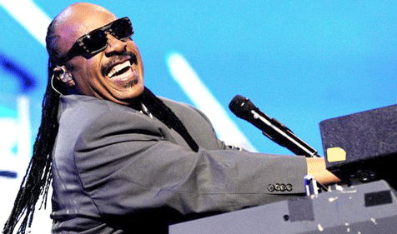

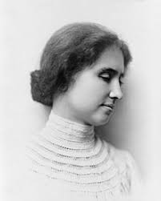

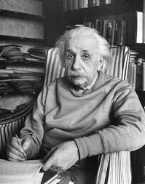
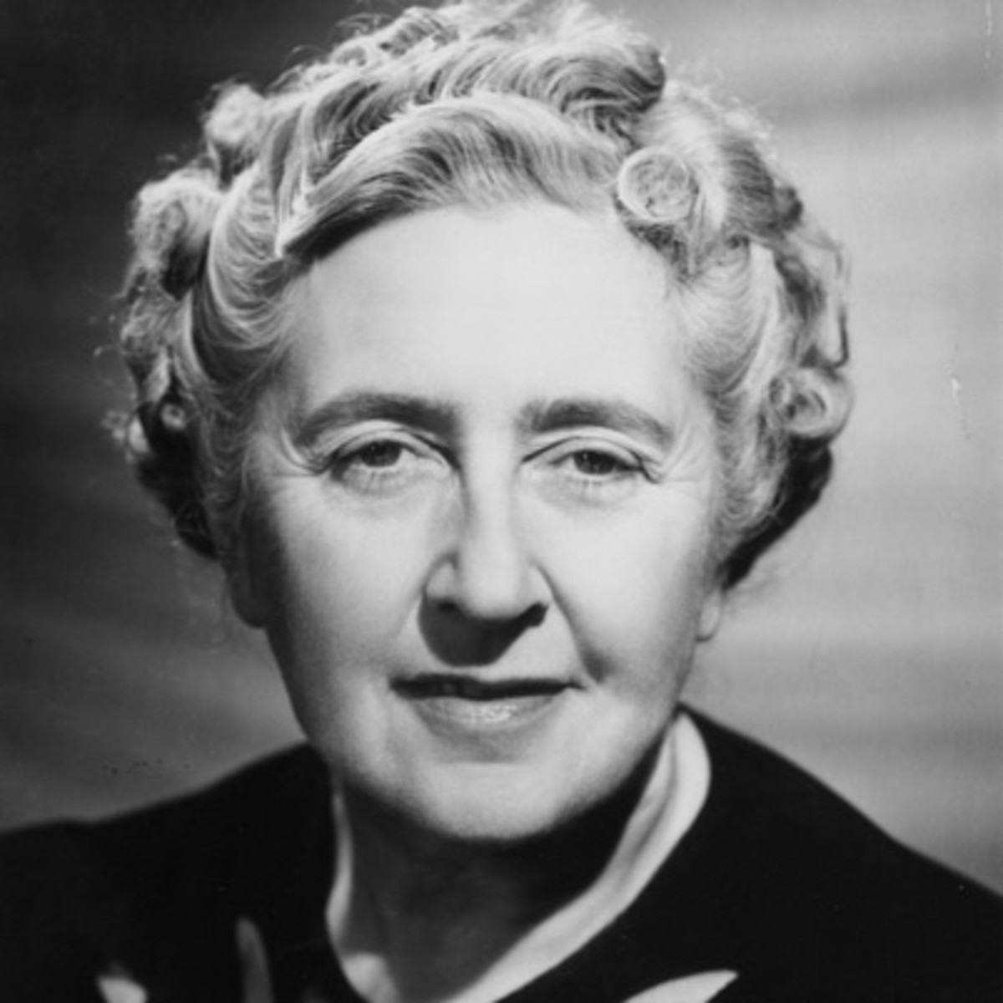
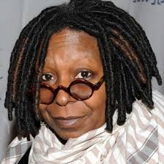
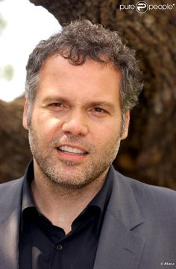



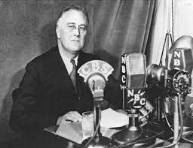
Notes:
Here are just a few of those people
Stevie Wonder
Albert Einstein
Channing Tatum
Frida Kahlo
Mark Ruffalo
Solange Knowles
Helen Keller
Stephen Hawking
Agatha Christie
Mozart
Whoopi Goldberg
FDR
More famous people with various disabilities: https://www.disabled-world.com/artman/publish/article_0060.shtml

Slide 22
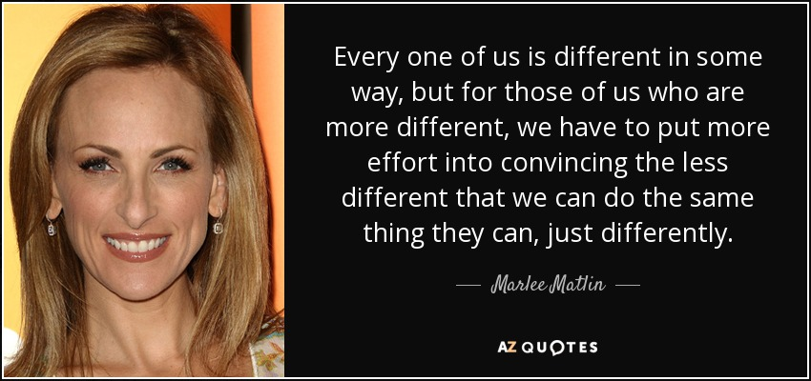
Notes:
A famous quote by deaf actress and Academy Award winner Marlee Matlin

Slide 23
Additional Resources
Designing an Accessible Online Course, Explore Access
SUNY Electronic & Information Technology (EIT) Accessibility Listserv
SUNY-EIT-subscribe-request@LS.SYSADM.SUNY.EDU
Facebook Workplace: Web Accessibility Group
SUNY’s EIT Accessibility implementation guidance for web, digital, procurement, libraries, and classroom accessibility may be found on SUNY Blue: blue.suny.edu
Self-paced accessibility training is freely available through Deque University.
Notes:
In sum, how you deliver your course can impact students with disabilities in different ways. It can create more access or present new or additional barriers. Keeping things simple and providing multiple ways to present/submit information will help reach the broadest possible audience.

Slide 24
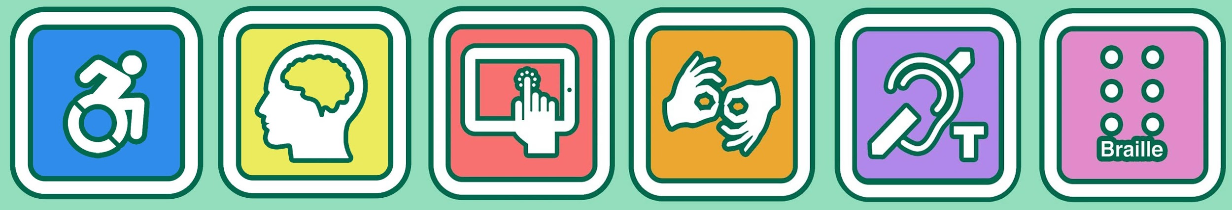
Contact Information
Nazely Kurkjian
Coordinator of Disability, Diversity & Nontraditional Student Services
Nazely.Kurkjian@suny.edu

