Slide 1
Being Open with students: Engaging students in OER and open pedagogy
Jessica Kruger, PhD, CHES
Clinical Assistant Professor
Director of Teaching Innovation and Excellence in the SPHHP at UB

Slide 2
By the end…
Why you should turn to your students for input in your courses…
-Before
-During
-After

Slide 3
Housekeeping
Back channel
Engage
Challenge
Add your own experiences

Slide 4
Agenda
Open Pedagogy Practices
How and When
Ideas and Lessons Learned
1
2
3

Slide 5
What?
“Open Pedagogy,” as we engage with it, is a site of praxis, a place where theories about learning, teaching, technology, and social justice enter into a conversation with each other and inform the development of educational practices and structures.

Slide 6
What its not…
Open Pedagogy is not a magical panacea for the crises that currently challenge higher ed.

Slide 7
Open Up
To open practices!

Slide 8
Collaboration
Viewing students as collaborators
Equal say (kind of…)
Transparency

Slide 9
In what way(s) do you currently collaborate with students?

Slide 10
Encourage
Speaking up
Questioning
Democracy
Supportive Environment

Slide 11
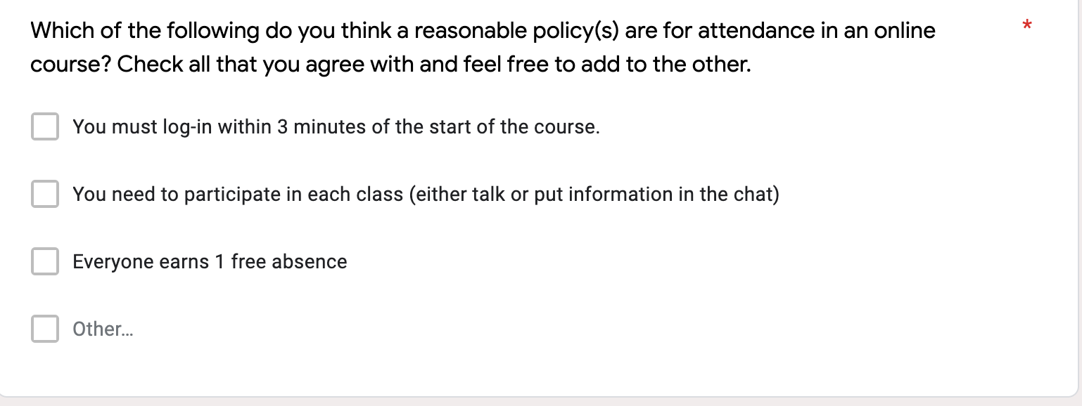
When?
Before
Course planning
Course policies
Expectations
Assessments
Delivery method

Slide 12
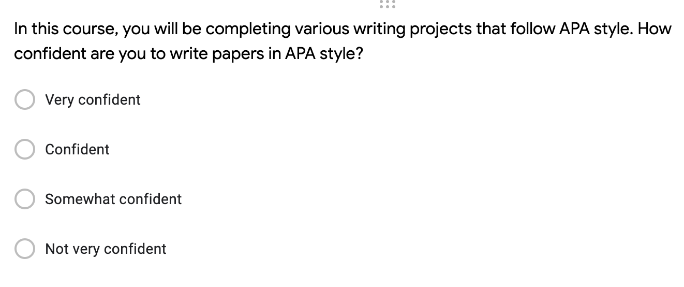
When?
During
Checking In
Re-evaluating
Transparency
Mid-term
Directions

Slide 13
When?
Before
Course planning
Course policies
Expectations
Assessments
Delivery method
During
Checking In
Re-evaluating
Transparency
Mid-term
Directions
After
End of semester evals
Course wrap-up
Exit interviews
W/Student Assistants

Slide 14
How?
Verbal
Check-in’s
Questioning
Small groups

Slide 15
How?
Written
Surveys
Evaluations
Reflections

Slide 16
Implementing
Be honest and open
Set the stage
Start small…

Slide 17
Caution
Place your screenshot here
With moving parts be sure to document the changes…

Slide 18
A bit about OER…

Slide 19
Build Content
Co-create materials
Textbook
Study guides
Assignments

Slide 20
Getting Started…
Start slow!
Get buy in…
Get enthusiastic!
Use the 5R’s
Translatable skills
Meeting learning objectives
Support growth

Slide 21
It starts with YOU!

Slide 22
Philosophy
Think about it…

Slide 23
Thanks!
Any questions?
jskruger@buffalo.edu

Slide 24
For recordings and other resources, please visit:
www.suny.edu/OTTER

Slide 25
Free templates for all your presentation needs
For PowerPoint and Google Slides
100% free for personal or commercial use
Ready to use, professional and customizable
Blow your audience away with attractive visuals

