Slide 2
Enhancing Excellence in Assessment
Building Pathways for Student Success: Assessment and Implementation of the General Education Framework
November 10, 2022

Slide 3
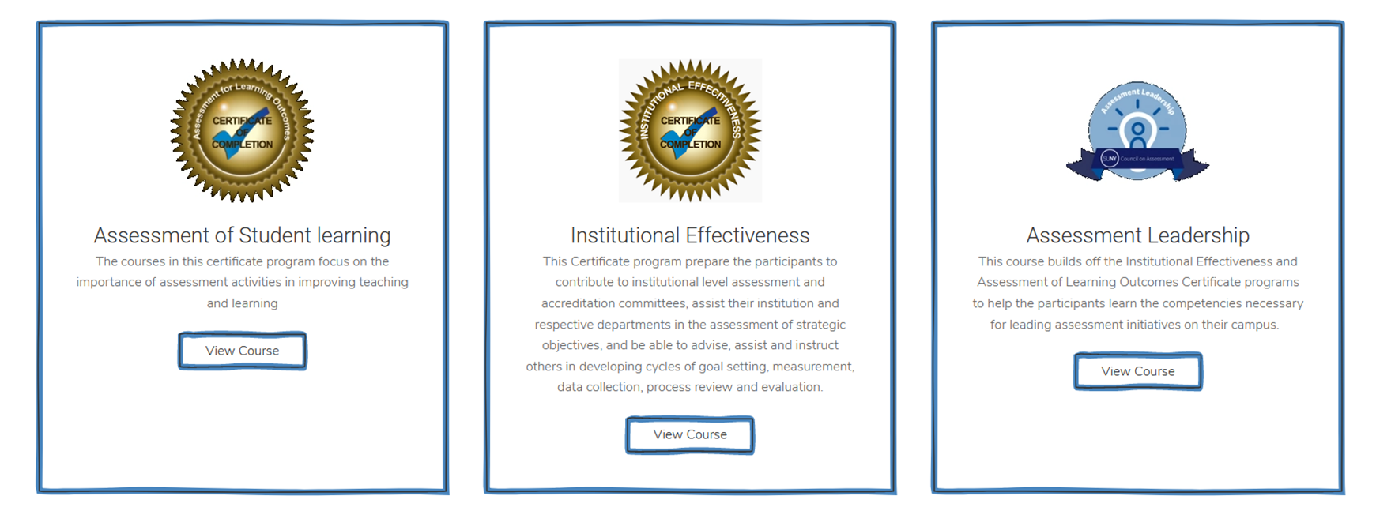
Agenda
Welcome & Introductions – Nicole Childrose
Review Outcomes – Kirk Jones
Assessing the new SUNY GE: the good, the bad, and the ugly. - Deborah Moeckle
Hitting the Ground Running with the General Education Framework. - Kirk Jones, & Jackie Snyder
Sponsored by SUNY Council on Assessment (SCoA) in partnership with the SUNY Center for Professional Development (CPD)

Slide 4
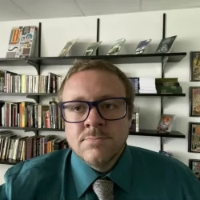
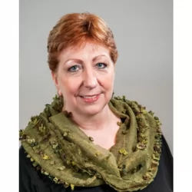
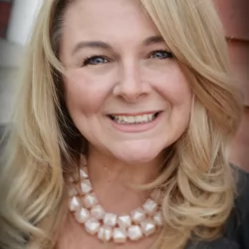
Introductions
Kirk Jones
Director of Academic Assessment
Interim Dean, School of Business and Liberal Arts
MSCHE Accreditation Liaison Officer SCoA Co-Chair
SUNY Canton
jonesk@canton.edu
Deborah Moeckel
Senior Assistant Provost for Assessment
and
Community College Education
SUNY System Administration
deborah.moeckel@suny.edu
Jackie Snyder
Associate Provost for Academic and Student Affairs
MSCHE Accreditation Liaison Officer
SCoA Co-Chair
Fulton-Montgomery CC jsnyder@fmcc.edu

Slide 5
Outcomes
SUNY General Education Framework and DEISJ
Network, share ideas, and uncover innovative solutions
Identify techniques for continuous improvement
Consider how to overcome potential roadblocks
Discuss strategies and share resources
Collaborate, discuss, plan, connect during time of change
Explore SUNY resources

Slide 6
Assessing the new SUNY GE: The good, the bad, and
the ugly.

Slide 7
Hitting the ground running with the General Education Framework
Faculty and committee processes and procedures
Adoption of DEISJ courses
Course and program-level assessment modifications
DEISJ rubric

Slide 8
Faculty and committee processes and procedures
SUNY Canton
S22 – Existing courses identified.
S22 – Approval process determined
F22 – New courses created
F22 – Curriculum changes and mapping.
Fulton-Montgomery CC
SP22 – Introduce changes
F22 - Faculty id courses, id DEISJ w/in academic program
SP23 – Curriculum changes and mapping
Shared governance approval process

Slide 9
Adoption of DEISJ courses
SUNY Canton
Faculty propose courses.
Vetted through ad hoc consisting of Assessment and Diversity Specialists.
Moved to normal shared governance approval process
Fulton-Montgomery CC
Faculty identify
Assessment/GELO consultation
Academic division propose
Shared governance

Slide 10
Course and program-level assessment modifications
SUNY Canton
Course-Level: Let the methodology & requisite tools do the work.
Program-Level: reconciling MSCHE Gen Ed & SUNY Gen Ed.
Our Methodology
Fulton-Montgomery CC
Review new GELO statements with faculty
Align assessment tools
Break out discuss further

Slide 11
DEISJ Rubric
Link to DEISJ Rubric: https://scoa.suny.edu/wp-content/uploads/2022/09/GER-DIVERSITY-ASSESSMENT-RUBRIC-Template-with-Framing-Language-Enumeration-and-Revision.pdf
Link to DEISJ Guidance Document: https://scoa.suny.edu/wp-content/uploads/2022/09/Guidance-on-DEISJ-courses-final.pdf

Slide 12
5 minute break
Break Out 1
New Gen Ed
Process Management
Break Out 2
New Gen Ed
Assessment Tools & Strategies

